Slide 1
Consumer Behavior Analysis: The Influence of Advertising on Purchasing Decisions
Authors: Raevschi Ana Teodora
Suto Mara Bianca
Toma Daria Elena
Year: 2024

Slide 2
Introduction
Consumer behavior is a complex field that lies at the intersection of psychology, sociology, and economics. In today's highly competitive market, understanding how advertising influences purchasing decisions is paramount for businesses striving to connect with their target audiences effectively. This presentation explores the theme of consumer behavior analysis, specifically focusing on the influence of advertising on purchasing decisions. We will delve into the reasons for choosing this theme and outline a working mode for conducting a comprehensive analysis.

Slide 3
Why this topic?
Relevance of the Theme:
Advertising is omnipresent in modern society, bombarding consumers with messages intended to persuade and influence their purchasing behavior. From television commercials to social media ads, businesses invest significant resources in advertising to attract consumers and drive sales. Understanding the impact of these advertising efforts on consumer behavior is essential for businesses seeking to optimize their marketing strategies and gain a competitive edge in the market.
Practicality:
Consumer behavior analysis provides actionable insights for marketers, enabling them to tailor their advertising campaigns to better resonate with their target audience. By understanding the psychological and sociological factors that influence consumer decision-making, businesses can craft more effective advertising messages and allocate their resources more efficiently.
Academic Interest:
The study of consumer behavior is a rich and multidisciplinary field that offers valuable insights into human psychology and societal dynamics. Exploring the influence of advertising on purchasing decisions adds depth to our understanding of how individuals navigate the marketplace and make choices in an increasingly media-saturated world. By examining theories and empirical studies in this area, researchers can contribute to the collective knowledge base and further refine our understanding of consumer behavior.
Business Impact:
Effective advertising can have a direct impact on a company's bottom line, driving sales and enhancing brand loyalty. By conducting a thorough analysis of the influence of advertising on purchasing decisions, businesses can identify opportunities to optimize their advertising strategies and maximize their return on investment. Whether it's through targeted messaging, innovative creative campaigns, or strategic placement, understanding the nuances of consumer behavior can help businesses gain a competitive advantage in the market.

Slide 4
Working mode
Literature Review
Data Collection
Data Analysis
Interpretation
Recommendations
Conclusion

Slide 5
This study examines Dove's advertising impact on Slovak consumers, showing that emotional appeals influence irrational buying behavior and vary by age. Emotional ads often have a more negative effect but strengthen brand connections, leading to impulsive purchases. The research highlights the importance of emotional appeals in enhancing self-confidence, social status, and perceptions of beauty, shifting consumer behavior from rational to emotional decision-making, with notable generational and gender differences.The study concludes that emotional ads are crucial in modern marketing, particularly affecting younger consumers, and that targeted emotional campaigns can enhance brand loyalty and market sustainability. Businesses should tailor emotional ads to specific age groups and societal issues, and future research should explore the neurological responses to emotional advertising.
Literature review (The power of emotional advertising appeals: examining their influence on consumer purchasing behavior and brand-customer relationship-2023)

Slide 6
This study explores how consumer attitudes, brand perception, and product characteristics affect purchasing decisions using surveys and multiple linear regression analysis. Findings show that product quality, brand image, and positive consumer attitudes significantly increase purchase likelihood, explaining 68% of the variance in buying decisions. Businesses are advised to innovate with high-quality materials, enhance brand image, and build consumer trust to boost market competitiveness and loyalty. Future research should examine additional factors influencing purchasing decisions.
Literature review(Analysis Of The Influence Of Consumer Behavior, Product Attributes And Brand Image On Purchasing Decisions Of Pharmaceutical Industry Products Consumers)

Slide 7
This study investigates Shopee's Affiliate Program's impact on consumer behavior, purchase intention, and buying decisions among Bali Semanggi customers during the COVID-19 pandemic. Using Structural Equation Modeling (SEM) and Partial Least Square (PLS) analysis, the findings reveal that affiliate marketing positively influences consumer behavior and purchase intention but has a minimal effect on actual buying decisions. The research highlights the rise in online shopping and the importance of digital and content marketing in enhancing consumer interest and influencing purchasing decisions.
Literature review(The Effect of Affiliate Marketing on Consumer Behavior, Purchase Intention and Purchase Decision)

Slide 8
Sah Gunja Kumari & Karki Sangita (2020) investigated the relationship between various advertisement dimensions (printing, broadband, outdoor, and social media) and consumer purchasing behavior. The research aims to explore how different media platforms influence consumers' decisions to purchase products. The study collected data through structured questionnaires and interviews with consumers in the Kathmandu valley. Key findings indicate a strong correlation between advertisement media dimensions and consumer purchasing behavior. Specifically, printing, outdoor, and social media were found to have a statistically significant impact, while broadband media showed insignificance. Demographic factors such as gender, age, education level, occupation, and annual income were analysed to understand respondents' characteristics. Results revealed a strong positive relationship between advertisements and consumer purchasing behavior.
Literature review(the impact of media advertisement on consumers purchasing behavior)

Slide 9
Irena Antosova (2023) provided an analysis of changes in consumer purchasing decisions over a 15-year period, focusing on both traditional (quality, price) and emerging factors (influencer recommendations, discount codes or extended return options) influencing consumer behavior. The research utilized a questionnaire survey conducted in the Czech Republic with 686 respondents. Data analysis involved descriptive statistics and multivariate exploratory factor analysis. Despite evolving trends, factors such as quality, price, and necessity remain the most influential in consumer purchasing decisions. This consistency underscores their enduring significance in shaping consumer behavior.
Literature review(changes in consumer purchasing decisions: traditional and emerging factors in the dynamic marketing landscape over 15 years)

Slide 10
Research methodology
In this case study the two samples are based on stratified random sampling in European countries.
The hypothesis testing follows the comparison between the US and European countries in terms of The Influence of Advertising on Purchasing Decisions in 2023.
Regarding the ANOVA Analysis, we wanted to determine if there is a correlation between consumer behavior and the Gross Domestic Product and population.

Slide 11
Data used
The data related to The Influence of Advertising on Purchasing Decisions in Europe has been extracted from Eurostat and Statista for the year of 2023.
Moreover, in order to find factors and variables correlated to our subject of study, we extracted information from Europa.eu, for the year of 2023, related to GDP, population and purchasing decisions.
See references at the end of the presentation.

Slide 12
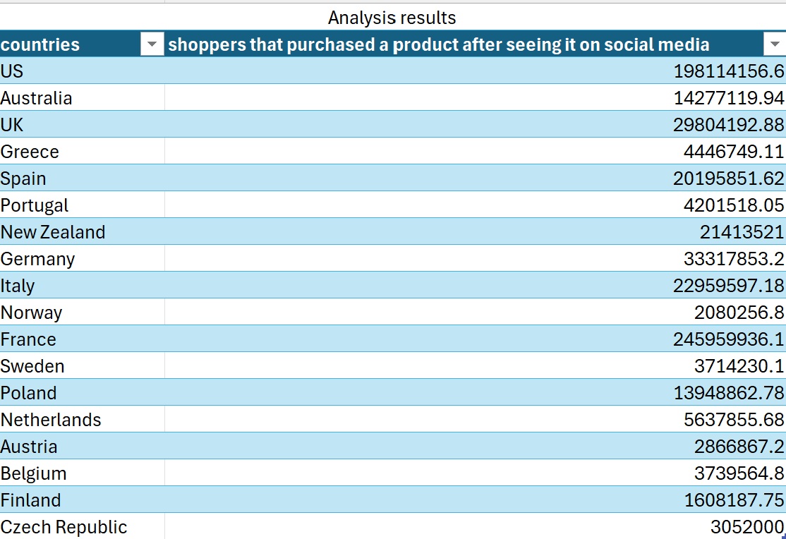
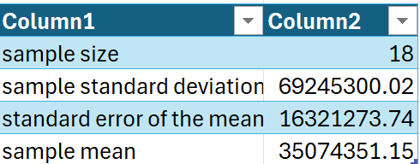
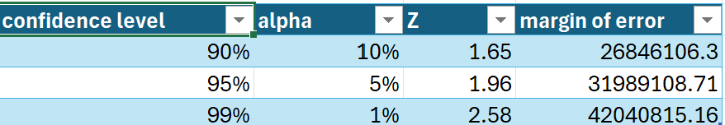
Empirical Chapter
Stratified random sampling
Based on the confidence levels we found the margins of error.
95% of European countries have a population that was influenced to purchase based on advertisement, situated between these two values: 3085242 and 67063460.

Slide 13
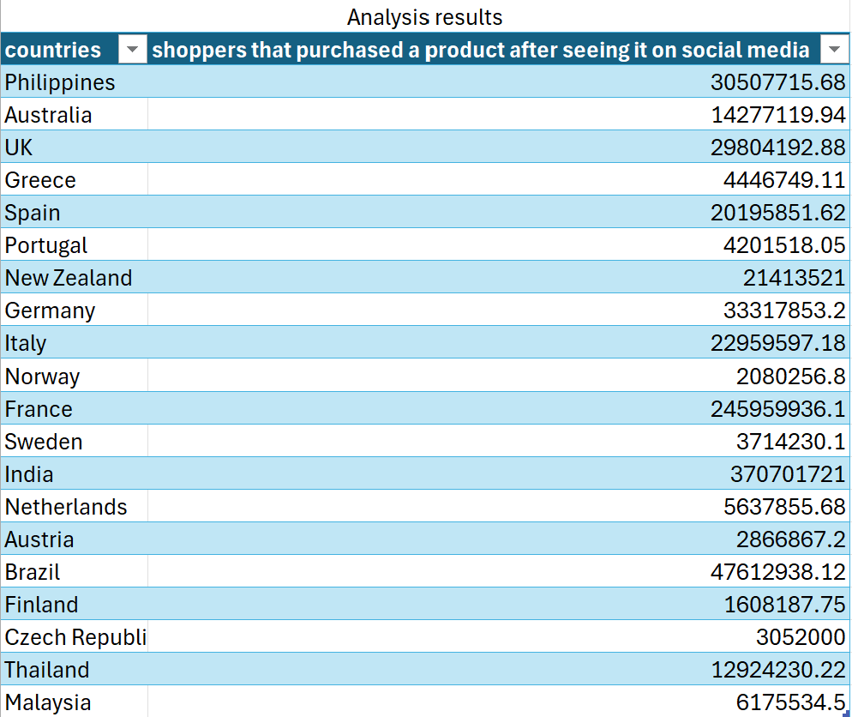
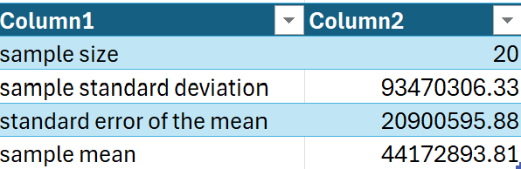
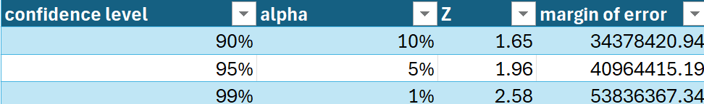
Empirical Chapter
Stratified random sampling
Based on the confidence levels we found the margins of error.
95% of European countries have a population that was influenced to purchase based on advertisement, situated between these two values: 3208478.618 and 85137309.

Slide 14
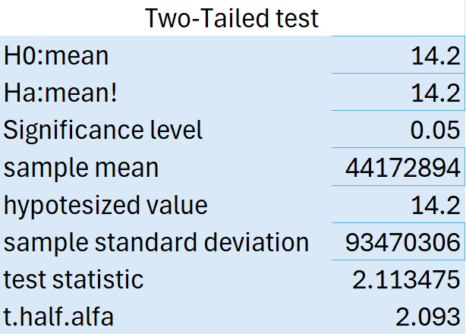
Empirical Chapter
Hypothesis testing: Two-tailed test
When doing the Hypothesis testing, we used the second sample at a 95% confidence level and compared with purchase decisions in the US.
From the two-tailed test we gathered that we can reject the null hypothesis because the test statistic is larger than the upper bound of the critical values interval.

Slide 15
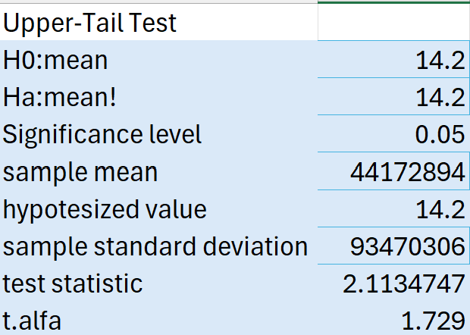
Empirical Chapter
Hypothesis testing: Upper-tail test
As a hypothesis we said that the purchase decisions are influenced mor in the US than in Europe by advertisements.
All in all we could say that, the hypothesis is false and see that the purchase decisions based on advertisement are higher in Europe then in the US because the test statistic is larger than the upper bound of the critical values interval.

Slide 16
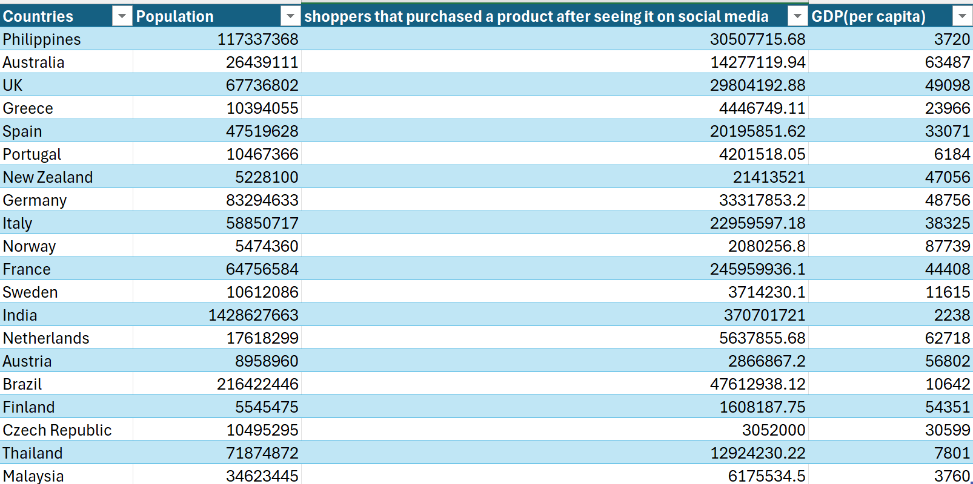
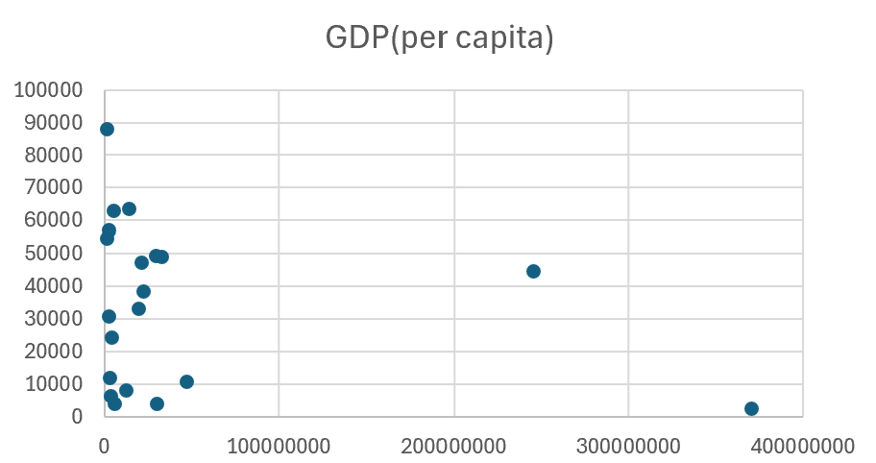
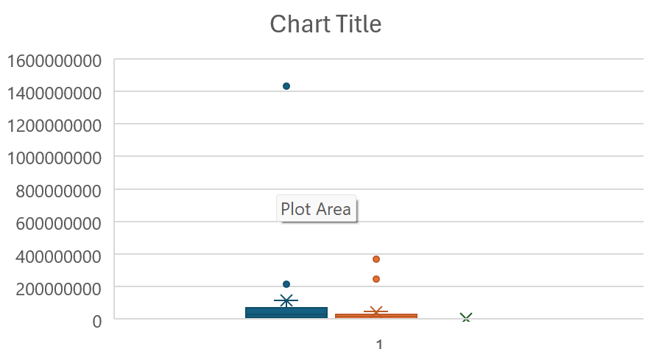
ANOVA Analysis

Slide 17
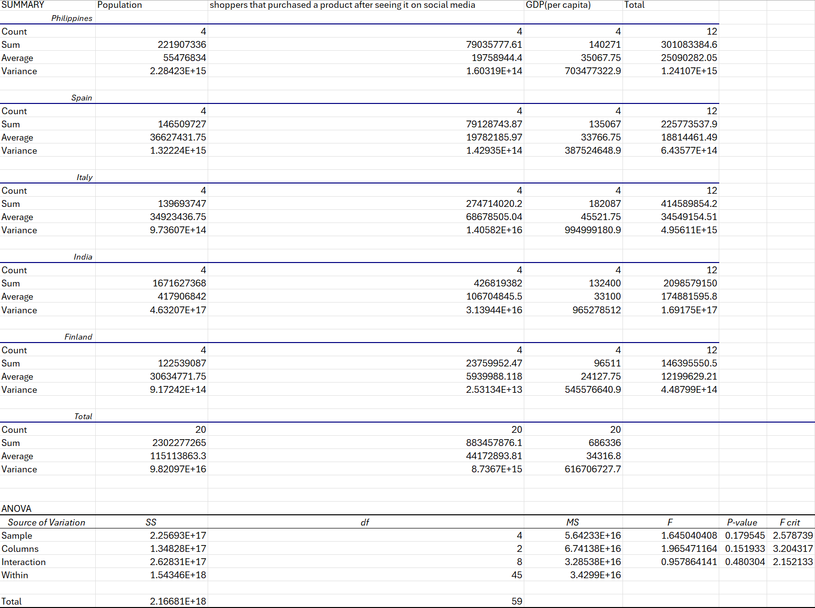
ANOVA Analysis

Slide 18
ANOVA Analysis
The goal is to determine if there are significant differences in the populations’ shoppers that purchased a product after seeing it on social media and GDP (per capita) among the countries.
For the null hypothesis there is no significant differences among group means.
As for the alternative hypothesis there is at least one group mean that is different.
Sample effect : When looking at the table we noticed that the P value (0.17954) is greater than the significance level. This means that there is no difference among countries.
Column effect: When looking at the table we noticed that the P value (0.15193) is also greater than the significance level. Thus, there is no significant difference among variables.
Interaction effect: The P value (0.48034) is greater than the significance level, implying that there is no significant interaction effect.
Therefore, none of the factors nor their interaction show statistically significant differences at the 0.05 significance level. This means that the differences in shoppers that purchased a product after seeing it on social media and GDP (per capita) are not significant.

Slide 19
Simple linear regression
For simple linear regression we analyzed the relationship between the dependent variable(shoppers that purchased a product after seeing it online) and two independent variables: spending on advertisements in each country and average internet speed(mbps).

Slide 20
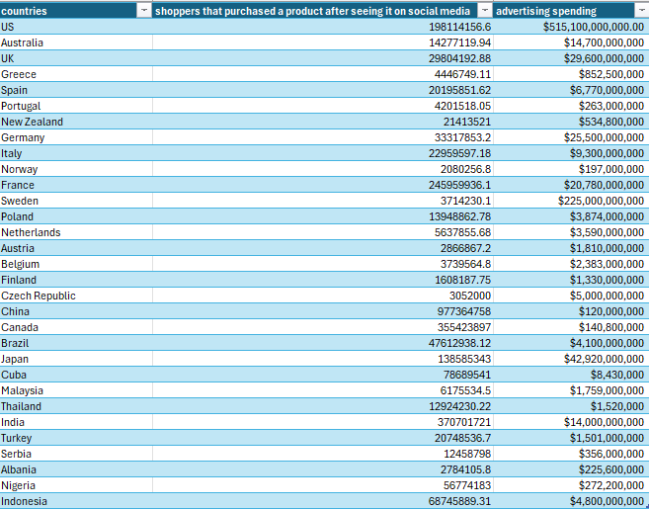
Simple linear regression
a)Total spending on advertisements in each country

Slide 21
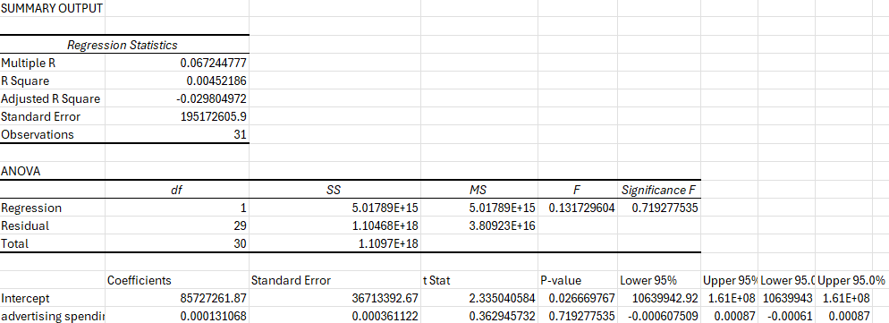
Simple linear regression
In this case, multiple R(0.06) indicates a very weak positive linear relationship. R square value shows that only 0.45% of the variability of the dependent variable is explained by the independent variable. Standard Error also suggests a large deviation of the data points from the regression line.
In addition, the high p-value(0.71>0.05) suggests that there is no linear relationship between the number of people influenced by ads and total spending on ads.

Slide 22
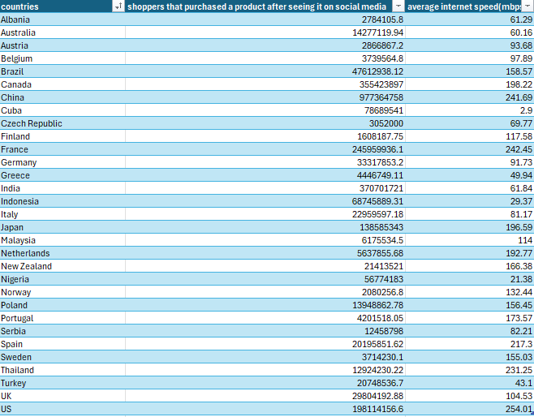
Simple linear regression
b)Average internet speed(mbps)

Slide 23
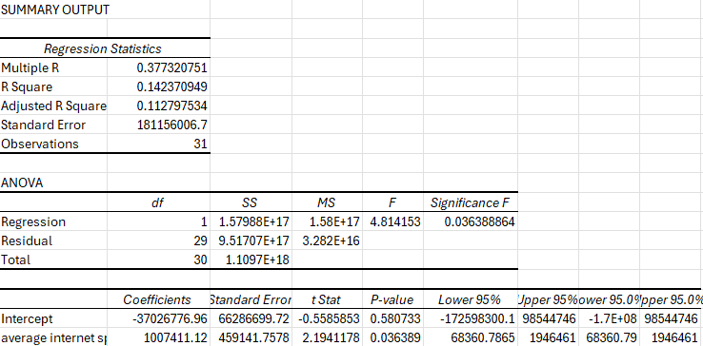
Simple linear regression
Here, the Multiple R value indicates a moderate positive relationship between the two variables. R square value shows that 14.23% of the variability of the dependent variable is explained by the independent one. On the other hand, the Standard error depicts a large deviation of the data points, indicating that the model has a low predictable character.
The low p-value(0.036<0.05) also suggests that there is a linear relationship between the two variables.

Slide 24
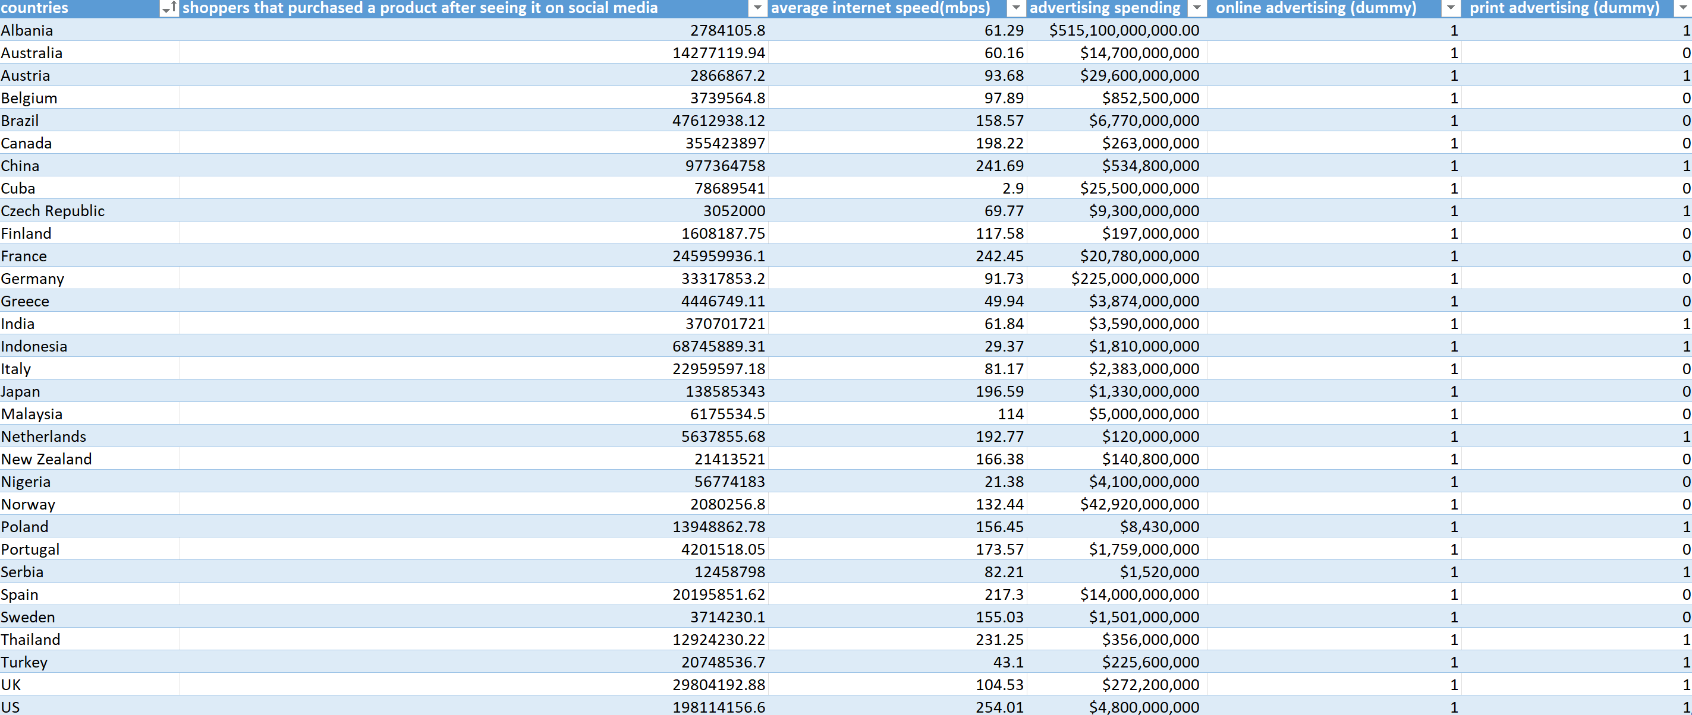
Multiple linear regression

Slide 25
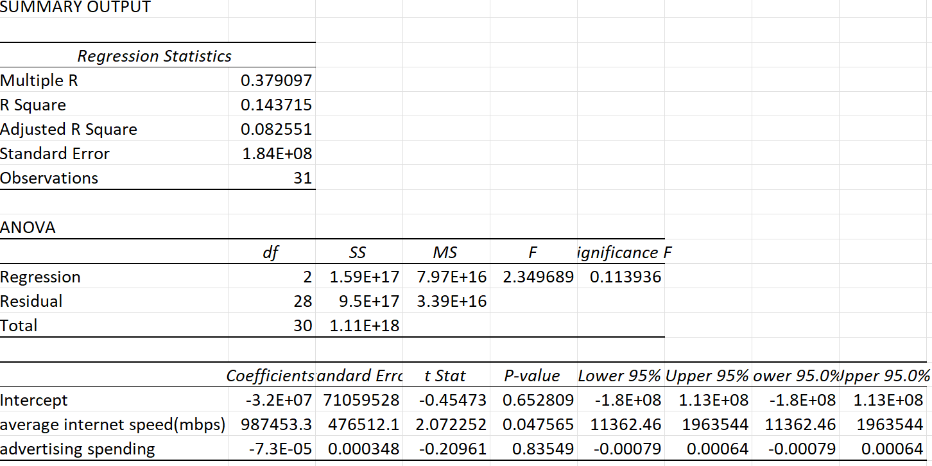
Multiple linear regression
Two independent variables and one dependent variable

Slide 26
Multiple linear regression
Two independent variables and one dependent variable
The intercept is not statistically significant (P-value = 0.652809), indicating that the expected number of shoppers influenced by social media, when both independent variables are zero, is not significantly different from zero. The wide confidence interval suggests high uncertainty in this estimate.
The average internet speed is statistically significant (P-value = 0.047565). For each additional Mbps in average internet speed, the number of social media-influenced shoppers increases by approximately 987,453. This positive relationship is supported by the confidence interval, which does not include zero, indicating a reliable effect.
Advertising spending is not statistically significant (P-value = 0.83549). The coefficient suggests a negligible inverse relationship, but this effect is not reliable, as indicated by the confidence interval, which spans zero. Therefore, advertising spending does not significantly impact the number of social media-influenced shoppers in this model.
All in all, among the variables analyzed, only average internet speed has a statistically significant and positive effect on the number of shoppers influenced by social media. The intercept and advertising spending do not show significant impacts within this model. This suggests that policies or strategies aimed at improving internet speeds might be more effective in increasing social media-influenced purchases compared to increasing advertising spending.

Slide 27
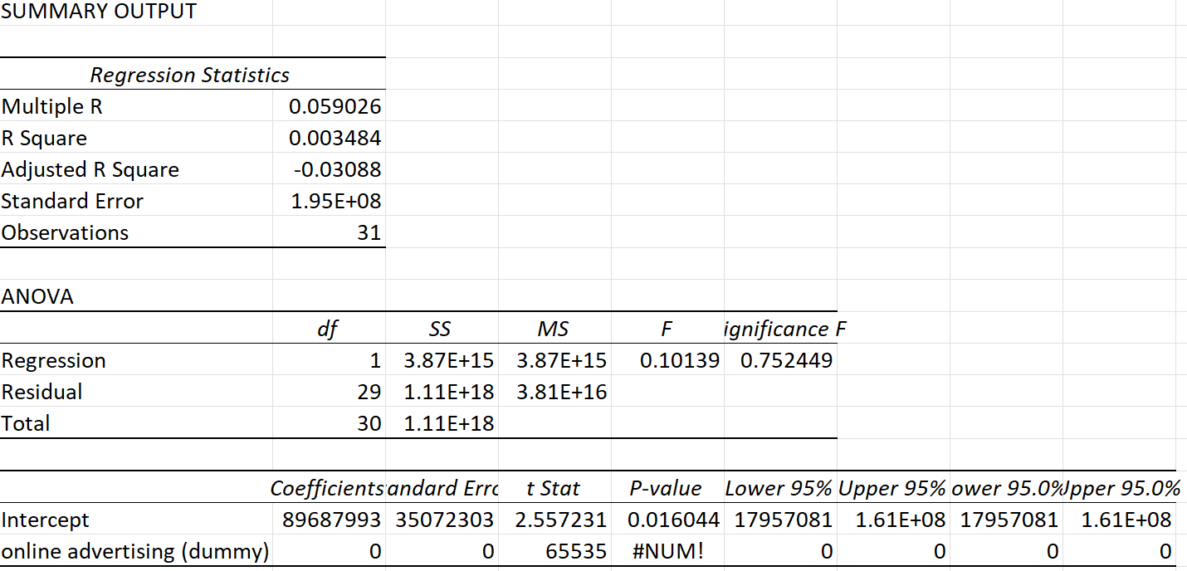
Multiple linear regression
Dummy 1

Slide 28
Multiple linear regression
Dummy 1
The regression model with the online advertising dummy variable does not provide meaningful insights.
The R Square is extremely low, indicating that the model explains almost none of the variability in the dependent variable.
The overall model is not statistically significant, as indicated by the F-test p-value of 0.752449.
The coefficient for online advertising shows computational errors, which suggests that the variable might not be properly coded or there is no variability.
The dummy variable for online advertising does not contribute to explaining the number of shoppers influenced by social media in this model. Further investigation is needed to understand the computational errors and lack of significance in this analysis.

Slide 29
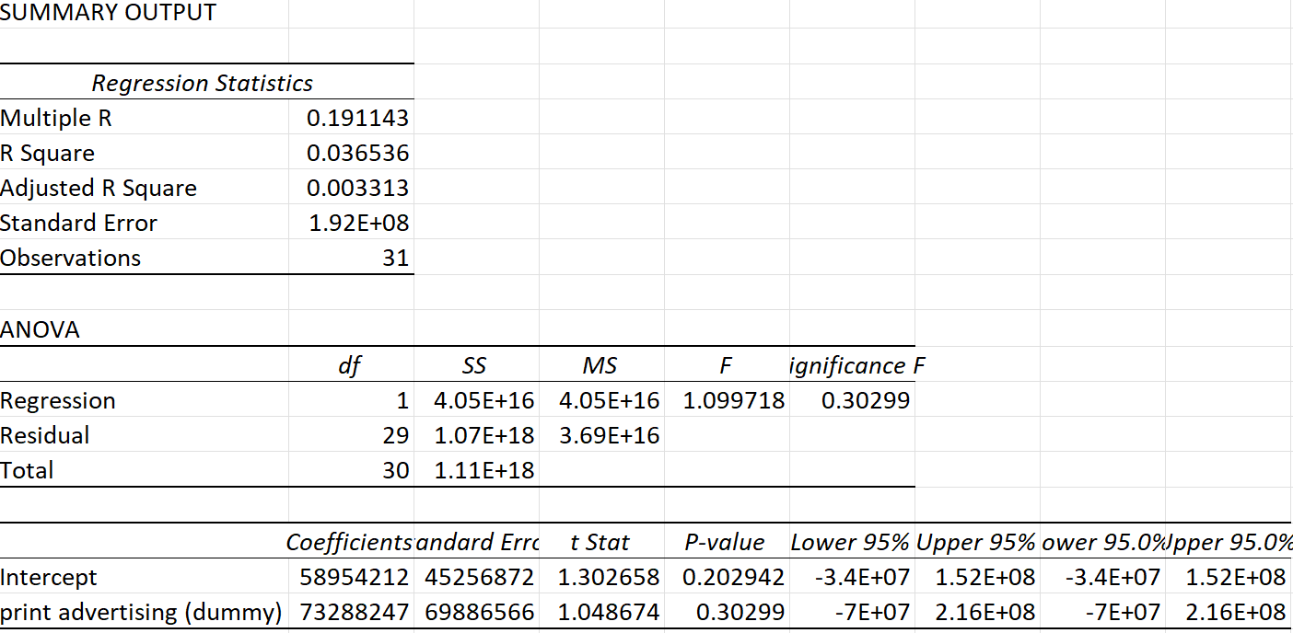
Multiple linear regression
Dummy 2

Slide 30
Multiple linear regression
Dummy 2
The regression model with the print advertising dummy variable also indicates a poor fit.
The R Square is slightly higher than with Dummy 1 but still very low, suggesting that the model explains only a small portion of the variability in the dependent variable.
The overall model is not statistically significant, as indicated by the F-test p-value of 0.30299.Both the intercept and the print advertising dummy variable have high p-values (0.202942 and 0.30299, respectively), indicating they are not statistically significant.
The wide confidence intervals further suggest a high level of uncertainty in these estimates.
This being said, the dummy variable for print advertising does not contribute to explaining the number of shoppers influenced by social media in this model. The analysis shows that neither the intercept nor the print advertising dummy significantly impacts the dependent variable. Further investigation with different variables or a more comprehensive model may be necessary to identify significant predictors.

Slide 31
Resources
https://www.statista.com/statistics/1275520/purchases-due-to-social-media-promoted-content-worldwide/
https://www.statista.com/statistics/1275520/purchases-due-to-social-media-promoted-content-worldwide/
https://www.zbw.eu/econis-archiv/bitstream/11159/631428/1/1863871837_0.pdf
https://journal.undiknas.ac.id/index.php/icfeb/article/view/4908/1445
https://www.mdpi.com/2071-1050/15/18/13337
https://ec.europa.eu/eurostat
https://insse.ro/cms/
https://www.visualcapitalist.com/mapped-the-fastest-and-slowest-internet-speeds-in-the-world/
https://ec.europa.eu/regional_policy/en/information/maps/regional_competitiveness/
https://resourcetrade.earth/data?year=2018&exporter=642&units=value
https://ourworldindata.org/grapher/covid-stringency-index
https://journal.lembagakita.org/index.php/jemsi/article/view/1648/1217
https://www.researchgate.net/publication/261031147_Impact_of_Advertisements_on_Purchase_Decision_of_Youth_with_reference_to_Consumer_Goods
https://wjarr.com/sites/default/files/WJARR-2022-0577.pdf

Slide 32
THANK YOU!

