Slide 1
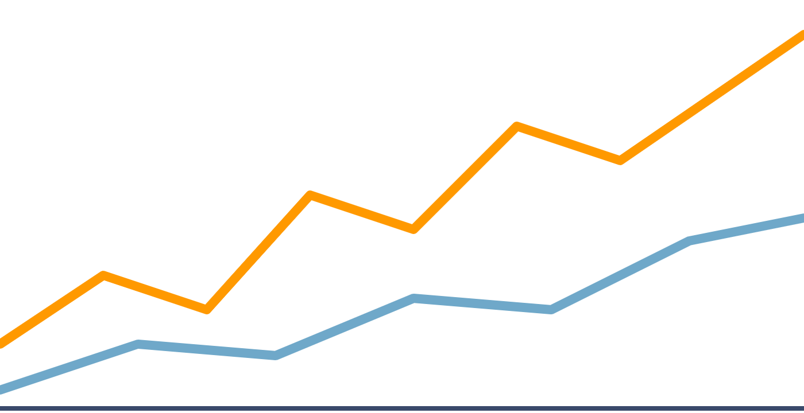
Cloud-Based Stock Market Analytics Dashboard
AWS PROJECT PROPOSAL · CTS2375 CLOUD INFRASTRUCTURE AND SERVICES
An interactive historical stock analytics platform with a Stock Query Assistant, hosted on AWS
Johnathan Nguyen · CTS 2375 · 10/14/2026

Slide 2
Problem and Stakeholders
The problem
Who it helps
Historical stock data is hard for beginners to understand
Students learning about the stock market
Comparing companies means visiting multiple websites
Beginner investors comparing companies
Raw financial data does not show market trends clearly
Anyone curious about historical stock performance
Answering financial questions often needs SQL or advanced tools
Why it matters: easier access to financial analytics
Notes:
Builds on the Stock Market Time-Series Database from the previous Database 1 course.

Slide 3
Goals and Success Criteria
1
Deploy a Streamlit app and PostgreSQL on AWS EC2
2
Integrate Amazon S3 for datasets or database backups
3
Demonstrate stock selection, historical charts and financial analysis
4
Answer supported predefined stock questions
5
Target: load typical dashboard results within 5 seconds
All items are goals to be verified, not completed results.

Slide 4
Proposed Solution and Use Case
INPUT
PROCESSING
OUTPUT
User selects a stock, changes dates or asks a question
→
Python queries PostgreSQL and calculates statistics
→
Plotly charts, statistics and assistant answers
Proposed three-panel interface
Data foundation
Left: stock search and list
Kaggle stock and ETF dataset [2]
Center: charts, dates, statistics
Database 1 project, now in PostgreSQL [1]
Right: Stock Query Assistant (keyword-based)
Historical data already loaded locally
✓
MVP: select a stock, retrieve data from PostgreSQL, view an interactive chart and statistics, and answer a few predefined questions.

Slide 5
AWS Cloud Architecture
AWS Cloud
EC2 security group: inbound control
HTTP requests →
Amazon EC2 (one instance)
Users
DB backups →
Amazon S3
Streamlit + Plotly + Stock Query Assistant
RESTRICTED: IAM role, limited access
Web browser, outside AWS
PUBLIC ACCESS
Object storage: processed dataset copies and database backups
↕ calls analytics functions
← Charts, answers
Python + Pandas analytics
← Dataset copies
↕ SQL queries / stock data
PostgreSQL: local access only
Proposed design, not yet deployed: Streamlit and PostgreSQL run on the same EC2 instance, connected to S3 for processed dataset copies and database backups.
Notes:
Planned flow: browser to Streamlit on EC2; Python queries PostgreSQL on the same instance; Pandas calculates results; Streamlit and Plotly return them. EC2 reaches S3 through an IAM role. The database port is not exposed publicly.

Slide 6
Technology and Service Choices
Amazon EC2
PostgreSQL
Amazon S3
IaaS
Relational database
Managed object storage
Hosts the app and PostgreSQL; full control of the server
Structured time-series data; SQL queries by ticker and date
Historical files, backups and exports
Python + Pandas
Streamlit + Plotly
IAM + Security Groups
Analysis
Interface
Access control
Returns, volatility, rankings and statistics
Browser dashboard with interactive charts
IAM limits EC2's S3 access; security groups limit network access
Monitoring: Amazon CloudWatch (basic). Sources: AWS, PostgreSQL, Streamlit and Plotly documentation [3–7]

Slide 7
Security, Reliability, Scaling and Cost
Security
Reliability and scale
Monitoring and cost
IAM role for restricted S3 access
S3 backups or exports
Basic monitoring with CloudWatch
Security group controls public access to EC2
Small demo workload on one EC2 instance
AWS billing alerts
PostgreSQL local access only, not public
Single instance: not highly available
Stop unused resources
No hardcoded passwords or AWS credentials

Slide 8
Implementation and Testing Plan
Completed or started (local)
Remaining
Testing plan
Build three-panel Streamlit dashboard
PostgreSQL query accuracy
Python environment and PostgreSQL setup
Integrate dashboard and backend
Returns, volatility and rankings
Historical stock data loaded
Configure S3 storage and backups
Stock navigation and charts
Financial analytics backend built
Deploy app and PostgreSQL to EC2
Assistant question interpretation
Test the deployed system
S3 connectivity and backups
Keyword question interpreter, initial tests
Prepare final presentation
Response times (5-second target)
Individual project: one student will complete all development, deployment, testing and documentation. Planned evidence: working demonstrations, test outputs and screenshots.

Slide 9
Risks and Alternatives
PostgreSQL setup or connection failure
Test locally first; check users, ports and settings
Incorrect results from missing or inconsistent data
Validate and clean data with Pandas; cross-check queries
Assistant misreads ambiguous questions
Limit to supported question types; show examples
EC2 deployment or networking problems
Rehearse deployment; verify security group rules
Unexpected AWS charges
Use billing alerts; stop unused resources
Time constraints
Prioritize the minimum viable product
Fallback: predefined query templates and a simplified Streamlit dashboard if the question interpreter needs more time. A local PostgreSQL and Streamlit setup may help with troubleshooting, but AWS integration remains the final goal.

Slide 10
Expected Outcome and References
Final demonstration
Expected outcome
1. Open the AWS-hosted dashboard
A cloud-hosted analytics platform
2. Search for a stock in the left panel
Users explore data and ask questions
3. View its price chart in the center
EC2, PostgreSQL and S3 working together
4. Adjust dates; review statistics
5. Ask the Stock Query Assistant a question
Next steps after approval
6. Show an answer backed by PostgreSQL data
Incorporate feedback
7. Show a file upload or download between EC2 and S3
Build the three-panel dashboard
8. Explain the EC2, PostgreSQL and S3 integration
Configure S3 and deploy to EC2
[1] github.com/sutomuz/cop-3701-stock-market-time-series-db
[5] AWS IAM and security groups: docs.aws.amazon.com
[2] kaggle.com/datasets/olehol/stock-market-dataset
[6] PostgreSQL documentation: postgresql.org/docs
[3] Amazon EC2 documentation: docs.aws.amazon.com/ec2
[7] Streamlit docs.streamlit.io; Plotly plotly.com/python
[4] Amazon S3 documentation: docs.aws.amazon.com/s3

