Slide 1

The News & Social Media Analytics Engine
Data Structures and Algorithms -3 (25CS2103E)
Team Number: 02
Section: 12
Under the guidance of
Ms. K. Chandusha
Assistant Professor, CS&IT
Submitted by:
Thota Jhana Sri 2520090121
Sutte Alekhya 2520090126

Slide 2
Introduction
The News & Social Media Analytics Engine is a full-stack web application that analyzes news articles, social media posts and user-provided text in one place. It helps users identify frequent keywords, hashtags, trending topics and sentiment patterns in large volumes of information.
The main focus of the project is the practical application of Data Structures and Algorithms to a real-world analytics problem. HashMap-based frequency counting and sorting rank keywords and trends, string-matching algorithms support searching, dynamic programming compares texts, and graph and number-theory algorithms are demonstrated in an Advanced DSA Lab. The system is built with React, Java Spring Boot and MySQL.

Slide 3
Problem Statement & Objectives
Problem Statement
Users receive a constant flow of news and social media posts from many sources. It is hard to see which topics are trending, what people feel about them, and which information matters.
Existing tools usually focus on only one task such as aggregation, keywords or sentiment.
Objectives
Analyze news, social posts and custom text in one workspace
Extract keywords, hashtags, trending topics and sentiment
Apply core DSA: hashing, sorting, string matching, dynamic programming and graph algorithms
Provide a secure web app with login, bookmarks, history and reports
Demonstrate algorithms from all six course outcomes in a DSA Lab

Slide 4
Literature Survey
S. No | Existing Approach | Technology / Method | Limitations
1 | News Aggregation Systems | Web APIs, Web Scraping | Mainly collect and display news
2 | Keyword Analysis Systems | Hashing, Frequency Counting | Limited trend analysis
3 | Sentiment Analysis Systems | Text Processing | Often focus only on sentiment
4 | Trending Topic Systems | Sorting, Ranking | May not combine multiple analytics
5 | Social Media Analytics | Hashtag & Keyword Analysis | Can be difficult to process large datasets
6 | Proposed System | Java + React + MySQL + DSA | Combines keyword, hashtag, sentiment and trend analysis

Slide 5
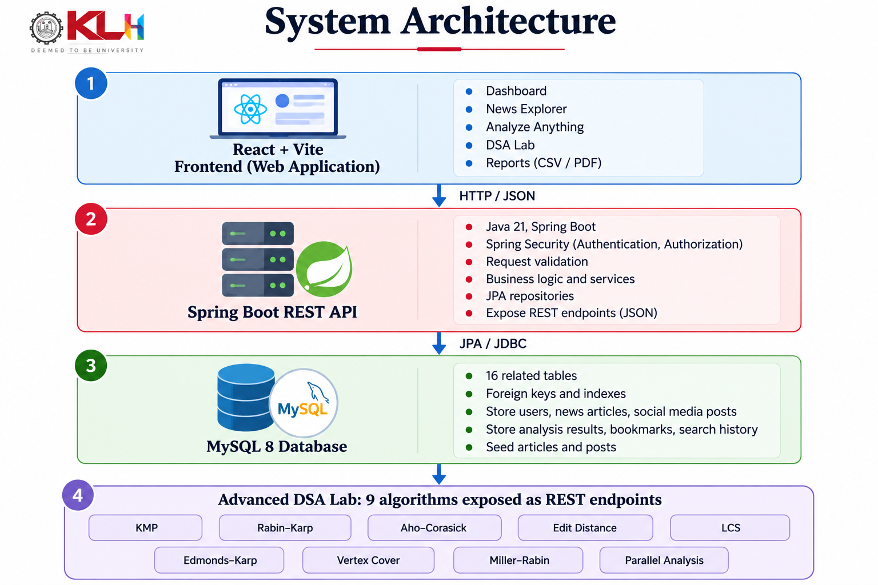
System Architecture

Slide 6
Software Requirements
Software | Purpose
Java 21 + Spring Boot 3 | Backend REST API and business logic
React 18 + Vite | Frontend user interface
MySQL 8 | Relational database
Spring Security (BCrypt) | Authentication and role-based access
Maven 3.9+ / Node.js 20+ | Build and dependency management
Recharts, Axios | Charts and API communication
IntelliJ IDEA / VS Code | Development environment
Git / GitHub | Version control and code management

Slide 7
Hardware Requirements
Component | Requirement
Processor | Intel Core i3 or above – runs the application
RAM | 4 GB minimum – supports program execution
Storage | 10 GB free space – stores project files and data
Monitor | 14" or above – displays the application
Keyboard & Mouse | Standard – user interaction

Slide 8
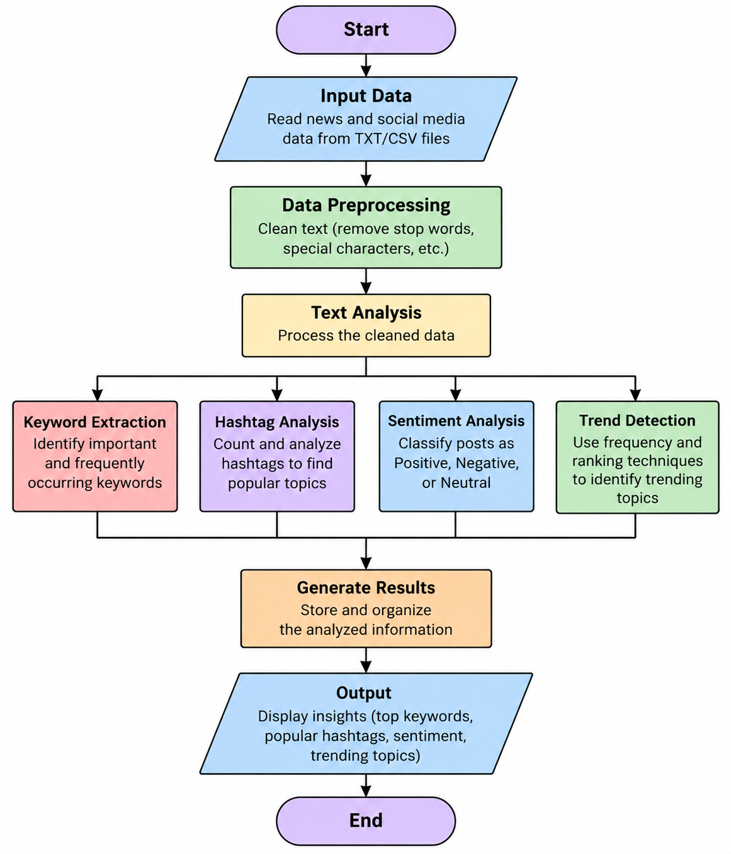
Methodology

Slide 9
Key Features
1
Secure Access
2
News & Social Analytics
3
Analyze Anything
Registration and login with BCrypt-hashed passwords and role-based admin access.
News explorer, social post summary and trending topics from stored data.
Keyword frequency, sentiment estimate and summary for pasted or uploaded text/CSV.
4
Personal Workspace
5
Reports & Export
6
Advanced DSA Lab
Bookmarks, search history, analysis history and notifications for each user.
Export results as CSV or print a report to PDF from the browser.
Run nine algorithms on custom input and view results with execution time.

Slide 10
Algorithms & CO Mapping
CO | Topic | Algorithms in the project
CO1 | Problem solving and query workflow | Centralized query explorer and analysis dispatch
CO2 | String algorithms | KMP, Rabin–Karp, Aho–Corasick
CO3 | Dynamic programming | Edit Distance (Wagner–Fischer), LCS
CO4 | Network flow | Edmonds–Karp max flow and min cut
CO5 | Approximation algorithms | Vertex-Cover 2-approximation
CO6 | Randomized and parallel | Miller–Rabin test, parallel text analysis

Slide 11
Algorithm Complexity
Algorithm | Time complexity | Used for
KMP | O(n + m) | Pattern search in text
Rabin–Karp | Expected O(n + m), worst O(nm) | Hash-based pattern search
Aho–Corasick | O(n + pattern length + matches) | Multi-keyword search
Edit Distance | O(nm) | Similarity of two strings
LCS | O(nm) | Longest common subsequence
Edmonds–Karp | O(VE²) | Max flow and min cut
Vertex Cover | O(E log V) as implemented | 2-approximation cover
Miller–Rabin | O(k log³ n) | Primality testing
Parallel analysis | Work split across CPU cores | Independent text processing

Slide 12
Database Design
Users & Access (3)
users, user_preferences, notifications
Content (7)
news_articles, news_sources, categories, social_posts, hashtags, post_hashtags, citation_edges
User Activity (4)
bookmarks, search_history, analysis_history, algorithm_runs
Analytics (2)
trending_topics, sentiment_results
16 tables · foreign keys with cascade rules · indexes on dates, categories and users

Slide 13
Limitations & Future Scope
Limitations
Live news and social feeds need an authorized API; stored data is sample data
Sentiment is dictionary-based, not a trained AI model
Summaries are extractive, built from selected sentences
DSA Lab inputs have no size limits yet
Future Scope
Connect authorized news and social media APIs for live data
Use machine-learning models for sentiment analysis
Add input-size limits and validation to the DSA Lab
Add email verification, cloud deployment and richer dashboards

Slide 14
Conclusion
The News & Social Media Analytics Engine shows how Data Structures and Algorithms can be applied to organize and analyze growing volumes of text. Users can explore news and social posts, find popular keywords and trends, estimate sentiment and analyze their own text through a secure web interface.
HashMap-based counting, sorting, string matching, dynamic programming, network flow, approximation and primality testing are implemented and can be tried live in the Advanced DSA Lab. Overall, the project turns raw text into useful insights and links classroom DSA concepts to a working full-stack application.

Slide 15
Thank You
Team 02 · Section 12
Thota Jhana Sri (2520090121) · Sutte Alekhya (2520090126)

