Slide 1
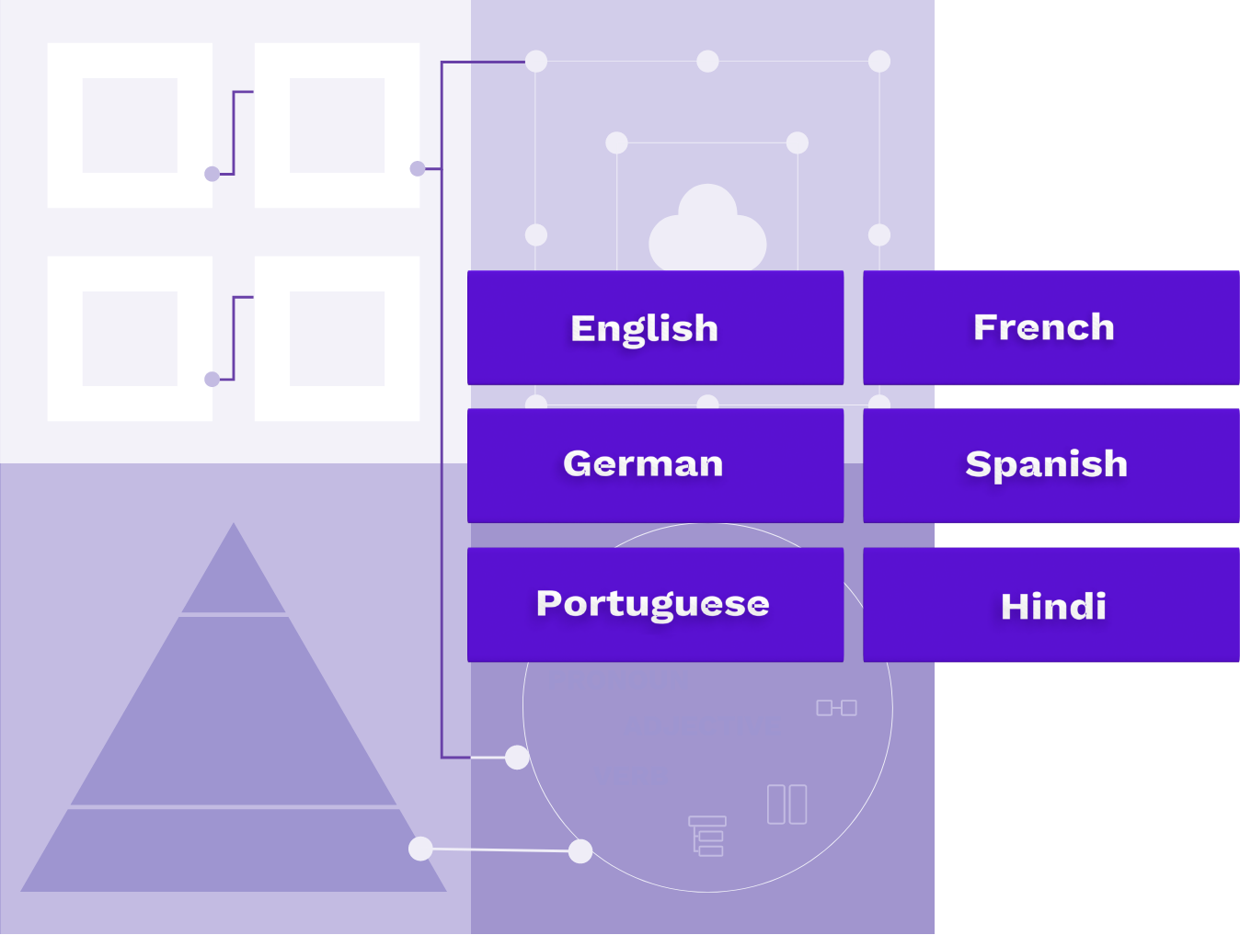

My work
for BRANE
Notepad
Back to Primary Portfolio

Slide 2
Notepad Overview
Notepad is a collaborative workspace platform which is stand alone and scalable. It is designed to help teams work together more efficiently by providing a space for documentation, project management, and knowledge sharing. Here are some of its key features
Rich Multi UI Control Editing: Offers a user-friendly editor with features like text formatting, tables, and media embedding.
Assistant: Assist and guide users at runtime.
Version Control: Keeps track of changes with version history, allowing users to view and revert to previous versions of a page
Real-time Editing: Multiple users can edit pages simultaneously.
Comments and Mentions: Users can leave comments, mention team members, and have discussions directly on pages.
Change Notifications: Receive notifications for page changes and updates.

Slide 3
Challenges
- Collaboration space for Developers, Project managers and Product designers.
- Knowledge sharing space for all stakeholders.
- Tracking space for Project managers.
- Sprint planning for developers

Slide 4
Target Audience
- Software Developers
- Content writers
- Product Managers
- Project Managers

Slide 5
Following are the screenshots of executed output.

Slide 6
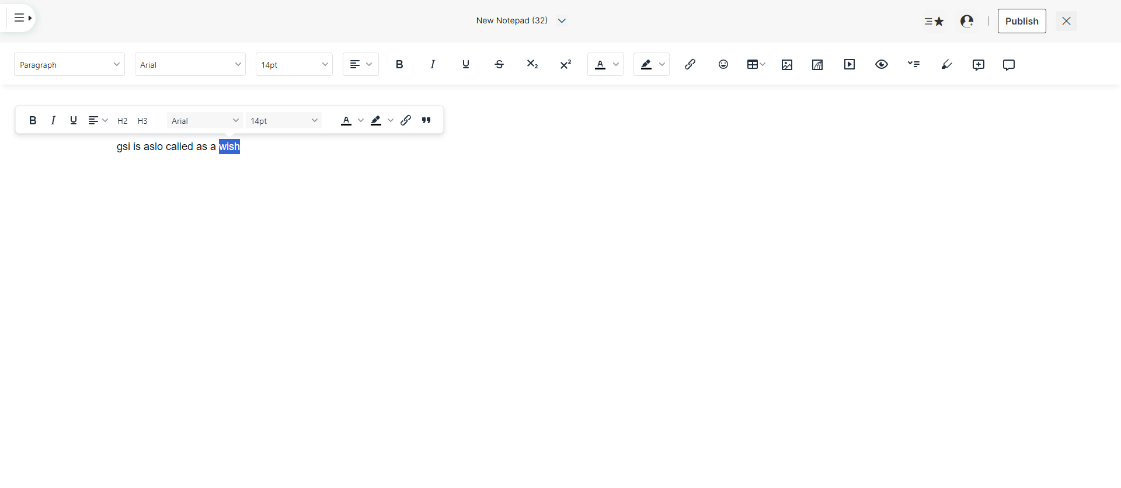

Slide 7
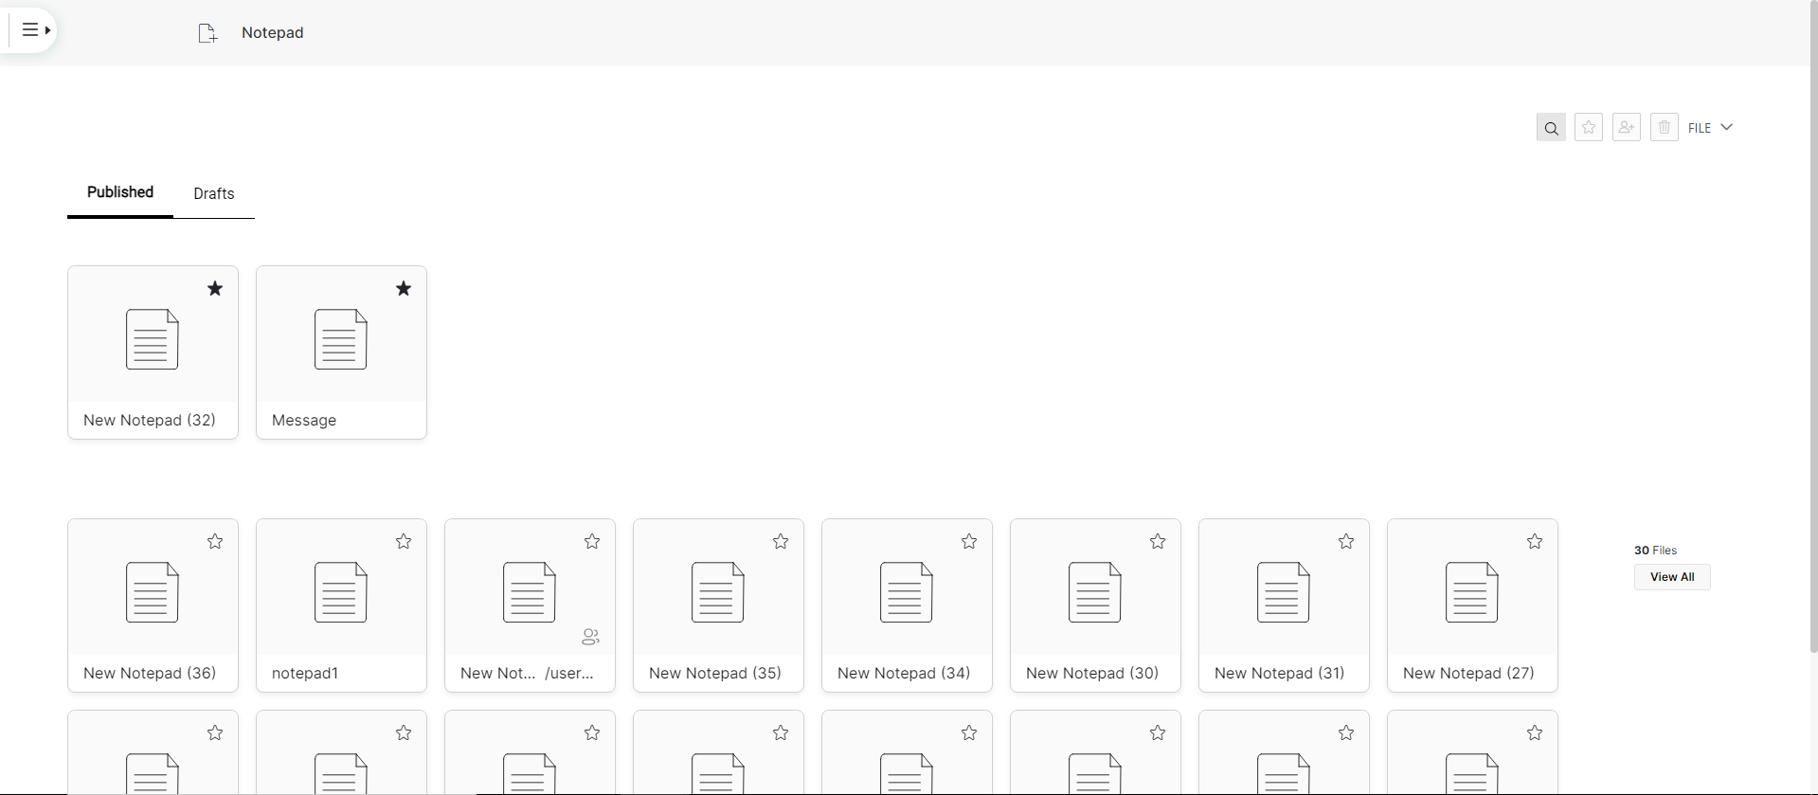

Slide 8
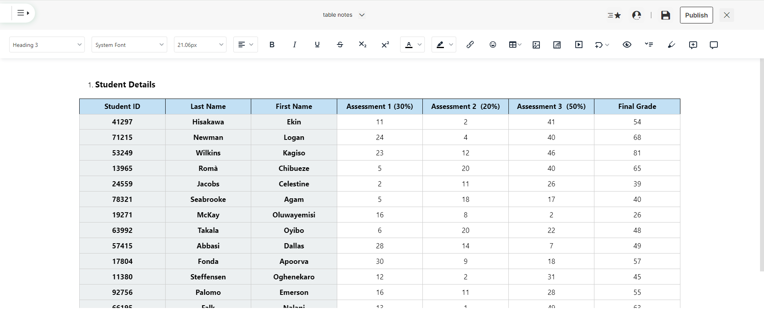

Slide 9
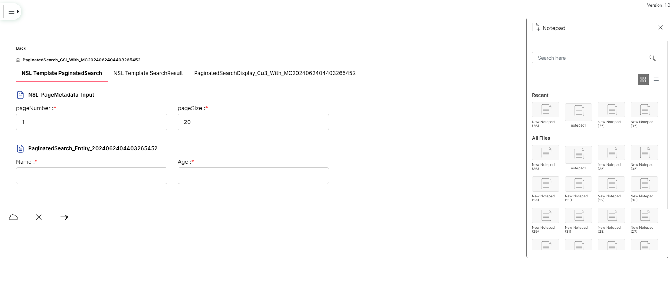

Slide 10
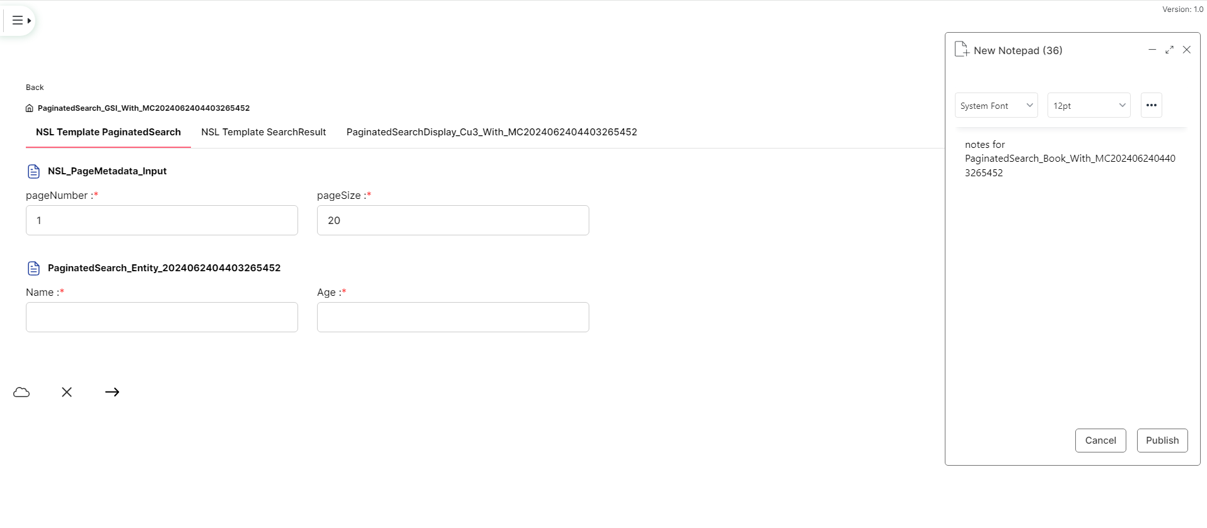

Slide 11
Thank You

