Slide 1
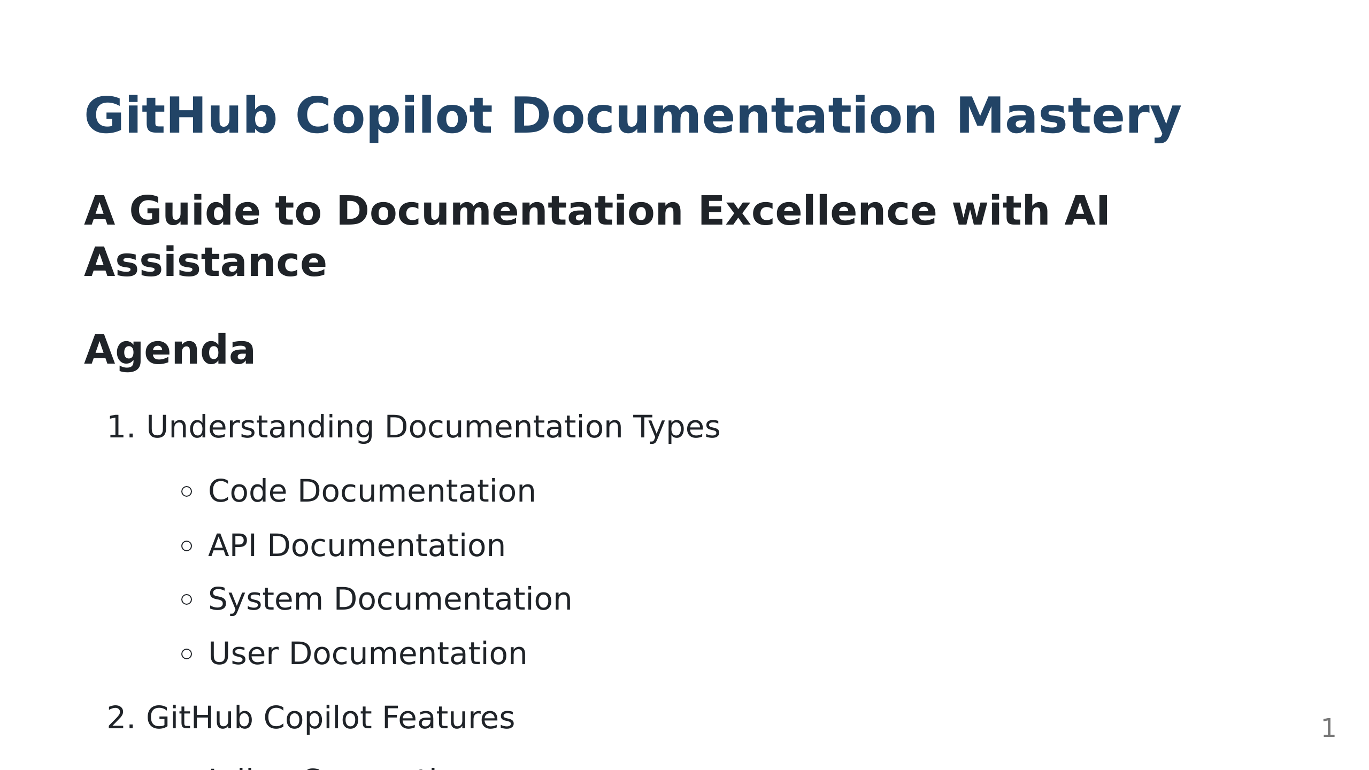
Notes:
Welcome to this presentation about mastering documentation with GitHub Copilot. Key takeaways: - Learn about different documentation types - Master Copilot's documentation features - Practice with real-world examples

Slide 2
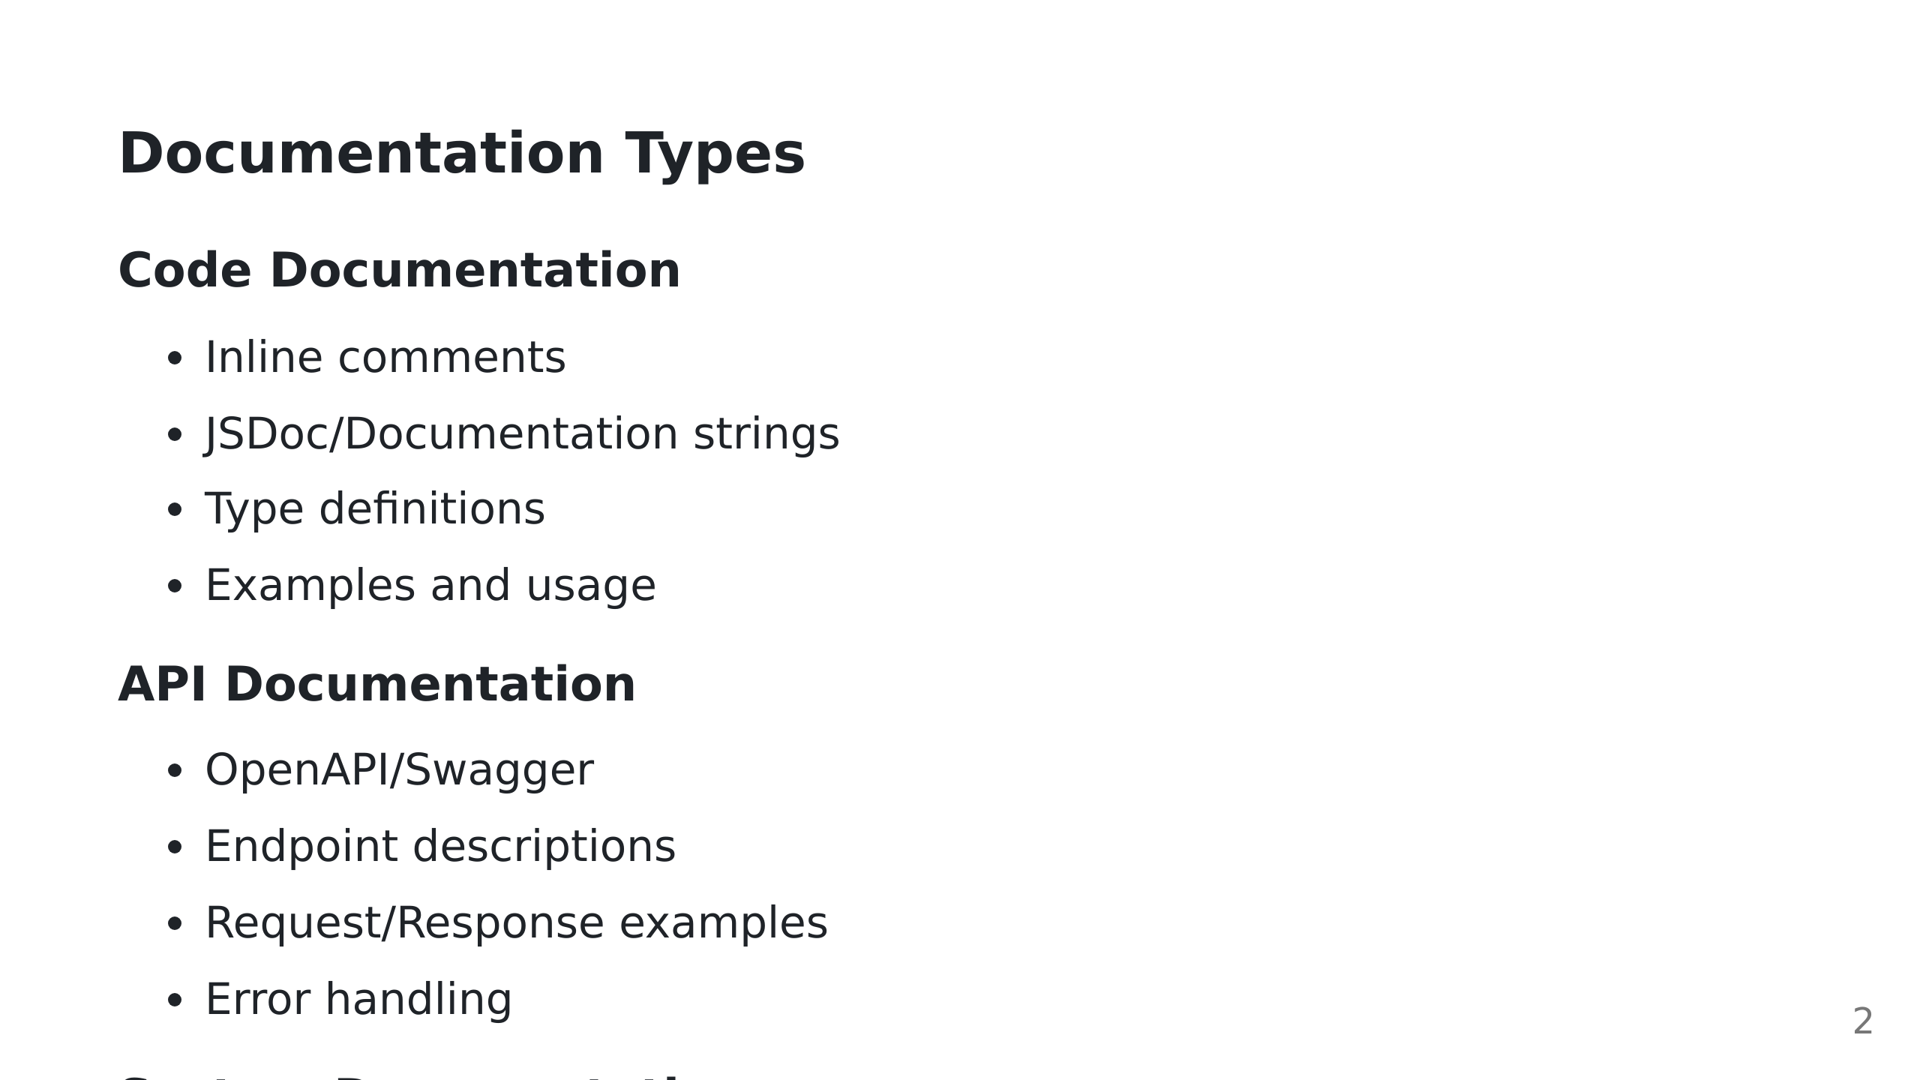

Slide 3
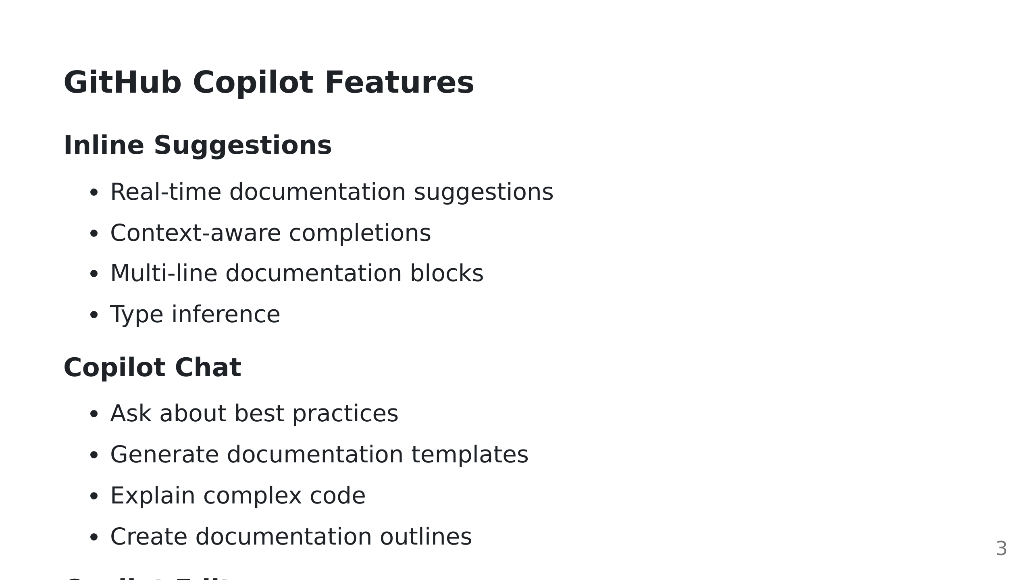

Slide 4
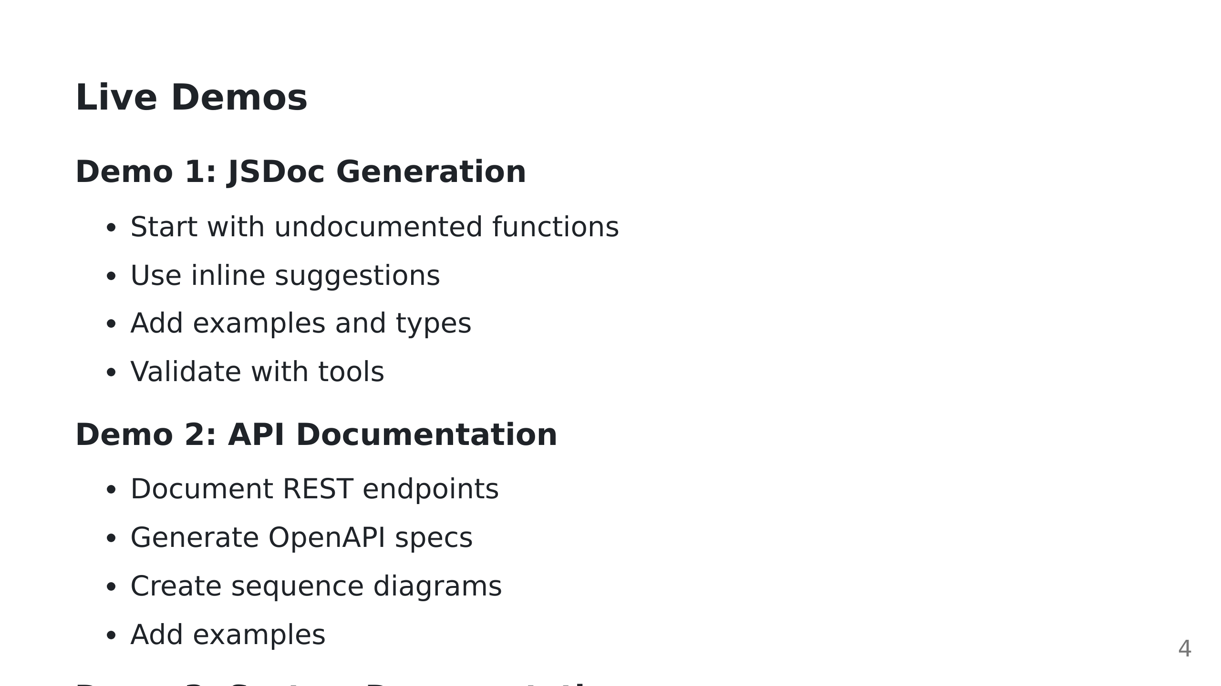

Slide 5
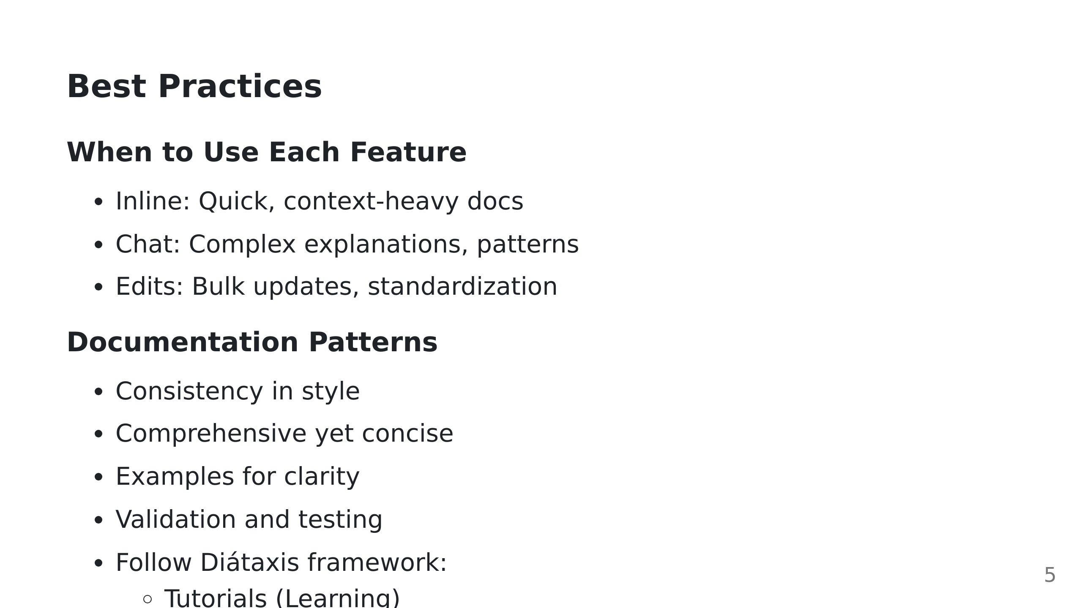

Slide 6
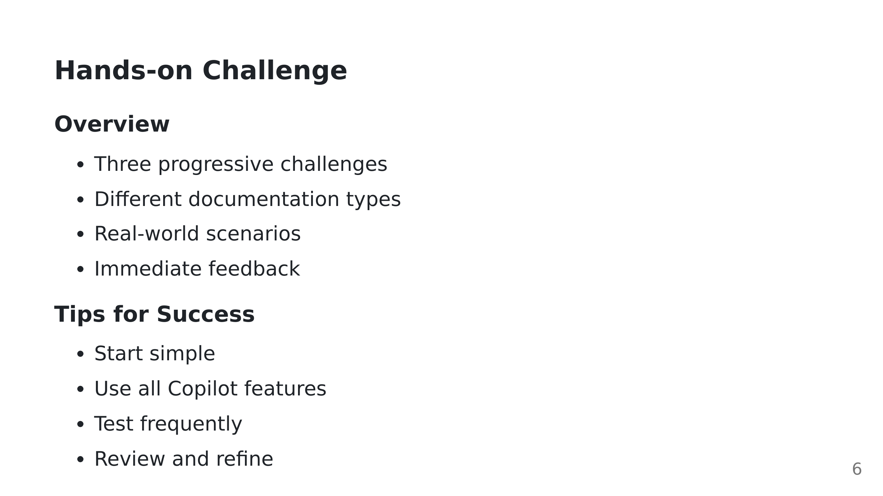

Slide 7


