Slide 1
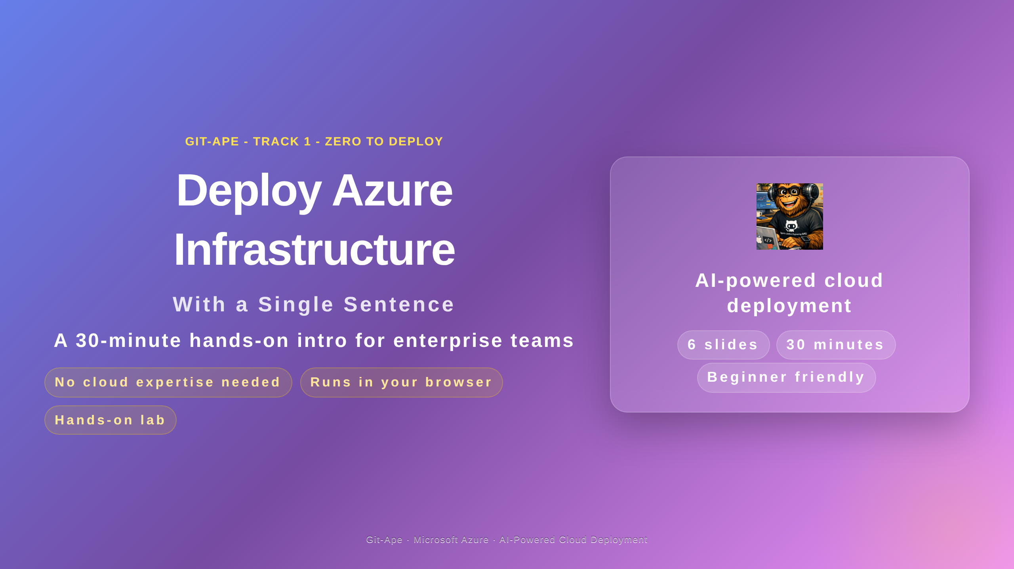
Notes:
Speaker notes (Slide 1 — Hero). Welcome the room and frame the session: this is a 30-minute hands-on intro for enterprise teams. By the end of the session every attendee will have deployed real Azure infrastructure using one English sentence. No prior ARM, Bicep, or Terraform knowledge is required. Before starting, confirm everyone has GitHub Codespaces, Dev Containers, or VS Code open, and that Copilot is signed in.

Slide 2
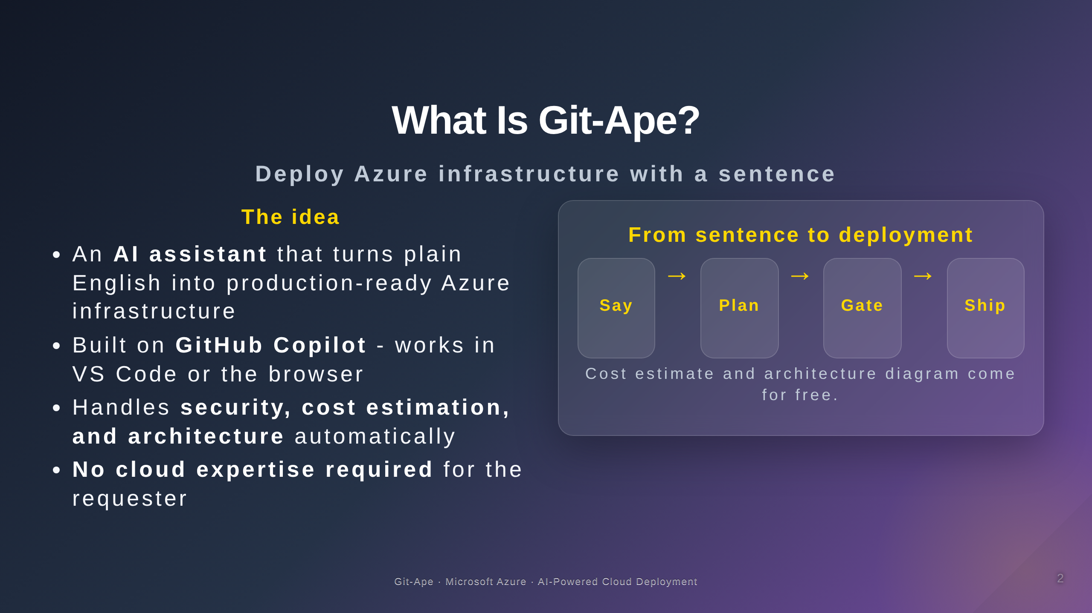
Notes:
Speaker notes (Slide 2 — What Is Git-Ape?). Lead with the value: Git-Ape turns plain English into production-ready Azure infrastructure. It is built on GitHub Copilot, so it lives inside the tools engineers already use — VS Code or the browser. On every deployment three things happen automatically: a security review, a real-pricing cost estimate, and an architecture diagram. Emphasise that no cloud expertise is required by the requester — this is designed for application developers, not infrastructure specialists. Pause for any quick questions before moving on.

Slide 3
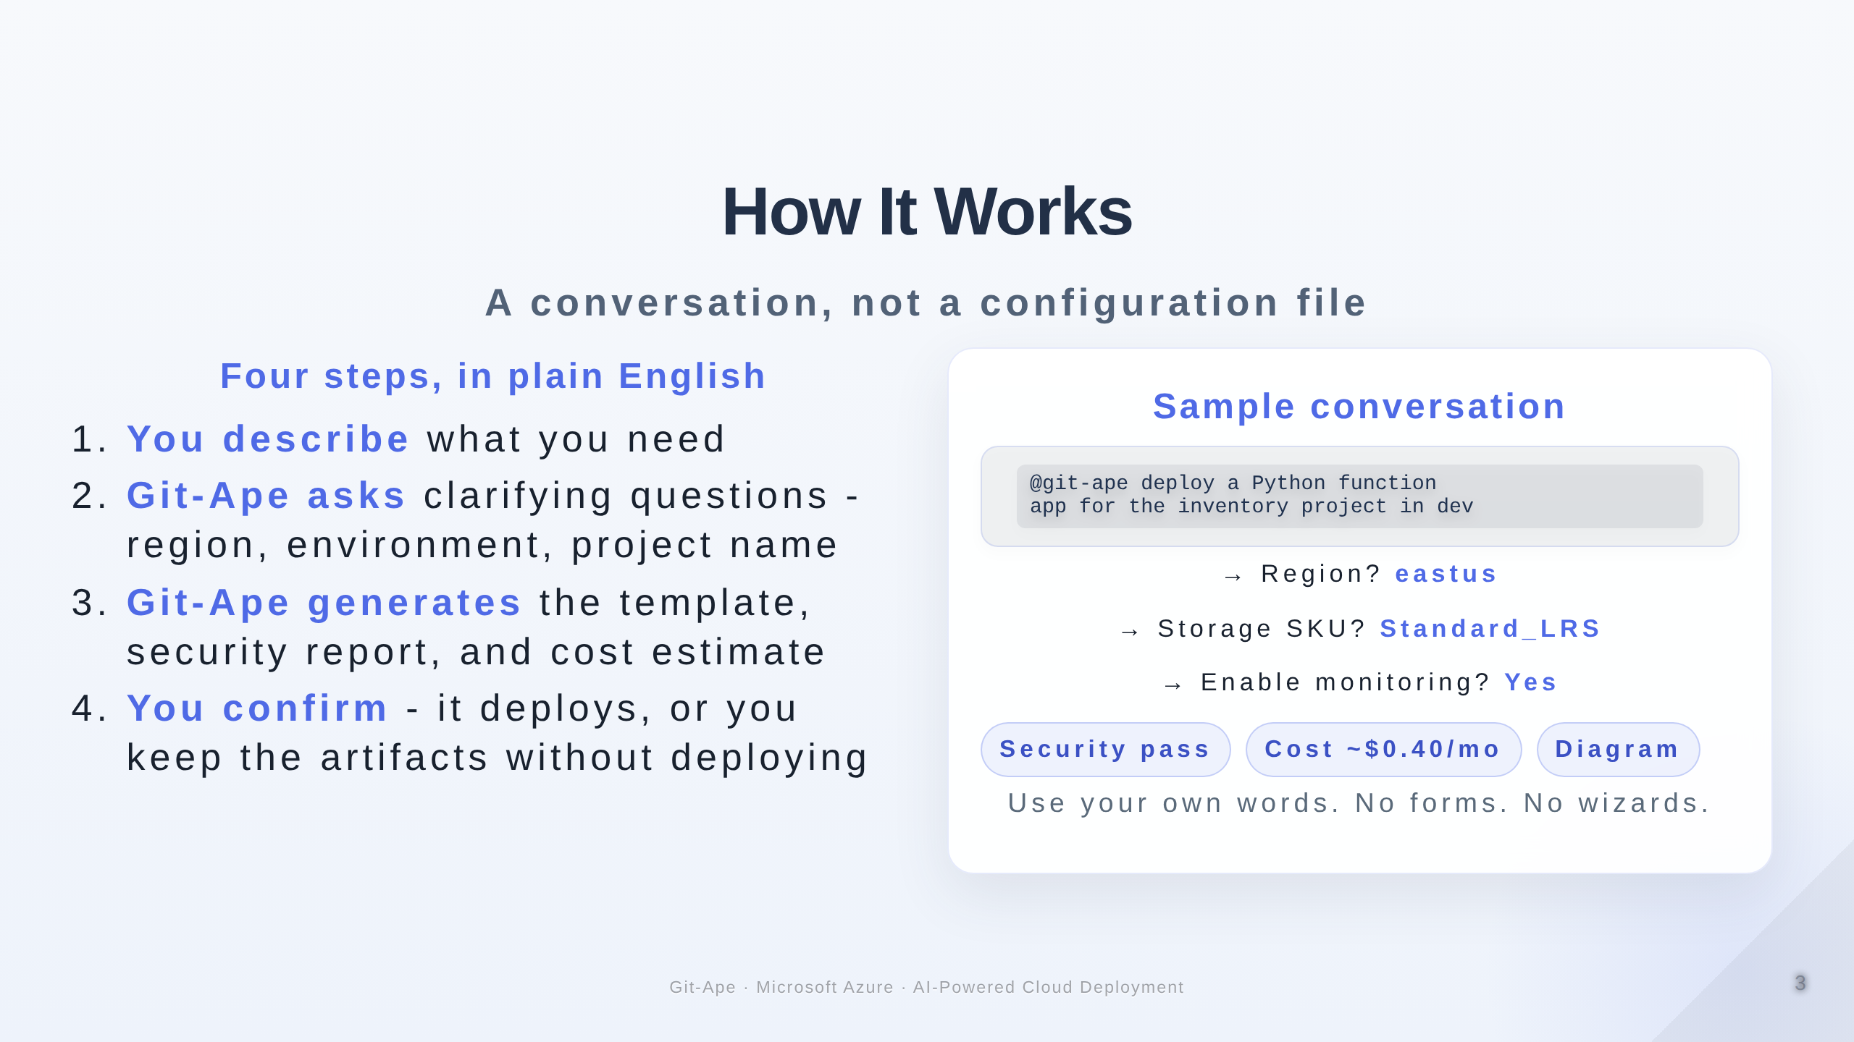
Notes:
Speaker notes (Slide 3 — How It Works). This is the most important slide for the early wow moment. Git-Ape is a conversation, not a wizard. Walk through the four steps in order. Stress that step two, the clarifying questions, is the secret to producing correct templates without forcing the requester to know Azure. The sample conversation on the right shows exactly what attendees will type in Lab 2. Remind attendees that three artifacts always come back regardless of whether they deploy: security report, cost estimate, and architecture diagram. Deployment itself is opt-in — they can stop at the artifacts.

Slide 4
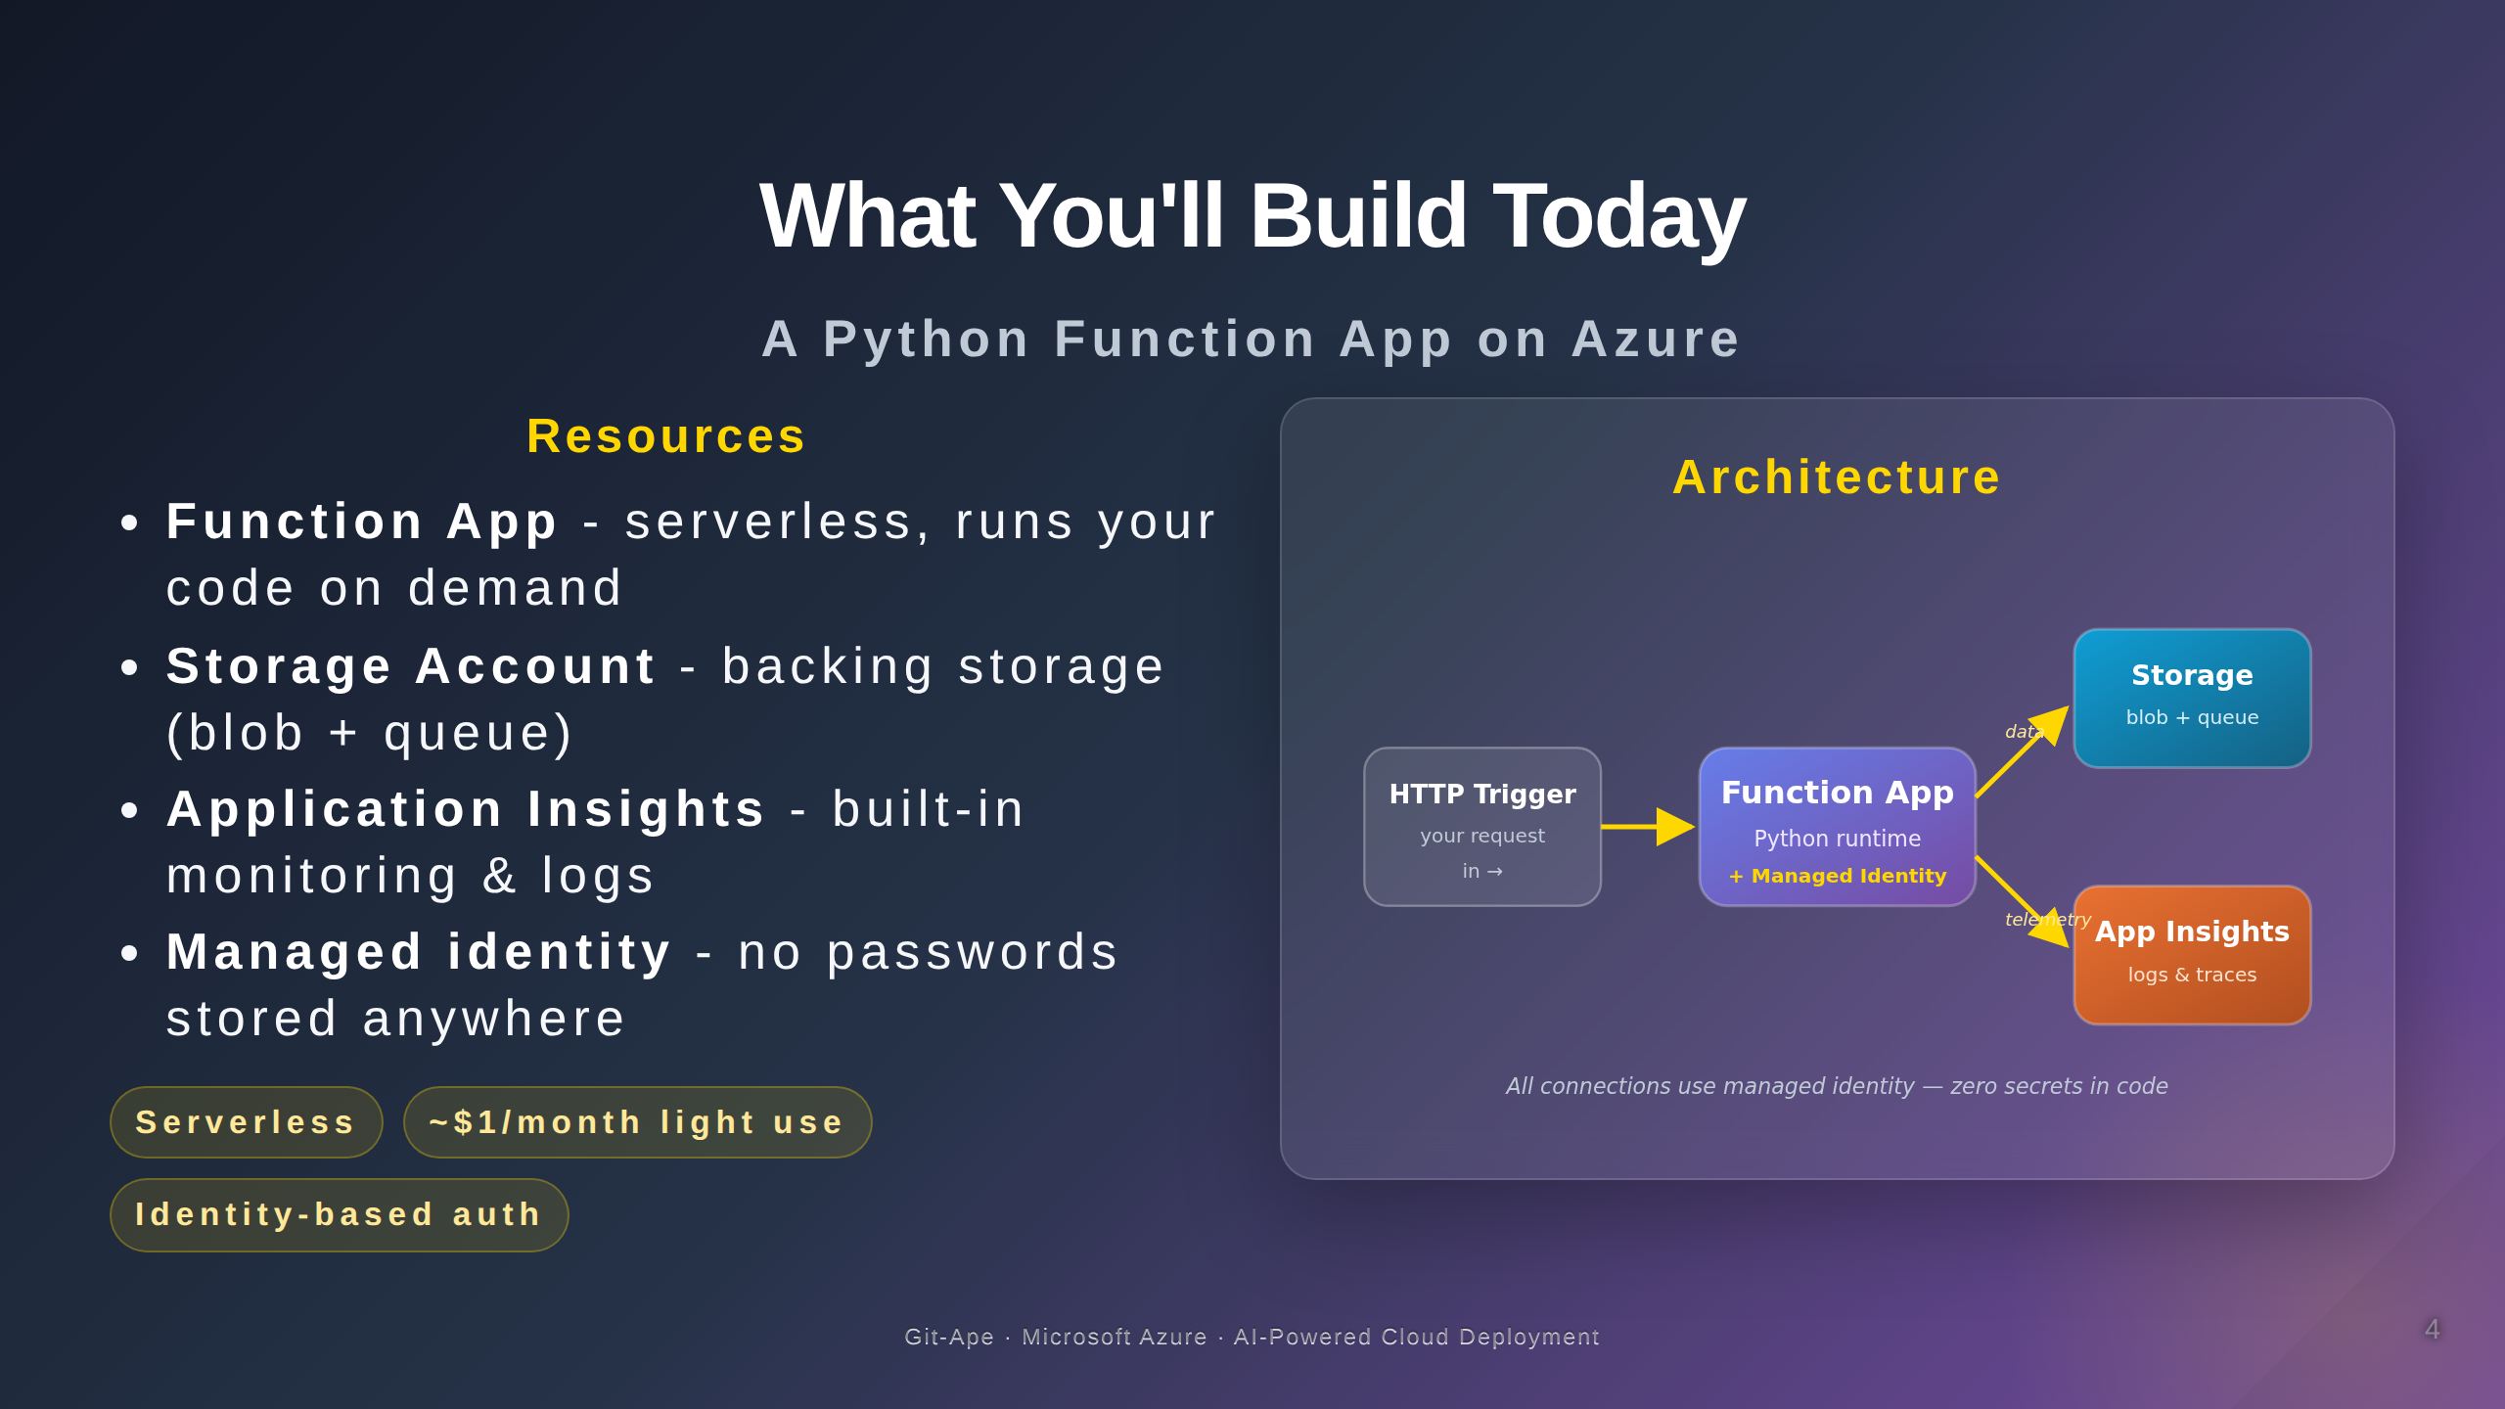
Notes:
Speaker notes (Slide 4 — What You'll Build Today). Today's lab deploys a Python Function App with a Storage Account and Application Insights. Highlight that every connection uses managed identity — zero secrets in code, zero connection strings, zero shared keys. Estimated cost is well under one dollar a month for light use; Storage at LRS is the largest line item. The architecture diagram on the right is generated automatically by Git-Ape — attendees will see this exact pattern emerge from their own prompt in Lab 2.

Slide 5
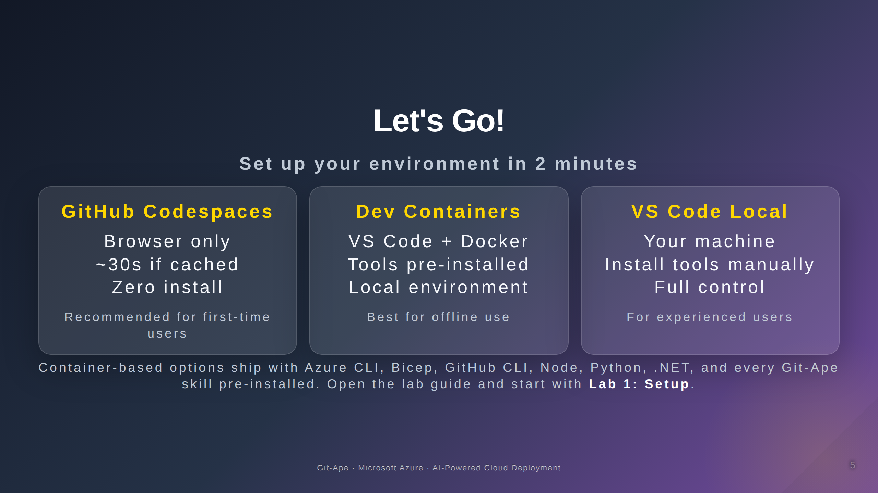
Notes:
Speaker notes (Slide 5 — Let's Go). Three environment options. All produce the same outcome. Codespaces is fastest for first-time attendees — no install, runs entirely in the browser. Dev Containers is the best fit for engineers who already use VS Code with Docker and want a fully local environment. VS Code Local works for experienced users who already have the prerequisites installed. Give the room two to three minutes to launch their environment and help any stragglers. Then point them to Lab 1: Setup in the lab guide.

Slide 6
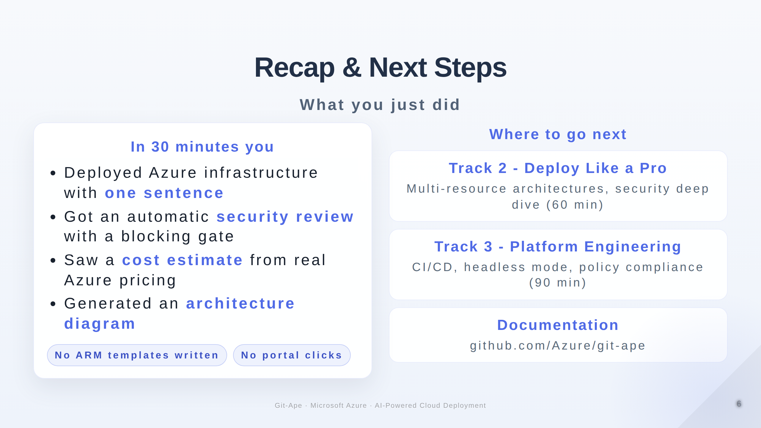
Notes:
Speaker notes (Slide 6 — Recap & Next Steps). Quick recap: in thirty minutes attendees deployed Azure infrastructure with one sentence, got an automatic security review with a blocking gate, saw a real-pricing cost estimate, and generated an architecture diagram. No ARM templates were written by hand. No portal clicks. This is the value proposition in concrete form. Point engineers and developers to Track 2 for multi-resource architectures and a security deep dive. Point DevOps and platform engineers to Track 3 for CI/CD, headless mode, and policy compliance. Finally, share the GitHub repository for documentation and community. Open the floor to questions or a volunteer demo if time permits.

