Slide 1
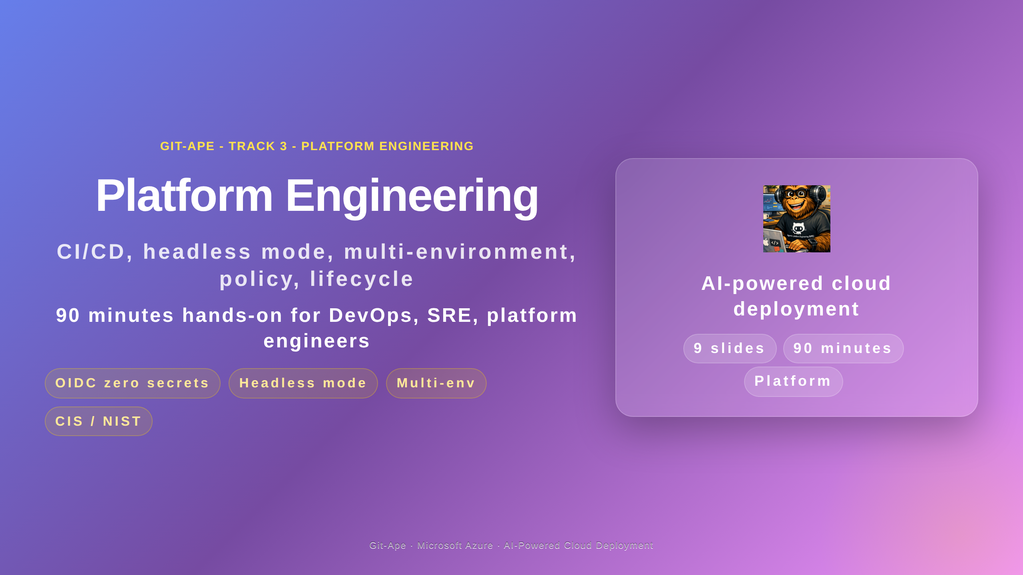
Notes:
Speaker notes (Slide 1 - Hero). Track 3 is for DevOps, SRE, and platform engineers. Ninety minutes covering CI/CD with OIDC, headless mode driven by Copilot Coding Agent, multi-environment promotion, Azure Policy compliance, IaC export from existing resources, and the full lifecycle through teardown. Prerequisite: Track 2 onboarding or equivalent Git-Ape experience.

Slide 2
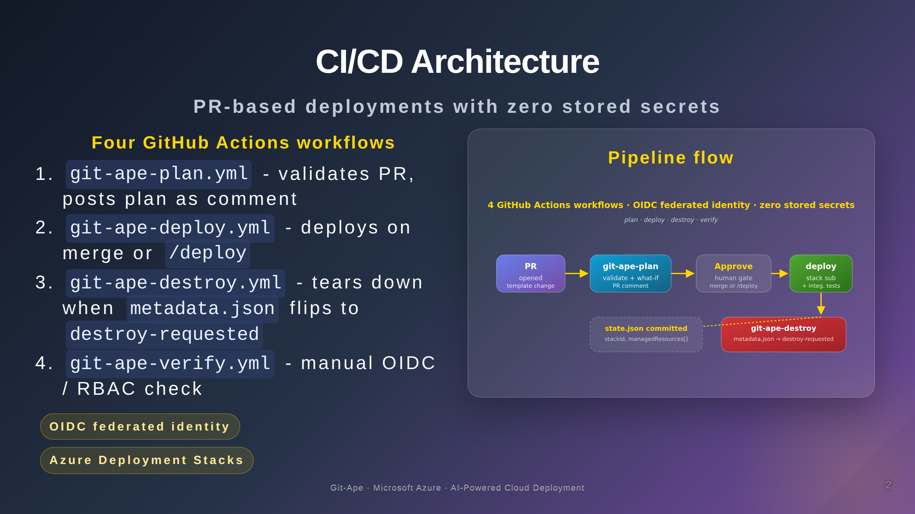
Notes:
Speaker notes (Slide 2 - CI/CD). Four GitHub Actions workflows. git-ape-plan runs on every PR with a template change - it validates the template, runs what-if, and posts the plan as an idempotent PR comment that updates on each push. git-ape-deploy runs on merge to main or on a slash-deploy comment on an approved PR - it deploys as an Azure Deployment Stack with action-on-unmanage set to deleteAll, runs integration tests, and commits state.json back to the repo. git-ape-destroy runs when metadata.json status flips to destroy-requested. git-ape-verify is a manual workflow for checking OIDC and RBAC configuration. All four use OIDC federated identity - zero stored secrets, no AZURE_CREDENTIALS secret in the repo.

Slide 3
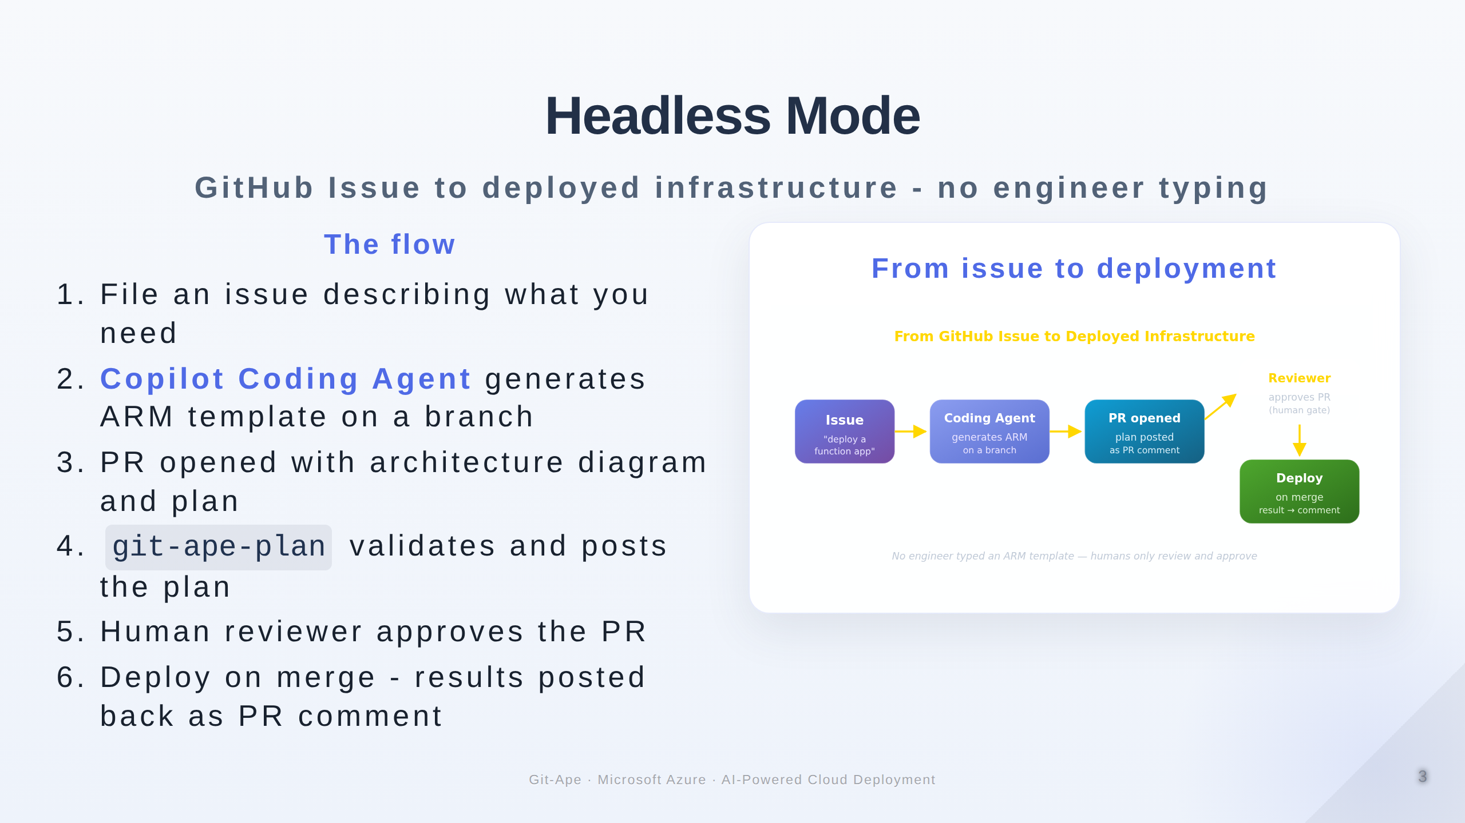
Notes:
Speaker notes (Slide 3 - Headless mode). This is the killer demo for platform teams. An engineer files a GitHub issue describing what they need. The Copilot Coding Agent picks it up, generates an ARM template on a branch, and opens a PR. The plan workflow validates and comments. A human reviewer approves and merges. Deployment runs and the result is posted back as a PR comment. No engineer typed a template, no engineer ran a CLI command, and the human gate is preserved at the approval step. This is self-service deployment with full audit trail.

Slide 4
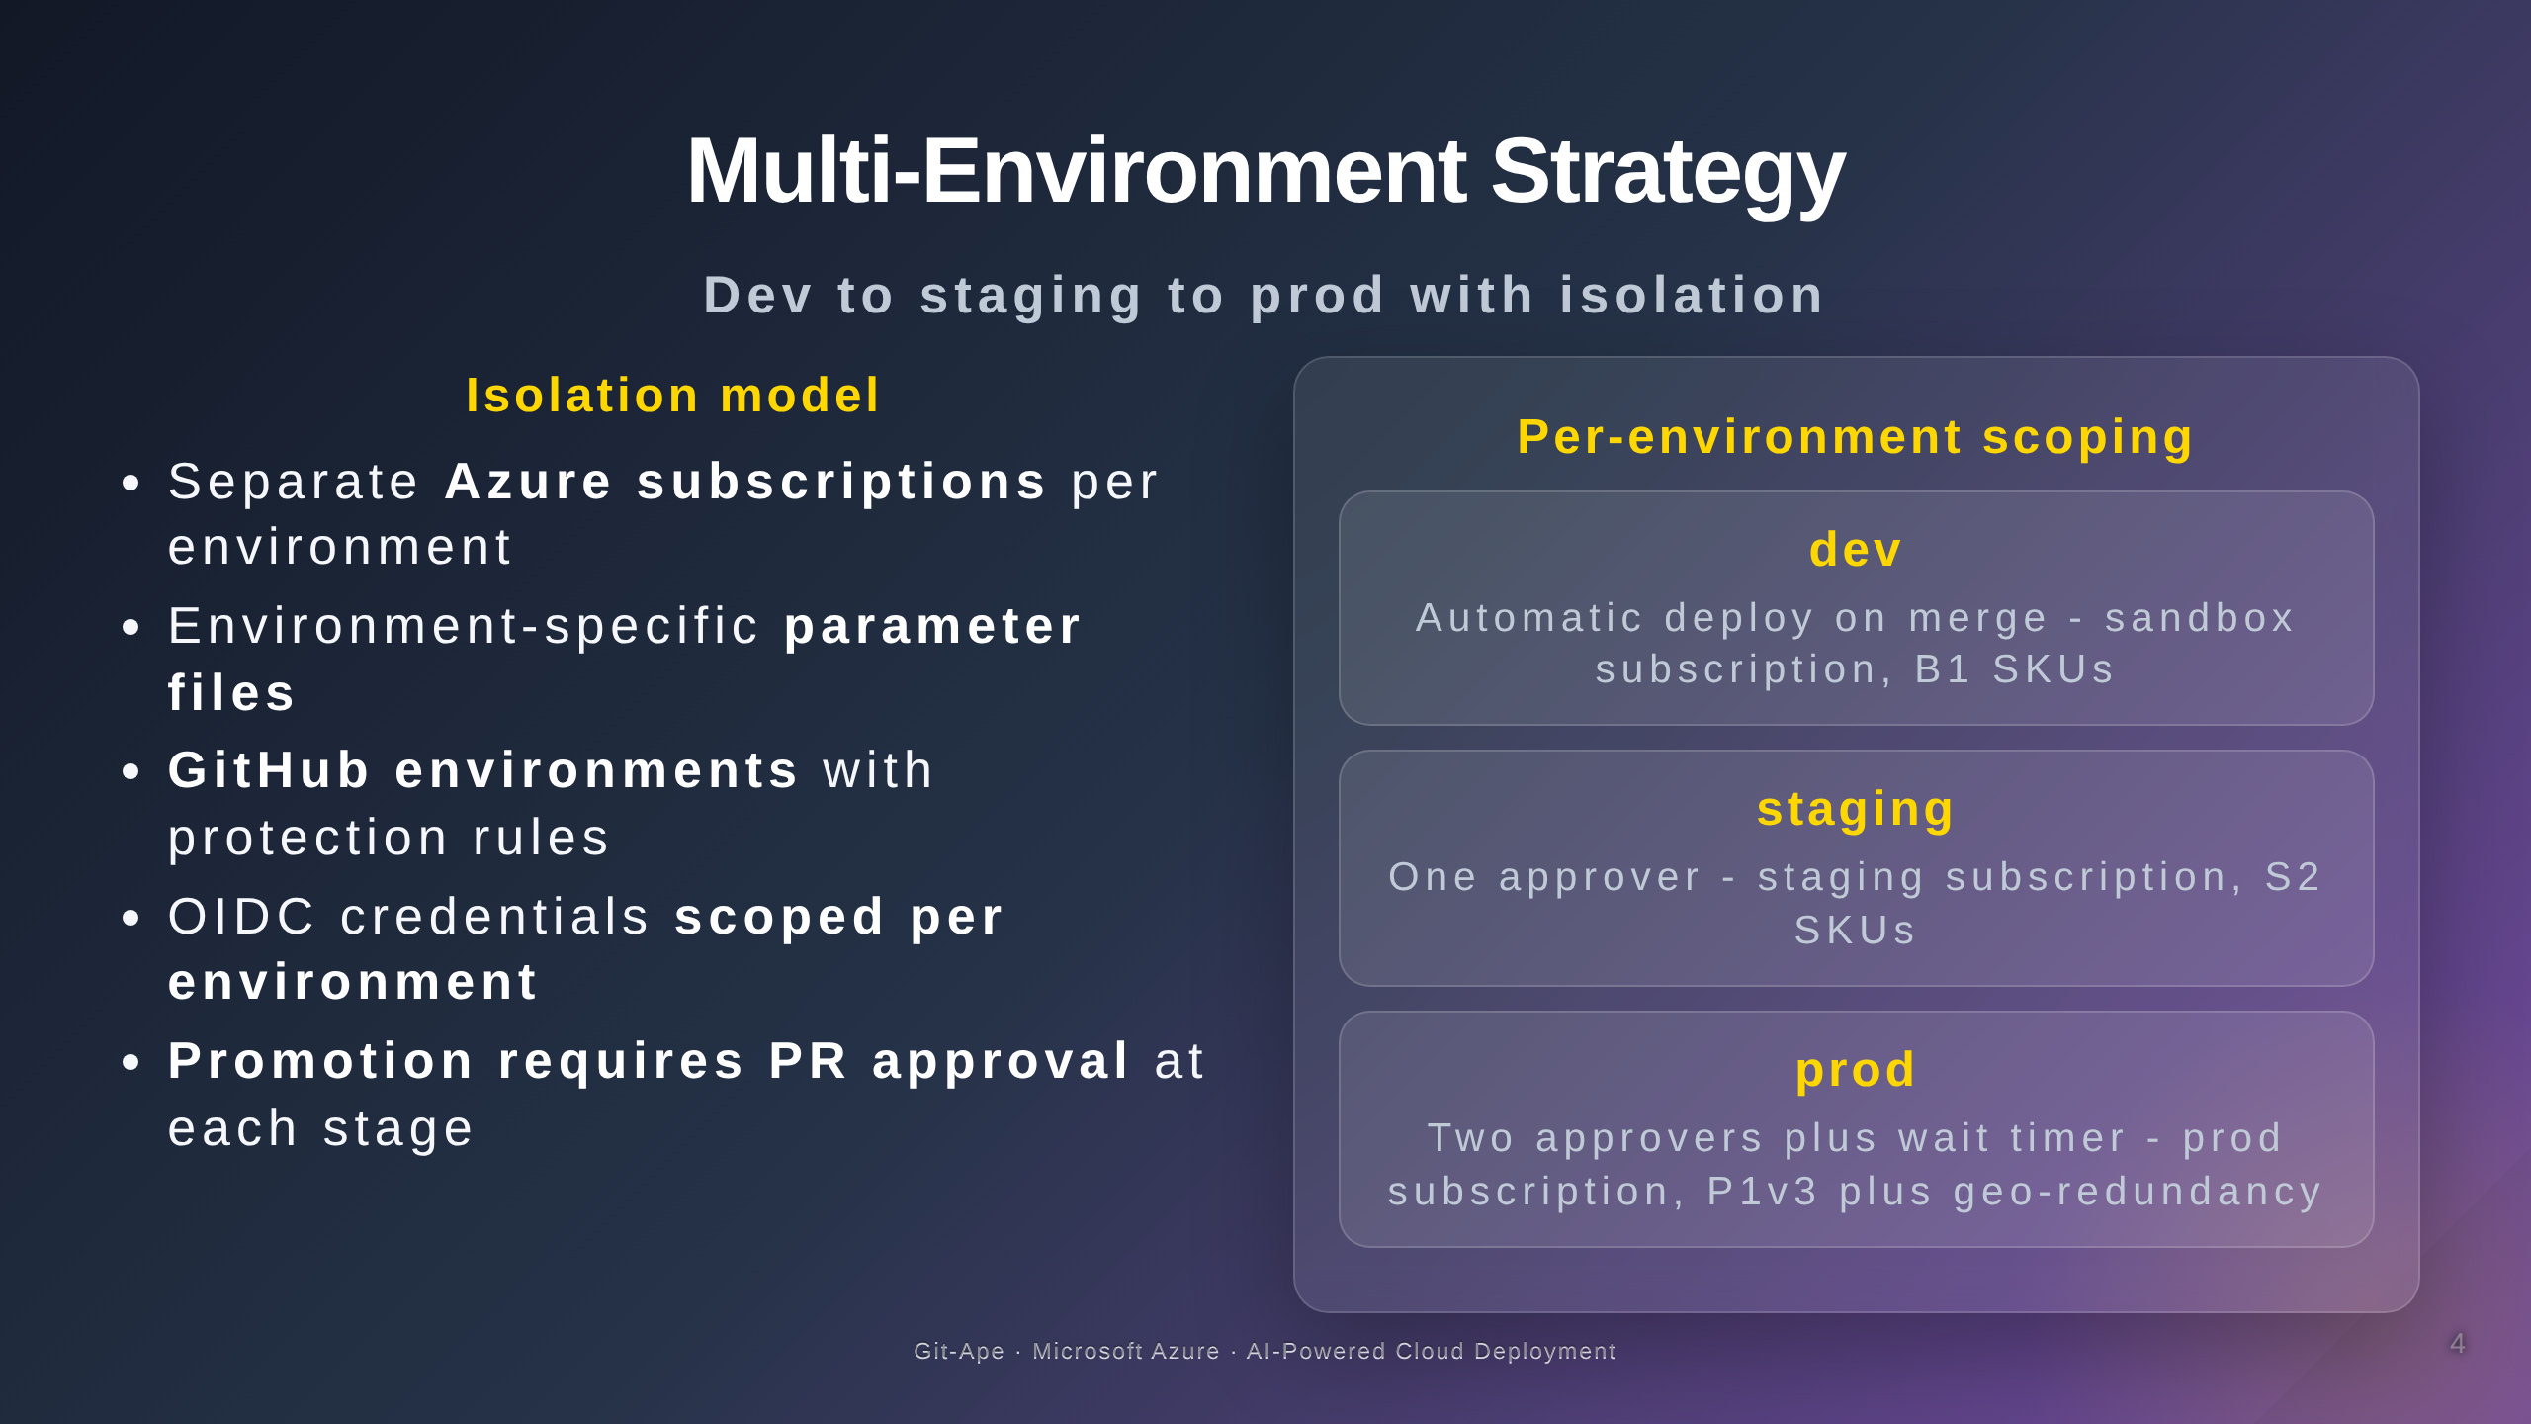
Notes:
Speaker notes (Slide 4 - Multi-environment). The recommended pattern is one Azure subscription per environment. This gives you the strongest blast-radius isolation. Each environment has its own OIDC federated credential scoped to the corresponding GitHub environment. Promotion is governed by GitHub environment protection rules - dev is automatic, staging needs one approver, production needs two plus a wait timer. Parameter files are environment-specific. The same template deploys to all three with different SKUs and different secret references.

Slide 5
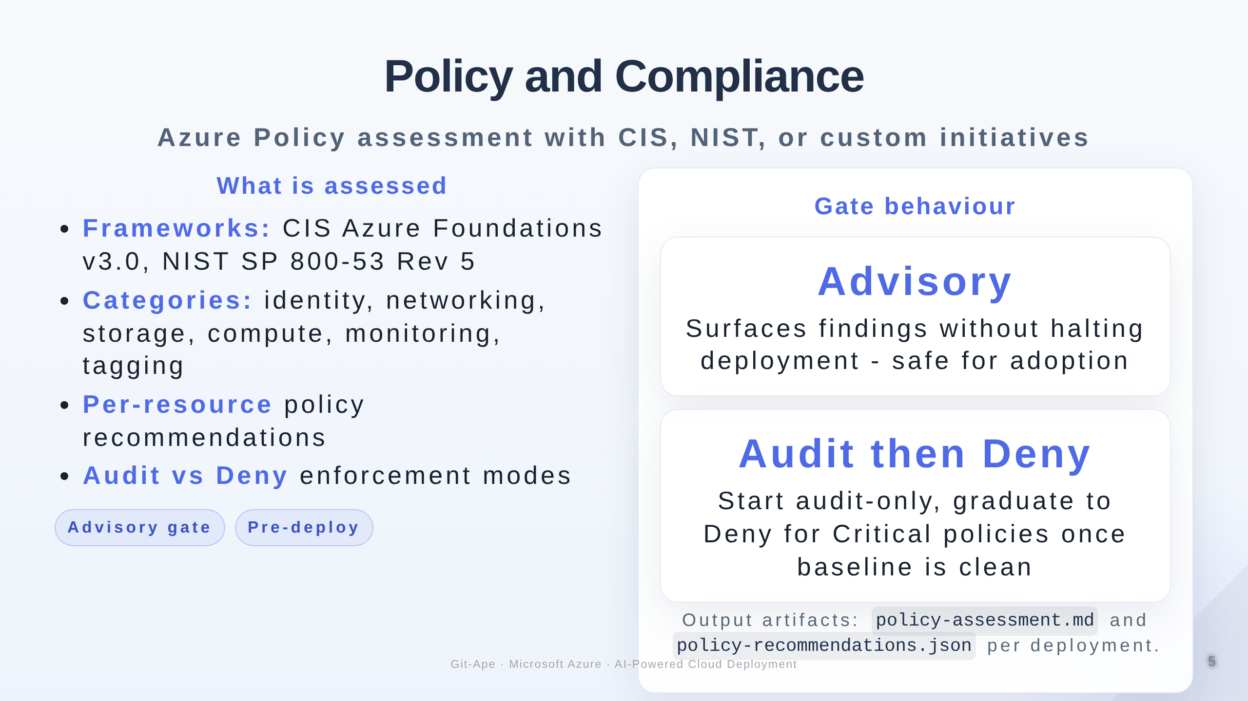
Notes:
Speaker notes (Slide 5 - Policy and compliance). The Policy Advisor agent assesses templates against Azure Policy frameworks. The defaults are CIS Azure Foundations v3.0 and NIST SP 800-53 Rev 5; custom initiatives are also supported. The policy gate is advisory rather than blocking - it surfaces findings without halting deployment, which keeps it useful during the early adoption period. Enforcement mode starts at Audit, then graduates to Deny for Critical-severity policies once the audit baseline is clean.

Slide 6
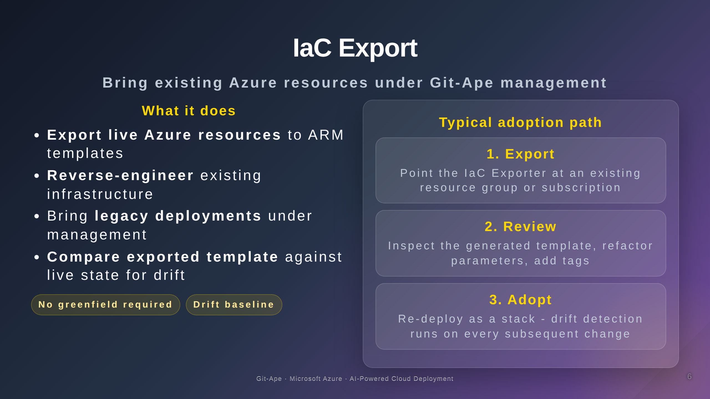
Notes:
Speaker notes (Slide 6 - IaC export). Most enterprises already have Azure resources that were created click-by-click in the portal or by hand. The IaC Exporter agent reverse-engineers live Azure state into an ARM template you can bring into Git-Ape management. This bridges the gap between legacy and new - you do not need to recreate everything from scratch to start using Git-Ape. The exported template can then be diffed against live state to detect drift.

Slide 7
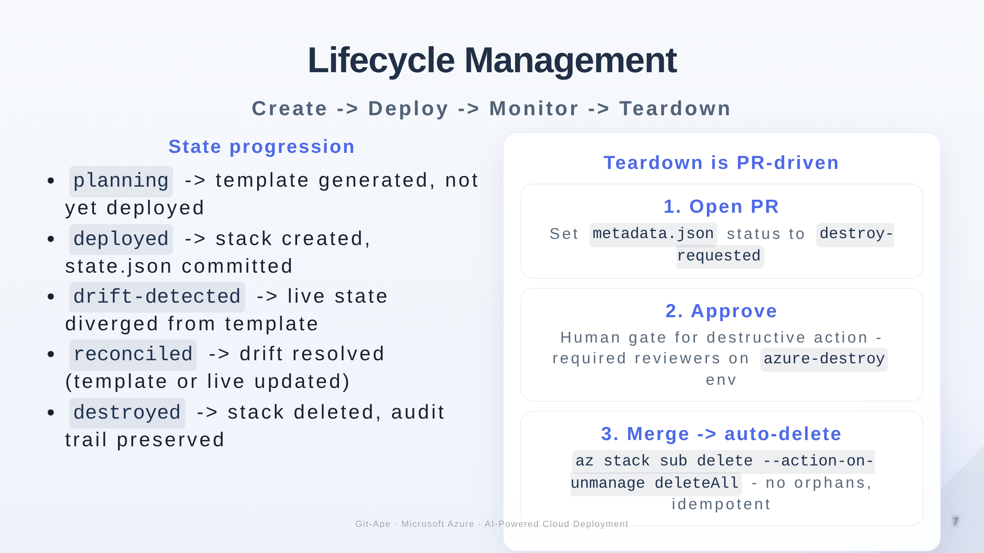
Notes:
Speaker notes (Slide 7 - Lifecycle). Every deployment is tracked through a clear lifecycle: planning, deployed, drift-detected, reconciled, destroyed. The state lives in dot-azure-slash-deployments and is committed back to the repo, so the audit trail is preserved even after teardown. Teardown itself is PR-driven: a PR sets metadata.json status to destroy-requested, the PR is reviewed and approved (human gate for destructive action), and on merge the destroy workflow executes deletion via Azure Deployment Stacks with action-on-unmanage set to deleteAll. No orphans, idempotent re-runs.

Slide 8
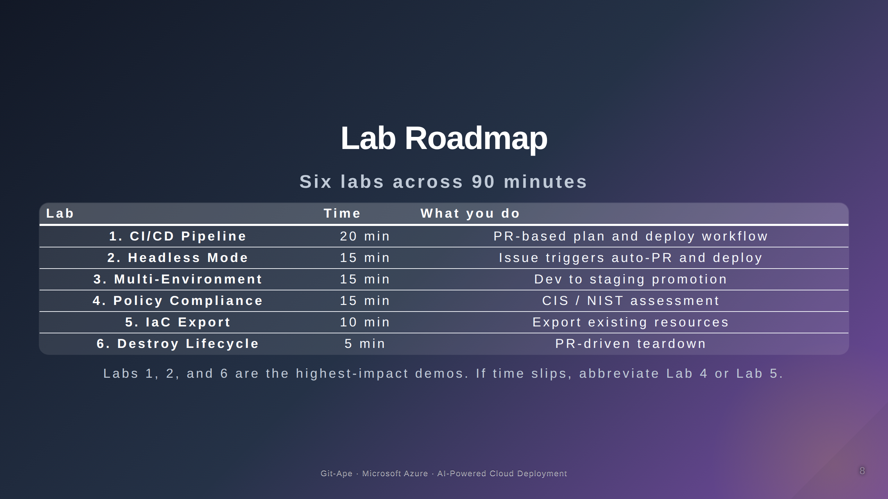
Notes:
Speaker notes (Slide 8 - Lab roadmap). Six labs across ninety minutes. Lab 1 is the CI/CD pipeline - this is the longest at twenty minutes and is the foundation for everything else. Lab 2 demonstrates headless mode from an issue. Lab 3 promotes from dev to staging. Lab 4 runs the policy assessment against your template. Lab 5 exports an existing resource group. Lab 6 closes the loop with PR-driven teardown. Labs 1, 2, and 6 are the most demonstrable; if running short on time, abbreviate Labs 4 and 5.

Slide 9
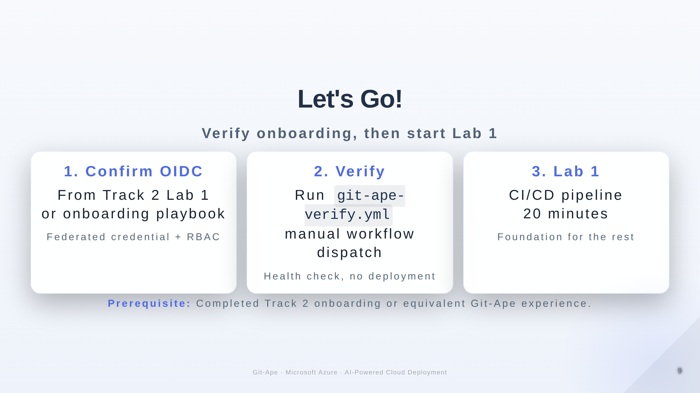
Notes:
Speaker notes (Slide 9 - Let's Go). Two quick checks before Lab 1. First, confirm OIDC and GitHub environments are configured from Track 2 Lab 1. Second, run the git-ape-verify workflow to confirm the federated credential is healthy. Then start Lab 1. Prerequisite: completed Track 2 or equivalent Git-Ape onboarding.

