Slide 1
Chef Workshop Assessment
Suvadip Mandal
15-12-2020

Slide 2
1_MongoDb
Description
MongoDB is an open-source, document-oriented database designed for ease of development and scaling
Automate the installation of MongoDB
Prerequisites
Follow install.rb in the GitHub repository (https://github.com/chef-cft/workshops/blob/master/1_MongoDB/install.rb )
Provision Redhat(RHEL) or CentOs from AWS account to execute successfully
Need to have GitHub account
Need to maintain kernel like 64 and 32 bit
Good to specify platform in cookbook to make easy to run on any platform like Redhat, Centos or Ubuntu
Good to have Chef server/Chef Zero/local mode
Chef Workstation/ Code Editor

Slide 3
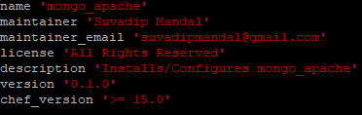

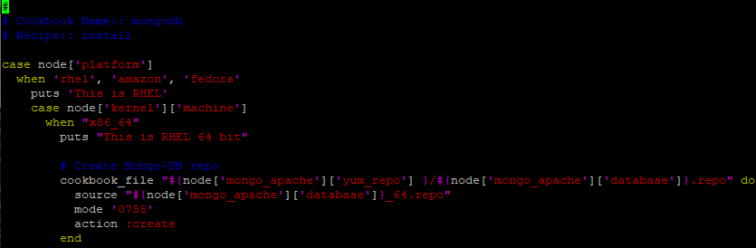
Create Cookbook
Need to create cookbook from the below command
Chef generate cookbook mongo_apache
Edit metadata.rb file to include maintainer name and maintainer email address
Create attribute folder and create a file to define the attribute values in the recipe
Write recipe install.rb in mongo_apache cookbook with following chef resources (reference: https://docs.chef.io/resource/ )

Slide 4
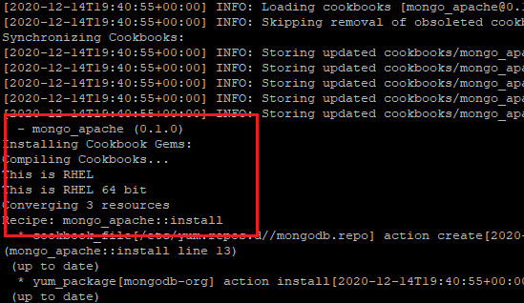
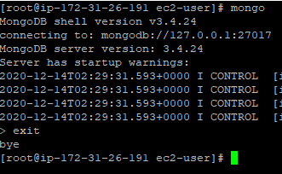
Execute cookbook mongo_apache::install
Ran chef-client –o mongo_apache::install
Check MongoDb installation
Type ‘mongo’ in cmd of RHEL and below screen should appear

Slide 5
Git
Cookbook should be commit and push to GitHub.
Commands
In the cookbook directory
git add .
git commit –m “Commit statement”
git push origin master

Slide 6
2_Tomcat
Description
The Apache Tomcat® software is an open source implementation of the Java Servlet, JavaServer Pages, Java Expression Language and Java WebSocket technologies. The Java Servlet, JavaServer Pages, Java Expression Language and Java WebSocket specifications are developed under the Java Community Process.
Automate the installation of Tomcat
Prerequisites
Follow INSTRUCTIONS.md in the GitHub repository (https://github.com/chef-cft/workshops/tree/master/2_Tomcat )
Previously Provisioned for MongoDb installation of Redhat(RHEL) or CentOs from AWS account to execute successfully
Need to have GitHub account
Good to specify platform in cookbook to make easy to run on any platform like Redhat, Centos or Ubuntu
Good to have Chef server/Chef Zero/local mode
Chef Workstation/ Code Editor

Slide 7
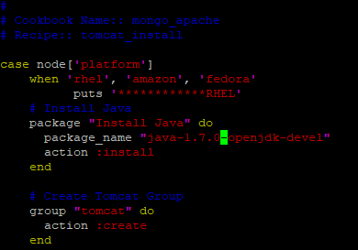
Create Cookbook
Created new recipe tomcat_install.rb in the previously created cookbook mongo_apache
Added tomcate.services.erb into templates directory
Write recipe tomcat_install.rb in mongo_apache cookbook with following chef resources (reference: https://docs.chef.io/resource/ )

Slide 8
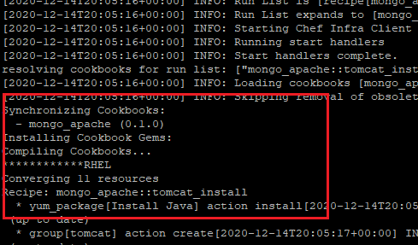
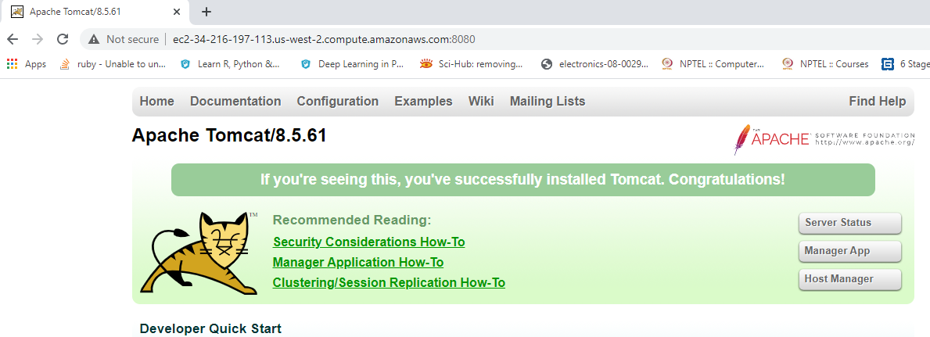
Execute cookbook mongo_apache::tomcat_install
Ran chef-client –o mongo_apache::tomcat_install
Verify Tomcat Installed
Copied Public IPv4 address
from AWS EC2 console with 8080
Port.

Slide 9
Git
Cookbook should be commit and push to GitHub.
Commands
In the cookbook directory
git add .
git commit –m “Commit statement”
git push origin master

Slide 10
4_Windows
Description:
Chef Remediate cookbook name – windows_remediate will execute in Windows server to check below points
Ensure ‘Allow logon locally’ need to set to ‘Administrators’ in Group Policy
Ensure ‘Allow logon through Remote Desktop Services’ is set to ‘Administrators, Remote Desktop Users’
Ensure ‘Accounts: Administrator account status’ is set to ‘Disabled’
Ensure ‘Interactive logon: Do not require CTRL+ALT+DEL’ is set to ‘Disabled’
Ensure ‘Enable Windows NTP Client’ is set to ‘Enabled’
Ensure ‘Enable Windows NTP Server’ is set to ‘Disabled’
GitHub Repository - https://github.com/suvadip30/workshops/tree/master/windows_remediate

Slide 11
Prerequisites
Windows Server 2019 (Used AWS Windows 2019)
Good to have Chef server/Chef Zero/local mode
Chef Workstation/ Code Editor
** Note – Used Chef Server as it already exists in my AWS account

Slide 12
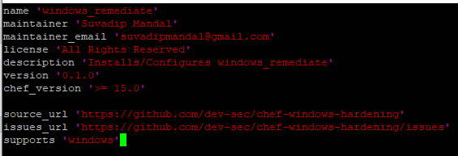
Create Cookbook
Need to create cookbook from the below command
Chef generate cookbook windows_remediate
Edit metadata.rb file to include maintainer name and maintainer email address

Slide 13

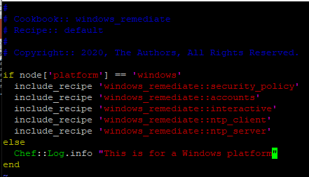
Create attribute folder and create a file to define the attribute values in the recipe
Create multiple recipes to troubleshoot easily if any error occurs in the recipes
Recipes
Ensure ‘Allow logon locally’ need to set to ‘Administrators’ in Group Policy – security_policy
Ensure ‘Allow logon through Remote Desktop Services’ is set to ‘Administrators, Remote Desktop Users’ - security_policy
Ensure ‘Accounts: Administrator account status’ is set to ‘Disabled’ – accounts
Ensure ‘Interactive logon: Do not require CTRL+ALT+DEL’ is set to ‘Disabled’ – interactive
Ensure ‘Enable Windows NTP Client’ is set to ‘Enabled’ – ntp_client
Ensure ‘Enable Windows NTP Server’ is set to ‘Disabled’ – ntp_server

Slide 14
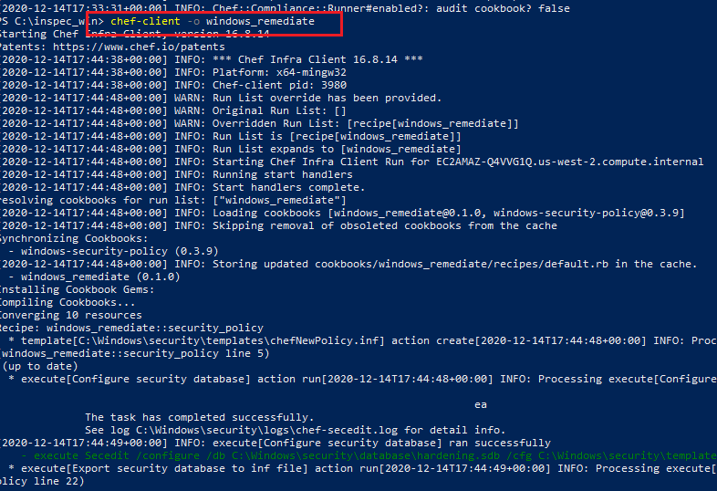
Execute cookbook windows_remediate
Ran chef-client –o windows_remediate to make sure all the points covered from Microsoft_Windows_Server_2019_Security_Benchmark.pdf (https://github.com/chef-cft/workshops/blob/master/4_Windows/Microsoft_Windows_Server_2019_Security_Benchmark.pdf)

Slide 15
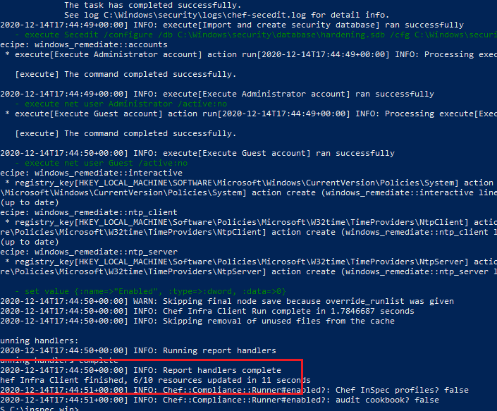
It executed successfully and maintained all the benchmark.

Slide 16
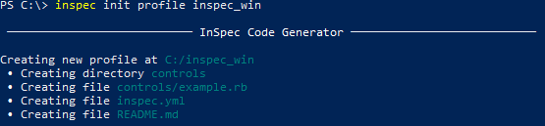
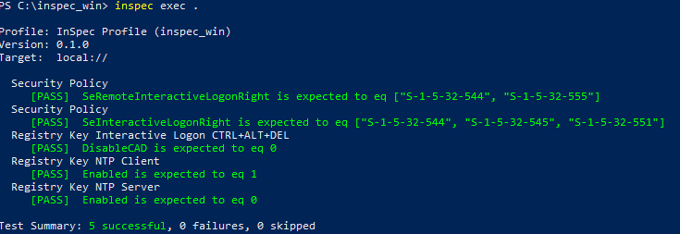
Inspec
Create Inspec profile with the below command
inspec init profile inspec_win
Modify ruby file in controls directory
Verify the controls after modify
inspec check path/ inspec check . (if inside the inspec directory)
Run the profile locally
inspec exec path/ inspec exec . (if inside the inspec directory)

Slide 17
3_Bonus – AWESOME_APPLIANCE_REPAIR
Description:
Awesome Appliance Repair is a sample web application written in Python. The application includes instructions for installing and initializing the application on Ubuntu using MySQL as the database and Apache as the web server.
Prerequisites
Follow AwesomeApplicanceRepair.pdf in the GitHub repository (https://github.com/chef-cft/workshops/blob/master/3_Bonus/Awesome_Appliance_Repair/AwesomeApplicanceRepair.pdf )
Need to have GitHub account
It will only execute in Ubuntu (Used version 18.04)
Good to have Chef server/Chef Zero/local mode
Chef Workstation/ Code Editor

Slide 18
Create Cookbook
Need to create cookbook from the below command
Used the same above cookbook mongo_apache
Create a recipe name aar.rb
Edit metadata.rb file to include maintainer name and maintainer email address
Added steps to install python in the recipe

Slide 19
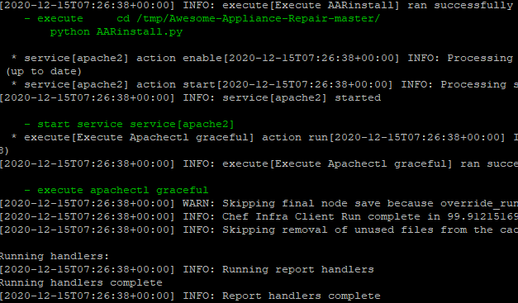
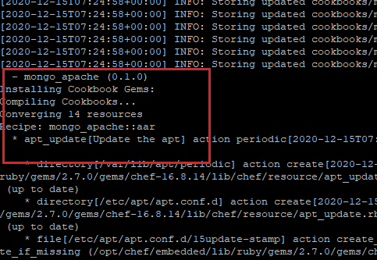
Execute cookbook mongo_apache
Ran chef-client –o mongo_apache::aar

Slide 20
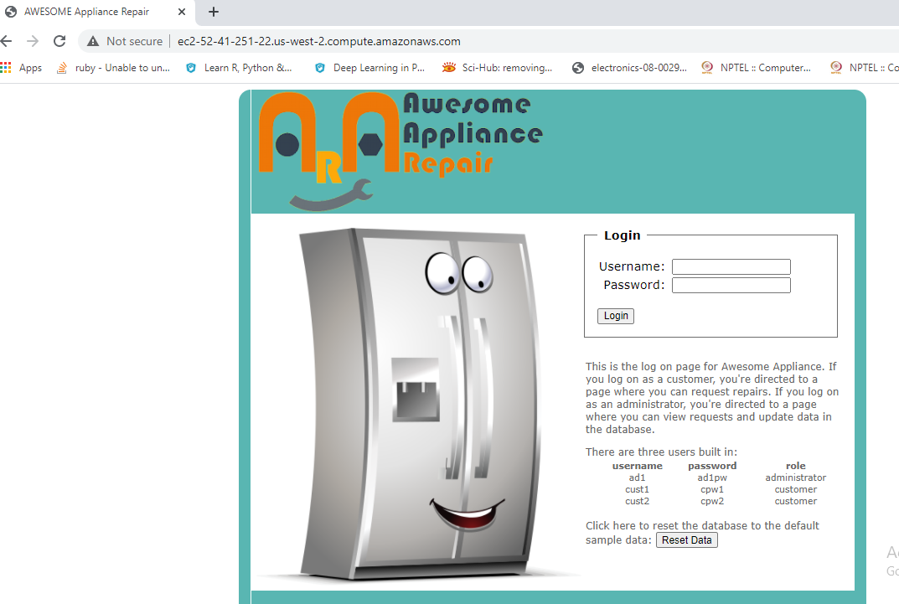
Verify Awesome Appliance Repair by accessing Public IPV4 DNS of aws Ubuuntu server

Slide 21
3_Bonus – Middleman
Description
Middleman is a static site generator using all the shortcuts and tools in modern web development. It is a ruby (sinatra) application.
Prerequisites
Follow INSTRUCTIONS.md in the GitHub repository (https://github.com/chef-cft/workshops/tree/master/3_Bonus/Middleman )
Need to have GitHub account
It will only execute in Ubuntu (Used version 18.04)
Good to have Chef server/Chef Zero/local mode
Chef Workstation/ Code Editor

Slide 22
Create Cookbook
Need to create cookbook from the below command
Used the same above cookbook mongo_apache
Create a recipe name middleman.rb
Edit metadata.rb file to include maintainer name and maintainer email address

Slide 23
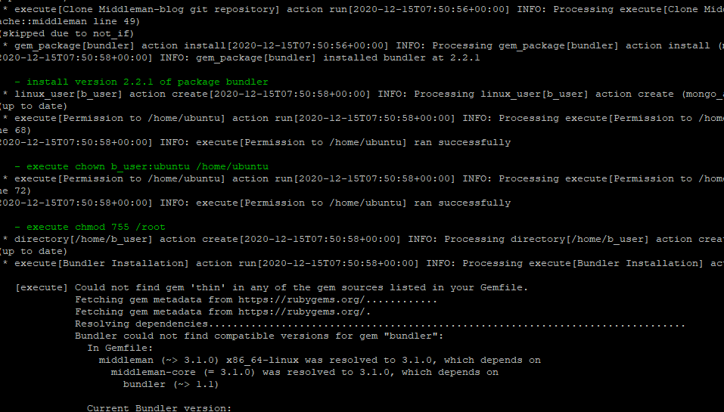
Execute cookbook mongo_apache
Ran chef-client –o mongo_apache::middleman

