Slide 1
DOS ATTACKS
Denial of service Attack
BY KISHOR SARKAR
CSE 3rd YEAR

Slide 2
CONTENT
What Is “DoS Attacks” ?
History
Types of Attacks
Main targets
How to Defend ?
Conclusion

Slide 3
WHAT IS “DOS ATTACK”
Denial-Of-Service Attack = DOS Attack is a malicious attempt by a single person or a group of people to cause the victim, site or node to deny service to it customers.
DoS = It’s a single host attacks
DDoS = It’s an multiple hosts attack simultaneously

Slide 4
DDOS INTRODUCTION
The average DDoS attack clock is about 50 Gbps
DDoS Duration :- Until Server Administrator Notice This Attack and Take Steps.
Main Targets:- Gaming Server , News Website,Govt. Property

Slide 5
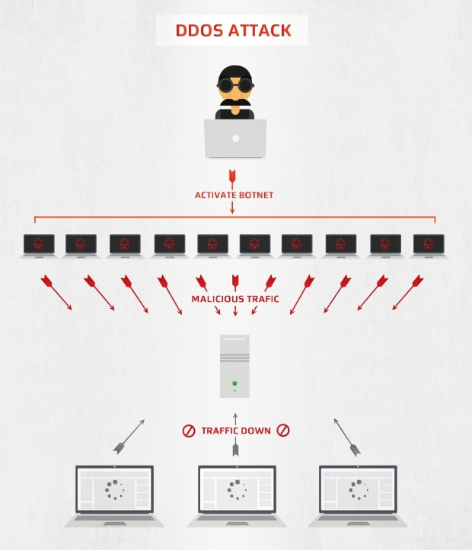
DDOS

Slide 6
HISTORY
DoS attack was made by Khan C. Smith in 1997 during a ”DEF CON” event
Recorded Attack :- On March 5, 2018 a Us-Based Service Provider “Arbor Networks” about 1.7 TBps.
Earlier On Feb 28,2018 “GitHub” was hit by an attack of 1.35 TBps

Slide 7
HISTORY
Morris Worm (November 2, 1988)
First DDoS attack to cripple large amounts of network infrastructure
Self-replicating, self-propagating.
Exploited software commonality
    Fingerd buffer overﬂow exploit
    Send mail root vulnerability
    Weak passwords

Slide 8
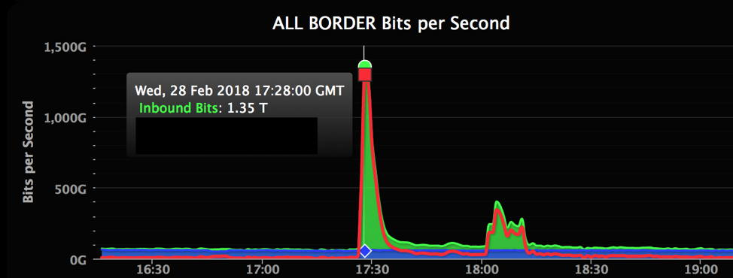
HISTORY
GitHub (February 28,2018)
A popular developer platform—was hit with traffic that clocked in at 1.35 Tbps

Slide 9
HISTORY
CLOUDFLARE (IN 2014)
Security provider and content delivery network Cloud Flare was Attack by approximately 400 Gbps of traffic. It was Conduct a single Cloud Flare customer and targeted servers in Europe and help of a vulnerability in the Network Time Protocol (NTP),

Slide 10
TYPES OF DOS ATTACKS
Penetration
Man-In-The-Middle
Flooding

Slide 11
TYPES OF DOS ATTACKS
Penetration
Attacker gets inside your machine
Can take over machine and do whatever he wants
Man-in-the-Middle
Attacker listens to output and controls output
Can substitute messages in both directions

Slide 12
TYPES OF DOS ATTACKS
Flooding
Attacker sends an overwhelming number of messages at your machine; great congestion
The congestion may occur in the path before your machine
Messages from legitimate users are crowded out Usually called a Denial of Service (DoS) attack, because that’s the effect.
Usually involves a large number of machines, hence Distributed Denial of Service (DDoS) attack

Slide 13
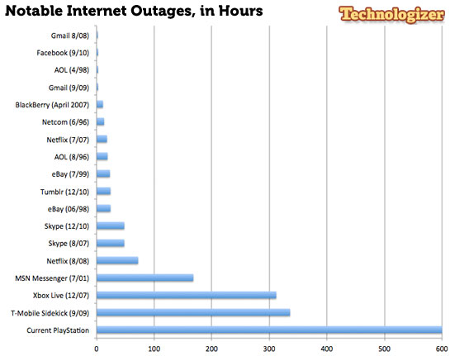
MAIN TARGETS

Slide 14
ESTONIAN CYBERWAR APRIL 27, 2007
128 unique DDOS attacks
Used hundreds or thousands of "zombie" computers and pelted Estonian Web sites with thousands of requests a second,
Inoperability of the following state and commercial sites:
  The Estonian presidency and its parliament.
  Almost all of the country’s government ministries.
  Political parties.
  Three news organizations.
  Two biggest banks and communication’s firms.
  Governmental ISP.
  Telecom companies.

Slide 15
ESTONIAN CYBERWAR APRIL 27, 2007
The attack heavily affected infrastructures of all network:
  Routers damaged.
  Routing tables changed.
  DNS servers overloaded.
  Email servers mainframes failure, and etc.

Slide 16
HOW TO DEFEND
Firewalls - can effectively prevent users from launching simple flooding type attacks from machines behind the firewall.
Switches - Some switches provide automatic and/or system-wide rate limiting, traffic shaping, delayed binding to detect and remediate denial of service attacks
Routers - If you add rules to take flow statistics out of the router during the DoS attacks, they further slow down and complicate the matter
DDS based defense
Clean pipes

Slide 17
CONCLUSION
Role of international boundaries - consoles located across international borders, law-enforcement problem
In the past, as the present, DDoS has been more a nuisance activity conducted by cyber vandals than an activity with speciﬁc socioeconomic aims
In the future, DDoS may be used as a disruptive force, with broad destabilization as its aim instead of the targeting of speciﬁc targets
Destabilization has a high (ROI) Return On Investment when compared to targeted attacks

Slide 18
REFERENCE
en.m.wikipedia.org
www.imperva.com
www.digitalattackmap.com
www.a10networks.com

Slide 19
THANK YOU

