Slide 1
High Performance Multi-Layer Channel Routing
Under Supervision of
Dr. Rajat Kumar Pal
Submitted by
Suprio Mukherjee Suvajit Sen Gupta
Roll: 91/CIS/020001. Roll: 91/CIS/020015.
Regn. No. 067705 of 1998-99. Regn. No. 077744 of 1998-99

Slide 2
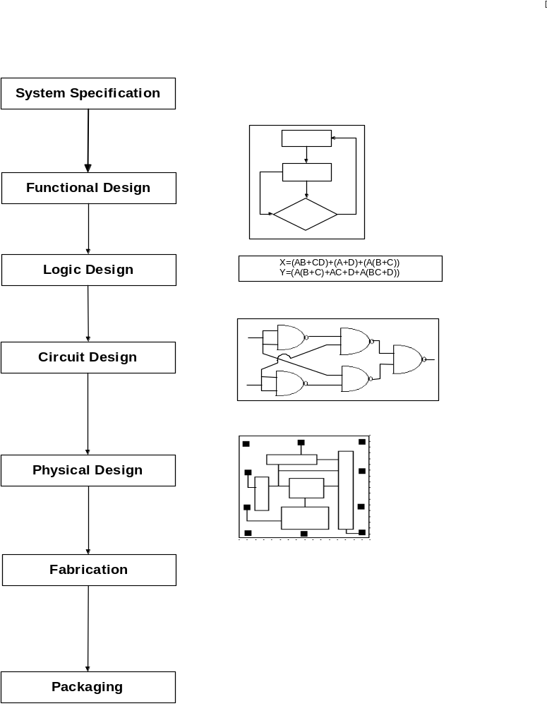
VLSI Design Cycle
System Specifications.
Functional Design.
Logic Design.
Circuit Design.
Physical Design.
Fabrication
Packaging.

Slide 3
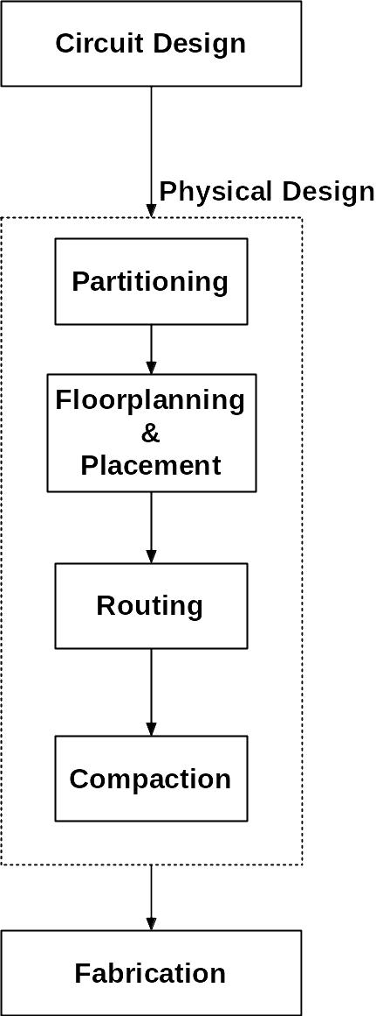
Physical Design Cycle
Partitioning.
Floor-planning and Placement.
Routing
  Global Routing.
  Detailed routing.
Compaction.

Slide 4
Routing Considerations
Number of terminals.
Net width.
Via restrictions.
Boundary type.
Number of layers.
Net types.

Slide 5
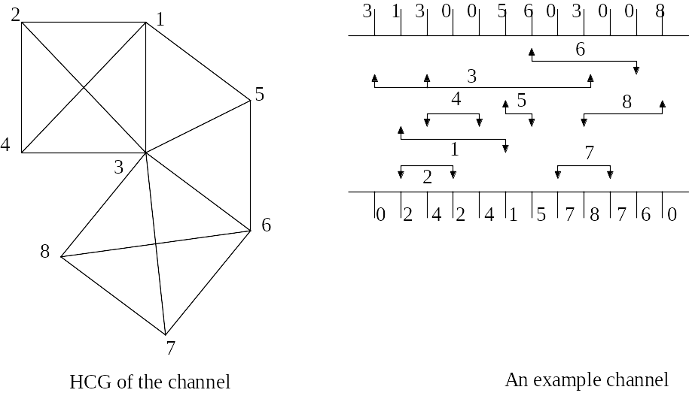
What is Channel Routing?
A routing region may have terminals only at two opposite sides of the region and is called the channel.
Objective of a channel router is to complete interconnections between blocks according to the specified Net-list using the shortest possible (rectilinear) wire lengths.
This procedure is called the Channel Routing.

Slide 6
General Objectives of a Channel Router
Minimizing the wire length.
Minimizing the routing area.
Reducing the number of Via holes.
Goals of High Performance Channel Routing
Minimizing the Crosstalk between the different wire segments.
Reducing the Power Consumption.
Reducing the formation of Hot-Spots.
Reducing the response time for the channel.

Slide 7
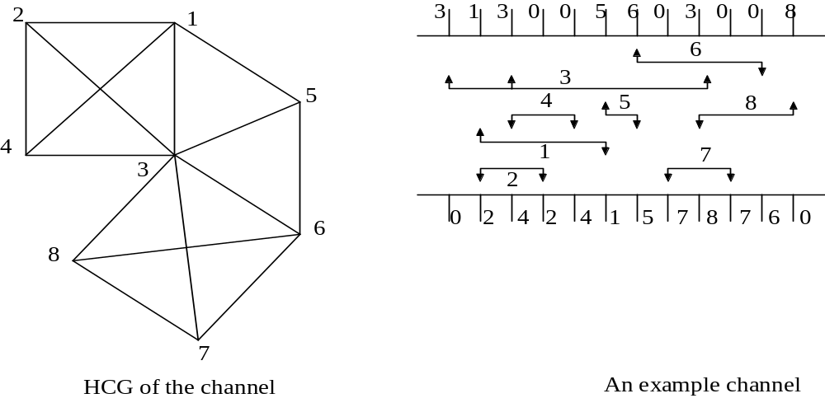
Various Constraints
Horizontal Constraints: Exist between two nets when the trunk of the two nets overlap when placed on the same track. Horizontal constraints determine the channel height (i.e., number of tracks).
Note: In the figure along the nets 3 and 6 have horizontal constraints, so does the nets 3 and 8 and so on.

Slide 8
Vertical Constraints: Exist between two nets if the top/bottom terminal belongs to one net and the bottom/top terminal belongs to the other. The vertical constraints determine the order in which the nets are to be assigned to a channel.
Note: the nets 1 and 2, 1 and 5, 3 and 4 etc. all have vertical constraints.

Slide 9
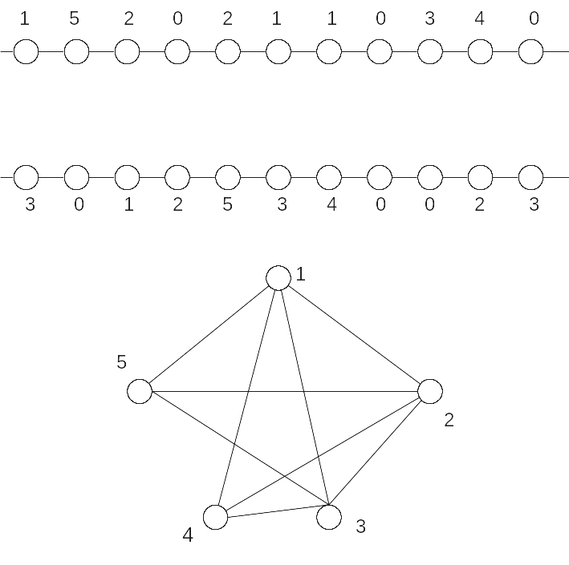
Representing Horizontal Constraints
Horizontal constraints between nets is represented by a Horizontal Constraint Graph (HCG) where each vertex represents a net; and each edge represents the horizontal constraint (or overlap) between the pair of nets that the edge connects.
Note: The maximum clique in HCG forms a lower bound for the channel height.

Slide 10
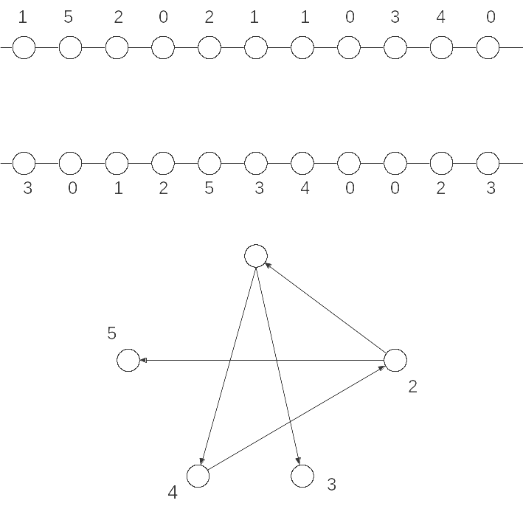
Representing the Vertical Constraints.
The Vertical Constraints between the nets is represented by the Vertical Constraint Graph (VCG) which has nodes corresponding to the nets and edges between the nodes corresponding to the vertical constraints and hence should be topologically sorted in order to assign them to the same column.

Slide 11
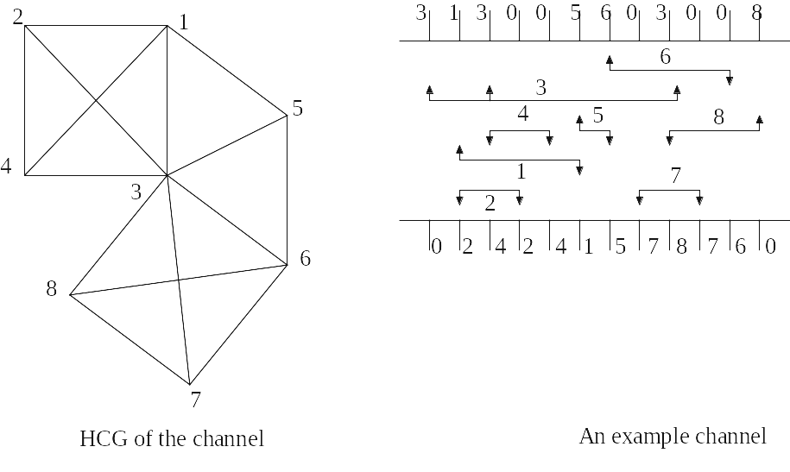

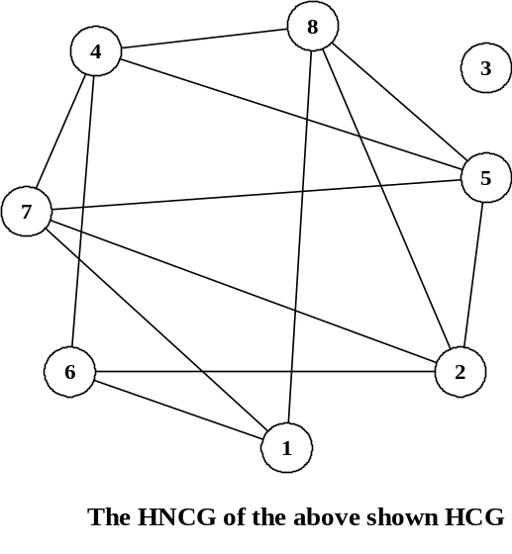
The Horizontal Non Constraint Graph HNCG
The complement of HCG is the HNCG (Horizontal Non-Constraint Graph). The clique of the HNCG is the set of non-overlapping intervals that are assignable on a single track.
Note: The top left figure is the HCG of the channel in top right. The figure below is the corresponding HNCG of the HCG in the top left. To find the maximal set of minimum cliques we need to transitively orient the HNCG.

Slide 12
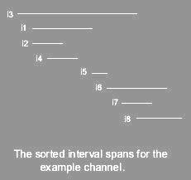
Transitively orienting the HNCG
Sort the intervals from left to right along the channel according to their starting positions (Indicated in the squares along the vertices).

Slide 13

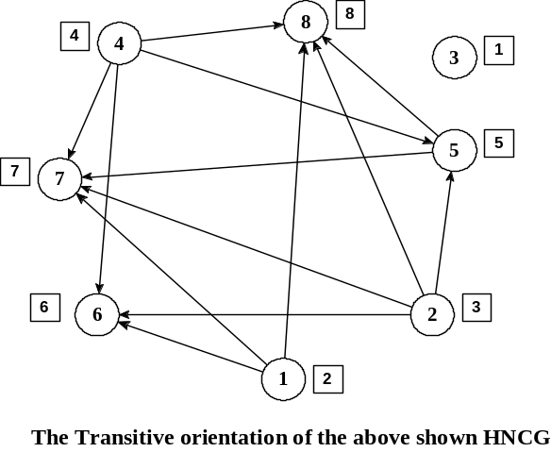
We orient an edge {Vi, Vj} of the HNCG from Vi to Vj, thereby defining the directed edge (Vi, Vj) in Transitively Oriented HNCG, if and only if the rightmost terminal of Vi < to the leftmost terminal of Vj.
This orientation has a transitivity property; for any three vertices vi, vj and vk, if vi→vj and vj→vk,, then vi→ vk.

Slide 14
Finding the Minimum Clique Cover for HNCG
Sort the intervals of the nets according to their starting columns
Select the first vertex in the sorted list and add it to an set C. Delete the vertex and all its edges (incoming and outgoing) from the transitively oriented HNCG and go to the adjacent vertex that occurs first in the sorted list of vertices.
Keep repeating the previous step until a vertex with no outgoing edge is reached. We stop and obtain the set C, of nets forming the minimum clique in the HNCG.
We repeat these steps till the graph is empty.*
* Algorithm: Minimum_Clique_Cover_1 [Pal00a].

Slide 15
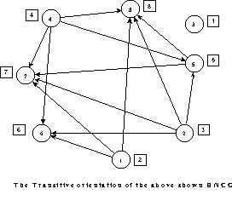
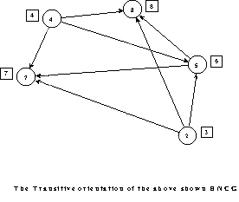
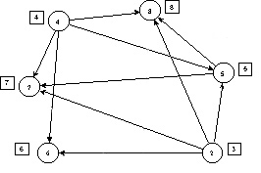
Select 3
Select 1
Select 6

Slide 16
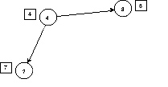
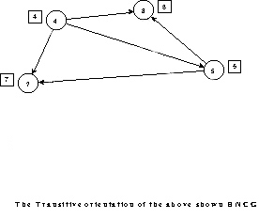
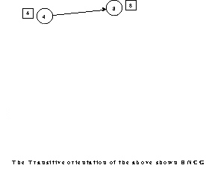

Select 5
Select 7
Select 4
Select 8

Slide 17
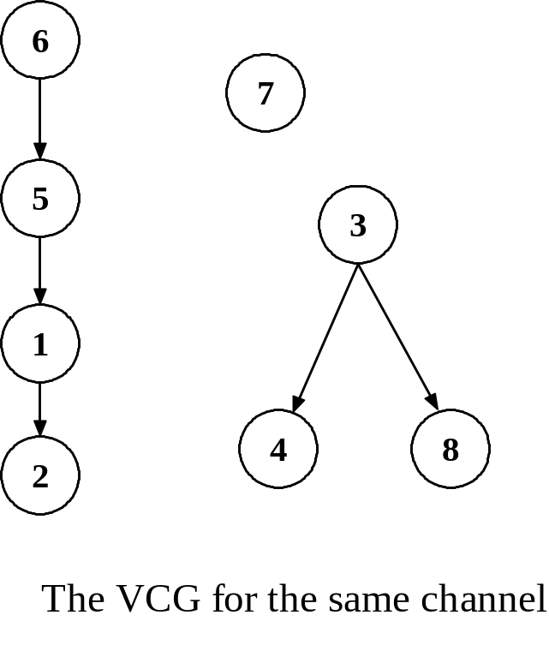
The Reduced Vertical Constraint Graph (RVCG)
MCC1 gives us the set of non-overlapping nets that can be assigned to the same track (here {{3}, {1, 6}, {2, 5, 7}, {4, 8}} ).
The VCG is modified to RVCG where each super-node consists of the set of non-overlapping nets.
3
1,6
7,5,2
4,8

Slide 18
Channel And Routing Considerations for Multi-Layers
The number of H-layers (say i)
The Model type i.e., Vi+1Hi, ViHi, ViHi+1.
The number of tracks per layer i.e., ( ⎡ dmax / i⎤) where dmax is the channel density (in our example, 4)
Presence or the absence of vertical constraints.
  Note: dmax is the number of non-overlapping sets of nets in the channel obtained from the MCC1.

Slide 19
Model Considerations
Depending on the model type, the channel allocation problem poses different considerations:
  For Vi+1Hi model- each H-layer is flanked by two V-layers; therefore vertical constraints are absent.
  For ViHi model- each H-layer except for the extreme one, is flanked by two V-layers. Vertical constraints are therefore present in all but one H-layer. We do have to take into consideration this vertical constraint while routing the channel.
  For ViHi+1 model- each H-layer except for the extreme ones have two flanking V-layers and have vertical constraints. We treat them the same way we will treat the H-layer in the previous model.

Slide 20
Our Proposed High Performance Channel Routing Algorithm
Identify the Rouge nodes i.e., the nodes that are possibly involved in cycles in the RVCG.
  Depending on the models Vi+1Hi, ViHi, ViHi+1 we have to identify i*(tracks/layer), (i-1)*(tracks/layer) or (i–2)*(tracks/layer) number of such nodes respectively.
  These are the nodes that may be assigned to the H-layers where no vertical constraints exist.
Identify the nodes that are to be assigned to the Extreme Horizontal layer. If vertical constraints without cycles exist then topologically sort them to assign them to different tracks.*
* Algorithm SELECT_NETS in the project report.

Slide 21
3
3
3
1,6
7,5,2
7,5,2
7,5,2
4,8
4,8
Sample run of our algorithm on the Example channel. Model ViHi and i=2 (i.e., Two H-layers).
Here the nodes which have a red dot along it in the RVCG are the nodes that are identified to be assigned to the H-layer having no vertical constraints. The remaining two vertices are then assigned to the Extreme layer without any problem.

Slide 22
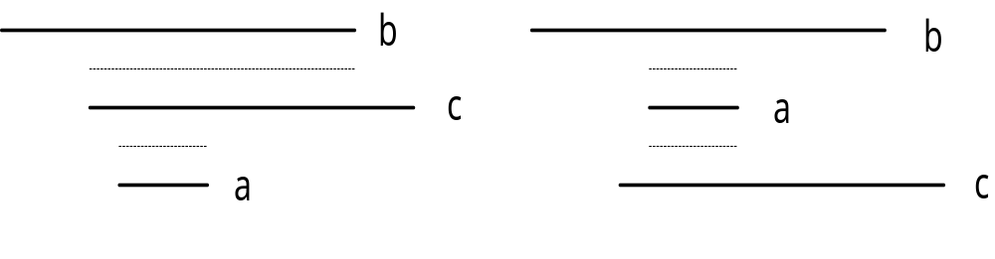
Crosstalk and its minimization
We measure the amount of Crosstalk in terms of number of units a pair of nets overlaps on adjacent tracks in a feasible routing solution.
Since all the three nets, in the example shown below, overlap, we have to assign the nets in three different tracks on the same horizontal layer in any feasible routing solution. We point out that;
  In the first diagram nets b and c that are assigned to two adjacent tracks share a crosstalk of say 19 units. Nets c and a share a crosstalk of say 4 units.
  Then by reassigning them in the order shown in the adjacent diagram we can reduce the overall crosstalk of the channel to just 8 from the previous total of 19 + 4 = 23 units.*
* [AsPal02]

Slide 23
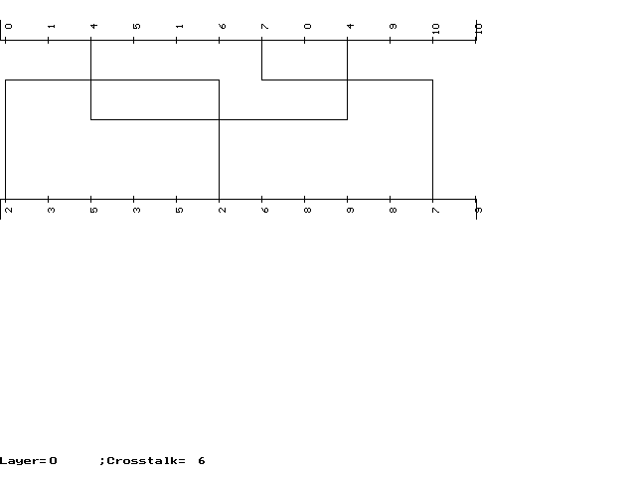
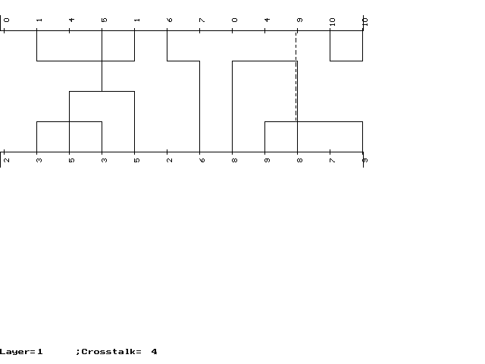
Example output for the channel:
Top :0 1 4 5 1 6 7 0 4 9 10 10
Bottom :2 3 5 3 5 2 6 8 9 8 7 9
with the model ViHi and layers = 2. Here dmax is 5.
The first H-layer with one V-layer has no vertical constraints while the second layer has vertical constraints and is represented by dashed lines.

Slide 24
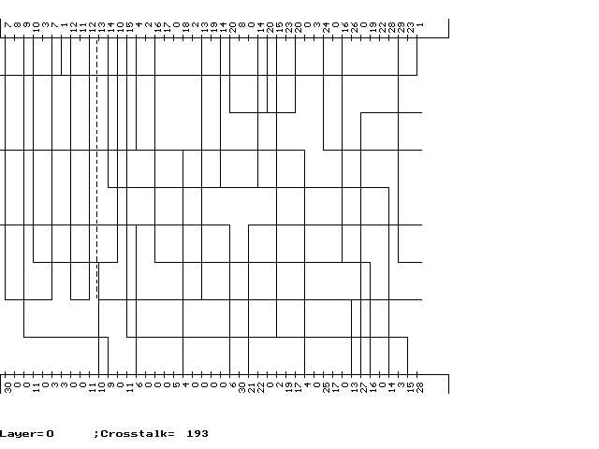
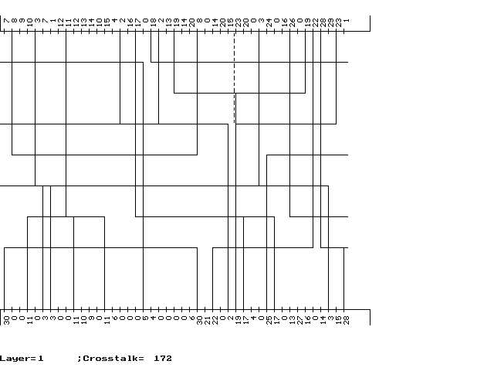
Top : 7 8 9 10 3 7 1 12 11 12 13 14 10 15 4 2 16 17 0 18 2 13 19 14 20 8 0 14 20 15 23 20 0 3 24 0 16 26 0 19 22 28 29 23 1
Bottom:30 0 0 11 0 3 3 0 0 11 10 9 0 11 6 0 0 0 5 4 0 0 0 0 6 30 21 22 0 2 19 17 4 0 25 17 0 13 27 16 0 14 3 15 28
LCS :1 2 3 4 5 6 RCS :18 21 24 29 28 25 26 13 27
Example 2 : Layers =2; Model = Vi+1Hi

