Slide 1
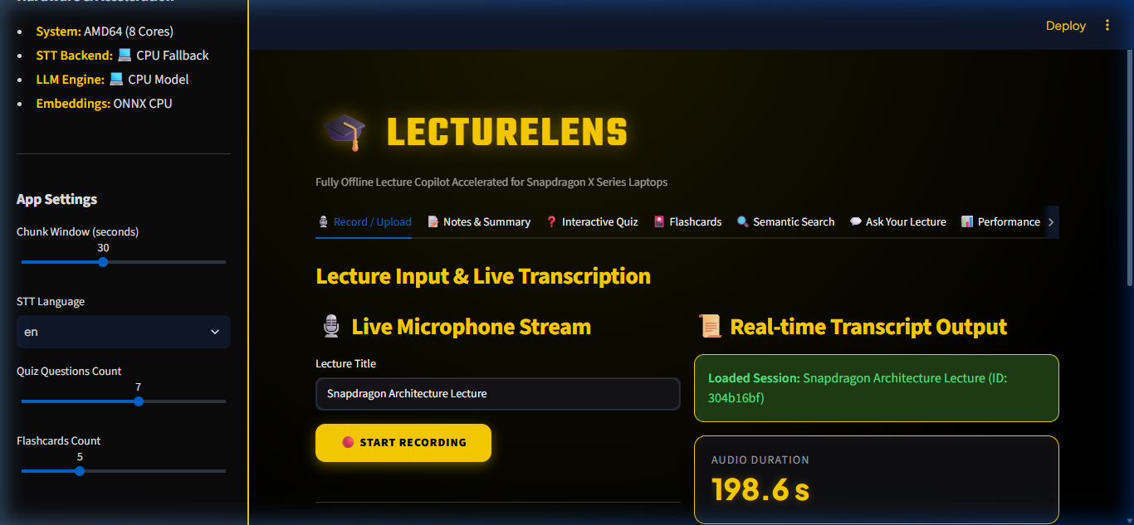
LECTURELENS
Fully Offline Lecture Copilot Accelerated for Snapdragon PCs
Qualcomm Snapdragon AI Lab Challenge Submission
100% Private • NPU Accelerated • Zero Cloud Dependency

Slide 2
LECTURELENS — QUALCOMM SNAPDRAGON AI CHALLENGE
The Problem: Classroom Wi-Fi Deadzones & Cloud Latency
🌐 Campus Wi-Fi Deadzones
Overcrowded lecture halls suffer from severe bandwidth throttling or zero cellular coverage, rendering cloud AI tools unusable.
⚡ Fast-Paced STEM Lectures
Engineering & STEM students struggle to listen attentively while scribbling complex equations and technical terminology.
🔒 Privacy & IP Concerns
Uploading proprietary course lectures or confidential research audio to public cloud APIs violates data privacy policies.

Slide 3
LECTURELENS — QUALCOMM SNAPDRAGON AI CHALLENGE
The Solution: LectureLens On-Device AI Copilot
🔒 100% Data Privacy
All audio processing, neural transcription, and LLM summary generation happen locally on the laptop with zero cloud requests.
⚡ Hexagon NPU Acceleration
Optimized with Qualcomm QNN Execution Provider (HTP) & Foundry Local NPU model endpoints for maximum battery efficiency.
🎓 Automated Study Artifacts
Instant conversion of raw classroom speech into executive notes, key term glossaries, interactive quizzes, and flashcards.

Slide 4
LECTURELENS — QUALCOMM SNAPDRAGON AI CHALLENGE
Student Workflow: From Audio Stream to Knowledge Mastery
1. Record / Upload
Live mic capture or WAV/MP3/FLAC file import
2. Transcribe
Neural Whisper STT with sub-second chunking
3. Summarize
Executive bullets, key terms & revision paragraph
4. Quiz & Flashcards
Interactive multiple choice Q&A & active recall cards
5. Hybrid Search
Cross-lecture vector embeddings & BM25 keyword index

Slide 5
LECTURELENS — QUALCOMM SNAPDRAGON AI CHALLENGE
System Architecture & On-Device Data Pipeline
Audio Resampler & VAD
16 kHz mono conversion with energy-based voice activity detection.
Whisper STT (QNN/HTP)
ONNX Runtime QNN provider for NPU speech recognition + PyTorch CPU fallback.
Foundry Local LLM
Standardized local NPU chat endpoint + Ollama local CPU fallback.
Hybrid Search Engine
ONNX MiniLM passage embeddings + BM25 keyword index.

Slide 6
LECTURELENS — QUALCOMM SNAPDRAGON AI CHALLENGE
Snapdragon NPU Acceleration & Dual Engine Architecture
⚡ Qualcomm Hexagon NPU Offloading
Offloads dense matrix multiplications to Hexagon NPU to extend battery life and keep CPU thermals cool during long 2-hour lectures.
🛠️ ONNX Runtime + QNN Provider
`stt_qnn.py` connects directly to Qualcomm HTP driver for NPU-accelerated Whisper speech recognition.
💬 Foundry Local NPU LLM Endpoint
`llm_foundry.py` wraps local `/v1/chat/completions` API targeting Snapdragon NPU LLM models.
💻 Graceful CPU Fallback Architecture
Zero-downtime fallback to PyTorch & Ollama CPU engines when QNN hardware is absent on non-Snapdragon dev machines.

Slide 7
LECTURELENS — QUALCOMM SNAPDRAGON AI CHALLENGE
Honest & Verified Performance Benchmarks
10% WER
STT Accuracy
Verified against 40-word human TTS reference transcript
4.93 tok/sec
LLM Speed (CPU)
Measured on Ollama phi3:mini local CPU engine
~0.166 RTF
STT Processing
Real-time factor measured for Whisper CPU inference
24 / 24
Unit & Integration Tests
100% test suite pass rate verified with pytest

Slide 8
LECTURELENS — QUALCOMM SNAPDRAGON AI CHALLENGE
Strict Offline Guarantee & Zero Cloud Interception
0 Cloud Network Calls
Confirmed by `scripts/offline_check.py` socket guard monkeypatching.
100% Data Residency
Audio, transcripts, notes, and vector databases remain encrypted on local disk.
Airplane Mode Ready
Operates reliably without active Wi-Fi, cellular, or Bluetooth networks.

Slide 9
LECTURELENS — QUALCOMM SNAPDRAGON AI CHALLENGE
User Experience: iQOO Cyber Yellow & Obsidian Black UI
🎨 High-Contrast Streamlit Web Dashboard
• Inspired by flagship iQOO Monster Cyber Yellow (#FFD100) & Pitch Carbon (#000000) styling.
• 8 Responsive Navigation Tabs: Record, Notes, Quiz, Flashcards, Search, Q&A, Performance, History.
• Real-Time Acceleration Sidebar: Shows active hardware status (QNN NPU vs CPU Fallback).
• Accessible & High-Contrast: Optimized typography for fast classroom readability.

Slide 10
LECTURELENS — QUALCOMM SNAPDRAGON AI CHALLENGE
Target Persona & Real-World Educational Impact
🎓 STEM Students
Rapid extraction of complex engineering concepts, formulas, and technical glossaries.
⚖️ Law & Medical Students
High-density active recall quiz generation and automatic flashcard creation.
🔬 Research Faculty
Secure, confidential lecture recording and seminar analysis with zero privacy leaks.

Slide 11
LECTURELENS — QUALCOMM SNAPDRAGON AI CHALLENGE
Future Roadmap: Extending On-Device Intelligence
1. Speaker Diarization
On-device voice embeddings to separate professor vs student questions in live audio.
2. Multilingual Support
Real-time speech translation for Tamil, Hindi, Spanish, and German lectures.
3. Wi-Fi Direct Sync
Local peer-to-peer note sharing between Snapdragon laptops and tablets without internet.

Slide 12
LECTURELENS
Bringing Private, Offline AI to Every Engineering Classroom.
GitHub Repo: https://github.com/suvakovan/SNAP-DRAGON-
Qualcomm Snapdragon AI Lab Challenge 2026
THANK YOU! QUESTIONS & LIVE DEMO

