Slide 1
Depth Image based Path Planning using A* algorithm
by
Suvam Bag

Slide 2
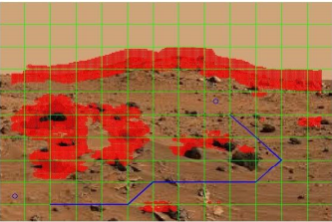
Introduction
Importance of path planning in unknown environments
Figure: Landscape on Mars taken by the Mars Rover

Slide 3
Points
Platform
A-star algorithm
Depth image processing
Algorithm
Video

Slide 4
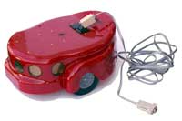
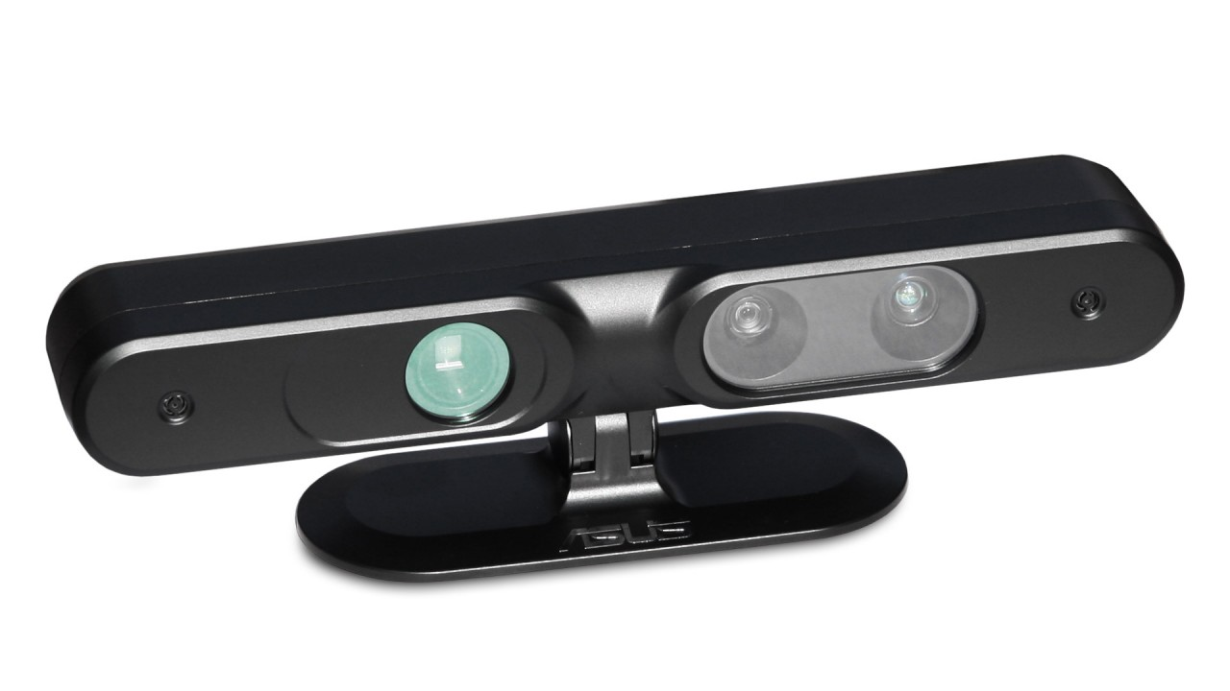
Platform
Operating System -
Robot Operating System (ROS) on Ubuntu (Linux)
Python
AmigoBot
RosAria
Asus Xtion
Openni2
OpenCV2

Slide 5
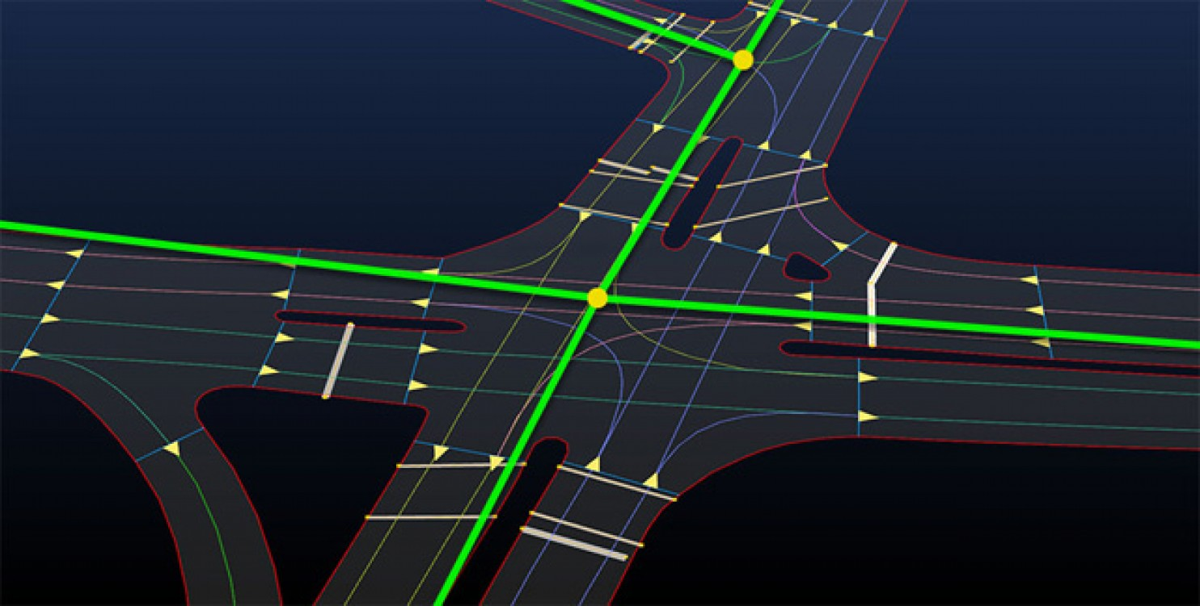
A-star algorithm
It uses a best-first search and finds a least-cost path path from a given initial node to one goal node. As A* traverses the graph, it follows a path of the lowest expected total cost or distance, keeping a sorted priority queue of alternate path segments along the way.
It uses a heuristic cost function.
cost = [2, 1, 1] - left, forward, right
x = init[0]
y = init[1]
o = init[2]
g = 0
h = abs(x - goalx) + abs(y - goaly)
f = g + h
g2 = g + cost[a]

Slide 6
Applications of A-star algorithm
Figure: (A) Optimal path finding Figure: (B) Freight Railroad Network of North America
taken from Wikipedia

Slide 7
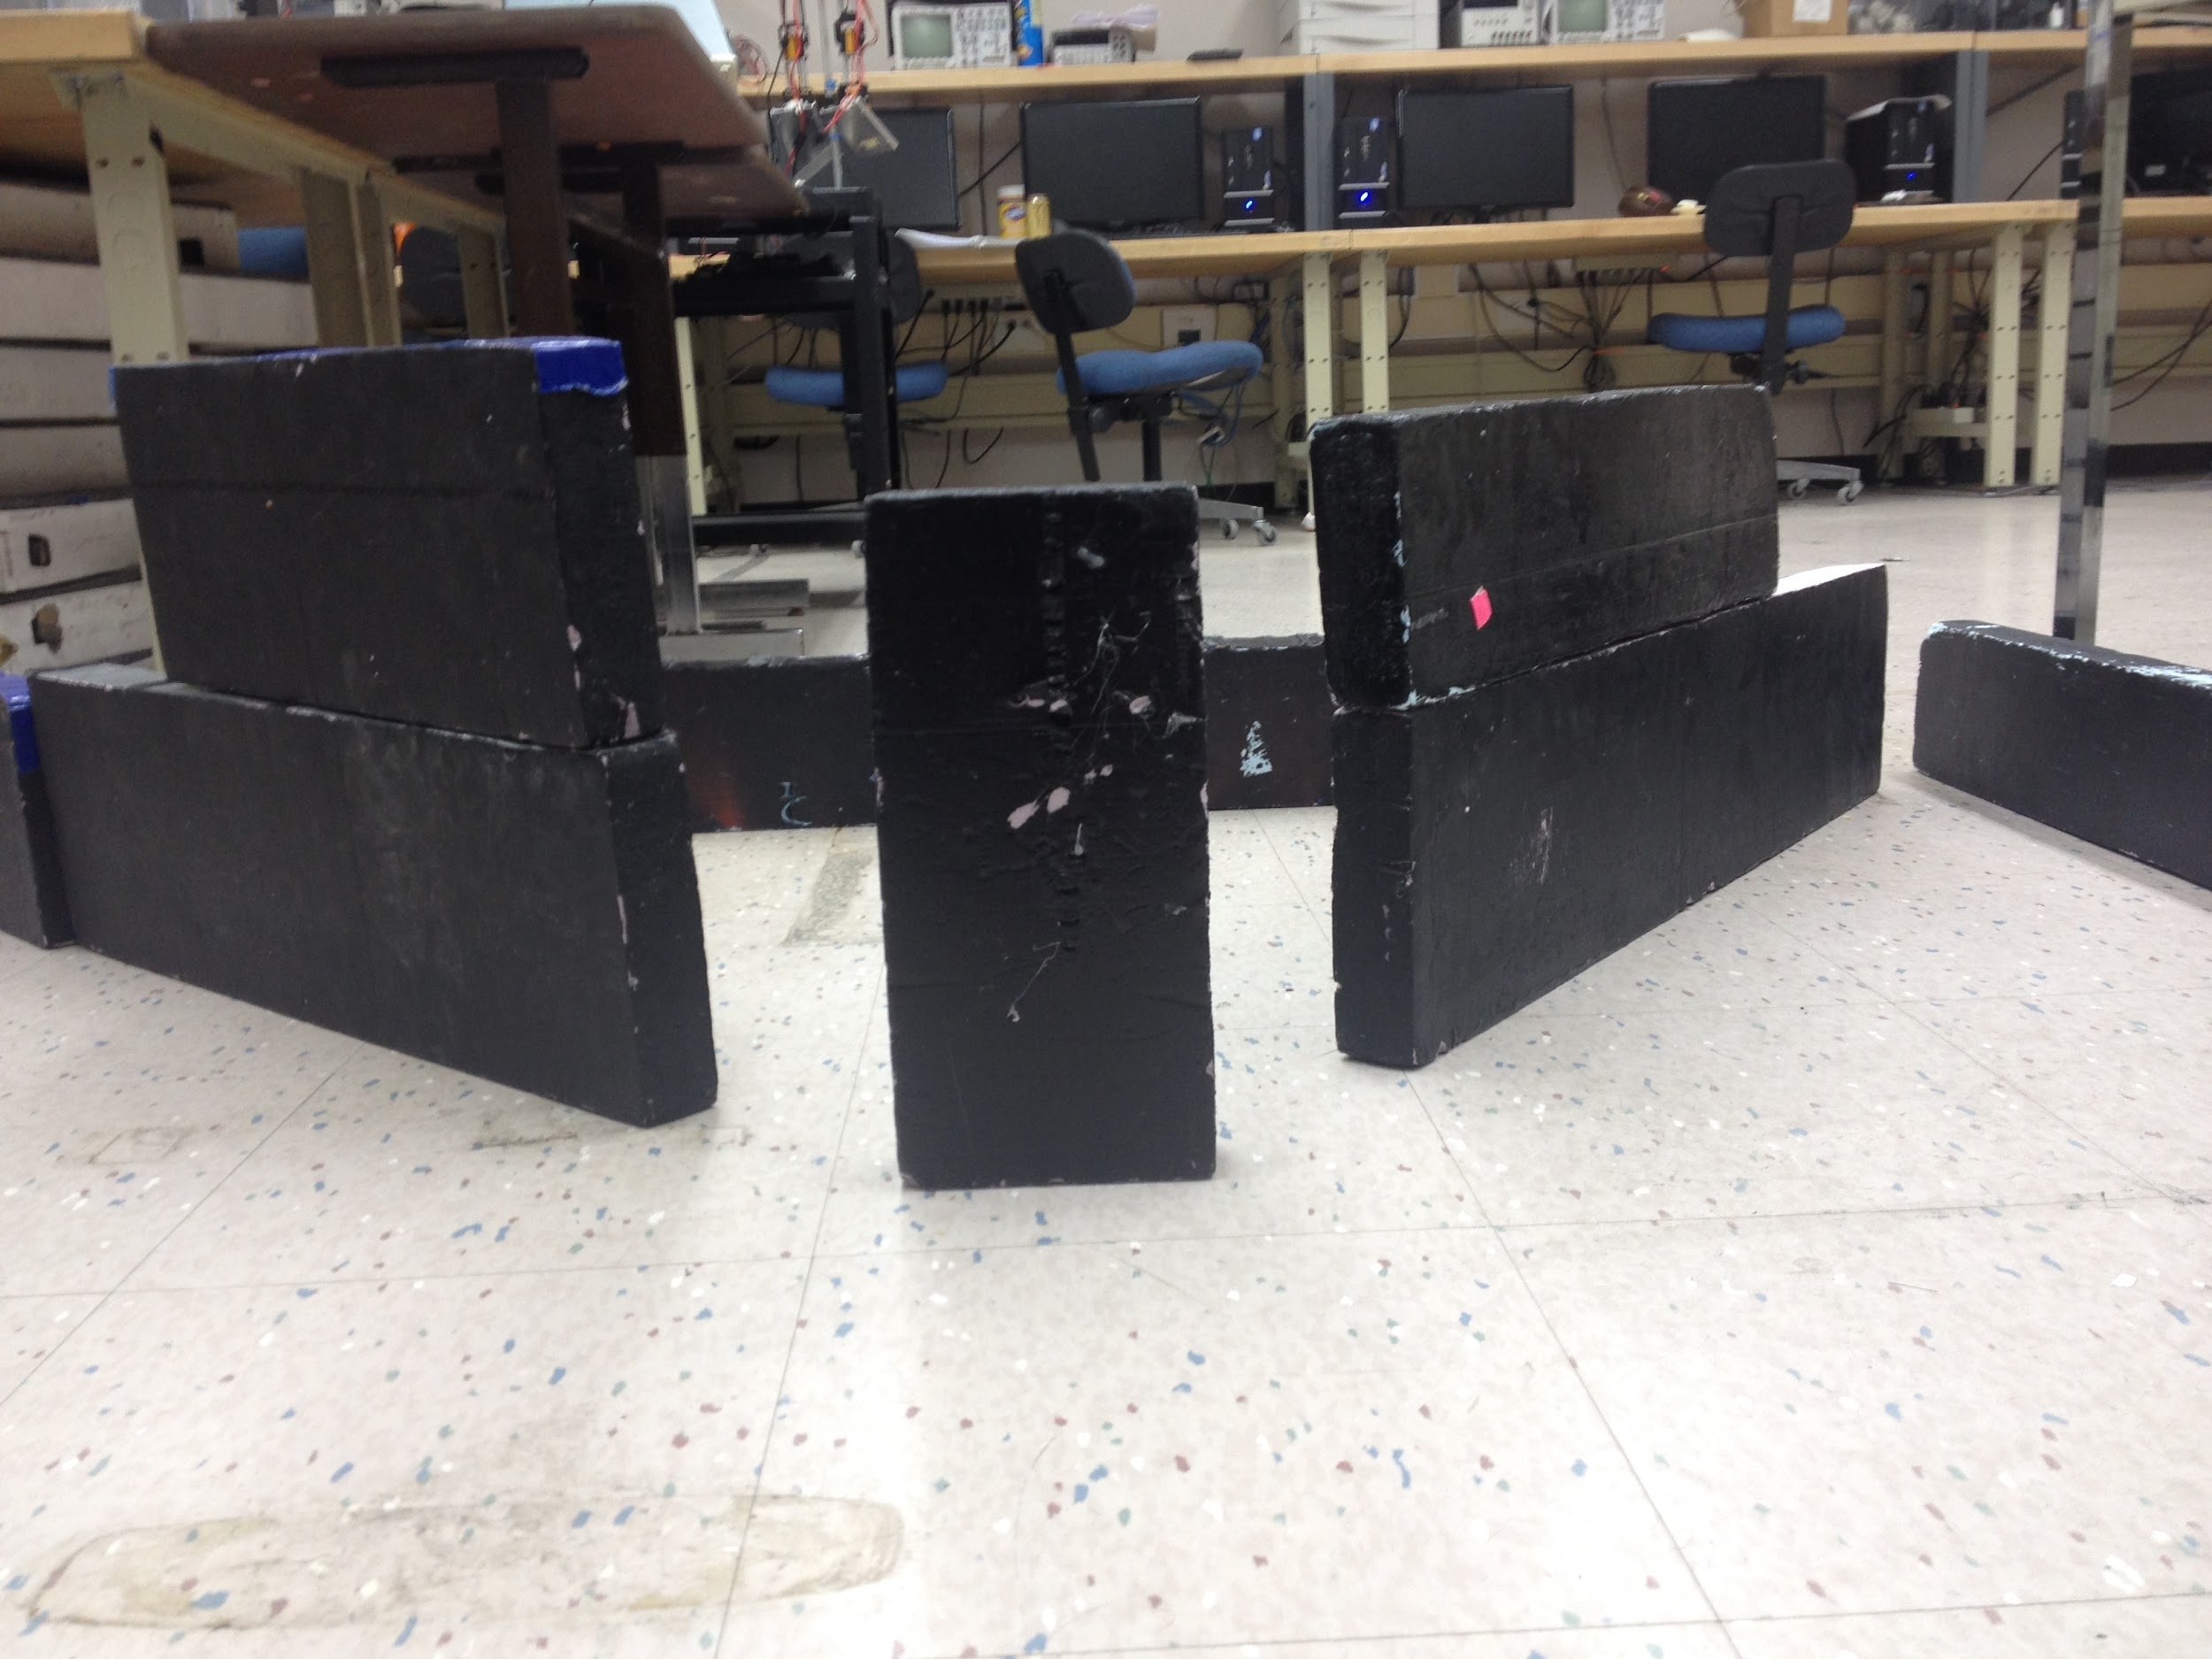
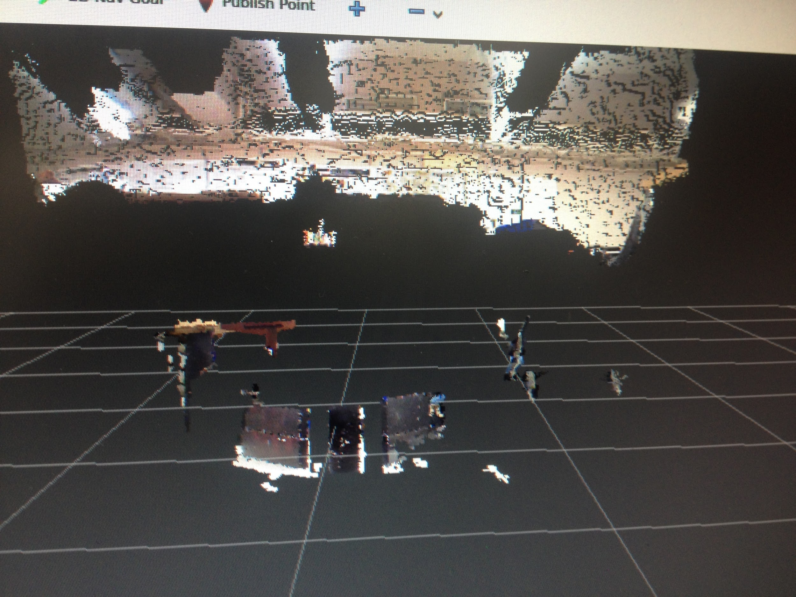
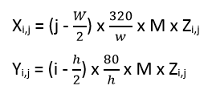
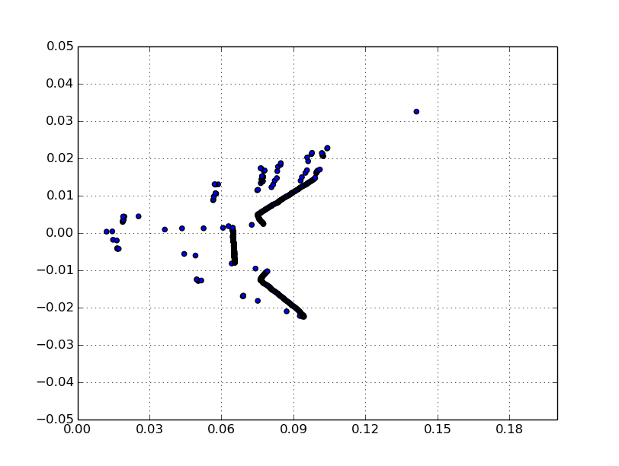
Depth Image for mapping
Cropped depth image (640x480 ->640 x [240:400])
Get the corresponding X and Y coordinate
Neglect Y since height is not important
Get the obstacle locations by minimization
Z’_{j} = min (Z_{0, j}, Z_{1, j} …. Z_{159, j})

Slide 8
Algorithm in ROS
subscribe
sensor_msgs
publish geometry_msg
depth/image/raw
NODE
RosAria/cmd_vel
calculate path
publish
depth_image
get 2D grid
unsubscribe
from Dimage
form & send 2D grid
convert to X-Y
map obstacles

Slide 9
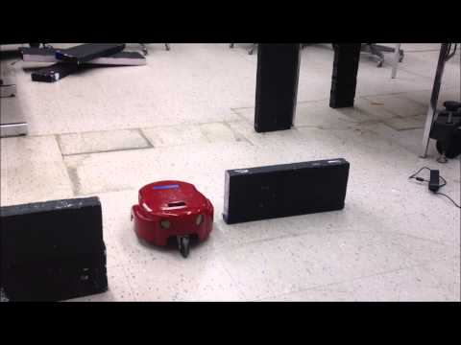
Video

Slide 10
Thank you

