Slide 1


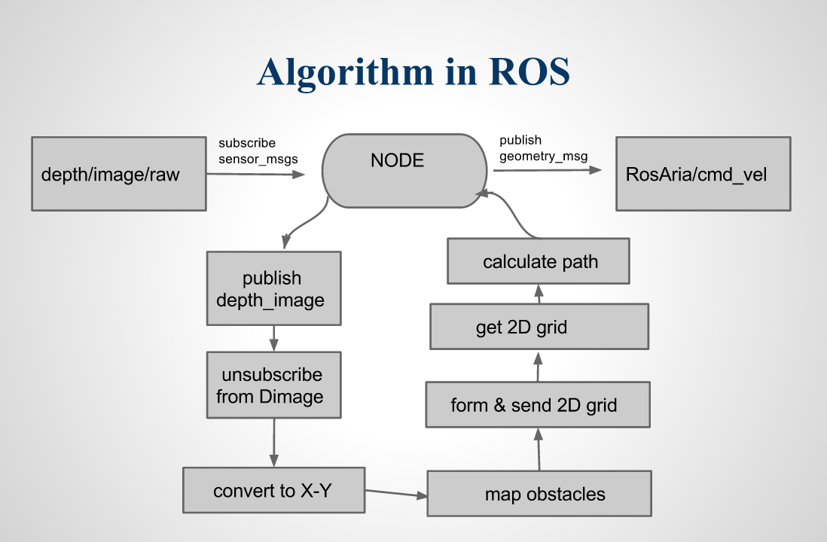
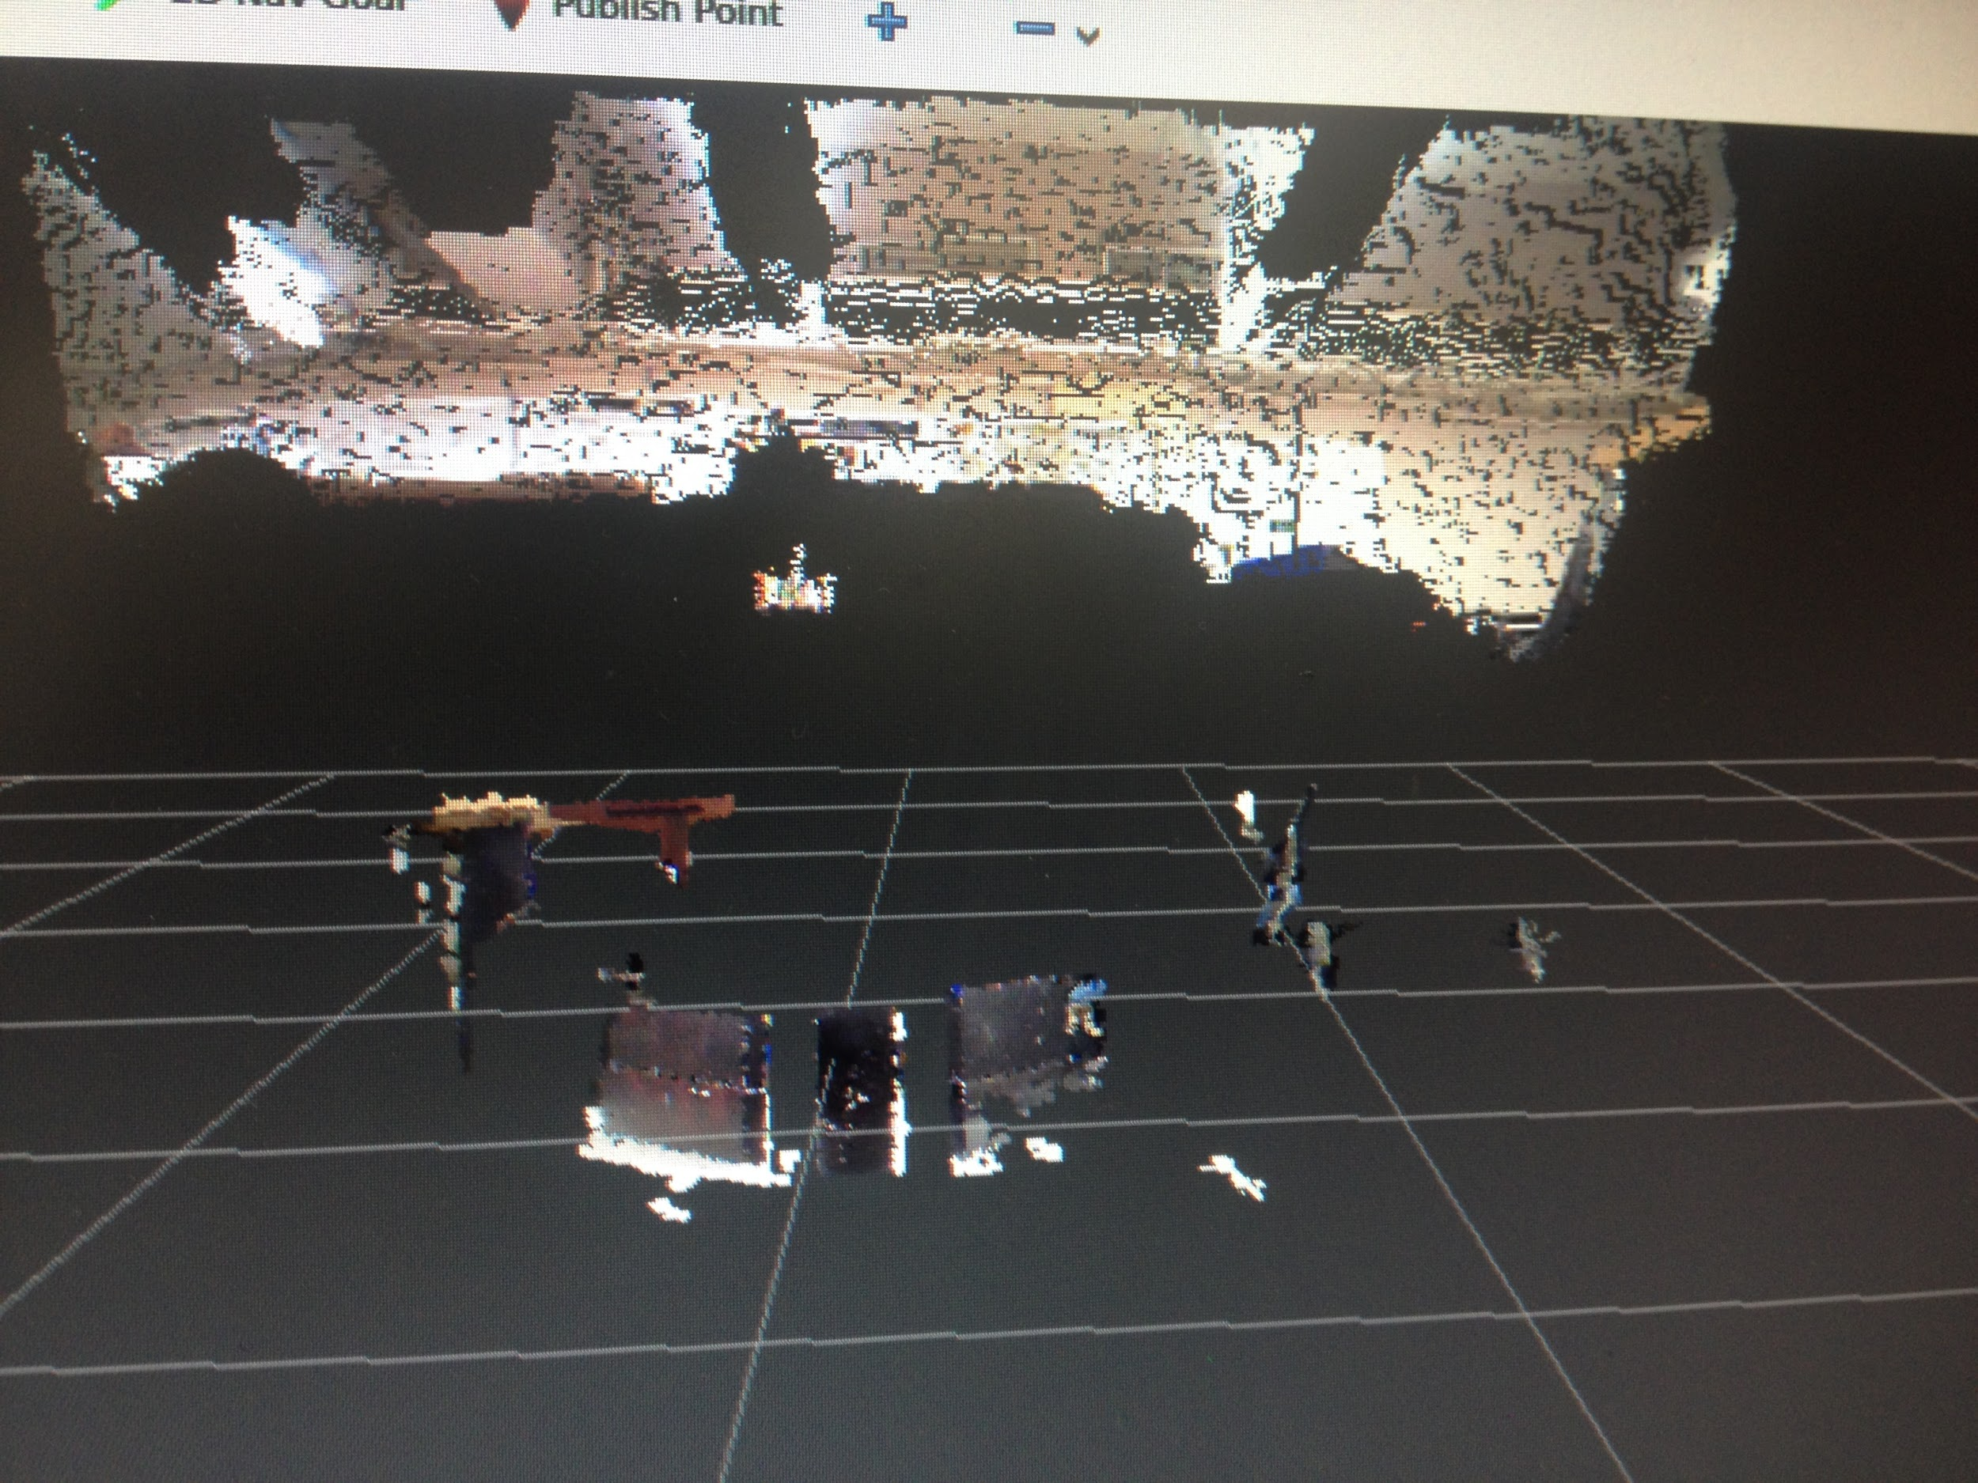




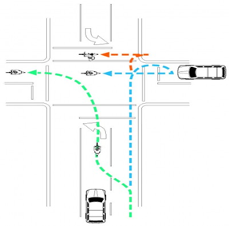
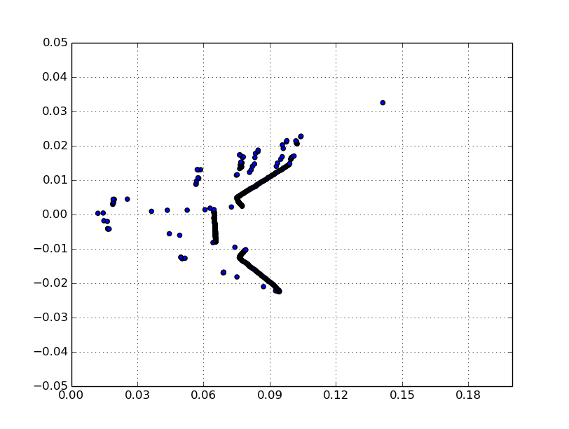




Depth Image based Path Planning using the A* algorithm
Suvam Bag, Dr. Ferat Sahin
Multi-Agent Biorobotics Lab
Rochester Institute of Technology
ADVANCED ROBOTICS
ABSTRACT
Find the shortest path to the goal position in a floor map with the help of depth image acquired from the Xtion Asus. Build the map iteratively so that the algorithm becomes dynamic.
OBSTACLES MAPPED
REAL TIME IMPLEMENTATION
A* ALGORITHM
DEPTH CONVERSION TO 2D GRID
X_{i, j =} (j - ) × × M × Z_{i, j}
Y_{i, j =} (i - ) × × M × Z_{i, j}
Z’_{j} = min (Z_{0, j}, Z_{1, j} …. Z_{239, j})
A iterative path finding algorithm having a cost function.
f = g + h
g = g + cost[a]
cost = [2, 1, 1]
= [L,F.R]

