Slide 1
Custom Object Character Recognition (OCR) on AWS
PROJECT-OCR
Name:SUVAM BANDHYA
NextHikeITSolutions

Slide 2

Introduction
This project focuses on building a Custom OCR system that combines YOLOv3 and Tesseract to read specific contents from lab reports and convert them into editable text files. The solution integrates AWS (SageMaker & S3) and Google Colab for model training, validation, and deployment.

Slide 3
Objectives
• Build a YOLOv3-based object detector for text regions.
• Extract detected regions and preprocess them for OCR.
• Use Tesseract to convert image text into editable format.
• Deploy and automate the workflow using Colab
• Evaluate accuracy and optimize model performance.

Slide 4
Data and Dependencies
• Dataset: https://drive.google.com/drive
• Dependencies:
- Tesseract OCR Engine
- PyTesseract
- OpenCV
- YOLOv3
• Model folder: Contains trained YOLOv3 weights.
• Input/Output storage: Google Drive

Slide 5

Workflow Overview
1. Environment Setup (Colab )
2. Dataset Preparation and Annotation
3. YOLOv8 Model Training and Validation
4. Object Detection and Cropping
5. Image Preprocessing and OCR using Tesseract
6. Output Generation and Evaluation
7. Deployment and Cost Management

Slide 6
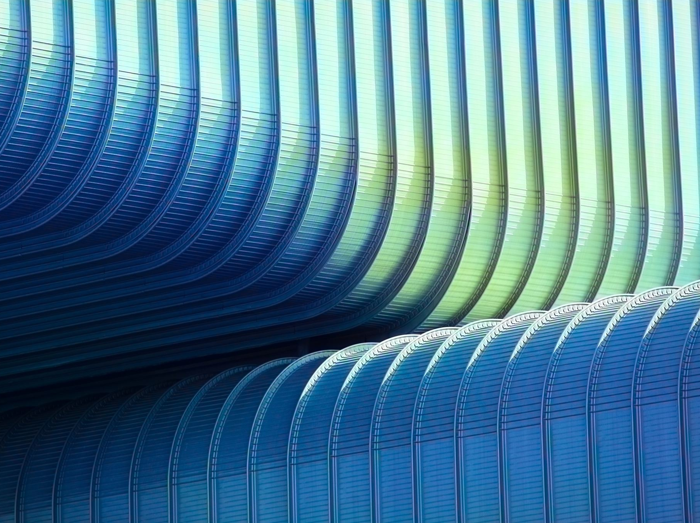
Step-by-Step Implementation
• Detect text regions using YOLOv3 bounding boxes.
• Crop and resize detected regions using OpenCV.
• Convert images to grayscale, apply Gaussian blur and threshold.
• Invert colors (bitwise_not) to optimize for Tesseract OCR.
• Extract text and export results as CSV.
• Validate and fine-tune for improved accuracy.

Slide 7
AWS Integration
• Colab used for model training and experimentation.
• Drive stores dataset, trained weights, and output files.
• Ensures scalability and data persistence.
• Enables future automation and CI/CD pipelines.

Slide 8

Evaluation and Optimization
• Evaluate OCR output against ground truth data.
• Measure detection and recognition accuracy.
• Fine-tune YOLOv3 anchors and thresholds.
• Optimize preprocessing for better Tesseract output.

Slide 9

Cost Management
• Google Colab: Free GPU access for small projects.
• Google Drive: 15 GB free storage.
• AWS SageMaker: Pay-as-you-go model.
• Estimated Total Cost: $0 for small-scale testing.
• Costs increase with larger datasets or higher-tier resources.

Slide 10
Final Google Drive Structure
Custom OCR Project
Datasets
Results
raw
Object names and YoLo weights
Models

Slide 11
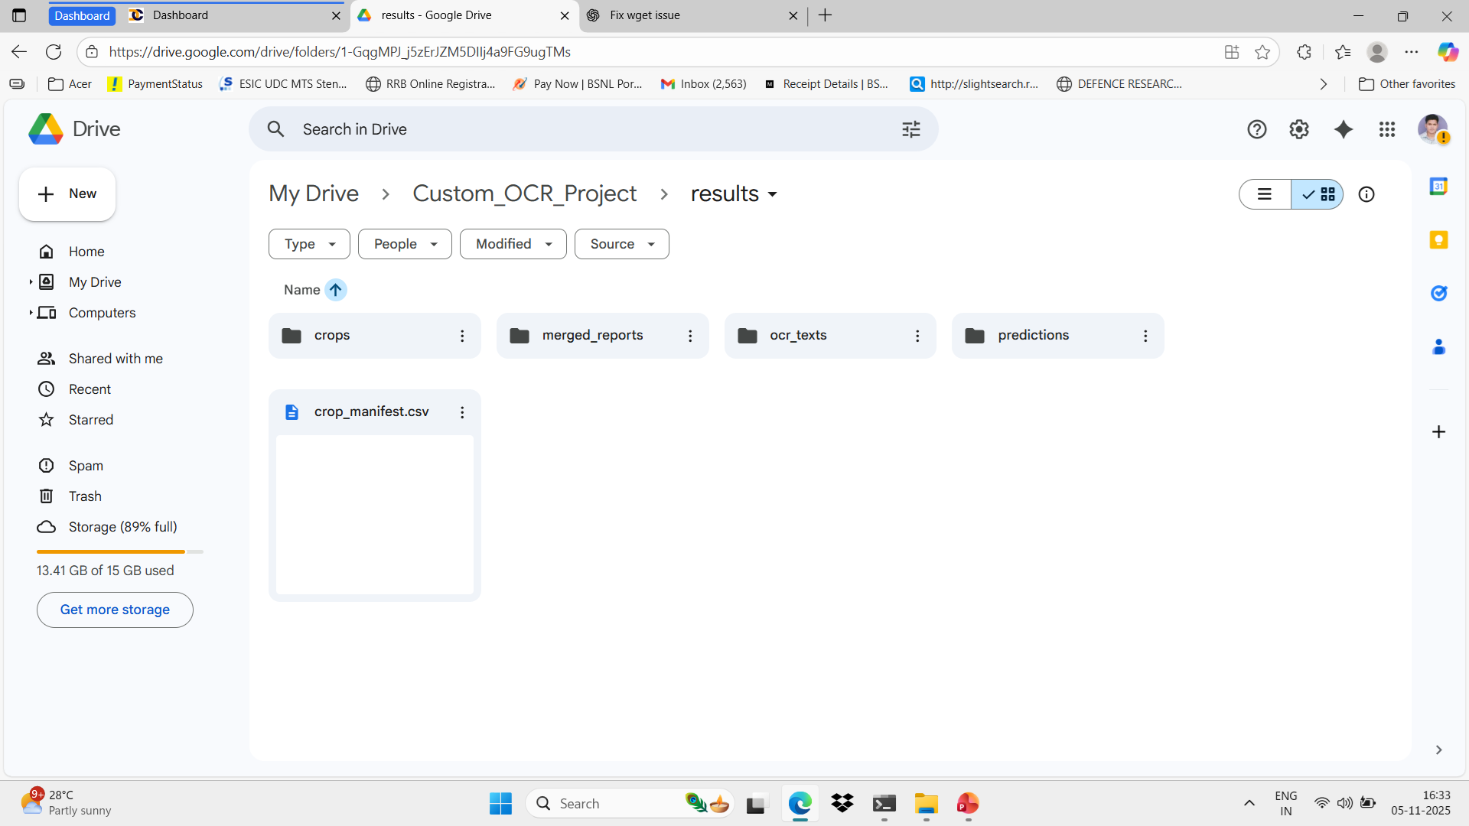
Final Result Folder

Slide 12
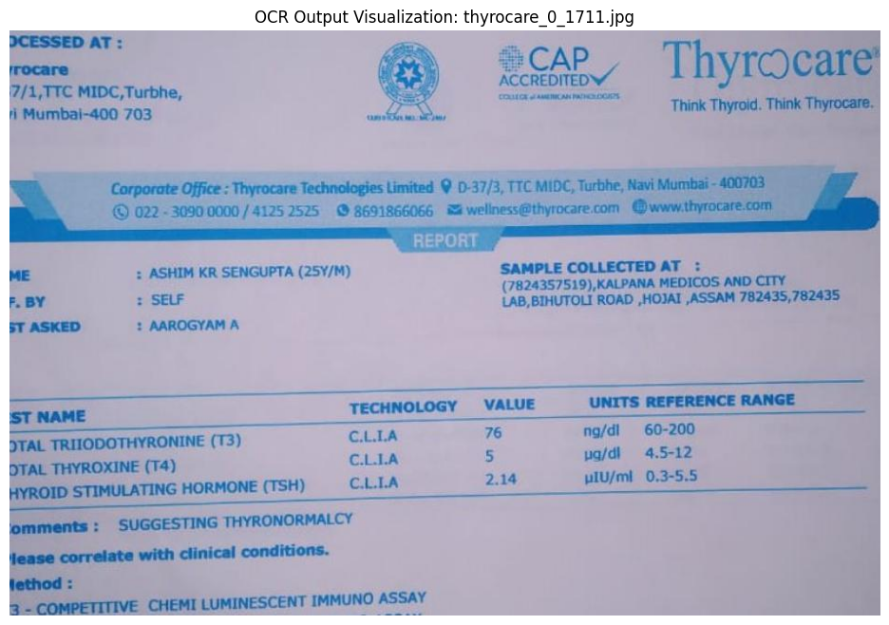
Final OCR output

Slide 13
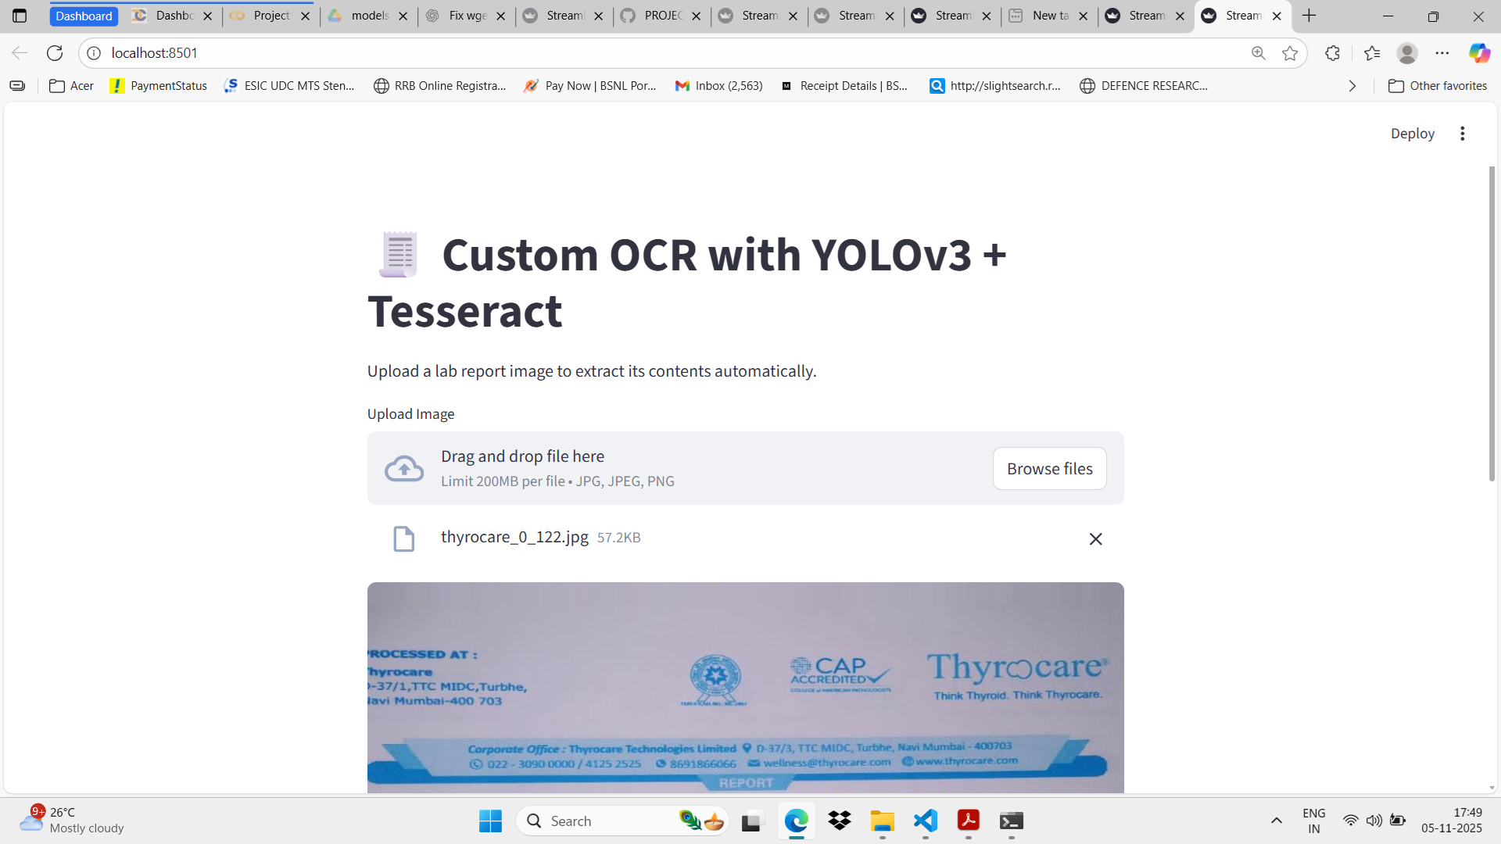
STREAMLIT APP VIEW

Slide 14
Conclusion
This project demonstrates the integration of YOLOv3 and Tesseract for custom OCR on lab reports. Using Colab ensures flexibility, cost efficiency, and scalability. Further improvements can include better OCR preprocessing, language model correction, and end-to-end deployment pipelines.

