Slide 1
Customer Shopping
Behavior Analysis
Data cleaning · SQL analysis · Power BI dashboard · Business recommendations
Suvam Priyaranjan Sahoo

Slide 2
OVERVIEW
Project Overview
This project analyzes 3,900 customer shopping transactions to uncover patterns in spending, product preferences, and subscription behavior — then translates those patterns into concrete business recommendations.
3,900
18
10
4
Transactions analyzed
Data fields
Business questions answered
Product categories
Workflow: Business Problem → Python EDA → SQL → Power BI → Report → Presentation → GitHub

Slide 3
METHODOLOGY
Dataset & Data Preparation
Dataset
Preparation Steps
3,900 rows × 18 columns of retail transaction data
Customer demographics: age, gender, location, subscription status
Purchase details: item, category, amount, season, size, color
37 missing Review Rating values, imputed by category median
Standardized column names to snake_case
Engineered age_group and purchase_frequency_days features
Dropped promo_code_used after confirming redundancy with discount_applied
Loaded cleaned data into PostgreSQL for SQL analysis

Slide 4
FINDING 01
Revenue by Gender
Male customers generate
2.1×
the revenue of female customers
($157,890 vs. $75,191)

Slide 5
FINDING 02
Top 5 Products by Rating

Slide 6
FINDING 03 & 04
Shipping & Subscription Behavior
Avg. Spend by Shipping Type
Revenue Share by Subscription
Non-subscribers spend marginally more on average ($59.87 vs. $59.49)

Slide 7
FINDING 05
Customer Segmentation
80%
of customers are classified as Loyal — only 2% are New, pointing to strong retention after a customer's first purchase.

Slide 8
FINDING 06
Revenue by Age Group
Revenue is fairly evenly spread across age groups, with Young Adult contributing the most.

Slide 9
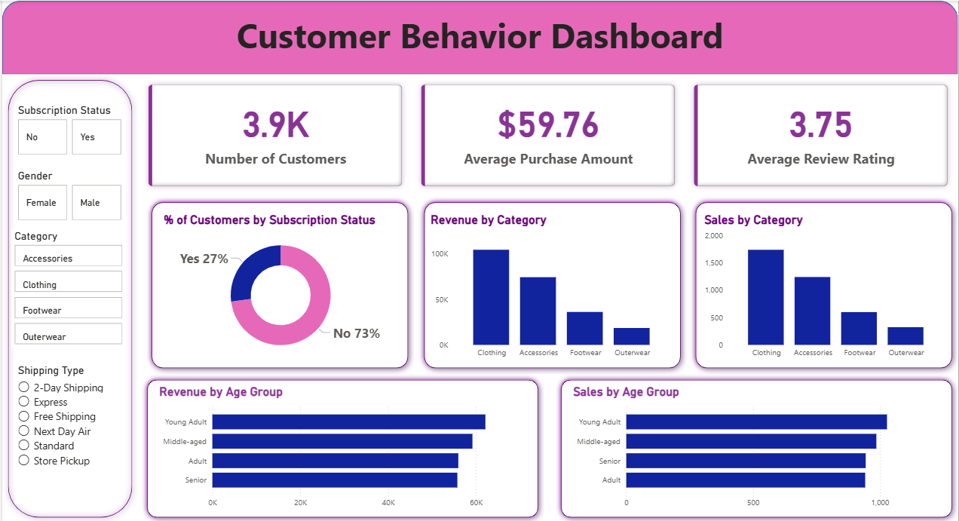
DELIVERABLE
Interactive Dashboard — Power BI

Slide 10
NEXT STEPS
Business Recommendations
01
Boost Subscriptions
Subscribers don't yet outspend non-subscribers — exclusive perks could change that.
02
Grow Retention Pipeline
Only 2% of customers are New; understand what drives early conversion to Returning/Loyal.
03
Review Discount Policy
Hat, Sneakers, and Coat rely on discounts for ~half their sales — watch margin impact.
04
Target Young Adults
The highest revenue-contributing age group for focused campaigns.

Slide 11
Thank You
Suvam Priyaranjan Sahoo
github.com/suvampriyaranjansahoo

