Slide 1
CAPSTONE2-EDA & Machine Learning
Halloween Candy Win percent – Machine Learning(Predictive Modelling )
By
Lakshmi Suvarchala
Moving towards Data Science…

Slide 2

1. What Is EDA?
Exploratory Data Analysis refers to the critical process of performing initial investigations on data so as to :
Discover patterns
Spot anomalies
Test hypothesis
Check assumptions with the help of summary statistics
Graphical representations
Moving towards Data Science…

Slide 3

2. Proposed Dataset-Candies Win percent during Halloween
Data set is collection of data.
This dataset was scraped from Five Thirty Eight-Candy Power Ranking
Proposed Dataset is collection of multiple candies records with specifications like flavors, sugar percent contained in them
Dataset contains 85 entries and 13 columns/variables
3 Numeric , 1 Categorical and 9 Boolean variables
Moving towards Data Science…

Slide 4

3. Problem Statement
The purpose of this research is to:
What’s the best (or at least the most popular) Halloween candy(win percent)?
Which specified features/columns are associated with higher rankings?
Identify how each feature has effect on other features , study the correlations
Moving towards Data Science…

Slide 5

4. What EDA did I do?
Identified count of candies by their specified features presence/absence
Applied Statistical measures on features/variables
Grouped data by specific features in the Candy Dataset
Identified relationships among different features/variables like sugar percent Vs price percent, Price percent Vs Win percent, etc..
Identified top ten(10) candies the Halloween Candy Power Ranking Dataset
Moving towards Data Science…

Slide 6
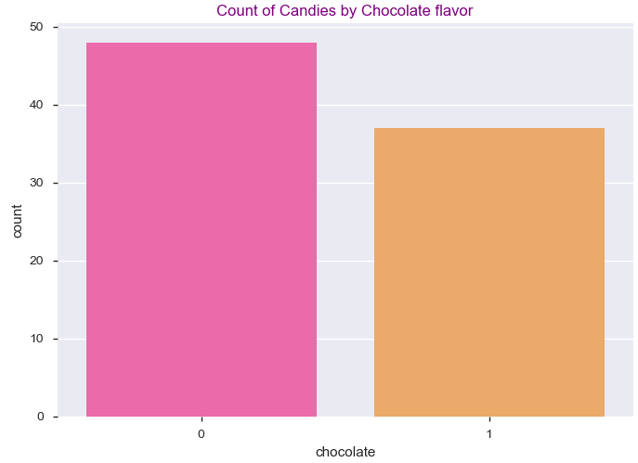
5. Plot Graph
Moving towards Data Science…

Slide 7
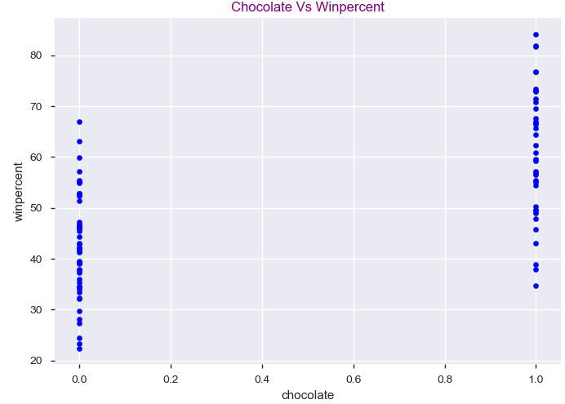
6. Plot Graph
Moving towards Data Science…

Slide 8
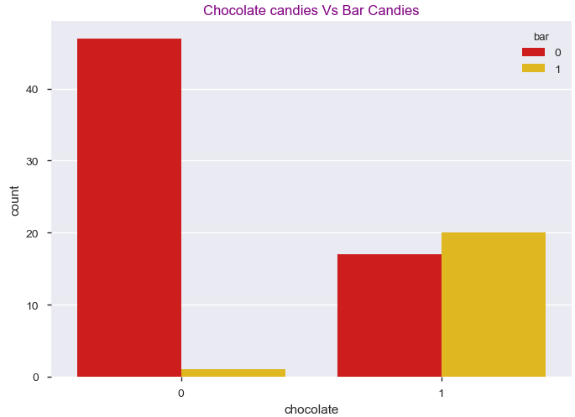
7. Plot Graph
Moving towards Data Science…

Slide 9
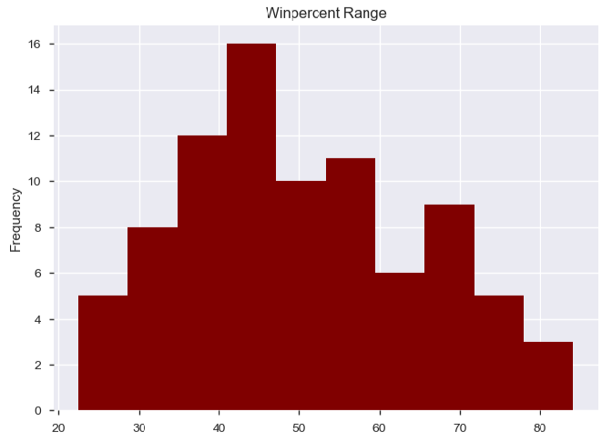
8. Plot Graph
Moving towards Data Science…

Slide 10
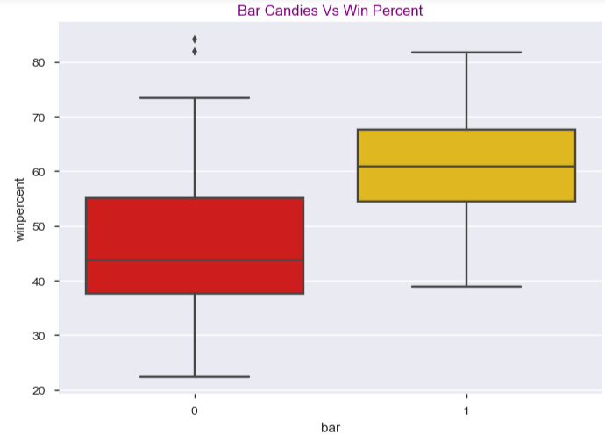
9. Plot Graph
Moving towards Data Science…

Slide 11
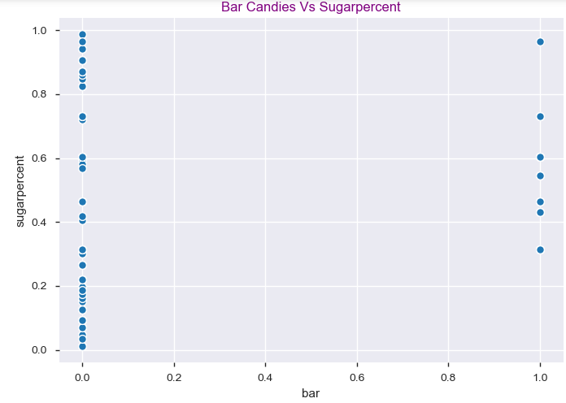
10. Plot Graph
Moving towards Data Science…

Slide 12
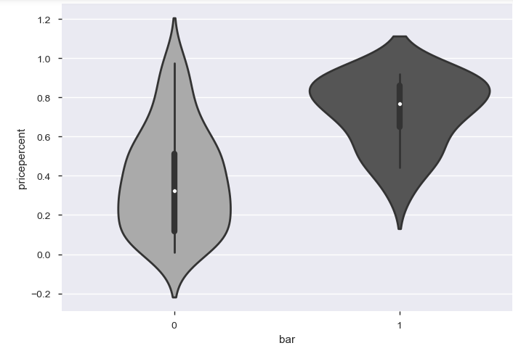
11. Plot Graph
Moving towards Data Science…

Slide 13
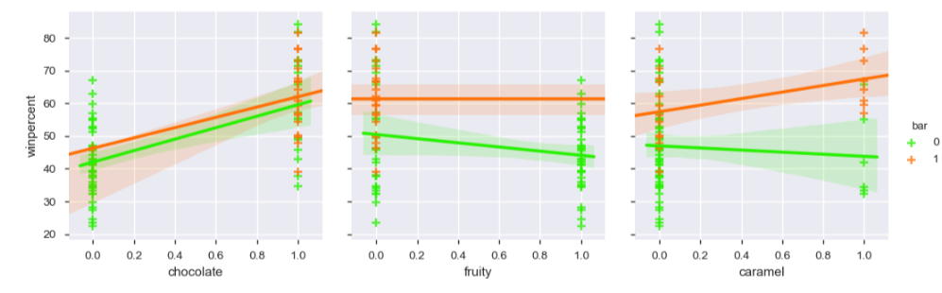
12. Plot Graph
Moving towards Data Science…

Slide 14
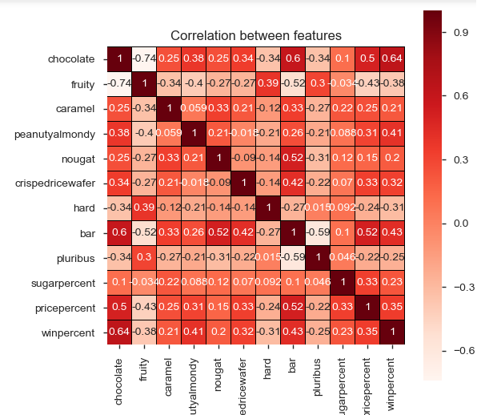
13. Plot Graph
Moving towards Data Science…

Slide 15

14. What is Machine Learning ?
After EDA and understanding the dataset i,e.; recognize patterns, we run ML Algorithm on Dataset
A computer program is said to learn from experience E w.r.t some class of tasks T and Performance measure P if its performance at tasks in T, is measured by P improves with Experience E
Machine Learning divided into three types of Learning
Supervised Learning
Un-Supervised Learning
Reinforcement Learning
Moving towards Data Science…

Slide 16
15. Applied Machine Learning Technique
In Candy dataset, win percent is numerical continuous variable-our target variable
After studying the data and detailed EDA, we chose to build Linear Regression Model so as to predict which flavored candy has high win percent, what sort of features are contributing to high/low win percent, etc.
Linear Regression Model is built, fit to data and results are predicted on Testing Data
Model is run against different combinations(Feature Selections) and evaluated using metrics like MAE.MSE.RMSE. R Square, Adjusted R Square
Noted the values and predicted win percent, popular flavors for high percent candies
Low RMSE value combination is identified and those features are used for predicting popular flavored candies
Moving towards Data Science…

Slide 17
16. Conclusions
Almost count of non flavored candies is more when countplot is plotted for each single feature/flavor
Studied Numerical Variable Distribution Trends
- Win percent: Distribution Curve is left skewed, many of candies have win percent less than mean win percent 50.30
- Price percent: Distribution Curve is normal, all candies have varying price percent
- Sugar percent: Distribution Curve is normal, all candies have varying sugar percent
Sugar percent is slightly increasing per price percent(reference is scatter plot)
Top win percent candies having high win percent 84.180,81.866 are Reeses Peanut Butter, Reeses Miniature contain following flavors
- chocolate, caramel, peanutyalmondy, not hard, not bar candies
Moving towards Data Science…

Slide 18
17. Conclusions(contd…)
Least win percent candies 22.44,23.41 are Nik L Nip, Boston Baked Beans have following flavors -fruity, pluribus, peanutyalmondy
chocolate, fruity, peanutyalmondy, nougat are Independent variables contributing to good win percent
Following are correlated variables having good win percent(combined flavors liked by people)
- Peanutyalmondy-Non bar candies combination mostly liked by people
- chocolate-non hard candies combination mostly liked by people
- crispedricewafer-caramel candies combination mostly liked by people
- Nougat-Bar candies combination mostly liked by people
- Bar-chocolate, caramel, crispedricewafer candies combination mostly liked by people
Most of the hard candies are not liked by people, all hard candies are non bar candies have less win percent
All pluribus candies are Non bar Candies
Moving towards Data Science…

Slide 19
18. Conclusions(contd..)
Predicted win percent range for combination of each single flavor presence(1) and price percent range(0,0.5,1)
- chocolate(1) - price percent(0,0.5,1)-> 50-65(win percent)
- fruity(1) - price percent(0,0.5,1)-> 39-52(win percent)
- caramel(1) - price percent(0,0.5,1)-> 43-62(win percent)
- peanutyalmondy(1) - price percent(0,0.5,1)-> 54-68(win percent)
- nougat(1) - price percent(0,0.5,1)-> 50-68(win percent)
- crispedricewafer(1) - price percent(0,0.5,1)-> 58-72(win percent)
- hard(1) - price percent(0,0.5,1)-> 34-51(win percent)
- bar(1) - price percent(0,0.5,1)-> 55-64(win percent)
- pluribus(1) - price percent(0,0.5,1)-> 39-56(win percent)
Hence, mostly correlated features do not fetch for Linear Regression Model, we drop those features in Feature selection like caramel, bar, hard, pluribus, crispedricewafer and then run model which on evaluation gives low RMSE value of 10.566, thus now our model is ready for predictions
Moving towards Data Science…

Slide 20
CAPSTONE2-EDA & Machine Learning
THANK YOU
By
Lakshmi Suvarchala
Moving towards Data Science…

