Slide 1
CAPSTONE1-EDA
Car Sales –Exploratory Data Analysis
By
Lakshmi Suvarchala
Moving towards Data Science…

Slide 2

1. What Is EDA?
Exploratory Data Analysis refers to the critical process of performing initial investigations on data so as to :
Discover patterns
Spot anomalies
Test hypothesis
Check assumptions with the help of summary statistics
Graphical representations
Moving towards Data Science…

Slide 3

2. Proposed Dataset-Car Sales in Ukraine Fleet
Data set is collection of data.
Proposed Dataset is collection of multiple car records with specifications that are available in the Ukraine Car Fleet
Dataset contains 9576 entries and 10 columns/variables
4 Numeric and 6 Categorical variables
Moving towards Data Science…

Slide 4

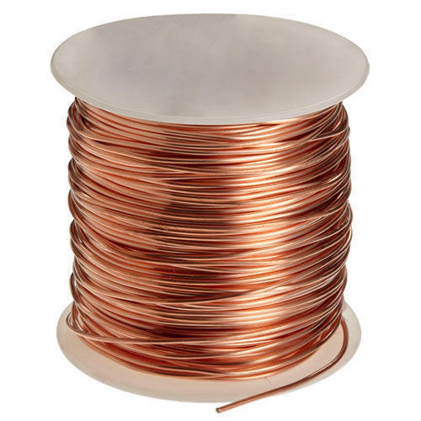
3. Data Cleansing
Raw /Un-Organized Data
Processed /Organized Data
Moving towards Data Science…

Slide 5

4. Data in Depth
After Cleansing, our proposed dataset is as following:
Number of Entries: 9463
Number of Variables: 12
Numeric Variables: 5
Categorical Variables: 7
Extended Variables: 2
Size in Memory: 887.2 kiB
Moving towards Data Science…

Slide 6

5. Problem Statement
The purpose of this research is to:
Identify how Fleet can grow based on data?
Identify how various brand cars are distributed in Ukraine Fleet by numbers?
How various car specifications effect the price?(helps in deciding what cars to buy and maintain in fleet)
Identify how car specifications effect each other?(understanding relationship between variables, so that it gives an idea of what type of cars have to be acquired for fleet growth)
Moving towards Data Science…

Slide 7

6. What EDA did I do?
Identified count of Registered/Un-Registered Cars in the Fleet
Applied Statistical measures on variables
Identified unique brands/manufacturers, models, body type, engine type of cars that are available in the Fleet
Grouped data by specific brand registered cars in the Fleet
Identified relationships among different variables like Mileage Vs Engine Volume, Price Vs Year, etc..
Identified top ten(10) models of top four(4) Brand cars that are available in the Fleet
Moving towards Data Science…

Slide 8
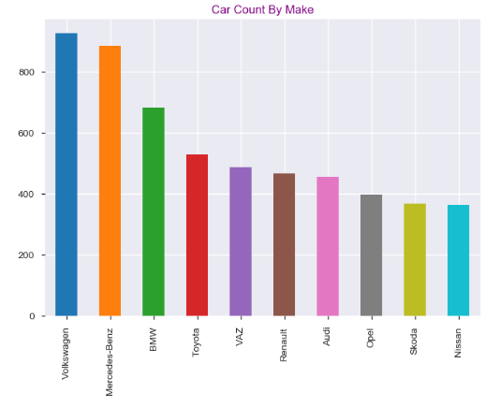
7. Plot Graph
Moving towards Data Science…

Slide 9
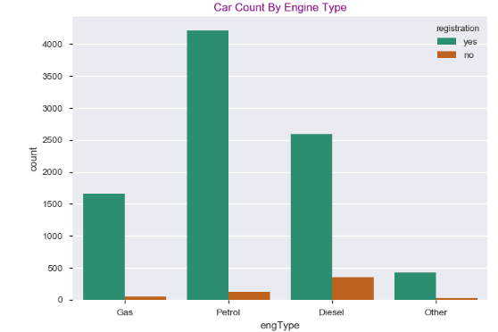
8. Plot Graph
Moving towards Data Science…

Slide 10
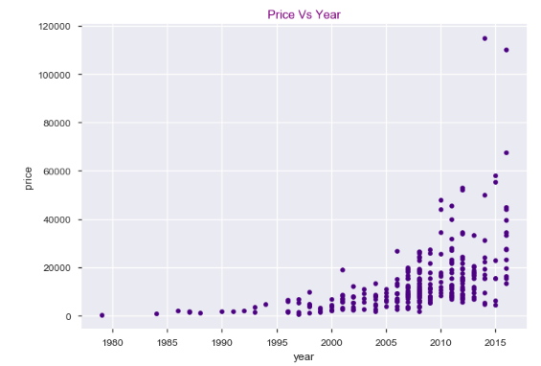
9. Plot Graph
Moving towards Data Science…

Slide 11
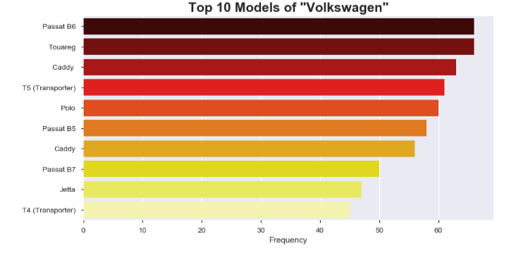
10. Plot Graph
Moving towards Data Science…

Slide 12
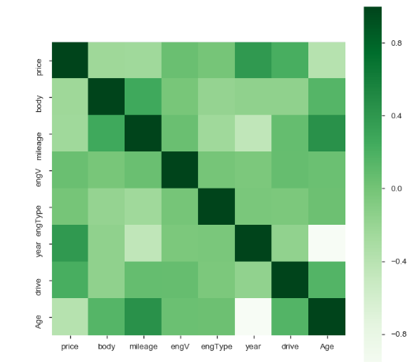
11. Plot Graph
Moving towards Data Science…

Slide 13
12. Conclusion
Count of cars with prescribed specifications in the Ukraine Car Fleet
Total of 9463 car entries were recorded with ten(10) variables and two(2) extended variables.
The Volkswagen manufacturer cars and models are most available registered cars in the Ukraine Car Fleet.
Studied relation between various car features and understood how each feature relates to one another.
Noted top five manufacturers and top model cars in each Manufacture/Car Type in the Ukraine Car Fleet.
Concluded that Price of car is effected by parameters like Engine Type, Engine Volume, Body Type, Manufacturing year ,etc.;
Studying all the features and their effect on parameters helps Ukraine Fleet Manager in making decision of what brand, new/used cars they have to maintain in order to grow the fleet and be a big Car Fleet in Ukraine
Moving towards Data Science…

Slide 14
CAPSTONE1-EDA
THANK YOU
By
Lakshmi Suvarchala
Moving towards Data Science…

