Slide 1


AUDISANKARA COLLEGE OF ENGINEERING & TECHNOLOGY :: GUDUR
Department of Master of Computer Applications
SMART ARTIFICIAL INTELLIGENCE-BASED
ONLINE PROCTORING SYSTEM
SUBMITTED BY:
GUIDED BY:
P. Suvarna Sai
23G21F00061
V. Chandrasekhar,
Associate Professor,
Department of MCA
Dept of MCA
01

Slide 2
ABSTRACT
This project is about developing a vision and audio-based proctoring system for online examinations powered by artificial intelligence. The system works using a webcam and microphone to check if a student is cheating. This system is capable of detecting suspicious behaviors such as head and eye movements, multiple faces, foreign objects like mobile phones or books, and unusual sounds like talking or other people in the room during examinations. This system acts like a human invigilator but without the need for someone to be there. It helps schools and colleges conduct safe and fair online exams while saving time and effort.
Dept of MCA
02

Slide 3
INTRODUCTION
With the rise of online education and remote learning, conducting secure and fair examinations has become a major challenge. Traditional methods of exam monitoring, which rely on human invigilators, are not practical for large-scale or remote exams. They are time-consuming, costly, and often fail to prevent dishonest practices. To address these issues, this project proposes an AI-powered online proctoring system that can automatically monitor students in real time. By using webcam and microphone data, the system can detect suspicious behavior such as unusual movements, the presence of additional people, or unauthorized devices. This smart solution aims to ensure the credibility of online exams while reducing the need for constant human supervision.
Dept of MCA
03

Slide 4
EXISTING SYSTEM
Requires human invigilators for monitoring
Need for continuous human attention throughout the exam
Difficulty in tracking multiple students simultaneously
Challenging to track facial expressions and eye movements
Lack of real-time detection of cheating incidents
Dept of MCA
04

Slide 5
DISADVANTAGES
High cost of employing human proctors for every exam
Limited real-time tracking; cheating may go unnoticed
Inability to detect background noise or off-screen activity
Rescheduling or canceling exams is challenging and time-consuming
Human distraction can lead to missed cheating attempts
Dept of MCA
05

Slide 6
PROPOSED SYSTEM
Our AI-based online proctoring system provides:
Real-time candidate monitoring using webcam and microphone inputs
Automated face recognition for identity verification
Intelligent detection of head movement, eye direction, and mouth motion
Object detection to identify mobile phones, books, and extra persons
Audio-to-text analysis for detecting verbal cheating attempts
Dept of MCA
06

Slide 7
ADVANTAGES
Fully automated system reduces the need for human proctors
Cost-effective compared to traditional manual proctoring
Real-time monitoring ensures timely detection of malpractice
Accurate face and behavior recognition improves exam integrity
Minimizes human error
Dept of MCA
07

Slide 8
SYSTEM REQUIREMENTS
Software Requirements :
Operating System: Windows
Programming Language: Python
Front-End: HTML, CSS
Database: MySQL
Hardware Requirements :
Processor: Intel Pentium or Core
RAM: Minimum 4 GB
Hard Disk: Minimum 20 GB of free space
Camera: Webcam (built-in or external)
Microphone: Built-in or external mic for voice monitoring
Dept of MCA
08

Slide 9








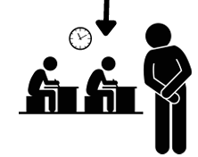
SYSTEM ARCHITECTURE
Student Device
Input Capture
AI Processing
Decision Engine
Student logs in. Webcam and microphone access is granted.
Captures student’s audio and video
If any suspicious behavior is found, it raises a flag.
Records evidence and stores it in the database.
Face Detection, Eye & Head movement, Mouth Movement, Object Detection, Speech Analysis
Invigilator Panel
Invigilator views flagged activities and take necessary actions.
Dept of MCA
09

Slide 10
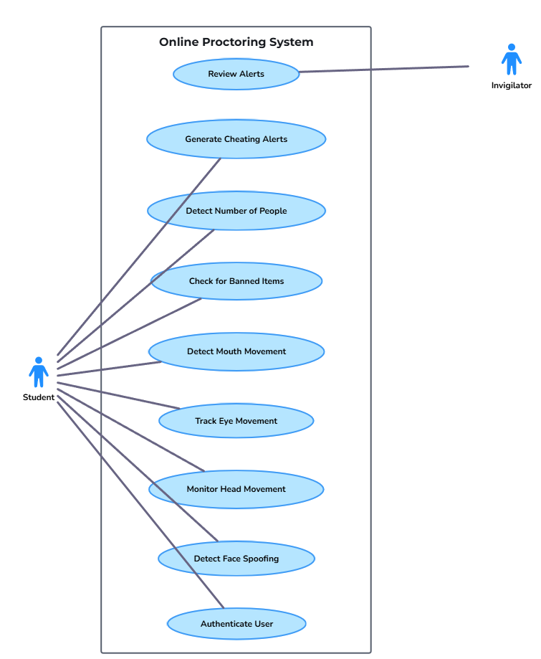
USE CASE DIAGRAM
Dept of MCA
10

Slide 11
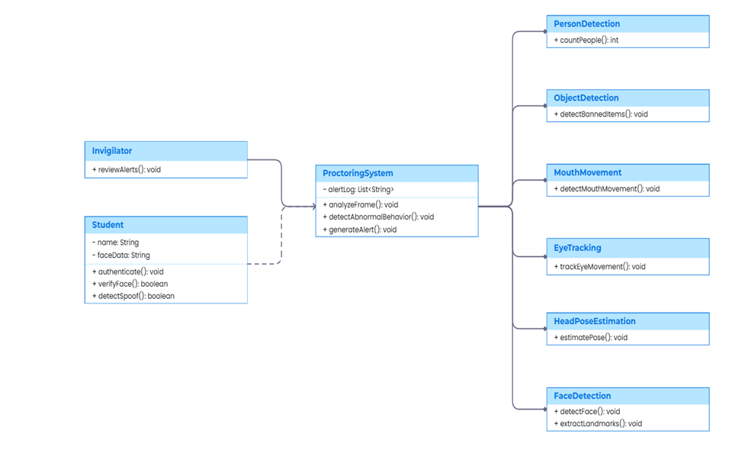
CLASS DIAGRAM
Dept of MCA
11

Slide 12
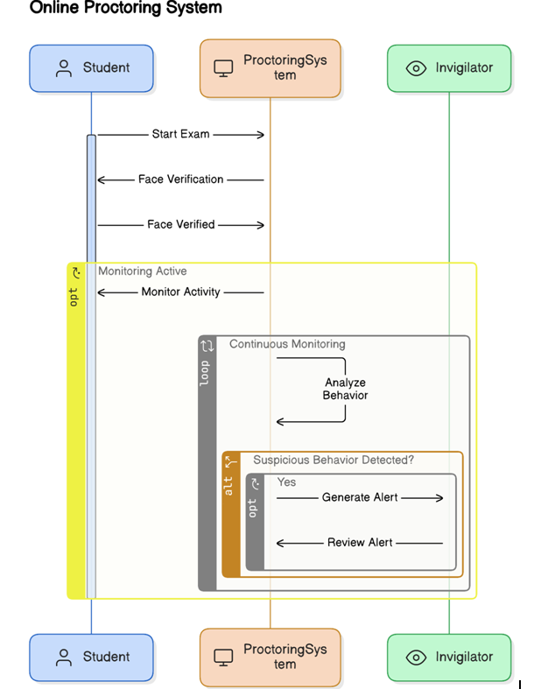
SEQUENCE DIAGRAM
Dept of MCA
12

Slide 13
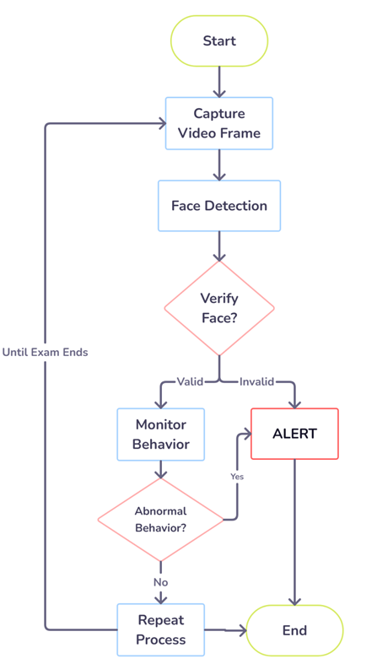
ACTIVITY DIAGRAM
Dept of MCA
13

Slide 14
MODULES
User Interface Module:
Provides a friendly interface for students to log in and take exams
Collects webcam and microphone access permissions from the user
Face Detection Module:
Captures and verifies the student’s face at login using stored face data.
Continuously monitors the face during the exam to ensure the same person remains.
Dept of MCA
14

Slide 15
MODULES
Behavior Monitoring Module:
Tracks eye and head movements to check for distractions or cheating behavior
Monitors mouth movements to detect speaking during the exam
Object and Person Detection Module:
Uses YOLOv3 to detect mobile phones, books, or any unauthorized materials
Detects if more than one person is present in the video frame
Triggers an alert when suspicious objects or persons are identified
Dept of MCA
15

Slide 16
MODULES
Audio Analysis Module:
Captures audio from the environment using a microphone
Converts speech to text to detect malpractice
Flags unusual noise or spoken words
Invigilator Panel Module:
Allows admins or teachers to log in and view exam activity
Views flagged activities and take necessary actions
Dept of MCA
16

Slide 17
CONCLUSION
In conclusion, This AI-based online proctoring system helps to make online exams safer and more reliable. It watches students using a webcam and listens through a microphone to detect any cheating. It can check if the right student is writing the exam and can find actions like speaking, looking away, or using a phone. The system reduces the need for human invigilators and saves time and effort. It also helps schools and colleges to conduct exams easily from anywhere. This smart solution makes online exams more honest and efficient.
Dept of MCA
17

Slide 18

THANK YOU
Dept of MCA
18

