Slide 1
INTERNSHIP PROJECT PRESENTATION
Hospital Management System – A Full-Stack Web Application
Presented by Suvarnalekhaa N
Registration No.: 810023205086 · B.Tech Information Technology · 2023–2027
Internship at ORMATRIX – The Complete IT Solution, Pudupalayam, Cuddalore, Tamil Nadu · 30-day internship
Notes:
I am presenting my Hospital Management System, developed as a full-stack web application during my internship. I will move from the project context to the workflow problems, system design, implementation, testing and future scope.

Slide 2
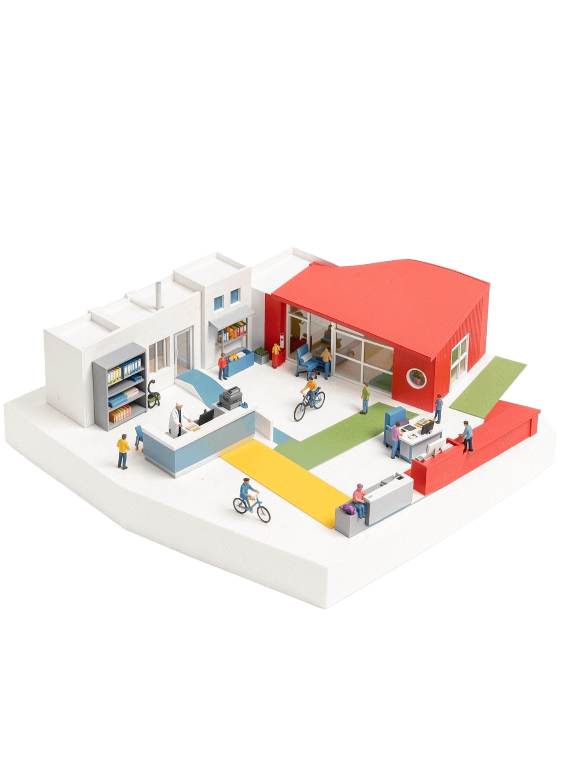




A 30-day internship became a role-based hospital platform
Full-stack web development
Focused on automating hospital operations.
Five roles
Administrator, Receptionist, Doctor, Patient, Billing Staff.
ORMATRIX capabilities
Web, software and mobile apps, UI/UX, database management, IT consulting.
Stack
HTML, CSS, JavaScript, Node.js, MongoDB, REST APIs.
Notes:
I began with a 30-day internship project and shaped it into a role-based platform for hospital operations. The project combines the capabilities of ORMATRIX with a practical full-stack stack, which leads to the workflow problem the system addresses.

Slide 3



THE NEED
Manual hospital workflows create avoidable friction
OBJECTIVES
EXISTING-SYSTEM PROBLEMS
Paper records, manual appointments and billing
No centralized data or consistent access control
Slow retrieval, weak security and limited accessibility
Digitize
Control access
Reduce friction
Replace paper-based processes with a digital platform.
Secure role-based access, patient records, scheduling and billing.
Reduce workload, errors and redundant data.
Notes:
The starting point was friction: paper records, manual appointments and billing, and no consistent access to centralized data. My objectives were to digitize these processes, secure access and reduce workload, errors and redundant data.

Slide 4








One centralized system connects every core capability
Role-based login
Patient add / update / view / delete
Doctor management
Appointment scheduling with conflict check
Automatic bill generation
Role-specific dashboards
Real-time data access
Responsive UI
AUTOMATION · ACCURACY · DATA SECURITY · SCALABILITY
Notes:
The platform brings the core capabilities into one place, from role-based login to patient management, scheduling and billing. The intended benefits are automation, accuracy, data security and scalability, all supported by real-time access and a responsive UI.

Slide 5
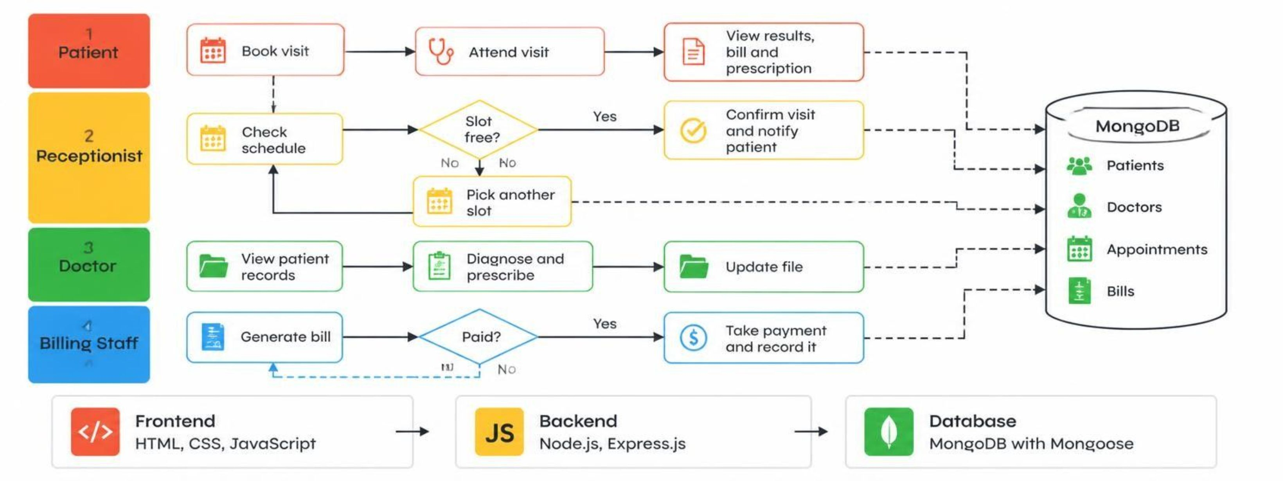
SHARED DATA FLOW
Four roles move one patient journey through shared data
Notes:
This swimlane shows how one patient journey moves through four roles while the data remains shared. MongoDB stores Patients, Doctors, Appointments and Bills, while the frontend, backend and database layers support the handoffs.

Slide 6





ACCOUNTABILITY
Role-based access turns modules into accountable workflows
Administrator
Receptionist
Doctor
Patient
Billing Staff
Manages all users and monitors the system.
Registers patients and schedules appointments.
Views history and updates diagnosis and prescriptions.
Views appointments and records.
Generates and stores bills.
01
02
03
04
05
Patient Management
Appointment Scheduling
Billing Management
Database Management
System Integration
Conflict prevention, auto-calculated charges and separate MongoDB collections support control and traceability.
Notes:
Each role has a defined responsibility, and the module flow connects those responsibilities from patient management through system integration. Conflict prevention, auto-calculated charges and separate MongoDB collections support control and traceability.

Slide 7
IMPLEMENTATION LOGIC
Four small algorithms protect the critical paths
01
02
03
04
User authentication
Appointment booking
Bill generation
Role-based access
Consultation + lab + medicine charges → total → store and display.
Credentials → validate → fetch user → compare → dashboard or “Invalid Credentials”.
Choose doctor and slot → check availability → confirm and store or “Slot Not Available”.
Retrieve role → match permissions → allow or restrict.
Express routes /login, /addPatient, /appointment and /billing · authorize(role) middleware returns 403 “Access denied” · Mongoose Patient schema.
Notes:
I implemented four focused algorithms around authentication, appointments, billing and permissions. The route structure and authorize(role) middleware connect these checks to the application, while the Mongoose Patient schema supports the stored records.

Slide 8
SAMPLE OUTPUT
Sample output shows the workflow from entry to action
SCREENSHOT PLACEHOLDER
SCREENSHOT PLACEHOLDER
SCREENSHOT PLACEHOLDER
Role Selection page
Login page
Admin Dashboard
Role-based entry point.
Secure login.
Dashboard controls.
SCREENSHOT PLACEHOLDER
SCREENSHOT PLACEHOLDER
SCREENSHOT PLACEHOLDER
Appointment Management
Doctor Management
Patient Registration
Booking and scheduling form.
Doctor profiles and management.
Patient registration form.
Notes:
These placeholders are arranged for the actual project captures: role selection, secure login, dashboard controls, appointment management, doctor management and patient registration. I will replace each panel with the corresponding screenshot while preserving the captions and workflow order.

Slide 9





VALIDATION
Testing focused on reliability at every handoff
Module-by-module testing: Authentication, registration, scheduling, billing and access control.
Performance and responsiveness: Quick responses, minimal latency and responsive dashboards.
Edge cases: Invalid logins, duplicate entries, incomplete forms and scheduling conflicts.
Result: No paperwork, fewer errors, centralized data and better administrative visibility.
Validation: Frontend and backend validation.
Notes:
I tested the system module by module and focused on the handoffs where failures could interrupt the workflow. I also checked edge cases, validation, response time and dashboard responsiveness, resulting in no paperwork, fewer errors, centralized data and better administrative visibility.

Slide 10
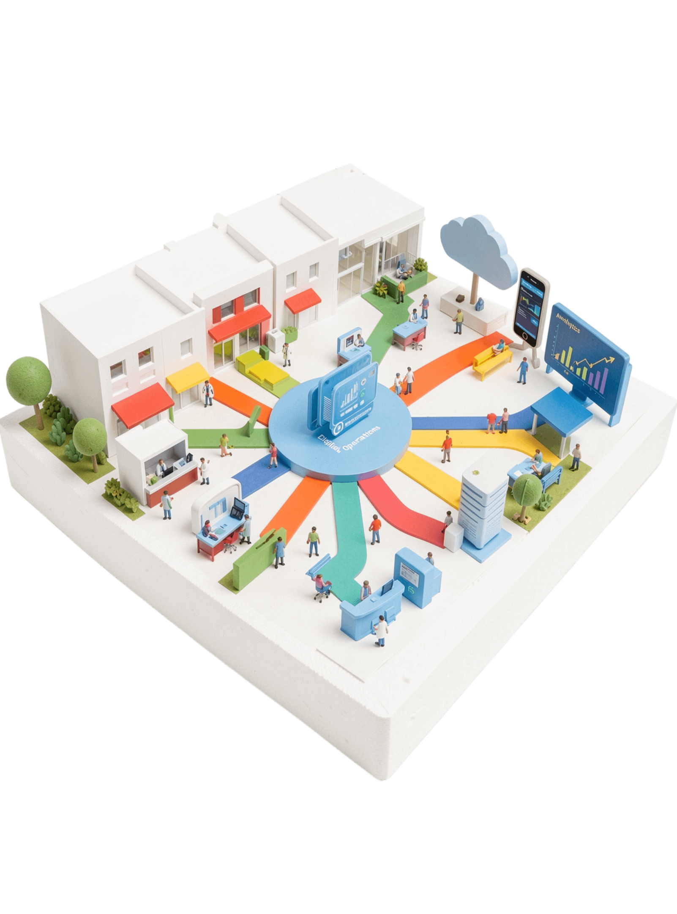
NEXT HORIZON
The platform is ready to grow beyond the internship
Conclusion: a centralized, role-based platform that reduces workload, minimizes errors and improves coordination.
Learning: full-stack development, MongoDB design, integration, debugging and testing.
JWT authentication · password encryption · mobile app · real-time notifications
Cloud deployment on AWS/Azure/GCP · medical report upload · analytics dashboards
Online payments · AI-based predictive features
Thank You
Notes:
I conclude with a centralized, role-based platform that reduces workload, minimizes errors and improves coordination, while reflecting my learning in full-stack development, MongoDB design, integration, debugging and testing. The next stage includes stronger authentication, mobile and cloud capabilities, uploads, analytics, online payments and AI-based predictive features.

