Slide 1
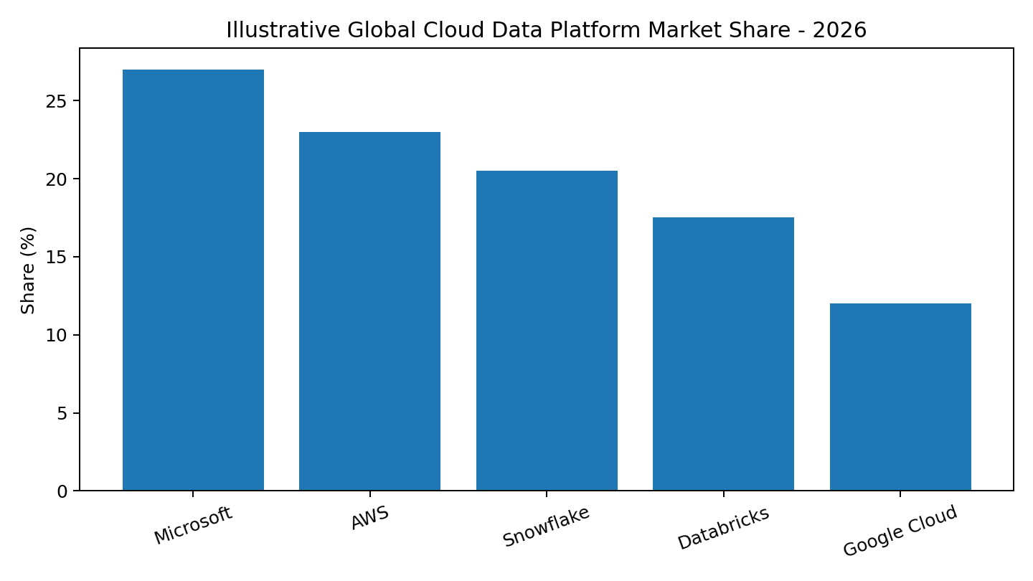
NovaTech 2026 Competitive Landscape
Illustrative market view for Enterprise Data & AI Platforms
Snowflake: governed data + native AI/search + data sharing
Databricks: engineering-led lakehouse + ML/AI flexibility
Microsoft: integrated Azure + productivity/security ecosystem
AWS: broad cloud services + infrastructure ecosystem
Google Cloud: analytics + AI innovation

Slide 2
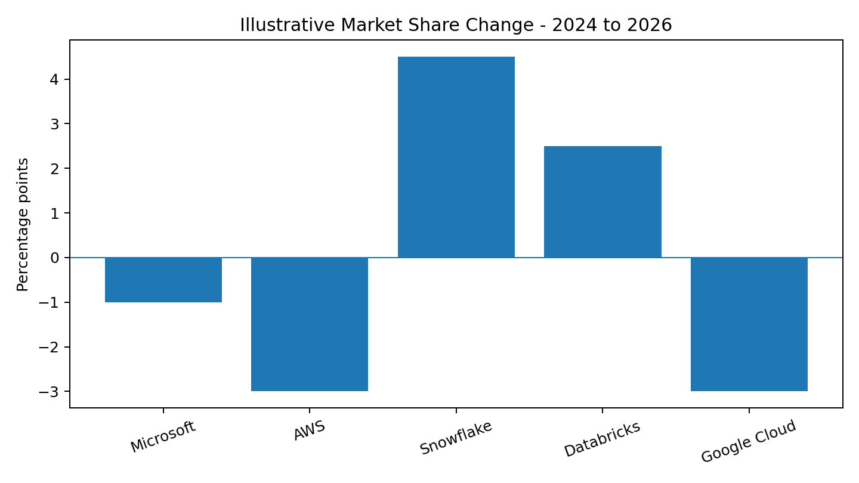
2024-2026 Share Movement
Key interpretation
Snowflake: +4.5 percentage points
Databricks: +2.5 percentage points
Microsoft: -1.0 percentage point
AWS: -3.0 percentage points
Google Cloud: -3.0 percentage points
Values are synthetic and illustrative.

Slide 3
Enterprise Buyer Decision Drivers
RAG implication
Search relevance alone is insufficient.
Authorization and freshness must shape retrieval.
Agent tools must be observable and governed.
Cross-source answers require provenance.

