Slide 1

2024 IEEE International Conference on Women in Computing (INCOWOCO) (13-15, November 2024)
Paper Title : Leveraging DenseNet features for machine learning based lung disease diagnosis from X-rays
Paper ID : WEC 1092
AUTHORS :
M Muthulakshmi
Suvetha SP
V Divya

Slide 2
Contents:
Introduction
Problem Statement
Literature Review
Dataset Overview
Model Parameters
Research Methods
Densenet Architecture
Results
Conclusion
References

Slide 3
Introduction
Lung diseases like bacterial pneumonia, COVID-19, and viral pneumonia affect millions worldwide.
Chest X-rays are widely used to detect lung issues, but manual interpretation can be inconsistent and may struggle to distinguish between diseases with similar patterns.
Deep learning models, particularly CNN architectures, have proven effective in medical image classification, improving diagnostic accuracy .

Slide 4
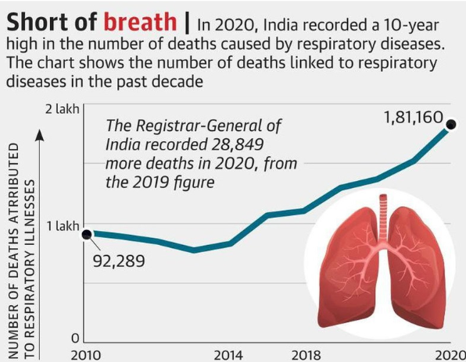
Problem Statement
In 2020, India saw a significant increase in deaths caused by respiratory diseases. This increase reached the highest level in the past ten years.
Develop a robust, automated system to accurately classify lung diseases from X-ray images, aiding healthcare professionals in diagnosing conditions like bacterial pneumonia, COVID-19, Normal and viral pneumonia, thereby improving diagnostic accuracy and efficiency.

Slide 5
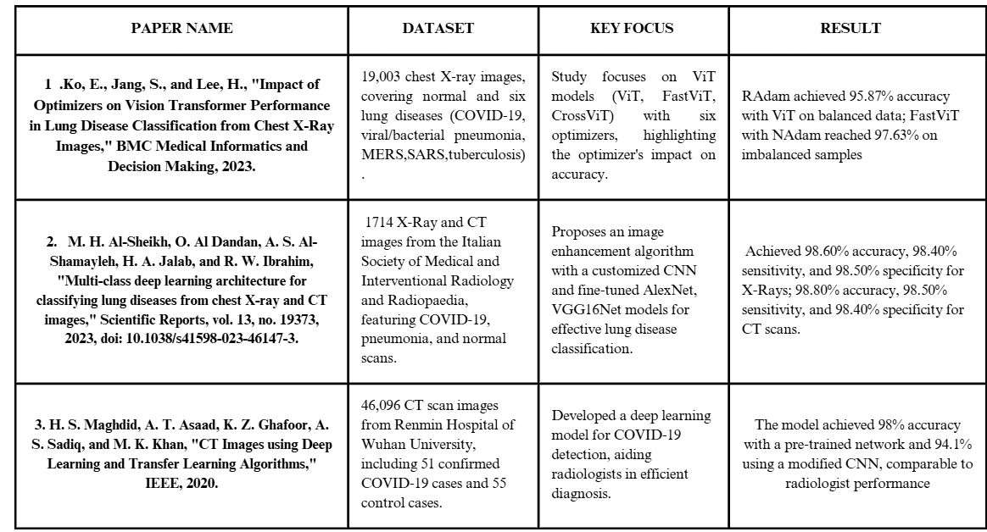
LITERATURE SURVEY

Slide 6
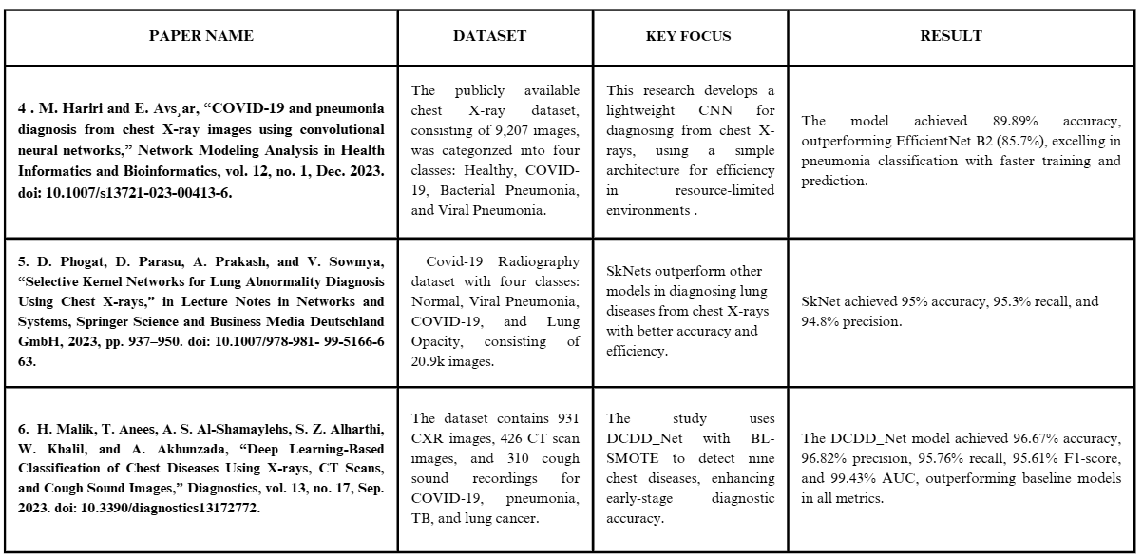

Slide 7
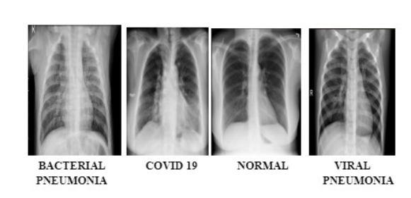
Dataset Overview
Source Name: Kaggle
Dataset Title: Lung Disease 5-Class Dataset
Total Images: 4202 chest X-ray images
Classes/Categories:
Bacterial Pneumonia: 1026 images
COVID-19: 1054 images
Normal: 1044 images
Viral Pneumonia: 1078 images
Dataset Splitting
Training Set: 80% of the dataset
Validation Set: 10% of the dataset
Testing Set: 10% of the dataset

Slide 8
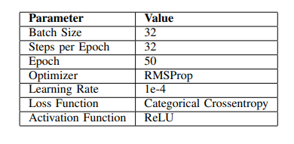
Model Parameters

Slide 9
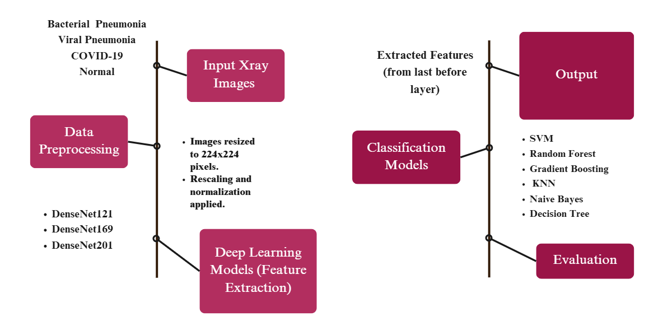
Research methods

Slide 10
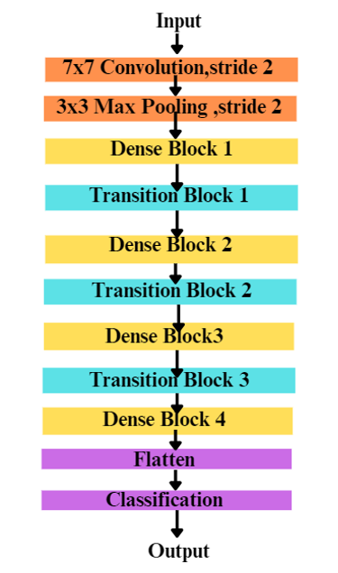
DenseNet architecture

Slide 11
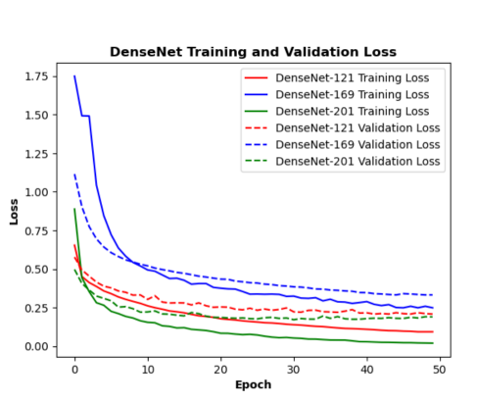
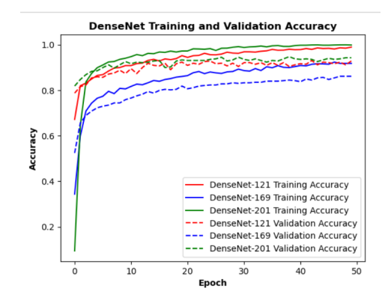
DenseNet model training and validation performance

Slide 12
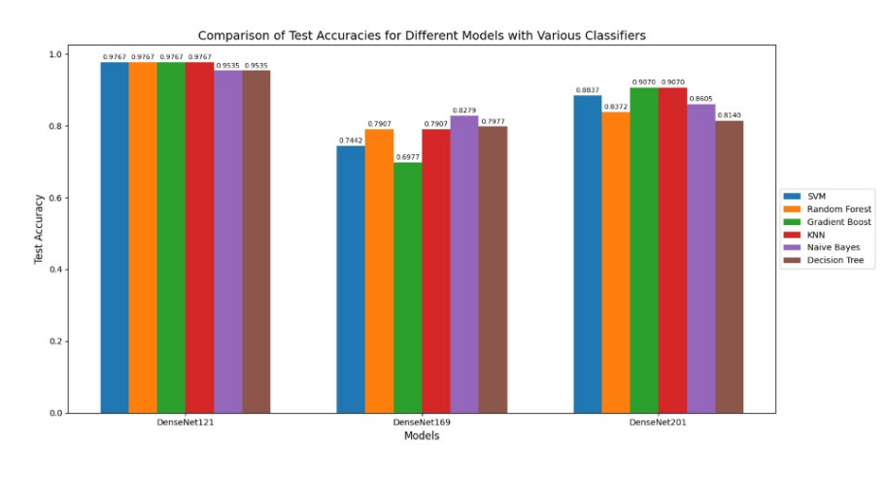
Performance evaluation of DenseNet models with various classifiers

Slide 13
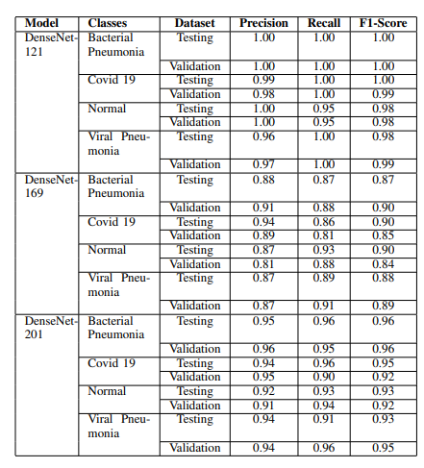
Model performance metrics across DenseNet variants​

Slide 14
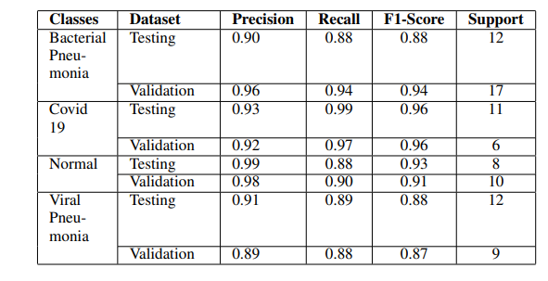
DenseNet-201 with SVM : Testing and Validation Performance

Slide 15
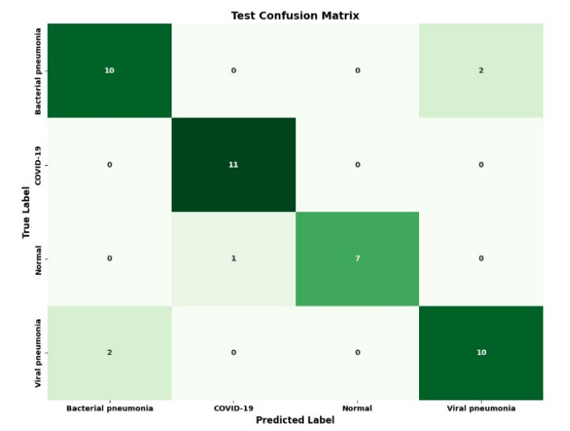
Test Confusion Matrix for DenseNet-201 with SVM

Slide 16
Conclusion
DenseNet-201 demonstrated superior performance in classifying lung diseases, achieving high accuracy and low test loss.
Combining DenseNet features with traditional classifiers like SVM, Random Forest, and Gradient Boosting improved diagnostic accuracy and efficiency.
DenseNet-121 offered a good balance between accuracy and computational efficiency for resource-constrained environments.
DenseNet-169 showed a tendency toward overfitting, highlighting the need for model selection and tuning.
Future work should explore additional deep learning architectures and hybrid models to further enhance diagnostic performance.

Slide 17
[1] J. Ko, S. Park, and H. G. Woo, "Optimization of vision transformer-based detection of lung diseases from chest X-ray images," BMC Medical Informatics and Decision Making, vol. 24, no. 1, 2024. doi: 10.1186/s12911-024-02591-3.
[2] M. H. Al-Sheikh, O. Al Dandan, A. S. Al-Shamayleh, H. A. Jalab, and R. W. Ibrahim, "Multi-class deep learning architecture for classifying lung diseases from chest X-Ray and CT images," Scientific Reports , vol. 13, no. 19373, 2023. doi: 10.1038/s41598-023-46147-3.
[3] H. S. Maghdid, A. T. Asaad, K. Z. Ghafoor, A. S. Sadiq, S. Mirjalili, and M. K. Khan, "Diagnosing COVID-19 pneumonia from x-ray and CT images using deep learning and transfer learning algorithms," in Proceedings of Multimodal Image Exploitation and Learning 2021, vol. 11734, article 117340E, Apr. 2021. doi: 10.1117/12.2588672.
[4] M. Hariri and E. Avs¸ar, “COVID-19 and pneumonia diagnosis from chest X-ray images using convolutional neural networks,” Network Modeling Analysis in Health Informatics and Bioinformatics, vol. 12, no. 1, Dec. 2023. doi: 10.1007/s13721-023-00413-6
[5] D. Phogat, D. Parasu, A. Prakash, and V. Sowmya, “Selective Kernel Networks for Lung Abnormality Diagnosis Using Chest X-rays,” in Lecture Notes in Networks and Systems, Springer Science and Business Media Deutschland GmbH, 2023, pp. 937–950. doi: 10.1007/978-981- 99-5166-6 63.
[6] H. Malik, T. Anees, A. S. Al-Shamaylehs, S. Z. Alharthi, W. Khalil, and A. Akhunzada, “Deep Learning-Based Classification of Chest Diseases Using X-rays, CT Scans, and Cough Sound Images,” Diagnostics, vol. 13, no. 17, Sep. 2023. doi: 10.3390/diagnostics13172772.
References

