Slide 1
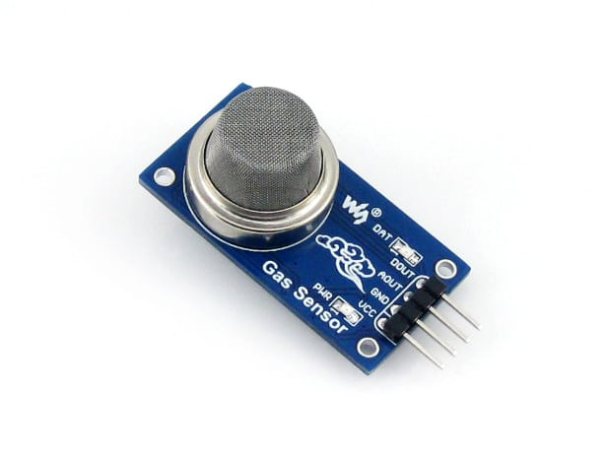
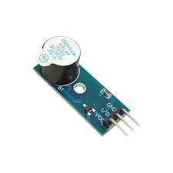
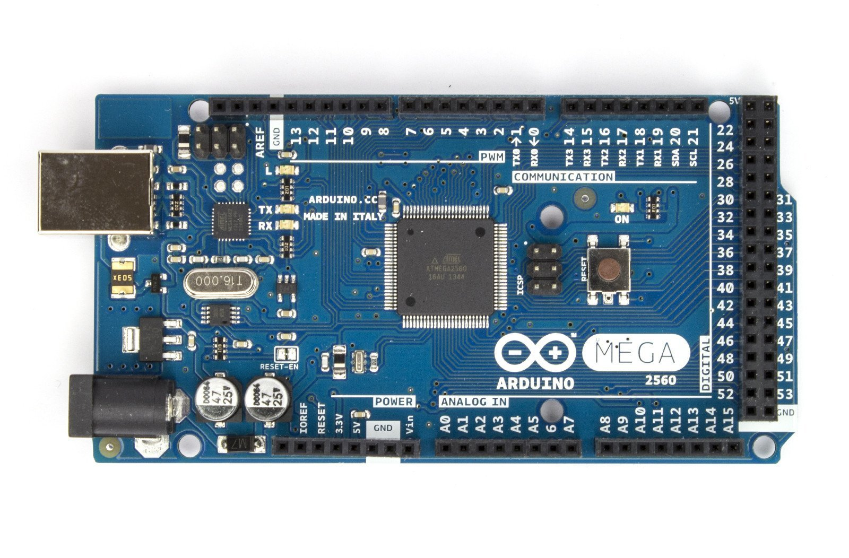
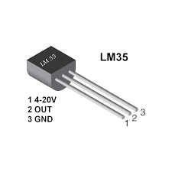
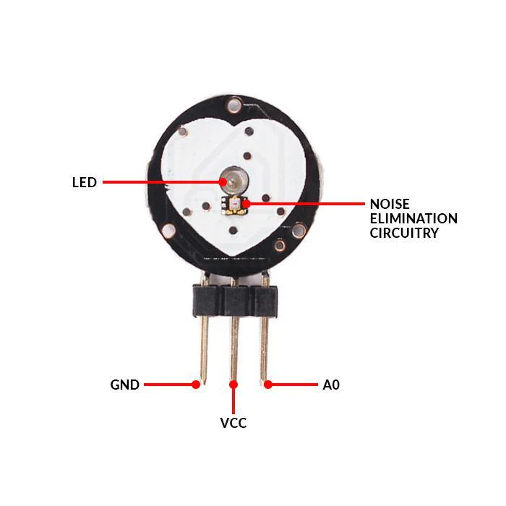
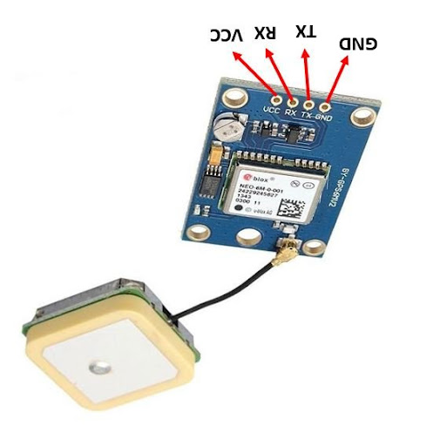
Serial Monitor
Serial Monitor

Slide 2
Pinout Description:
1.Gas Sensor
Aout –A2
Dout-5
2.Temperature Sensor
Aout-A0
3.Heart beat sensor
Aout –A1
4.GPS
Rx-3
Tx-4
5.Buzzer
I/o-8

