Slide 1


RTOS BASED -SOLDIER TRACKING AND HEALTH MONITORING SYTEM
EMBEDDED COMPUTING LAB
19CCE283
REVIEW -2
SUVETHA. SP - CH.EN.U4CCE22041
V DIVYA - CH.EN.U4CCE22045
NEESHNA LAKSHMI H - CH.EN.U4CCE22049

Slide 2



Contents
01
INTRODUCTION
02
LITERATURE SURVEY
03
COMPONENTS
04
BLOCK DIAGRAM
05
HARDWARE OUTPUTS
06
SOFTWARE OUTPUTS
07
CONCLUSION

Slide 3
LITERATURE SURVEY

Slide 4

NAME OF THE PAPER | W. Swedan, H. Al_Issa, A. Aloqoul, H. Alkofahi, and R. Obeidat, "An Interactive Graphical User Interface Module for Soldier Health and Position Tracking System," in International Journal of Electronics and Telecommunications, vol. 68, no. 3, pp. 571-575, 2022. DOI: 10.24425/ijet.2022.141276.
SUMMARY | Integrated Soldier Health Monitoring and Position Tracking: This research introduces the IGUIM, a system that combines advanced components like a GPS module, A6 GSM/GPRS Module, and various sensors. It enables precise monitoring of soldier health and accurate tracking of their positions in real-time. Unified Soldier and Monitoring Unit (SMU/MSU): The study presents a novel unit merging the Soldier Mobile Unit (SMU) and Monitoring Station Unit (MSU). This unit serves as both a frontline device and central hub, facilitating communication, emergency responses, and real-time data collection. LabVIEW-Programmed IGUIM: The paper discusses the development of a user-friendly visual interface using LabVIEW, providing effective management of communication links and displaying critical real-time soldier data. Swift Emergency Response System: In emergency scenarios, soldiers can swiftly communicate critical data to the army base by pressing a designated button on the SMU/MSU. This feature underscores the system's reliability and effectiveness, particularly in combat situations.

Slide 5
NAME OF THE PAPER | A. V. Patil, V. P. Doiphode, S. S. Bhosle, S. V. Ghadge, and A. M. Kumbhar, "Soldier Health Monitoring and Tracking System Using IoT and AES," Journal of Emerging Technologies and Innovative Research (JETIR), vol. 8, no. 6, pp. 460, 2021.
SUMMARY | The primary goal is to ensure the continuous monitoring of soldier health and real-time tracking of their locations. The model tackles the challenges like increased costs and maintenance by using budget-friendly components like biosensors, GPS NEO-6M, and the ESP8266 Wi-Fi module. The paper idenifies the challenges posed by extreme climatic conditions and presents the development of a smart army jacket to address health risks associated with temperature extremes. The smart jacket is designed to monitor health parameters and send emergency notifications via SMS. AES(Advanced Encryption Standard) is integrated into the data transmission process to safeguard sensitive information like health records and location data, ensuring confidentiality and integrity.

Slide 6
NAME OF THE PAPER | D. J, R. J, S. Raj, and Dr. P. B. D, "Soldier Health and Position Tracking System using GPS and GSM Modem," International Journal of Engineering Research & Technology (IJERT), Special Issue - 2018.
SUMMARY | This paper utilizes GPS and GSM technology for monitoring soldiers' health and precise location The system incorporates various sensors such as a pulse sensor (SEN-11574) to measure heart rate , a temperature sensor, and an oxygen level sensor to monitor environmental conditions . These sensors are part of a wireless body area sensor network (WBANS) , which enables the continuous monitoring of vital signs and environmental parameters. The GP-20U7 GPS receiver enables precise location tracking, while the GSM modem establishes communication for real-time data transmission. In the event of abnormalities in health readings, the GSM module establishes communication between soldiers and the base unit, enabling the transmission of current location and health status for prompt intervention.

Slide 7
HARDWARE AND SOFTWARE REQUIREMENTS
Hardware Components
Arduino Mega
Pulse Sensor
Temperature Sensor (LM35)
GPS Neo 6 M
Buzzer
Jumper wires
Battery(12V)
Software Components
Arduino IDE
Proteus Simulation
FreeRTOS

Slide 8
Arduino | RTOS
Code runs sequentially, line by line. | We can create multiple tasks, and each task runs independently. This allows for concurrent execution.
The main code is placed within the loop() function. The loop() function runs continuously for executing code sequentially. | In RTOS, tasks are created using xTaskCreate() and scheduled by the RTOS scheduler.
Delay functions are commonly used in the code. | In RTOS, blocking functions are avoided to allow other tasks to run. Tasks should be designed to be non-blocking.

Slide 9
RTOS IN SOLDIER HEALTH MONITORING AND POSITON TRACKING
Hard Real-Time Operating System (RTOS) will be used for Soldier health monitoring and tracking, ensuring tasks are completed within set time frames.
Employing priority-based scheduling with fixed execution times, crucial for critical systems where missing deadlines can have severe consequences.
Temperature Monitoring Task: Assigned Medium priority.
Heart Rate Monitoring Task: Assigned High priority.
GPS Tracking Task: Assigned Highest priority.

Slide 10

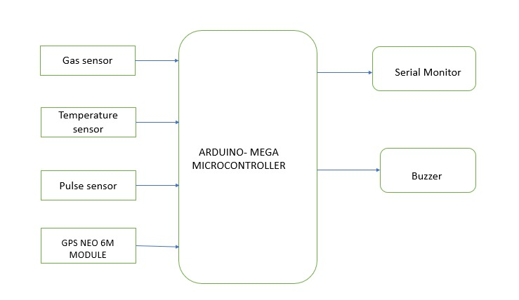
OVERALL BLOCK DIAGRAM

Slide 11
BLOCK DIAGRAM EXPLANATION
A pulse sensor to detect and monitor the soldier's heart rate.
A temperature sensor (LM35 sensor) is used to measure and monitor the soldier's body temperature.
A GPS module is used to continuously track and monitor the live location of the soldier.
The buzzer is used as an audible alert system to notify the soldier or nearby person’s regarding the critical condition of the soldier, such as abnormal heart rate or body temperature.

Slide 12
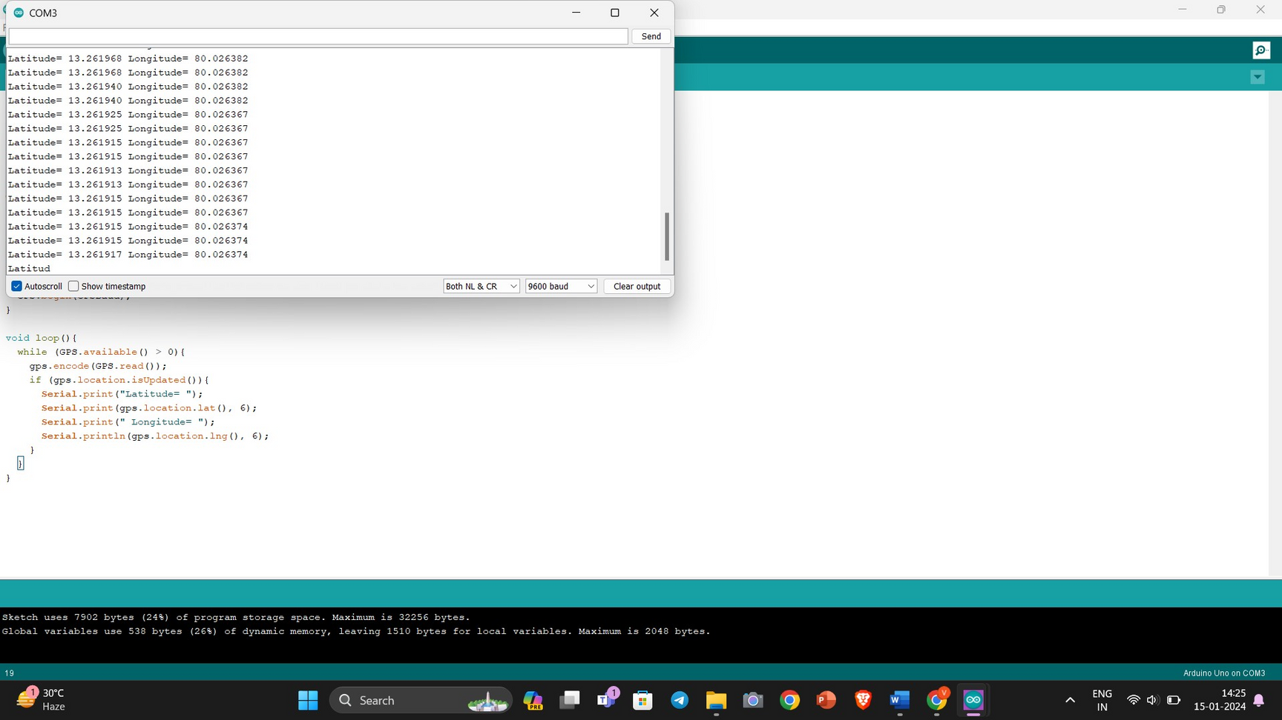
Output:

Slide 13
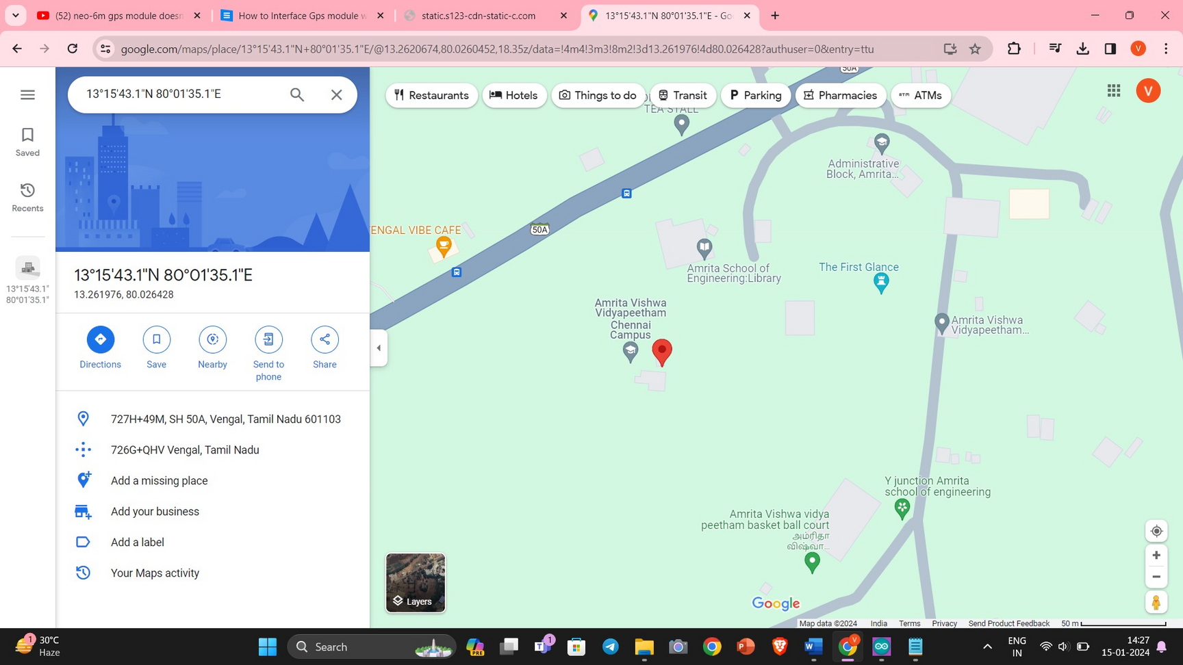

Slide 14
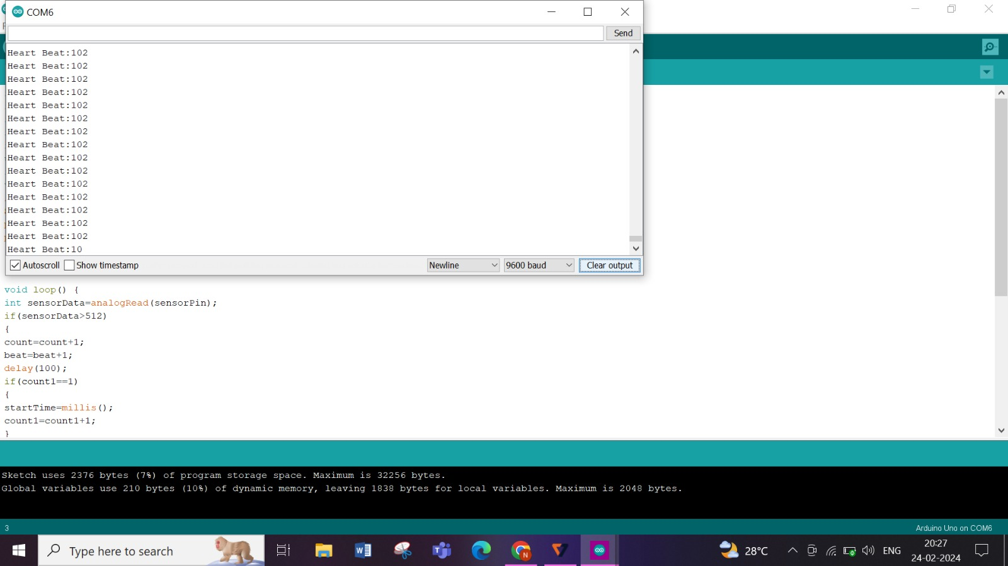

Slide 15
CONCLUSION
The Soldier Tracking and Health Monitoring System is empowered by RTOS capabilities, ensuring real-time monitoring of soldier health and location tracking.
Integration of real-time health monitoring and precise location tracking substantially enhances the safety and security of soldiers.
The GPS module plays a vital role in accurately tracking soldiers' movements, providing crucial data for informed decision-making during military operations.
The system is described as responsive and sophisticated, capable of swiftly reacting to changes in soldiers' health status or movements.
Beyond enhancing soldier safety, the system proves invaluable in critical military operations and emergency responses.

Slide 16
REFRENCES
[4] A. Padikar, C. C. K., E. Chaithra, C. Chethan, and D. N. Puneeth Kumar,"Health Monitoring and Soldier Tracking System using IoT," in NCETESFT - 2020 Conference Proceedings, Sri Siddhartha Institute of Technology, Tumakuru, India, 2020.
[5] E. Shalini, S. Priya, S. Sabitha, S. R. Shalini, and C. Shanmugam, "Soldiers Health Monitoring and Tracking System," International Journal of Research in Engineering, Science and Management, vol. 4, no. 7, pp. 194-196, July 2021.
[6] P. Kulkarni and T. Kulkarni, "Secure Health Monitoring of Soldiers with Tracking System using IoT: A Survey," Int. J. Trend Sci. Res. Dev., vol. 3, no. 4, pp. 693, May-Jun 2019. www.ijtsrd.com. e-ISSN: 2456-6470.

Slide 17
Thank You!

Slide 18
REFRENCES
[1] W. Swedan, H. Al_Issa, A. Aloqoul, H. Alkofahi, and R. Obeidat, "An Interactive Graphical User Interface Module for Soldier Health and Position Tracking System," in International Journal of Electronics and Telecommunications, vol. 68, no. 3, pp. 571-575, 2022. DOI: 10.24425/ijet.2022.141276.
[2] A. V. Patil, V. P. Doiphode, S. S. Bhosle, S. V. Ghadge, and A. M. Kumbhar, "Soldier Health Monitoring and Tracking System Using IoT and AES," Journal of Emerging Technologies and Innovative Research (JETIR), vol. 8, no. 6, pp. 460, 2021.
[3] D. J, R. J, S. Raj, and Dr. P. B. D, "Soldier Health and Position Tracking System using GPS and GSM Modem," International Journal of Engineering Research & Technology (IJERT), Special Issue - 2018.

