Slide 1
BBN Problems

Slide 2
Class work1
Storm
BusTourGroup
 | S, B | S, ¬B | ¬ S, B | ¬ S, ¬ B
C | 0.4 | 0.1 | 0.8 | 0.2
¬ C | 0.6 | 0.9 | 0.2 | 0.8
Lightning
Campfire
Thunder
ForestFire
What is the Prob for Campfire (C), Storm(S) & Bustourgroup(B) ?
Ans: P(Campfire ( C) =True | Storm(S) =true, Bustourgroup(B) =true)
= 0.4

Slide 3
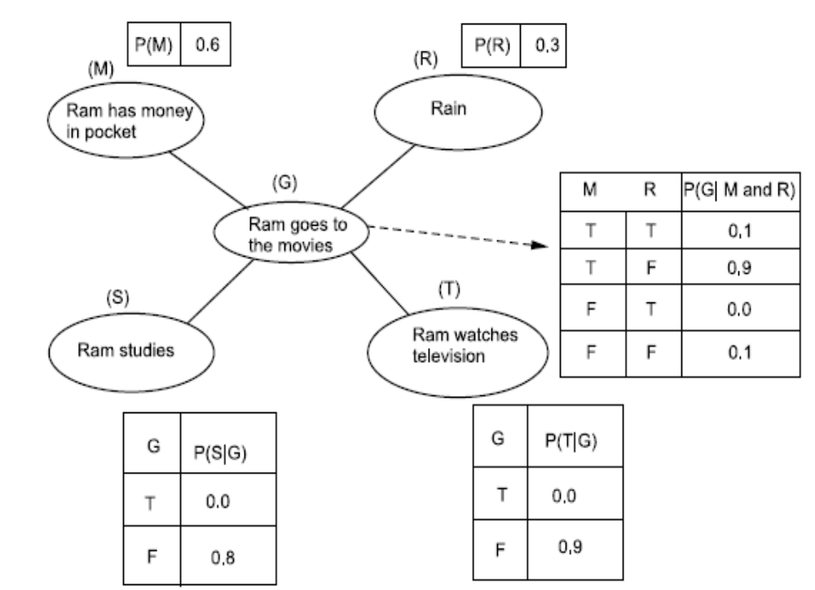

CW 2 What is the prob that it does not rain, Ram does not have money, Ram goes to watch movie, Ram does not watches TV?

Slide 4
What is the prob that it does not rain, Ram does not have money, Ram goes to watch movie, Ram does not watches TV?
P(¬R)*P(¬M)*P(G|¬R and ¬M)*P(¬T|G)
=(0.7*0.4*0.1*1.0) = 0.028

Slide 5
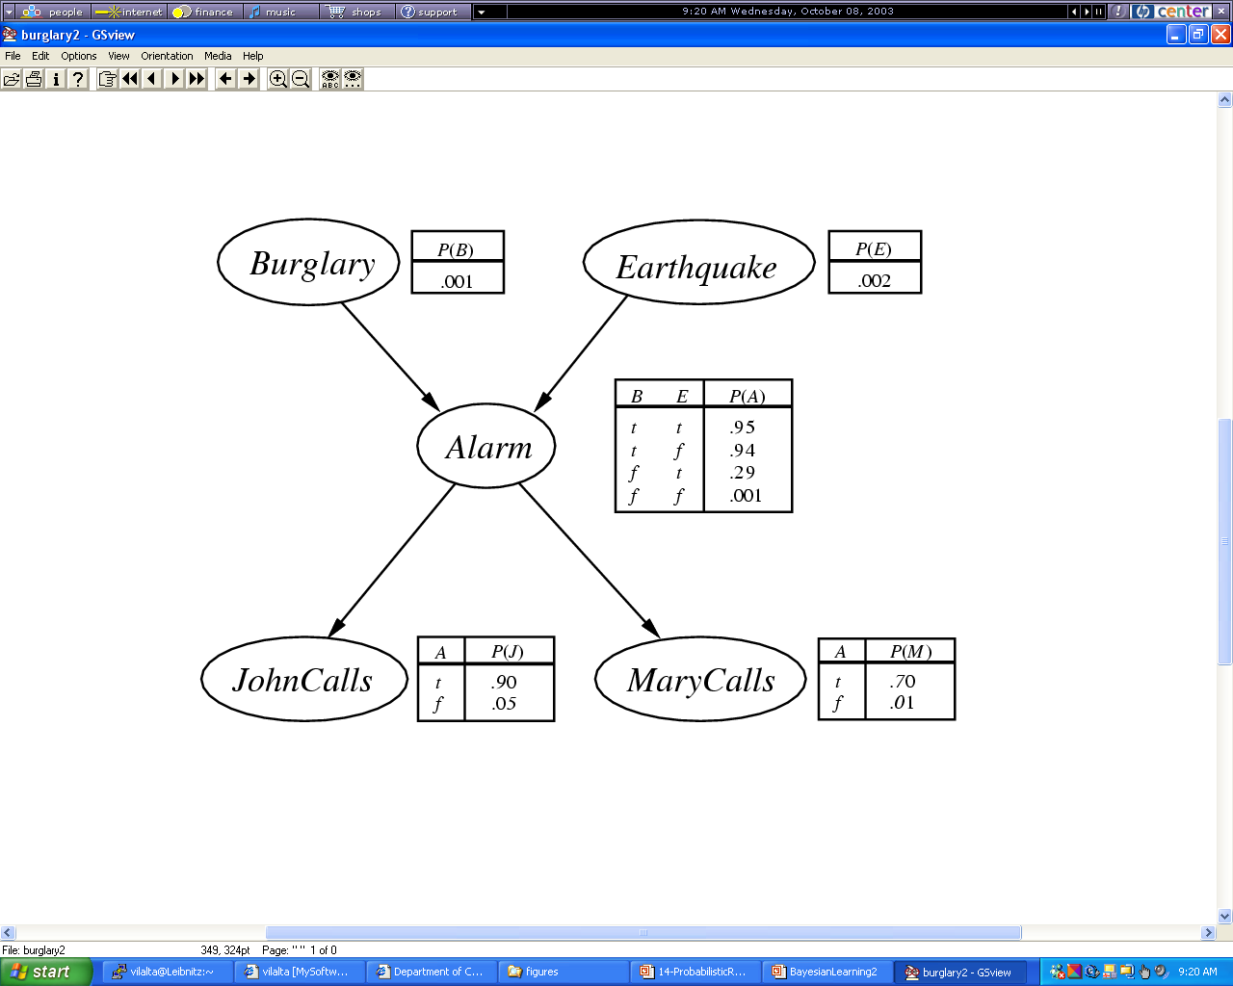
Home work1
i) What is the prob that alarm went off when earthquake occurred but burglary did not happen?
ii) P(b, e, a, ~j, m) = ?
Notes:
What is machine learning?

Slide 6
i) What is the prob that alarm went off when earthquake occurred but burglary did not happen?
P(E|A,¬B) = (P(E|¬B)*P(A|E,¬B))/P(A|¬B)
P(E|¬B) = P(E) = 0.002 (Since no relation)
P(A|¬B, E) = 0.29 (from table)
P(A|E,¬B) and P(A|¬E,¬B) weighted on P(E) and P(¬E) –Averaging it
P(A|¬B) = P(E) * P(A|¬B, E) + P(¬E) * P(A|¬B, ¬E)
=0.002*0.29 + 0.998*0.001 = 0.001578
∴ P(E|A,¬B) = (P(E|¬B)*P(A|¬B, E))/P(A|¬B)
=0.002 * 0.29 / 0.001578 = 0.3675

Slide 7
ii) P(b, e, a, ~j, m) = ?
probability of a variable only depends on its direct
successors; P(b,e,a,~j, m)
= P(b)*P(e)*P(a|b,e)*P(~j|a)*P(m|a)
=0.01*0.02*0.95*0.1*0.7

Slide 8
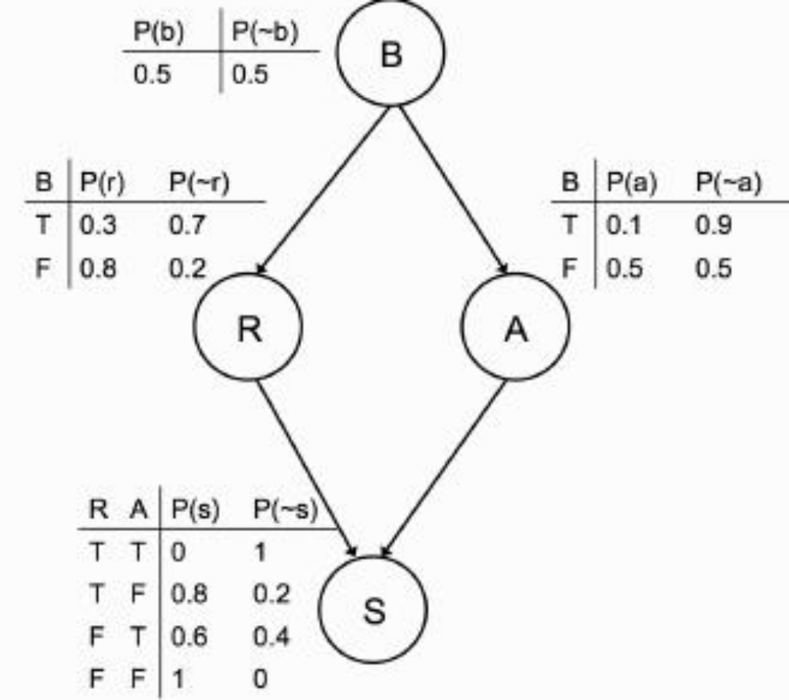
HW2: What is the prob of being scared for the exam? P(b, r, a, s) =?

Slide 9
BBN Ex

