Slide 1
Raspeberry PI3 Booting Process

Slide 2
Steps
Powe ON
GPU turns ON
GPU executes
1st BL from ROM
2nd stage BL
-> bootcode.bin
2nd stage BL
-> bootcode.bin
2nd stage BL
-> bootcode.bin
2nd stage BL
-> bootcode.bin
2nd stage BL
bootcode.bin
1st Stage BL reads the 2nd Stage BL
from SD Card & loads it into L2 Cache
And run it
3rd Stage BL
loader.bin
2nd Stage BL enables SD RAM & loads the
3rd Stage BL to RAM and run it
3rd Stage BL reads the GPU Firmware
start.elf reads system confi parameters & loads the kernel.img

Slide 3
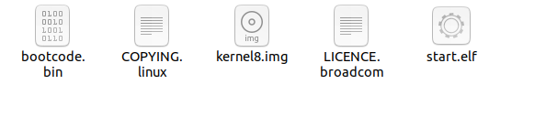
Formating a micro SD Card with BOOT Partition
Boot Partititon contains Bootloader files and kernel.img

