Slide 1
RL in Classic Platform Games: A Case Study on Dangerous Dave
Dhruvit Kothari, Suvigya Vijay, Swapnil Khare
CSE 546
April 10, 2024

Slide 2

Project Description
We address the challenge of sparse rewards and complex navigation in the platform game Dangerous Dave using reinforcement learning (RL). Inspired by RND and Go-Explore's success in Montezuma's Revenge, we aim to enhance exploration in RL within the context of dangerous dave.

Slide 3
Background: Related Works
Our project draws inspiration from the RND and Go-Explore algorithms' success in overcoming sparse rewards in Montezuma's Revenge. Both methods have set precedents for enhancing exploration in RL environments with complex navigation challenges.
https://www.uber.com/blog/go-explore/

Slide 4
Our Approach vs. Others
Unlike traditional approaches that primarily focus on reward maximization, our methodology emphasizes on solving exploration and credit assignment problem. We are planning to adapt RND and Go-Explore for Dangerous Dave, considering the game's unique challenges, which sets our approach apart.

Slide 5
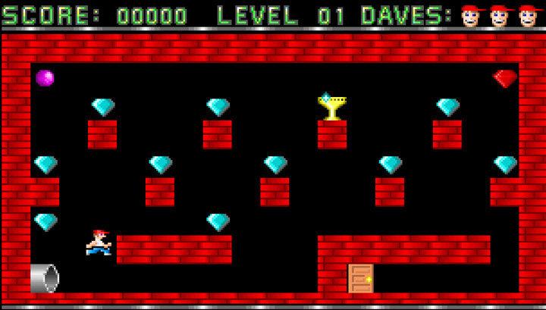
Environment
We developed a custom emulation of Level 1 of Dangerous Dave compatible with the Gymnasium interface, featuring multiple observation modalities including RGB images and text matrices of the levels. This environment accurately mirrors the game's challenges and objectives.

Slide 6
States
The states of the game can be represented by the environment's observations, which can be either images or text representations:
Image Representation (env_rep_type='image'): The observation space is defined as a 3D space representing a grayscale image of the game screen. This is a gym Box of Size (96,40,1)
Text Representation (env_rep_type='text'): The observation space is defined based on the game's map, with each element representing different entities in the game (like scenery, items, player, etc.). The observation is a array of encoded labels for each map element. This is a gym Box of Size (1,11,19)

Slide 7
Actions
The game environment's action space is defined with four discrete actions representing the player's movement directions:
Up,
Left
Right
Down.
These actions are mapped to specific keyboard keys (pygame.K_UP, pygame.K_LEFT, pygame.K_RIGHT, pygame.K_DOWN).

Slide 8
Reward Structure
Score Based: The reward is the difference between the current and previous scores. Each goal in the game has a specific reward :
Collecting trophy : 1000 score
Going to the door after collecting trophy : 1000 score
Collecting in game diamonds : 100 score
A negative reward is given (penalty) for no score change: A penalty of -1 is applied if there's no score change.
Penalty for no movement: -2, is applied if the player hasn't moved from its last position.
The reward structure is currently under active refinement and evolves based on ongoing experimental outcomes.

Slide 9
Termination or Truncation
Termination: An episode ends if the player's game ends, either by losing all lives or completing the final level.
Truncation: An episode is truncated if it reaches a certain number of timesteps (2500 in our implementation) without meeting the termination conditions. This prevents episodes from running indefinitely and helps to control the training time for learning algorithms.

Slide 10
Methods: Our Approach
Our methodology integrates a blend of RL techniques with a focus on RND and Go-Explore for exploration. We plan to adapt these algorithms to Dangerous Dave, enhancing them with reward shaping and experience replay for improved learning efficiency.

Slide 11
Alternative Approaches Considered
We considered traditional RL methods like Q-learning and DQN for benchmarking. However, their limited exploration capabilities in complex environments like Dangerous Dave led us to prioritize exploration-centric approaches.

Slide 12
Results: Baseline Model
Image based representation : DQN, PPO, A2C Models were unable to collect trophy and solve Level 1 of dangerous dave. This might be due to the sparse positive rewards
Text Based representation : PPO, A2C models were able to collect trophy but unable to reach the door position afterwards. This might be due to lack of exploration after collecting the trophy
DQN with fine tuning was able to solve the environment in a few episodes, buts it’s learned behaviour is inefficient and inconsistent. This was possible due to the high exploration forced initially.

Slide 13
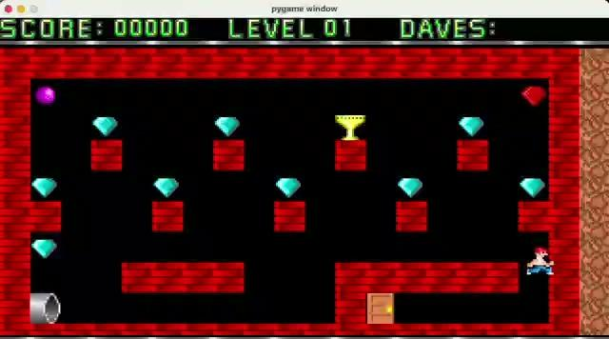
Results: Video demo
Dave collecting diamonds :
https://drive.google.com/file/d/1JUU62yGjX_Hq6qMytB-TpaVg9KwWTgQ5/view?usp=sharing

Slide 14
Results: Learning Efficiency
Over a series of 20k episodes, our RL agent demonstrated remarkable improvement in average return, showcasing the effectiveness of our exploration-centric approach. The learning curves indicated faster convergence compared to baseline methods.

Slide 15
Demo Insights
The live demo of our RL agent in action highlighted its ability to navigate the first levels with proficiency, effectively leveraging learned strategies to maximize rewards and efficiently complete levels.

Slide 16
Key Observations /Summary
To be added

Slide 17
Team Contributions
Dhruvit Kothari: Algorithm Adaptation
Suvigya Vijay: Environment Development
Swapnil Khare: Performance Evaluation and Analysis

Slide 18
References
https://www.uber.com/blog/go-explore/
Mnih, V., Kavukcuoglu, K., Silver, D., Graves, A., Antonoglou, I., Wierstra, D., & Riedmiller, M. (2013). Playing Atari with Deep Reinforcement Learning. arXiv (Cornell University). https://doi.org/10.48550/arxiv.1312.5602
Burda Y, Edwards H, Storkey A, and Klimov O (2018) Exploration by Random Network Distillation. arXiv preprint arXiv:1810.12894.
[9] Salimans T, and Chen R (2018) Learning montezuma’s revenge from a single demonstration. OpenAI Blog.

Slide 19
Thank You!

