Slide 1

SMART BUDGET TRAVEL APP USING PYTHON
Project Presentation
Submitted by
LAKSHMANAN R (23CU0320047)
SUVIN BRETTLEE ROY B (23CU0320095)
BRIAN BENTON NELSON (23CU0320017)
Under the guidance of
DR. T. SUDALAI MUTHU
in partial fulfillment for the award of the degree of
BACHELOR OF TECHNOLOGY
In
AI & DS
DEPARTMENT OF COMPUTER SCIENCE AND ENGINEERING
SCHOOL OF COMPUTING SCIENCES

Slide 2
PROJECT SUMMARY
Project Summary
• Personalized Trip Planning Helps users plan their trip based on budget, destination, dates, and preferences.
.• Smart AI Travel Agents Uses AI experts for flights, hotels, and activities to suggest the best options.
• Clean and Easy Interface Simple forms, neat layout, and soft colors make it easy to use.
• AI-Generated Itinerary Automatically creates day-wise travel plans with places to visit, stay, and explore.
• Export & Share Options Download plans as PDF or send them directly by email.

Slide 3
Introduction
✈ Introduction
🔹 AI Travel Buddy Turns your trip ideas into a full travel plan in just seconds using powerful AI.
🔹 Virtual Travel Experts Smart agents help you pick flights, hotels, and activities based on your needs.
🔹 Simple Trip Input Just enter your destination, travel dates, budget, and what you like — that’s it!
🔹 Instant Itinerary & Suggestions Get the best travel, stay, and fun ideas all in one neat travel plan.
🔹 Export & Share Easily Download your plan as a clean PDF or email it directly from the app.

Slide 4
Scope
🌍 Scope
🔹 Easy-to-Use Web App Designs travel plans based on your choices with a simple and clean interface.
🔹 AI-Based Suggestions Smart system recommends the best flights, hotels, and activities from your input.
🔹 Fast & Accurate AI Built using Groq’s LLaMA 3 model through LiteLLM for quick and smart planning.
🔹 PDF & Email Sharing Download your travel plan as a neat PDF or share it via email in one click.
🔹 Future Add-ons
➤ Multi-city trip support
➤ Live pricing updates
➤ Smarter day-wise plans
🔹 Works on All Devices Fully responsive – smooth experience on desktop, laptop, or mobile.
🔹 Data Privacy Your info is safe – secure handling of email and API data.

Slide 5
Motivation
🌟 Motivation
🔹 Trip Planning is Time-Consuming While Planning a trip involves hours of research across many websites, making it stressful.
🔹 Overwhelmed by Options Travelers struggle to compare flights, hotels, and activities while staying within their budget.
🔹 AI to Simplify the Process Artificial Intelligence can reduce the complexity of planning by offering faster, more accurate recommendations.
🔹 Project Goal Create a smart, interactive travel planner that generates customized itineraries based on user preferences.
🔹 Smart Travel Suggestions Uses advanced language models like Groq’s LLaMA 3 via LiteLLM for quick, personalized travel advice.

Slide 6
Proposed Method
🚀 Proposed Method
🔹 Web App The app will be built using Streamlit for a clean, responsive, and user-friendly design.
🔹 User Input FormUsers enter essential details like origin, destination, travel dates, budget, and preferences.
🔹 AI Travel AgentsFlight Specialist: Suggests the best flights.Accommodation Expert: Recommends ideal hotels.Activity Planner: Plans exciting activities.Each agent handles a different part of the travel plan.
🔹 Smart AI ModelUses LiteLLM with Groq’s LLaMA 3 to create personalized travel plans in seconds.
🔹 PDF Export & EmailUsers can easily download their itinerary as a PDF or send it via email directly from the app.

Slide 7
Module description
🧳 Module Description
🔹 User Interface Built with Streamlit for a responsive, interactive design Collects user travel details Displays results in a clear, engaging way
🔹AI Agent System
Flight Specialist: Finds the best flights
Accommodation Expert: Suggests top hotels
Activity Planner: Plans exciting things to do
🔹 LLM Integration Powered by Groq’s LLaMA 3 model via LiteLLM Delivers fast, accurate travel suggestions
🔹PDF Export Converts the itinerary into a neat, downloadable PDF
🔹Email Sharing Sends travel plans via email using SMTP
🔹 Session History Stores recent travel plans for quick access
🔹Configuration Module Manages API keys and user email settings securely

Slide 8
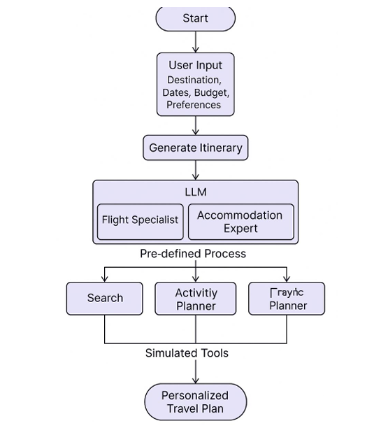
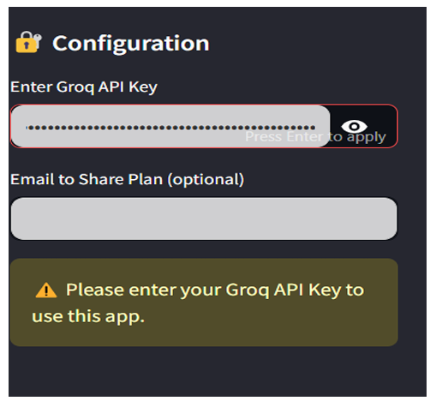
Sample Screenshots
ARCHITECTURE DIAGRAM

Slide 9
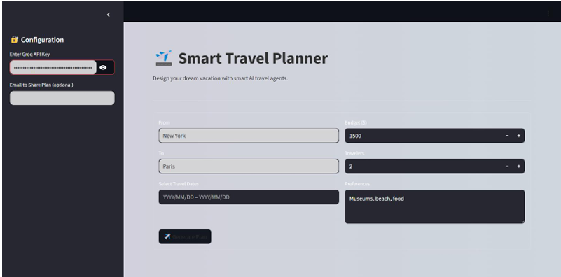

Slide 10
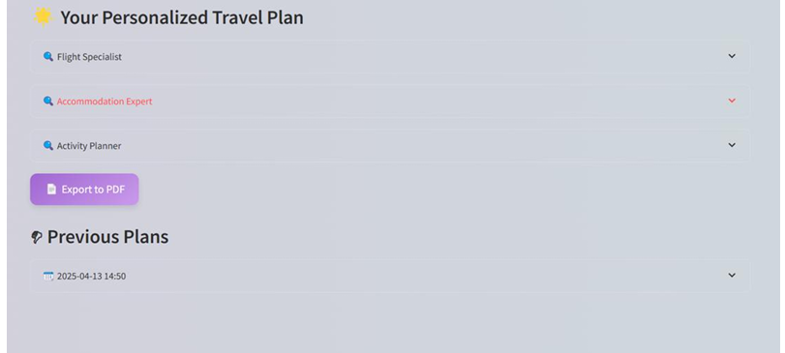

Slide 11
Testing and Evaluation
🧪 Testing and Evaluation
🔹Feature Testing Test all core functionalities:
➤ Ensure user input forms work as expected.
➤ Verify AI suggestions (flights, hotels, activities) are accurate.
➤ Check PDF export and email sharing features for smooth operation.
🔹 User Experience Testing :
Collect user feedback to ensure the app is intuitive and easy to navigate.
🔹Speed and Performance :
Measure the response time of the AI model to ensure quick and efficient travel plan generation.
Evaluate the overall performance, ensuring there are no lags or delays in the app.
🔹Data Security Test how securely the app handles sensitive data (API keys, user emails).
🔹Device Compatibility Test :
The app’s responsiveness and functionality across multiple devices (smartphones, tablets, desktops).
Ensure that the design adapts well to different screen sizes for a seamless experience.

Slide 12
Individual Team Members Contribution
LAKSHMANAN R:(AI & Backend Integration ) - Connected Groq's LLaMA 3 API- Built Agent & Tool classes for task distribution- Implemented multi-agent travel planning logic.
SUVIN BRETTLEE ROY B: (Features & Functionality ) - Developed PDF export functionality- Created trip history tracking- Added preferences, budget input, and form logic.
BRAIN BENTON NELSON: (Deployment & Testing ) - Handled deployment on Render- Fixed module errors and setup issues- Performed functionality and usability testing.

Slide 13
REFERNECE
OpenAI. (2023). GPT-4 Technical Report. https://openai.com/research/gpt-4
Hugging Face. (2024). LLaMA 3 Model Documentation. https://huggingface.co/meta-llama
Streamlit Inc. (2023). Streamlit Documentation. https://docs.streamlit.io
LiteLLM. (2024). LiteLLM: Unified API for LLMs. https://github.com/BerriAI/litellm
FPDF. (2022). FPDF for Python: PDF generation library. https://pyfpdf.github.io/fpdf2/

Slide 14


