Slide 1
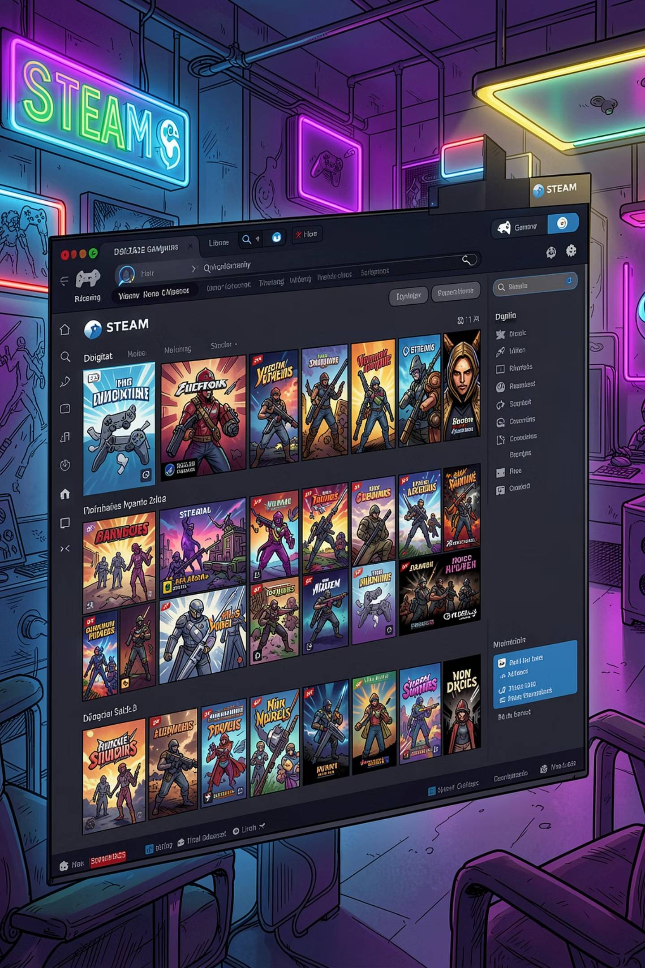
Steam ETL Pipeline
An end-to-end data engineering project — from live web scraping to business insights — powered by Python, MongoDB Atlas, and automated CLI control.
DATA ENGINEERING
ETL ARCHITECTURE

Slide 2
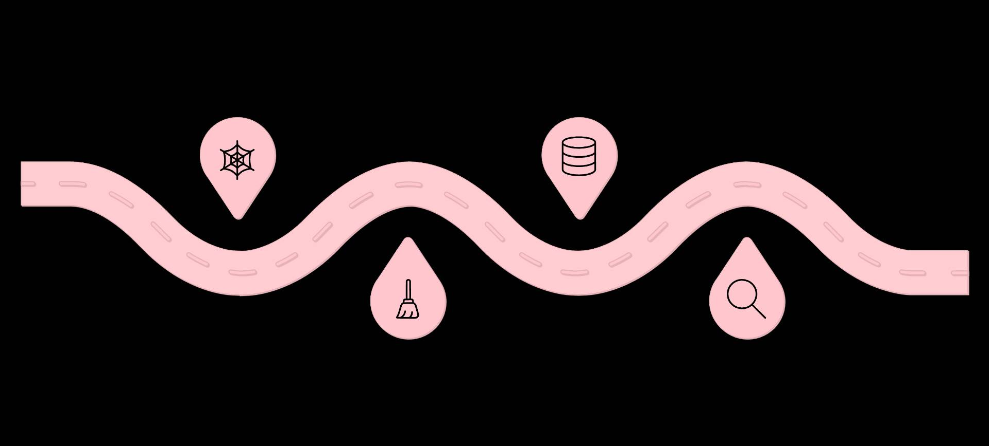

The Full Pipeline at a Glance
Seven discrete stages take raw Steam Store pages and transform them into actionable business intelligence. Each stage is modular, automated, and designed for reuse.
Scraping
Storage
Extract raw HTML from Steam store pages
Persist cleaned data to MongoDB
Cleaning
Retrieval
Normalize, dedupe, and validate records
Query datasets for downstream use and visualization
Think of this as a factory line — raw HTML goes in one end, and polished insights come out the other. Every step has a single responsibility, making the system easy to debug, extend, and rerun on demand.

Slide 3


Step 1: Web Scraping
The pipeline kicks off with automated, real-time data collection directly from the live Steam Store.
HTTP Requests via requests
Each call targets Steam's search endpoint. The start parameter handles pagination, pulling 50 games per page across multiple pages for large-scale coverage.
Parsing with BeautifulSoup
HTML is parsed to extract structured fields: Title, Price, Discount, Release Date, and Platform support. Results are stored as a clean list of dictionaries.
Key Idea: No manual downloads. The scraper runs on demand, always pulling the freshest data directly from Steam.

Slide 4
Step 2: Data Cleaning & Transformation
Raw scraped data is rarely analysis-ready. This stage uses pandas to normalize, repair, and enrich the dataset before it touches the database.
Type Conversion
Missing Value Handling
Price strings like "$19.99" are cast to floats. Discount strings become integer percentages. Inconsistent formats are unified.
Free-to-play games often have no price field. Null values are explicitly handled to prevent downstream errors in aggregations.
Feature Engineering
Deduplication
A new game_type column is derived — classifying each title as Free or Paid — enabling cleaner segmentation in analytics.
Duplicate records introduced by overlapping scrape runs are detected and dropped, ensuring data integrity before storage.

Slide 5


Step 3: Data Storage — MongoDB Atlas
Cleaned records are persisted in MongoDB Atlas, a fully managed cloud database. Two key design decisions ensure reliability and scalability.
Bulk Upsert Operations
Unique Index on Title
Rather than inserting blindly, each write operation checks for an existing record first. If found, it updates in place. If not, it inserts. This makes reruns safe and idempotent.
MongoDB enforces a unique constraint on the game title field at the database level — a second line of defense against duplicate data creeping into the collection over time.
Key Idea: MongoDB is the single source of truth. Scalable, persistent, and cloud-accessible from anywhere.

Slide 6



Step 4: Data Retrieval
Once data lives in MongoDB, there's no need to re-scrape Steam on every run. The retrieval layer loads records directly from the database — dramatically faster and less brittle than hitting a live website repeatedly.
Primary: MongoDB Query
Fallback: CSV Backup
Data is fetched directly from the Atlas collection using a simple find query and loaded into a pandas DataFrame for downstream processing.
If the MongoDB collection is empty — for example, during a first run or a connectivity issue — the system gracefully falls back to a local CSV export.
Key Idea: Efficient data reuse. Scrape once, analyze many times.

Slide 7
Step 5: Business Analytics
With clean, structured data in memory, the analytics layer surfaces the insights that actually matter to stakeholders. All analysis is performed using pandas aggregations on the loaded DataFrame.
💰 Pricing
🆓 Free vs. Paid
Average game price across the catalog. Most expensive titles ranked by price.
Distribution split between free-to-play and paid titles. Share of each segment.
🏷️ Discounts
🎮 Platforms
Highest discount percentages in the dataset. Identifying best-value deals on Steam.
Popularity breakdown across Windows, Mac, and Linux. Cross-platform coverage rates.

Slide 8

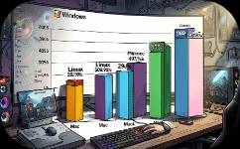
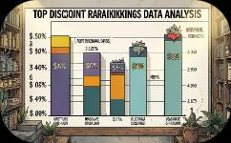
Step 6: Data Visualization
Numbers in a table tell a story — charts make that story undeniable. This stage uses Matplotlib and Seaborn to render the analytics output into publication-ready visuals.
Free vs. Paid — Pie Chart
Platform Distribution — Bar Chart
Top Discounts & Expensive Games
Instantly shows the market share split between free-to-play and paid titles in the scraped catalog.
Visualizes how game support is distributed across Windows, Mac, and Linux platforms.
Ranked charts highlighting the steepest discounts and highest-priced titles — ideal for deal-hunting analysis.

Slide 9


Step 7: CLI Control — main.py
The entire pipeline is orchestrated through a single entry point: main.py. Command-line arguments give operators precise control over what runs, when, and at what scale — without touching the source code.
--refresh
1
Triggers a fresh scrape from Steam. Use this to update the dataset with the latest prices, discounts, and newly released titles.
--export-csv
2
Saves the current MongoDB collection to a local CSV file. Acts as a portable backup and enables offline analysis.
--max-pages
3
Controls how many Steam search pages to scrape. Set low for quick tests, high for production-scale data collection.
Key Idea: One command runs everything. The pipeline is fully reusable, configurable, and CI/CD friendly.

Slide 10
The One-Line Story
Scrape → Clean → Store → Load → Analyze → Visualize
Six verbs. Seven steps. One automated pipeline that turns a live gaming marketplace into structured business intelligence — on demand, at scale, with a single CLI command.
🌐 Data Source
🛠️ Core Stack
Steam Store (live)
Python · pandas · BeautifulSoup · MongoDB Atlas
📊 Output
⚙️ Control
Charts · Analytics · CSV Exports
CLI arguments via main.py

