Slide 1

Face Recognition using Facenet
and Deepface
AA521 Final Project Presentation
Mohammad Alkhawaldeh, Narendra Fadnavis, Subhabrata Ganguli
(Group 2)
University of San Diego
09 Dec 2024

Slide 2
Overview
Introduction
Data Preprocessing and EDA
Face Verification
Face Identification

Slide 3
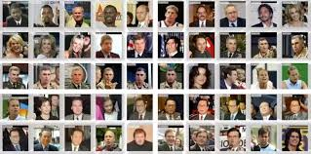
Introduction
Significance of Facial Recognition
Pivotal technology in modern computer vision.
Widely used in security, authentication, and social networking platforms.
Project Objective
Develop and evaluate a face recognition system using FaceNet and DeepFace models.
Compare model performances on the Labeled Faces in the Wild (LFW) dataset.
About the LFW Dataset
Hosted by the University of Massachusetts Amherst.
Contains 13,233 images of 5,749 individuals
Features:
Unconstrained conditions (pose, lighting variations).
Pre-processed and centered images for consistency.
Ideal for benchmarking facial recognition systems.

Slide 4
Data Preprocessing and EDA
The Labeled Faces in the Wild (LFW) dataset was utilized to evaluate FaceNet and DeepFace models for face recognition.
Dataset Overview:
Total images: 13,233
Unique individuals: 5,749
Benchmark dataset for facial recognition under real-world, unconstrained conditions.
EDA Purpose:
Understand the dataset structure, image quality, and class distribution.
Detect potential issues like duplicates or imbalances.

Slide 5
Data Preprocessing Overview
Dataset Handling:
Extracted LFW dataset into subfolders, each representing a unique individual.
Dataset location: /content/drive/MyDrive/AAI521_FinalProject/lfw/lfw-deepfunneled.
Image Preprocessing:
Resized images to 160×160 pixels (required by FaceNet).
Converted to RGB format to ensure compatibility with FaceNet and DeepFace.
Dataset Conversion:
Stored images and corresponding labels as NumPy arrays for efficient handling during training.
Enabled structured and memory-efficient access to the dataset.
Classes with fewer than two images were removed.
Data Saving and Loading:
Saved processed data using the pickle module, avoiding redundant preprocessing in future experiments.
Ensured fast and consistent loading of images and labels for modeling workflows.

Slide 6
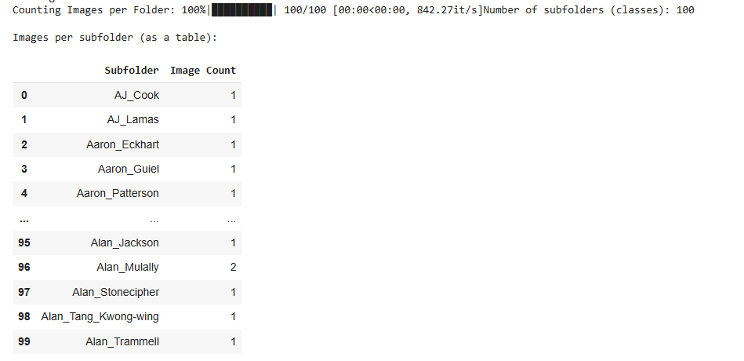

Exploratory Data Analysis (EDA)
EDA was conducted to gain insights into the dataset and prepare it for embedding extraction and model training.
Folder Structure Summary - dataset consists of 100 subfolders (classes) in the processed subset
Image Size Analysis - Confirmed all images were uniform in size (250×250 pixels).

Slide 7
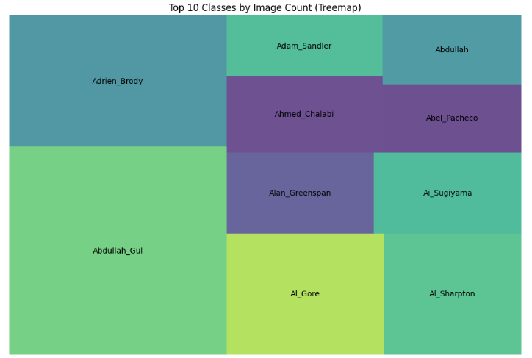
Exploratory Data Analysis (EDA)
Treemap for Top-N Classes - Visualized the top 10 classes with the highest number of images, highlighting dataset imbalance.
Notes:
Image Quality Assessment: -Assessed sharpness using Laplacian variance; most images exceeded the acceptable threshold.

Slide 8
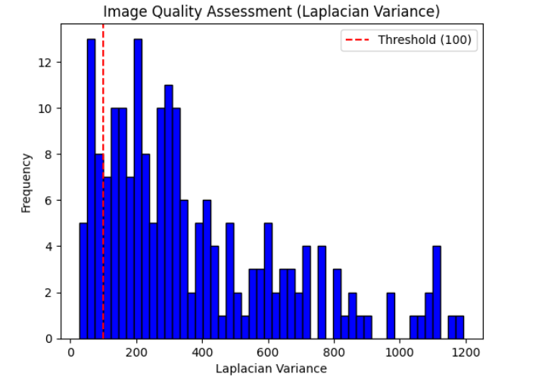
Exploratory Data Analysis (EDA)
Image Quality Assessment - Images were analyzed using the Laplacian variance method to assess sharpness and detect blurry images.
Duplicate Detection:
Duplicate images were identified using MD5 hash comparisons.
Data Filtering and Splitting Classes with fewer than 2 images were removed
filtered dataset was split into training (80%) and testing (20%) sets using stratified sampling
Notes:
Histogram of Laplacian variance with a threshold line indicating acceptable sharpness.
Total valid images: 162
Total valid labels: 162
Training set size: 129 images, 129 labels
Testing set size: 33 images, 33 labels
histogram of Laplacian variance with a threshold line indicating acceptable sharpness. Total valid images: 162
Total valid labels: 162
Training set size: 129 images, 129 labels
Testing set size: 33 images, 33 labels

Slide 9
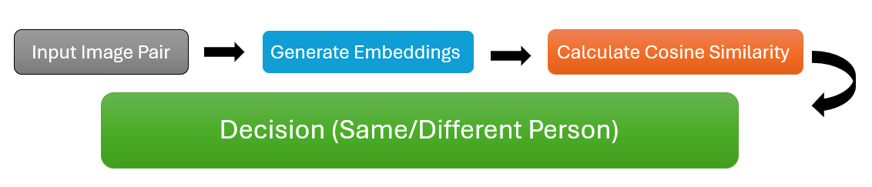
Face Verification
Goal:
Verify if two face embeddings represent the same person.
How:
Generate embeddings using pre-trained FaceNet and DeepFace models.
Compare embeddings using cosine similarity.
Threshold decides if it's a match (e.g., 0.6 for FaceNet, 0.5 for DeepFace).

Slide 10
Methodology:
Randomly paired images tested.
Cosine similarity calculated using verify_faces.
Threshold determines “Same Person” or “Different Person.”
Results:
FaceNet: High accuracy in matching identities.
DeepFace: With many tests, it’s slightly less accurate but still very effective.

Slide 11
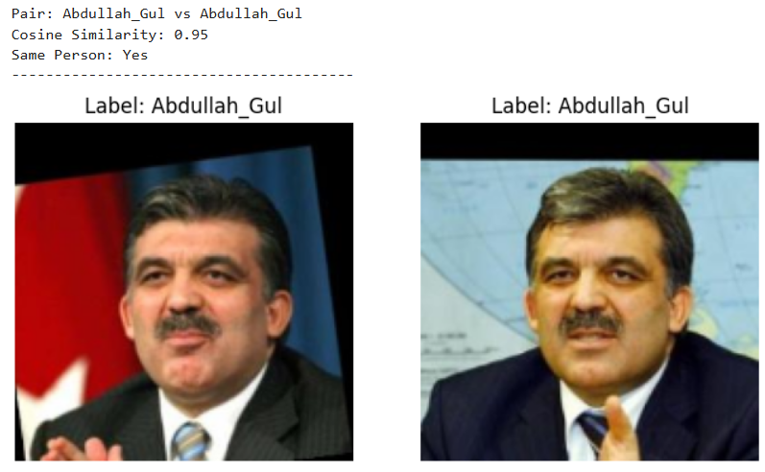
Matching Example

Slide 12
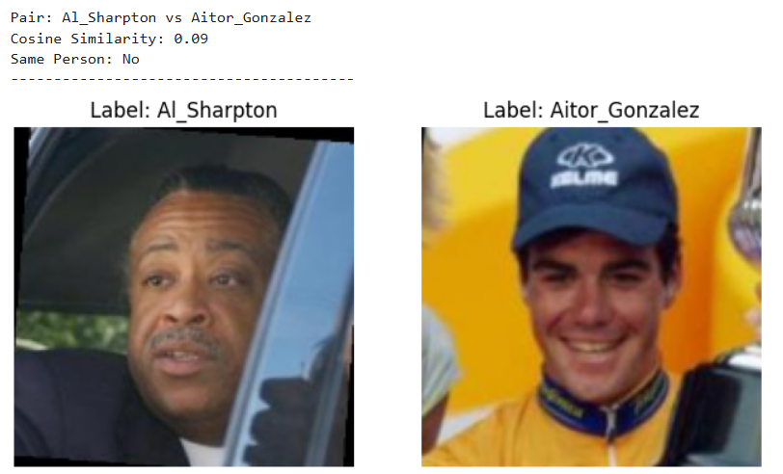
None-Matching Example

Slide 13
Key Findings from Face Verification
Strengths:
Robust and highly accurate, Always achieving success rates above 80% in our tests.
Cosine similarity effectively separates matches vs. mismatches.
Future Directions:
Explore advanced embedding techniques or ensemble methods.
Test on larger datasets for better generalization.

Slide 14
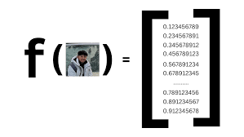
Face Identification using Deep Learning
Goals:
Evaluate the effectiveness of face embeddings on face identification tasks.
Analyze the impact of image resolution on classification accuracy.
Face embeddings:
High-dimensional numerical representations of facial images generated by deep learning models.
Encode the unique features and characteristics of a face, such as the shape, texture, and structure, into a compact vector (e.g., 128-dimensional)
Embedding models: Facenet (Schroff, 2015) and VGG-Face (Parkhi, 2015).

Slide 15
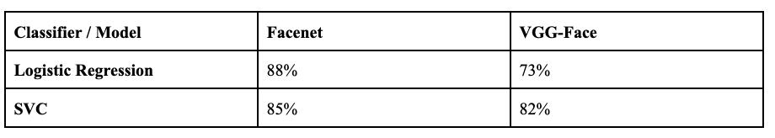
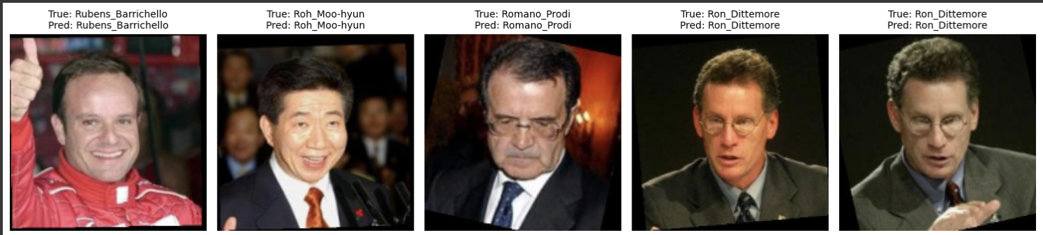
Classification Models
Key Observations:
Facenet:
High accuracy with Logistic Regression
Effective for both linear and non-linear classifiers.
VGG-Face:
Strong performance with non-linear SVC.
Weaker with Logistic Regression due to limited linear separability.
Image Data: Split 80%-20% as training and test data
Classification Methods: Logistic Regression and SVC.
Classification Accuracy

Slide 16
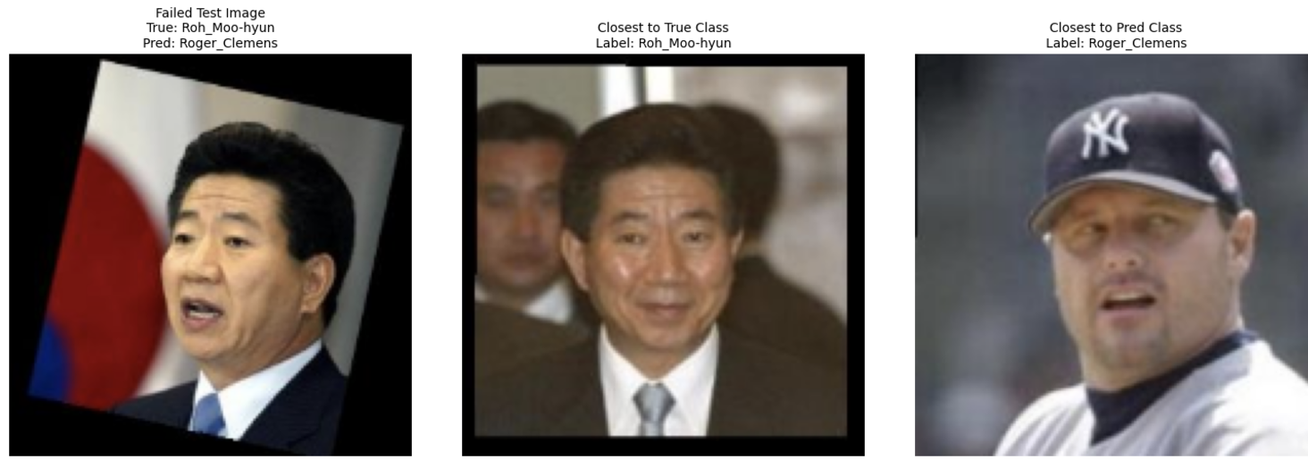
Failure Analysis and Effect of Resolution
Failure Case
Example: True Label: "Roh Mun Hyun"; Misclassified as: "Roger Clemens".
Cosine Distances:
True Class: 0.5318.
Predicted Class: 0.2379.
Cause: Pose and inclination similarity
Image Resolution
Simulated low-resolution image (scaled down by factor of 2) created using OpenCV’s bilinear interpolation (INTER_LINEAR)
Low-resolution images were upscaled back to their original resolution using PIL's LANCZOS filter
Classification Accuracy with Logistic Regression:
88% with original images
85% with low resolution images
Alternatives for image enhancement: SRCNN, EDSR, SRGAN
Predicted Match
Test Image
True Match

Slide 17
Teamwork
Narendra Fadnavis
Data Preprocessing and EDA
Report and Presentation
Mohammad Alkhawaldeh
Face Verification
Report and Presentation
Suvo Ganguli (Team Lead)
Face Identification
Report and Presentation

