Slide 1

Hospital Readmission Prediction System
AAI-540: Machine Learning Operations
University of San Diego
Team 2 : Muhammad Haris, Suvo Ganguli, Daniel Shifrin

Slide 2
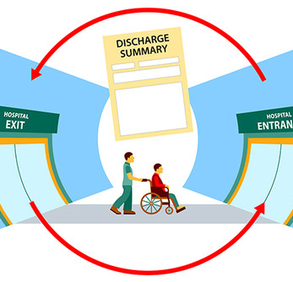
Business Use Case & Problem
Hospital readmissions are costly and indicative of care quality issues. Our goal is to predict high-risk patients using machine learning, enabling early interventions, better outcomes, and reduced costs.

Slide 3

Dataset Overview
Dataset: Diabetes 130-US hospitals dataset
100K+ de-identified patient encounters
Features: demographics, diagnosis, treatment codes, discharge info
Target: 30-day readmission (binary classification)

Slide 4

Solution Overview
Developed a hospital readmission prediction system using the UCI Diabetes dataset.
Phase 1: Model Design → Logistic Regression selected (out of 4 models)
Phase 2: SageMaker pipeline built for: - Data ingestion - Feature engineering - Model training and evaluation - Batch inference - Simulated CI/CD & bias monitoring

Slide 5
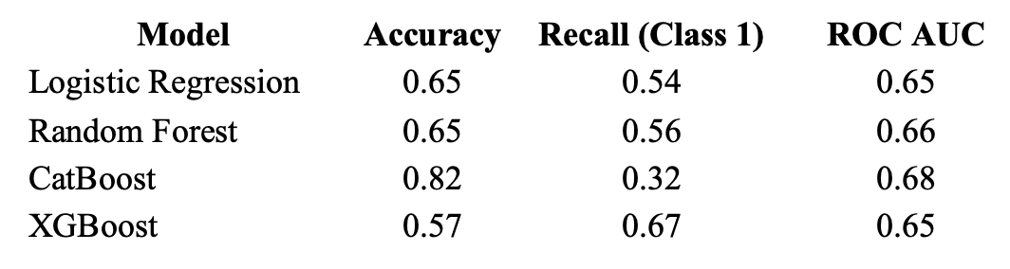
Phase 1: Model Selection
Model comparison and rationale for final selection
Selected Model: Logistic Regression - Chosen for its balance of recall, transparency, and ease of deployment - Well-suited for healthcare, where interpretability is critical
Backup Model: Random Forest - Slightly higher recall - Reduced interpretability — kept as fallback
Excluded Models: - CatBoost: High accuracy, but low recall — misses too many at-risk patients - XGBoost: Highest recall, but low accuracy — too many false positives for clinical use

Slide 6
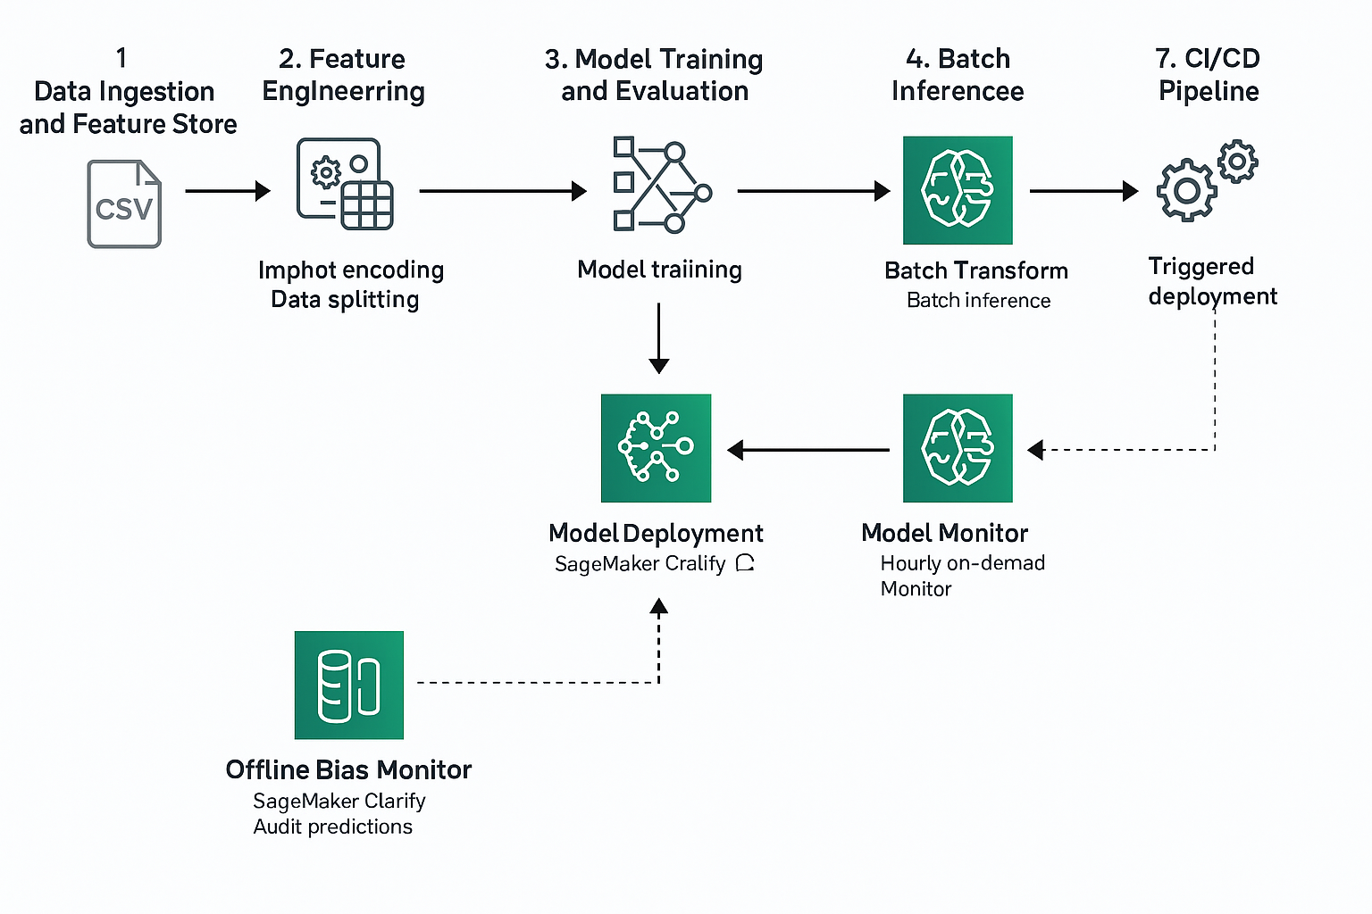
Phase 2: System Architecture
1. Data Ingestion
and Feature Store
2. Feature Engineering
and Data Preparation
3. Model Training
4. Model Evaluation
6. Batch Inference
7. CI/CD
Pipeline
Oneshot Encoding
Data Splitting
Model Training
Batch Transform
Model Deployment
5. Model Monitor
Hourly
On Demand
Offline Bias Monitor
SageMaker Clarify
Audit predictions

Slide 7

Feature Store & Engineering
Ingested cleaned data into SageMaker Feature Store (online & offline modes)
Queried features using Athena for consistency and versioning
Applied preprocessing: missing value handling, one-hot encoding, scaling
Created training, validation, and test sets for downstream tasks

Slide 8

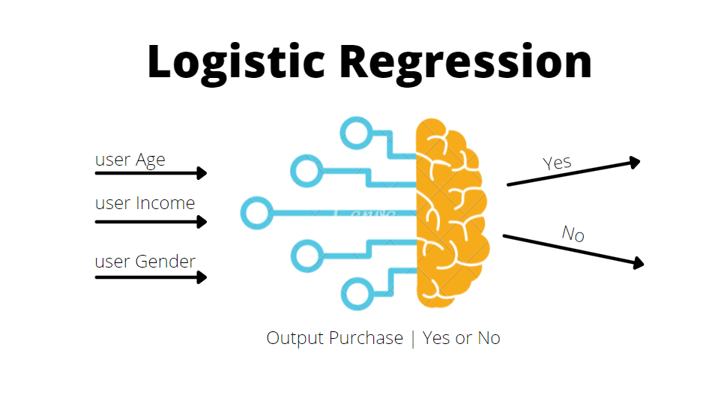
Model Training & Evaluation
Trained Logistic Regression using SageMaker with standardized features
Used Pipeline (StandardScaler, LogisticRegression) on training set
Evaluated on test set: - Accuracy: 0.65 - Recall (Readmitted): 0.54 - ROC AUC: 0.65
Model artifact saved and uploaded to S3 for deployment

Slide 9
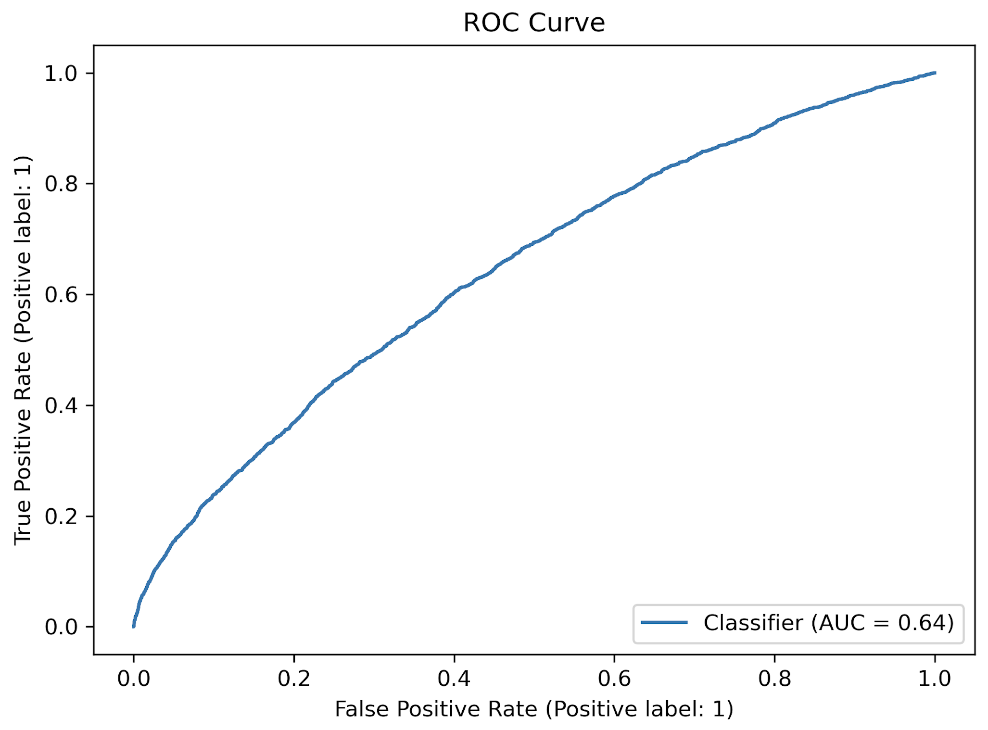
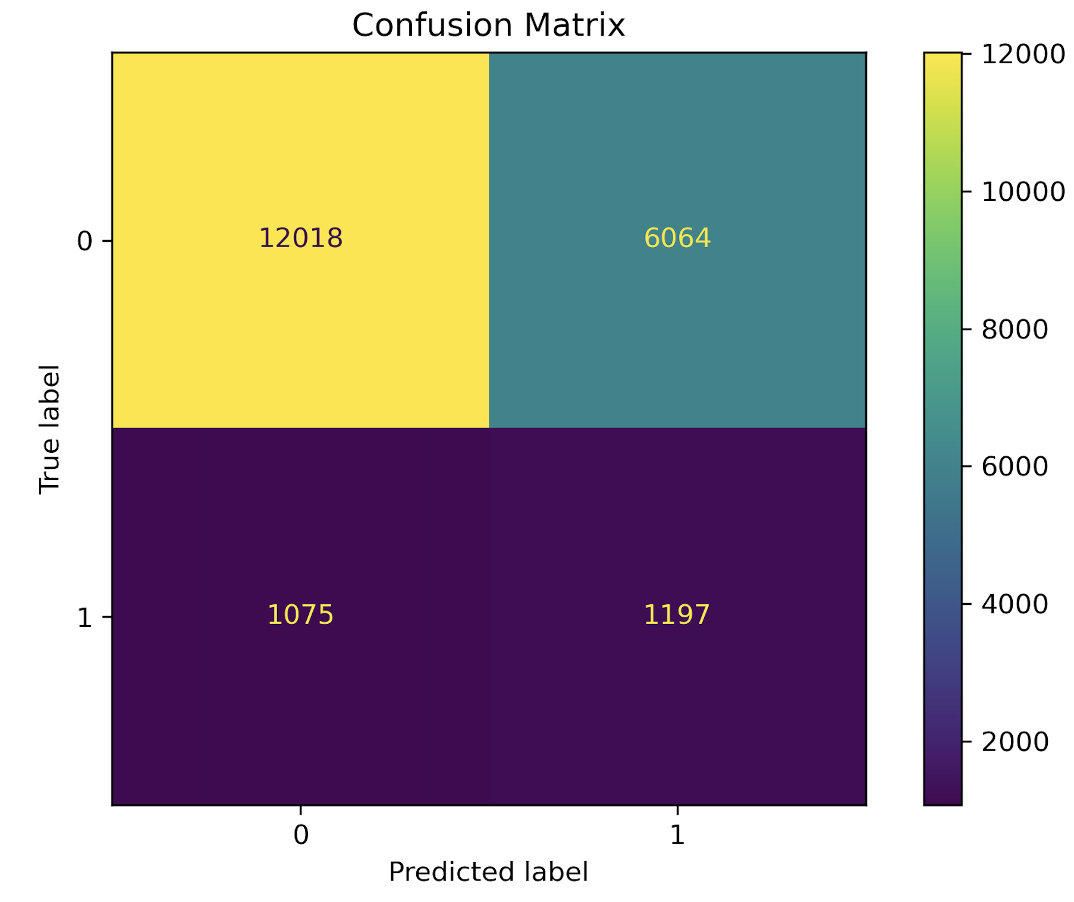
Batch Inference
Used SageMaker Batch Transform with validation dataset
Packaged model + inference script into deployable archive
Predictions saved to S3 and evaluated for performance
Validation results consistent with test set: – ROC AUC ≈ 0.64 (Balanced recall and accuracy)
Output used for offline bias monitoring and CI/CD simulation
Notes:
“Here you can see the ROC curve from batch inference on validation data. The AUC is around 0.64 — similar to our test set.”
“Confusion matrix shows class imbalance — the model is more conservative in predicting readmissions, which is expected with our Logistic Regression setup.”

Slide 10

Monitoring & Registry
Registered final Logistic Regression model for downstream use
Created baseline constraints and statistics using test data (json format)
Model Monitor jobs (hourly & on-demand) simulated in CI/CD stage
Registry approval logic tied to monitoring outcomes

Slide 11
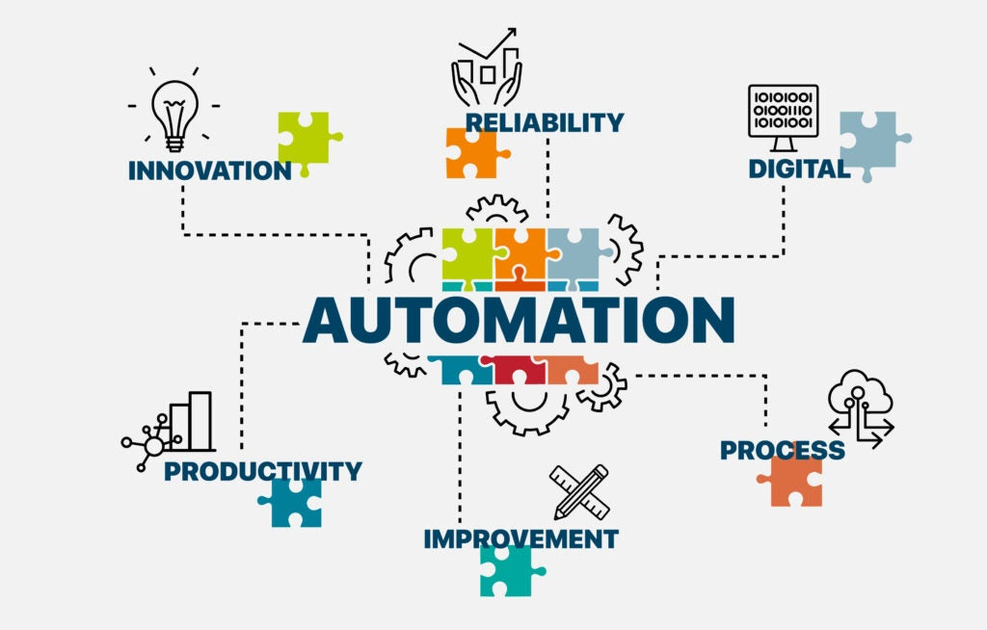
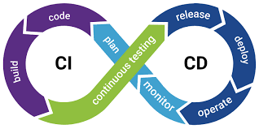
CI/CD Automation
Simulated CI/CD pipeline in SageMaker to validate deployment logic
Used monitoring outcomes as quality gates for model approval
Auto-approved model if no violations; rejected if drift detected
Demonstrated MLOps best practices despite lab constraints

Slide 12
SageMaker Challenges
Batch Inference and CI/CD Model Deployment succeeded, but required extensive debugging: - Fixed multiple input format issues - Updated inference.py repeatedly - Used CloudWatch logs to trace and resolve silent errors
Model Monitor jobs failed due to lab limitations: - Encoding mismatches - Missing CloudWatch logs - Silent container crashes - Real-time monitoring not fully testable — simulated instead

Slide 13
Summary
Baseline notebook covered data extraction, EDA, feature engineering, 4 ML models, and final model selection
Modular SageMaker pipeline built across multiple notebooks
Batch inference on validation data successfully completed
Full CI/CD pipeline implemented with automated model deployment and approval logic
Included code for two online monitoring modes (hourly & on-demand)
Due to AWS lab issues, online monitoring output not visible — simulated ‘Completed’ status used for approval
Offline Bias Monitoring completed successfully — no racial bias detected in batch predictions

Slide 14
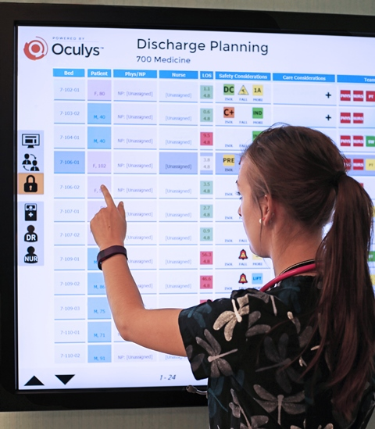

Healthcare Use Cases
Real-time discharge planning
Reducing preventable readmissions
CMS compliance, quality-based care models

