Slide 1
Aircraft Characterization in Icing Using Flight Test Data
Ed Whalen
University of Illinois Urbana Champaign
42nd Annual Aerospace Sciences Conference
Reno, NV January 5-8, 2004

Slide 2
Research Goals
Establish a baseline, clean aircraft from flight test data in clear air.
Identify the changes in trim, stability and control and performance as a result of the onset of icing IPS activation, selective deicing, etc
Identify which of these parameters are the best indicators of icing
Investigate the correlation between icing severity, as measured by η, and the magnitude of the changes in both trim and stability and control derivatives.
Aid in the development and evaluation of real-time identification methods for use with the SIS system.

Slide 3
Program Summary
Two flight test periods – February and March in 2001 and 2002
2001 – Collected data across test matrix in both clear air and icing conditions and established a baseline aircraft
  4 icing flights and 5 clear air flights
2002 – Focused on elevator doublet data collection in icing conditions
  11 icing flights and 4 clear air flights

Slide 4
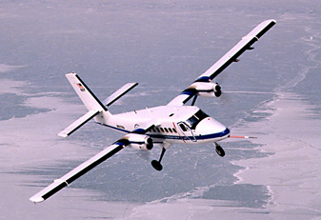
The Twin Otter
deHavilland DHC-6
High-wing, twin engine commuter class aircraft
Max Gross Weight: 11,000 pounds
Cruise Speed: 130 KIAS
Fully instrumented to collect aerodynamic, performance, icing and atmospheric data.

Slide 5
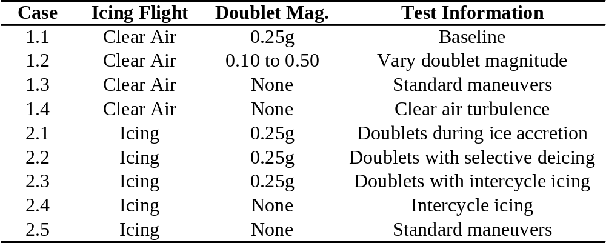
Flight Test Cases

Slide 6
Data Reduction
Data filtered using a 10Hz low-pass filter (post-processing in 2001 and in flight in 2002).
Data corrected for instrument offsets and angular rate contributions to airspeed measurements.
Aerodynamic parameters recalculated from data.
Filtered data passed to Systems IDentification Programs for Aircraft (SIDPAC).
  Data compatibility used to calibrate instrumentation.
  Stepwise regression algorithm used to identify stability and control derivatives.
Trim data was extracted immediately before each maneuver by time averaging the data.

Slide 7
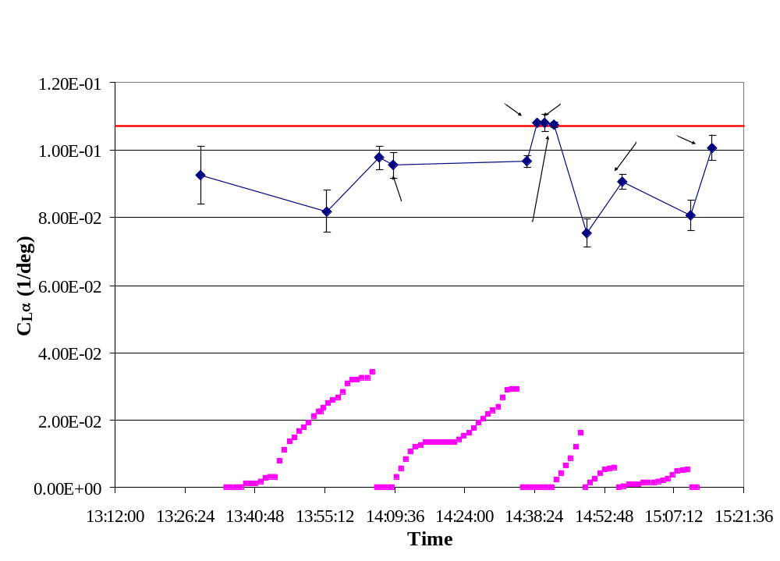
Typical Icing Flight

Slide 8
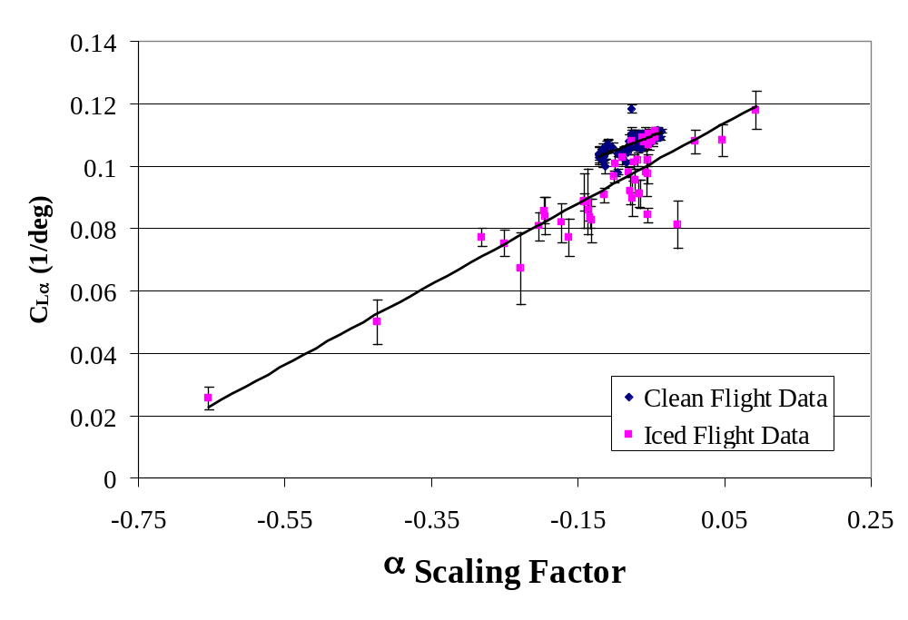
Atmospheric Turbulence

Slide 9
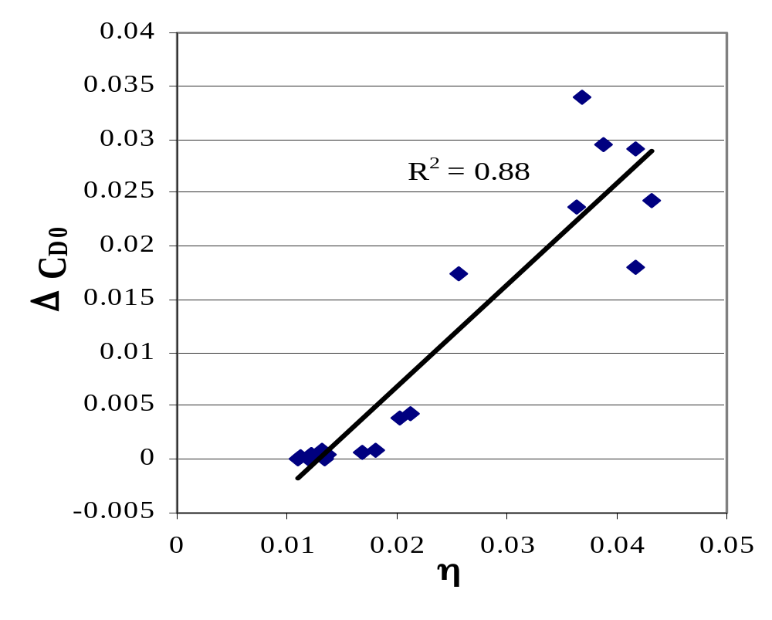
Parasite Drag

Slide 10
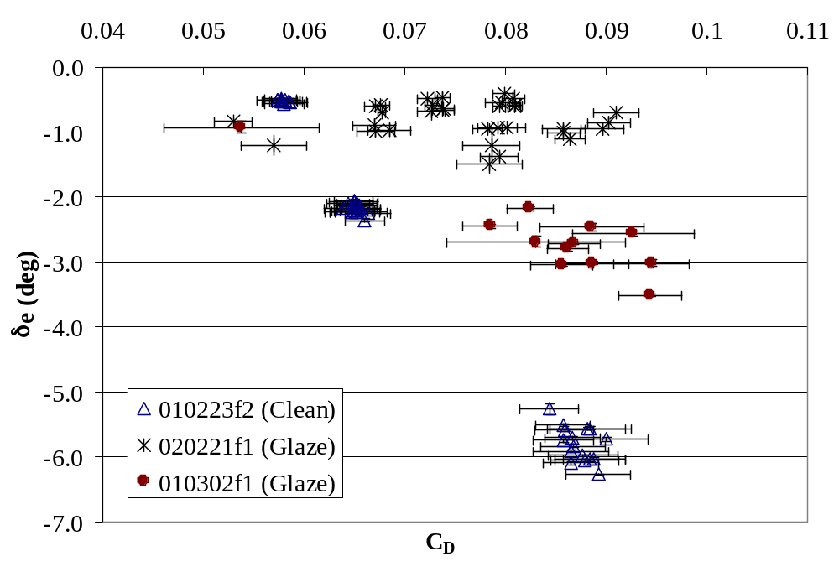
Trim Values

Slide 11
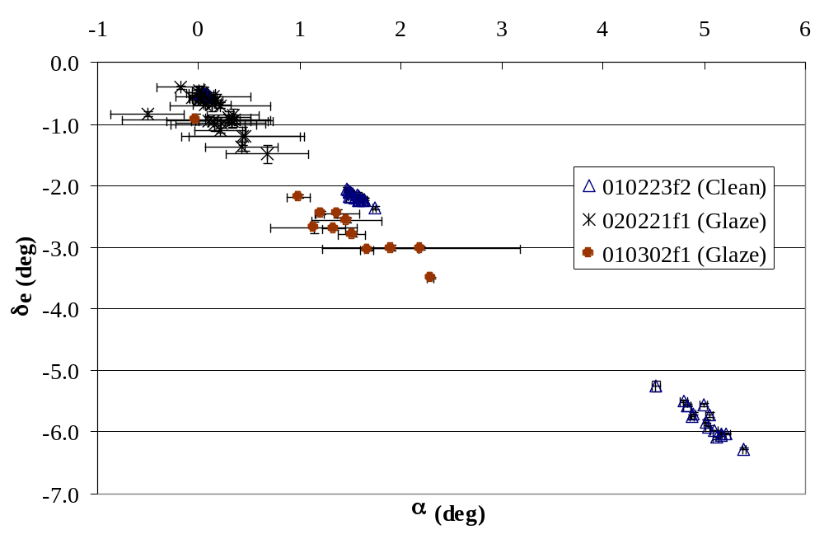
Trim Values

Slide 12
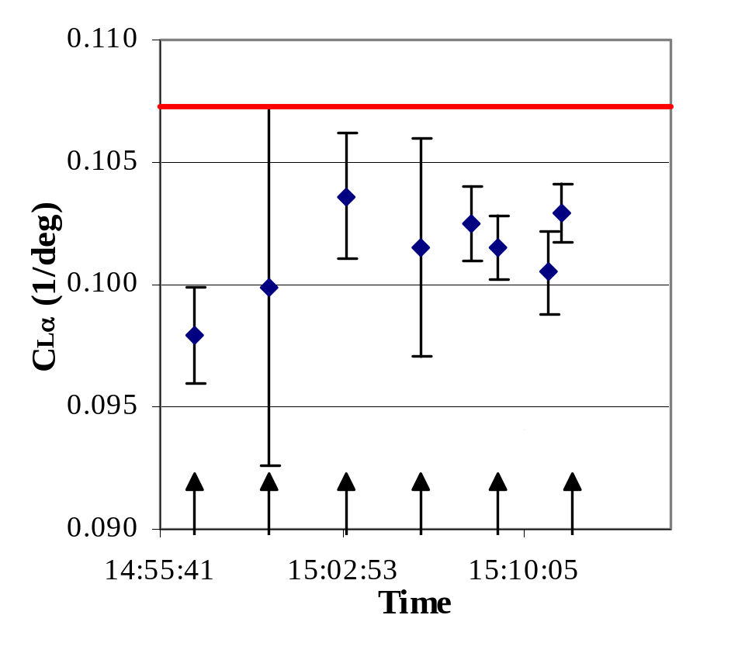
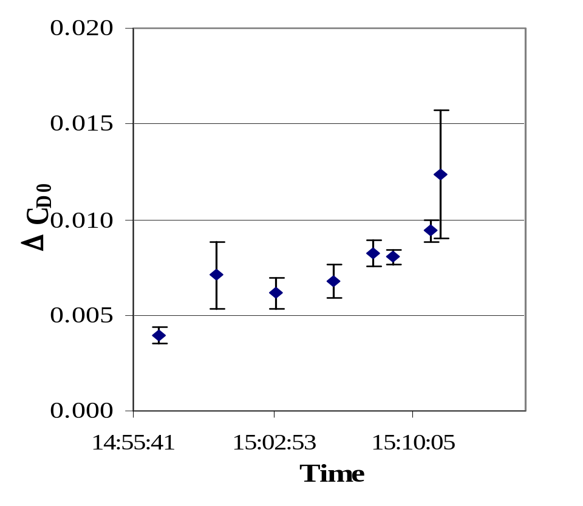
IPS Activation: Automatic Cycle

Slide 13
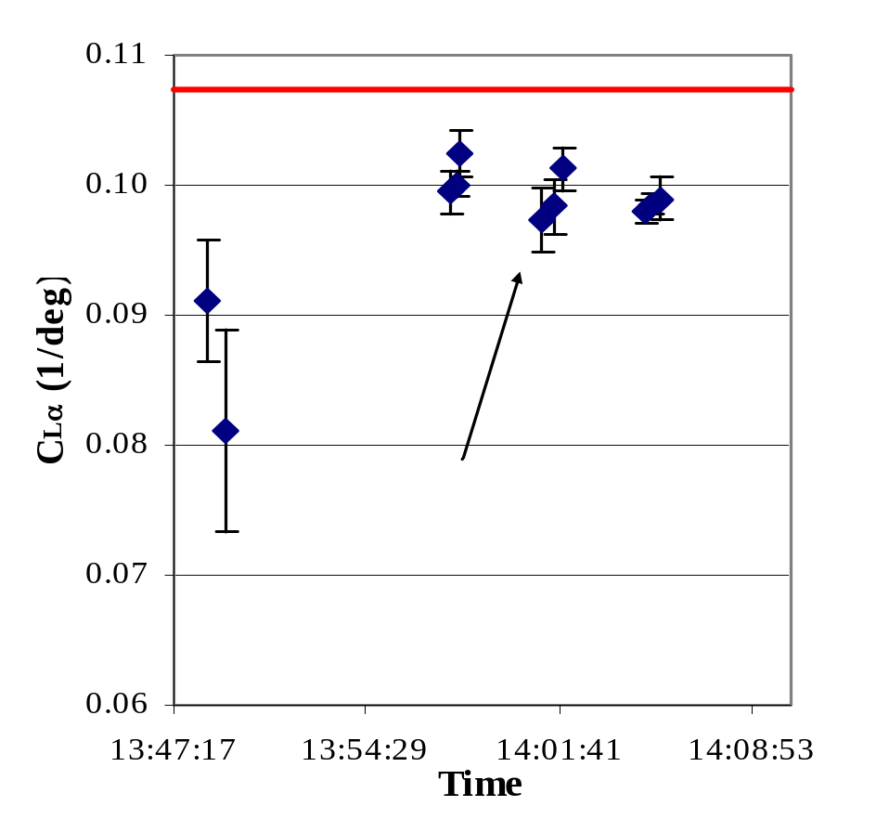
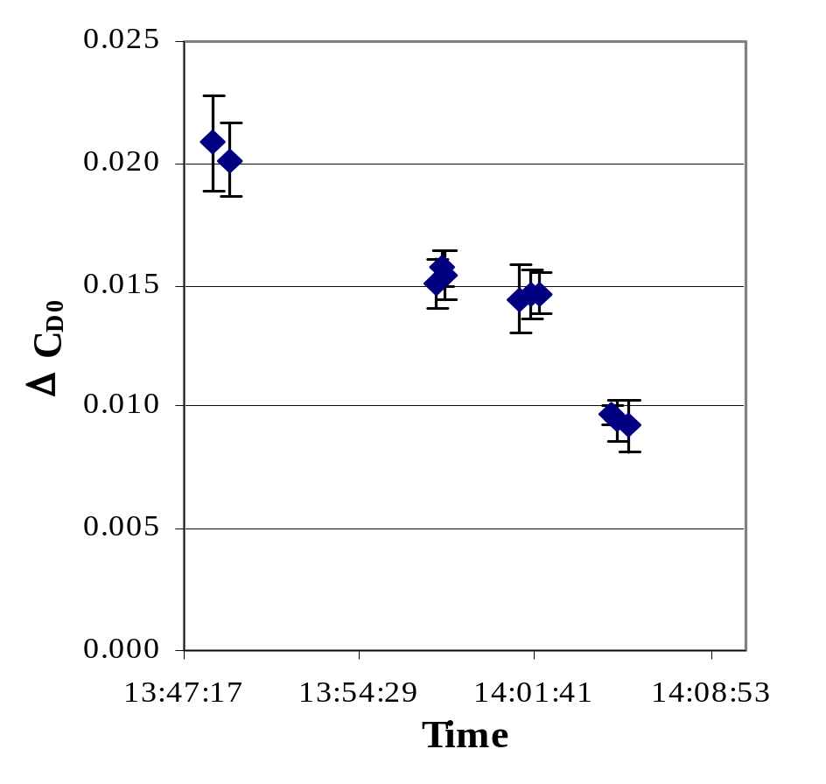
IPS Activation: Selective Deicing

Slide 14
H∞ Parameter Identification
H∞ generally refers to an algorithm/controller that achieves guaranteed performance in the presence of unknown harmful input.
  “worst-case performance”
H∞ does not require statistical descriptions of unknown quantities.
Given pilot input, think of ID as a system with turbulence and measurement noise as an unknown input and the parameter estimate error as the output. We would like to have the estimate error go to zero regardless of input.
The H∞ ID provides a worst-case gain from unknown input to error.
The H∞ ID algorithm is recursive and hence depends on an initial estimate.
The H∞ ID algorithm is robust to model uncertainties and can be used for time-varying and nonlinear systems as well.

Slide 15
Tuning the H∞ Algorithm
The H-infinity ID algorithm was tuned so that the final estimate of a doublet portion of data is largely insensitive to the initial estimate value hence, estimates are dominated by excitation provided by the doublet input.
Performed multiple calculations for various initial estimate values.
Looking for variation in final estimate values to be a small fraction of variation in initial estimate values
Involves a tradeoff between responsiveness to doublet excitation and sensitivity to measurement noise and turbulence.
Obtained good convergence for all (C_{Zα}, C_{Mα}, C_{Mq}, and C_{Mδe}) but C_{Zα} for doublets with low trim velocity (approx 47 m/s).

Slide 16
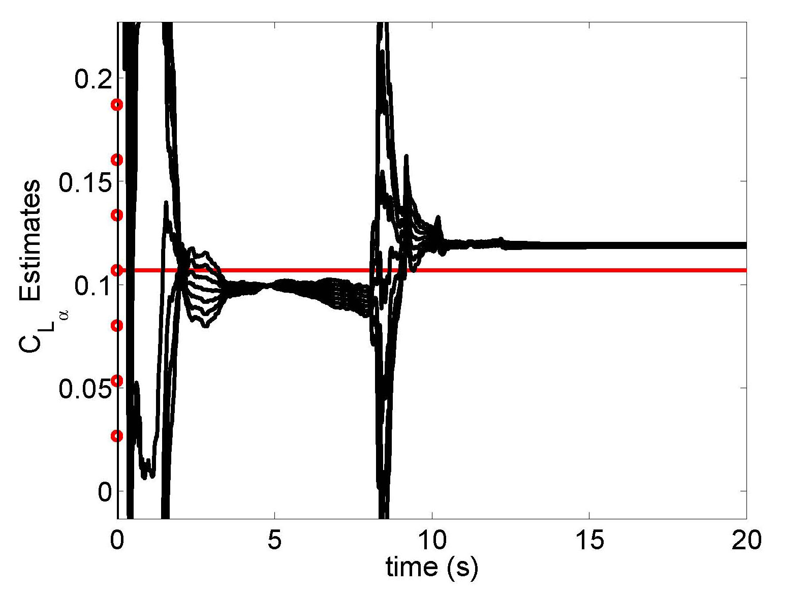
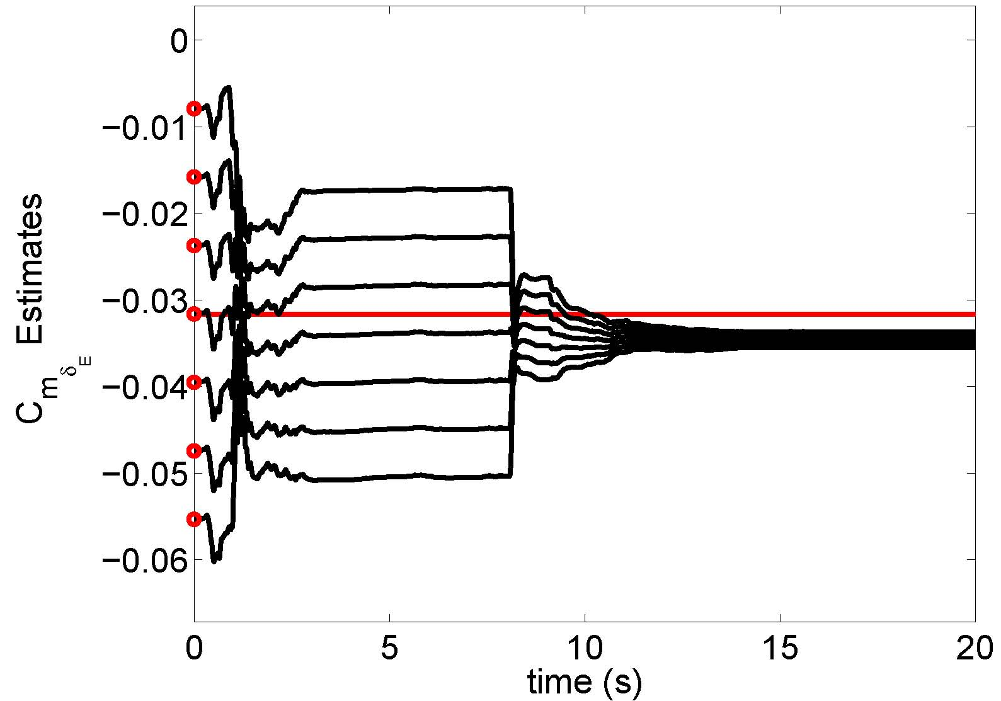
Clean Parameter Estimation
C_{Lα} Estimation
C_{Mδe} Estimation

Slide 17
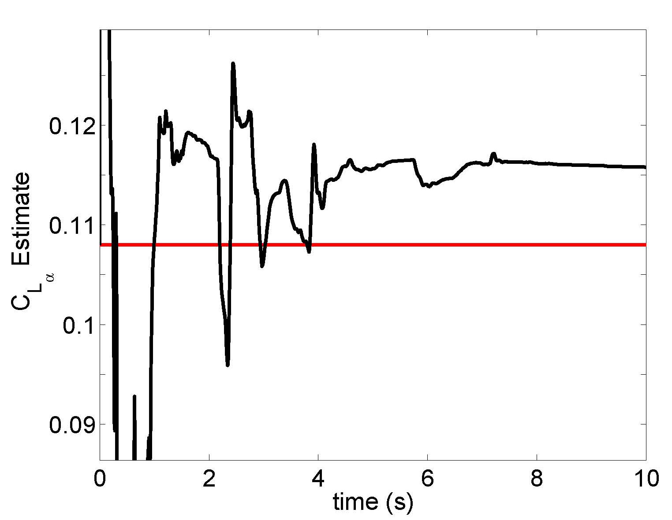
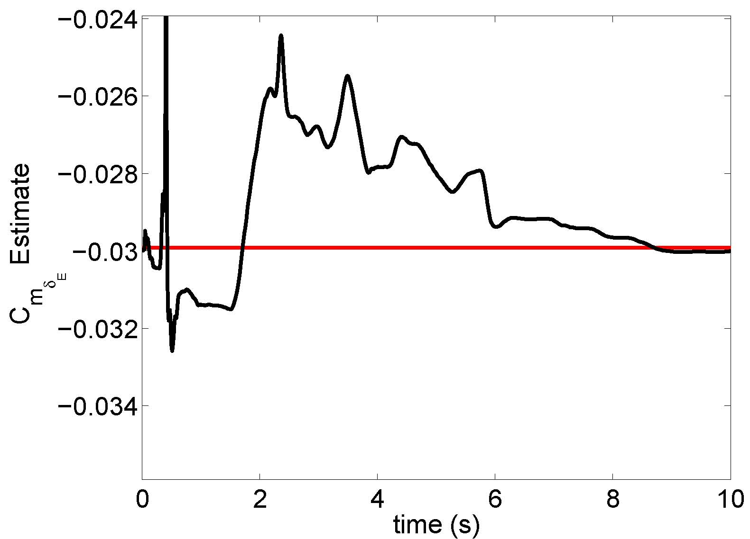
Parameter Identification in Icing
C_{Lα} Estimation
C_{Mδe} Estimation

Slide 18
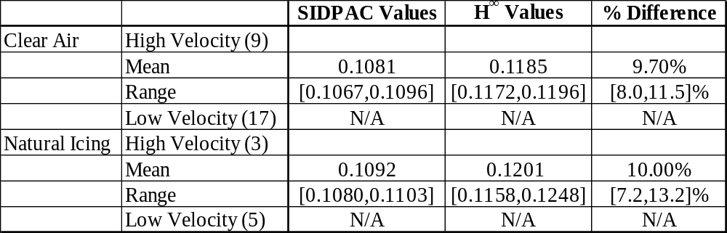
Comparison of H∞ Results with SIDPAC Results (C_{Lα})

Slide 19
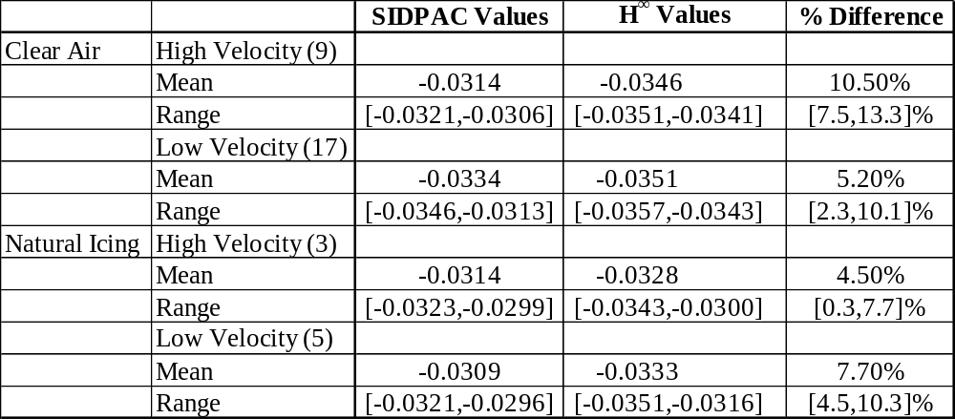
Comparison of H∞ Results with SIDPAC Results (C_{Mδe})

Slide 20
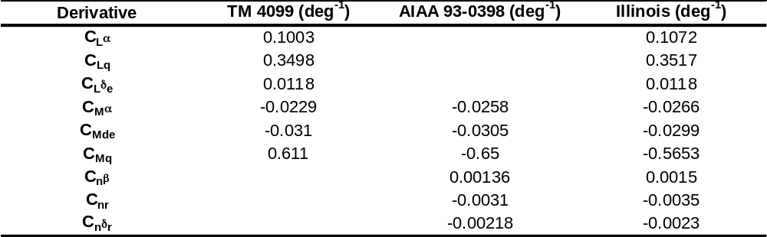
Other Comparisons to SIDPAC Results

Slide 21
Conclusions
C_{Lα} and C_{Mα} indicate the effects of icing on the aircraft, but are significantly affected by atmospheric turbulence.
Parasite drag is an excellent indicator of the severity of the ice accretion, as seen through its correlation with an icing severity parameter, η.
Trim values, especially α, δ_{e} and C_{D}, are excellent indicators of icing onset and the effect of icing on control and performance.
The effect of IPS operation is visible in both the stability parameters and the parasite drag including: selective deicing, standard deicing boot cycles and full deicing.

Slide 22
Conclusions
Using trim values to characterize the effect of icing shows the most promise, at this time, in terms of accuracy and reliability.
Further investigation into the effects of atmospheric turbulence is required to improve parameter identification.
Real-time H∞ PID provides pitching moment derivative estimates that are consistent with SIDPAC estimates
Real-time H∞ PID provides C_{Lα} estimates that are consistent with SIDPAC for higher trim velocities.

