Slide 1
Final Report
Matt Purkeypile, Aryaz Zomorodi, Subhabrata Ganguli
February 2024

Slide 3
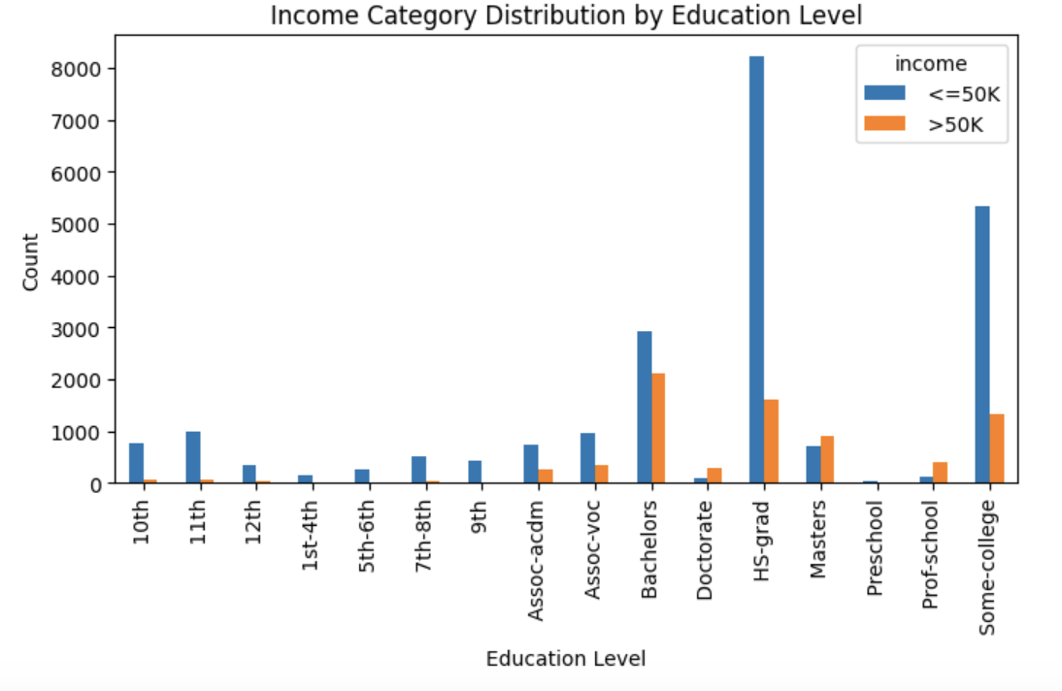
Education vs Income

Slide 4
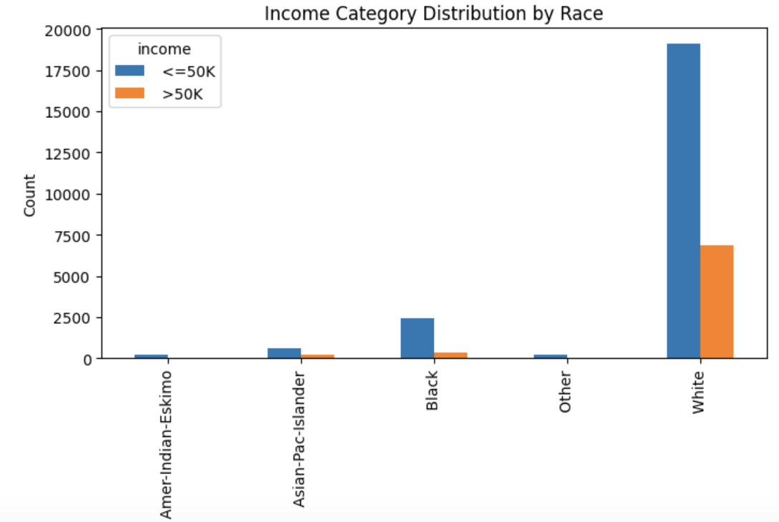
Race vs Income

Slide 5
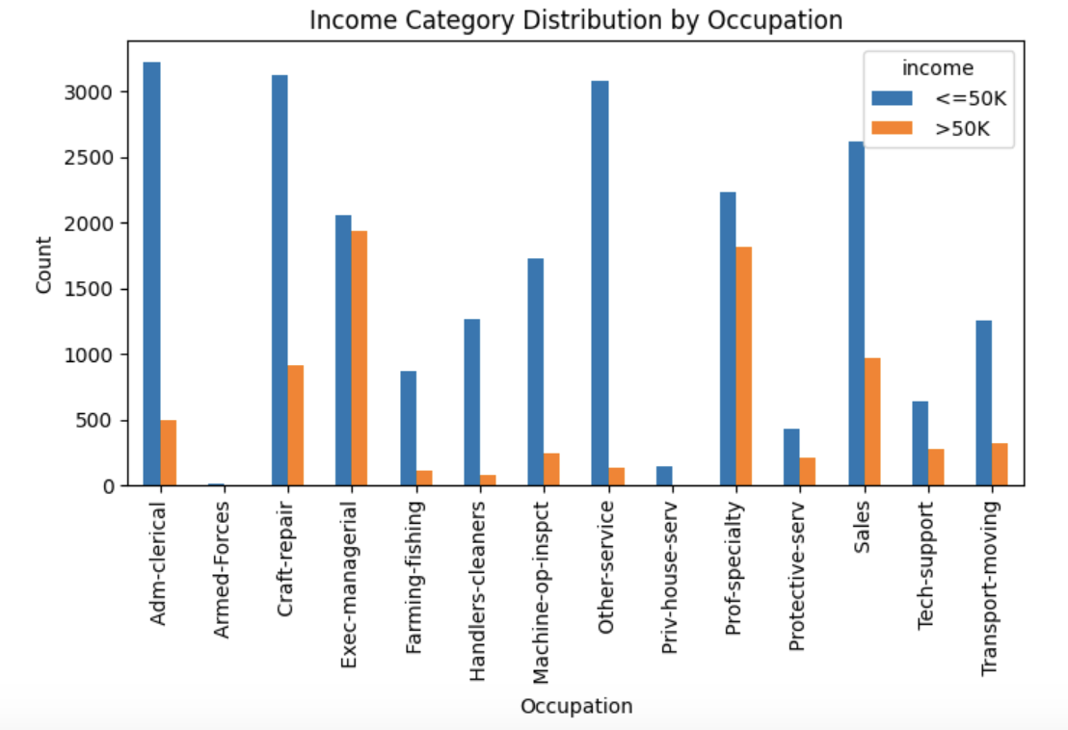
Occupation vs Income

Slide 6
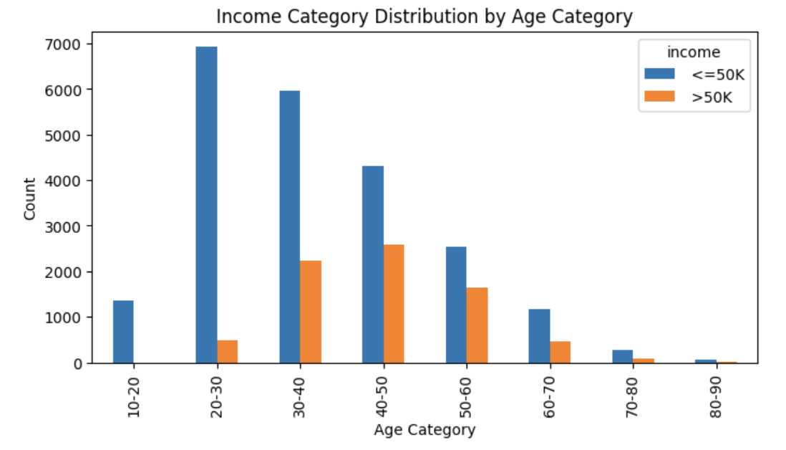
Age Category vs Income

Slide 7
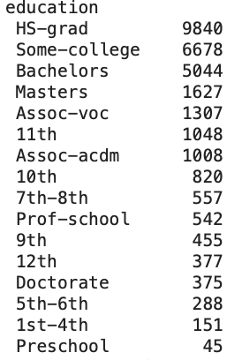
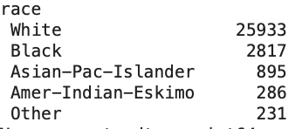
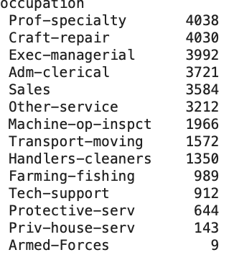
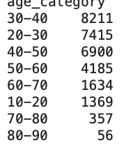
Value Counts

Slide 8
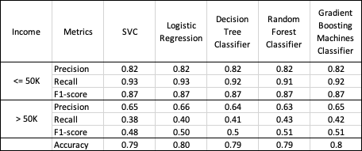
Metrics for Classifiers

