Slide 1
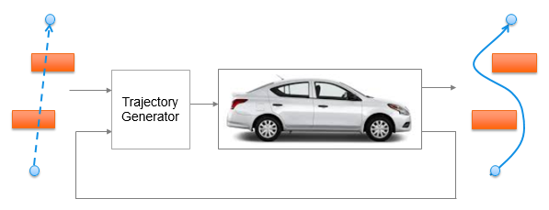
Trajectory Generation in High Density Environment
Analysis for Safety Margin
Suvo Ganguli
Oct 2018

Slide 2
<number>
Overview
Trajectory Generation Analysis for Safety Margin
1 obstacle (a specific case)
Varying obstacle size
Varying safety margin
Varying path width
Goal: A systematic way of chosing the two design parameters
safety margin
pathwidth

Slide 3
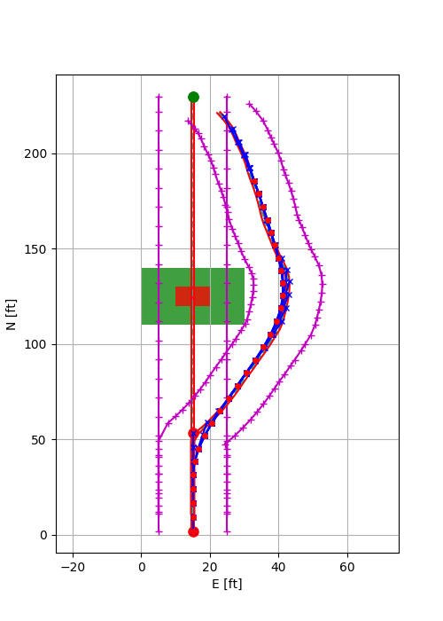
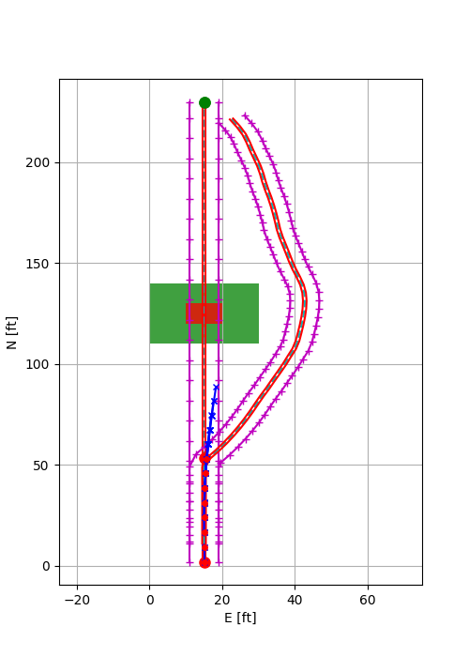
Obstacle Width (with safety margin) = 30 ft
Safety Margin = 10 ft
Path Half Width = 10 ft
Obstacle Width (with safety margin) = 30 ft
Safety Margin = 10 ft
Path Half Width = 4 ft
Case 1
Case 2
Decreasing path width can lead to infeasible solution

Slide 4
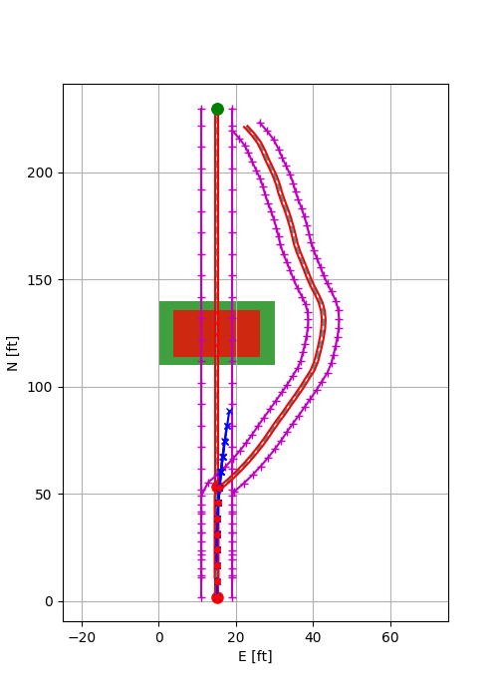
Obstacle Width (with safety margin) = 30 ft
Safety Margin = 10 ft
Path Half Width = 10 ft
Obstacle Width (with safety margin) = 30 ft
Safety Margin = 4 ft
Path Half Width = 4 ft
Case 1
Case 3
Decreasing safety margin (hence path width) can lead to infeasible solution

Slide 5
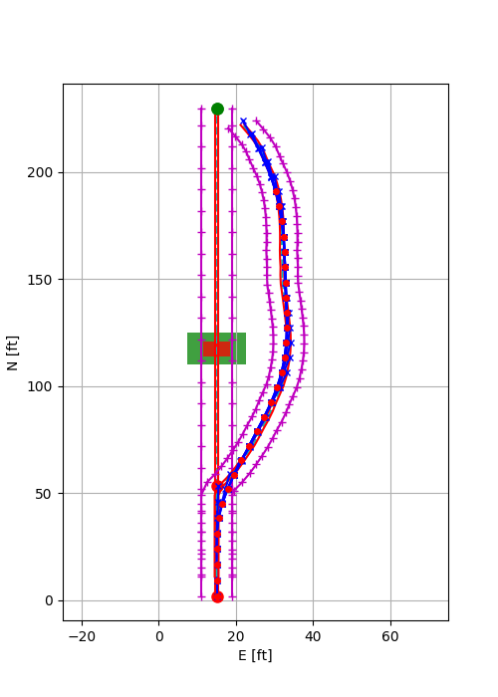
Obstacle Width (with safety margin) = 30 ft
Safety Margin = 10 ft
Path Half Width = 10 ft
Obstacle Width (with safety margin) = 15 ft
Safety Margin = 4 ft
Path Half Width = 4 ft
Case 1
Case 4
Smaller obstacle size can use less path width

Slide 6
 | Obstacle Width (with Safety Margin) | Obstacle Width | Safety Margin | Path Half Width | Look Ahead Distance | SM/ OW | PHW/ OW | PHW/SM | Feasibility
 | OWSM | OW | SM | PHW | LD | R1 | R2 | R3
 | ft | ft | ft | ft | ft
Case 1 | 30 | 10 | 10 | 10 | 100 | 1.0 | 1.0 | 1.0 | Yes
Case 2 | 30 | 10 | 10 | 4 | 100 | 1.0 | 0.4 | 0.4 | No
Case 3 | 30 | 22 | 4 | 4 | 100 | 0.18 | 0.18 | 1.0 | No
Case 4 | 15 | 7 | 4 | 4 | 100 | 0.57 | 0.57 | 1.0 | Yes
Case 5 | 20 | 8 | 6 | 6 | 100 | 0.75 | 0.75 | 1.0
Empirical Relations (for this specific case):
> PHW/OW >= 1.0, PHW/SM >= 1.0 (LD / OWSM <= 0.30)
> PHW/OW >= 0.57, PHW/SM >= 1.0 (LD / OWSM <= 0.15)
Test:
> PHW/OW >= 0.75, PHW/SM >= 1.0 (LD / OWSM <= 0.20)

Slide 7
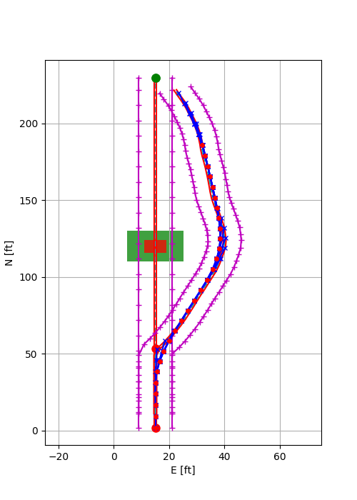
Obstacle Width (with safety margin) = 30 ft
Safety Margin = 10 ft
Path Half Width = 10 ft
Obstacle Width (with safety margin) = 20 ft
Safety Margin = 6 ft
Path Half Width = 6 ft
Case 1
Case 5

