Slide 1
Design Problem
Define: Delta Heading = Goal Heading - N-th point Heading
Vehicle reaches goal for Delta Heading = 45 deg
Vehicle does not reach goal for Delta Heading = 90 deg
Reason: Vehicle takes a tighter turn in the 2nd case.
Vehicle could have reached goal in 2nd case if the velocity was reduced.
Design Problem: How to change velocity if the vehicle seems unable to reach goal?

Slide 2
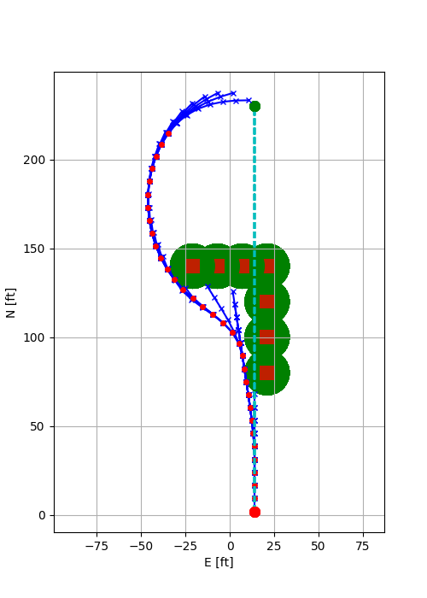
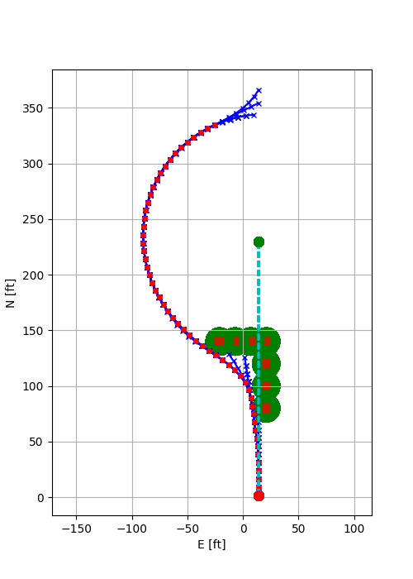
Delta Heading = 45 deg
Delta Heading = 90 deg

Slide 3
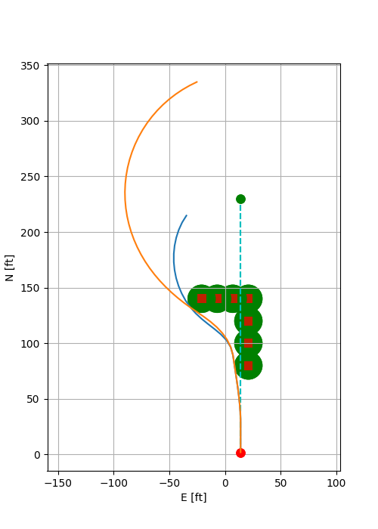
Delta Heading = 90 deg
Delta Heading = 45 deg

Slide 4
