Slide 1
MPC Trajectory Generation
Robustness to Navigation Error
Suvo Ganguli
2018-08-28

Slide 2
Robustness to Navigation Error
MPC Problem
MPC Problem with Navigation Error
Analysis

Slide 3
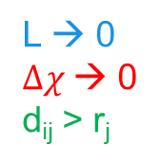

MPC Problem
$$Δχ$$
L
where:
subject to constraints:
L → 0
$Δχ$→ 0
d_{ij} > r_{j}
r_{j}
d_{ij}

Slide 4
MPC Problem with Navigation Error
$$Δχ$$
L
where:
subject to constraints:
L → 0
$Δχ$→ 0
d_{ij} > r_{j}
r_{j}
d_{ij}
May need to modify the optimization problem to account for noise

Slide 5
Analysis
Problem: Generate trajectory with 1 obstacle
At every time step:
Add noise to current state vector
Solve the optimization problem to find the control signal for the current time
Experiments
Std. Dev. | Units | Low Noise | Medium Noise | High Noise
 | m | 0.1 | 0.25 | 0.5
 | m | 0.1 | 0.25 | 0.5
 | m/s | 0.1 | 0.25 | 0.5
 | deg | 0.1 | 0.25 | 0.5

Slide 6
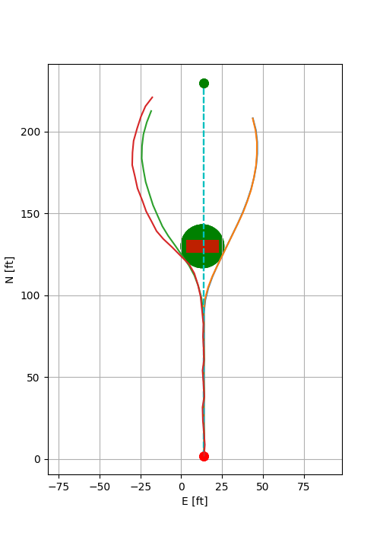
Path (E vs N)
no noise
low noise
medium noise
high noise

Slide 7
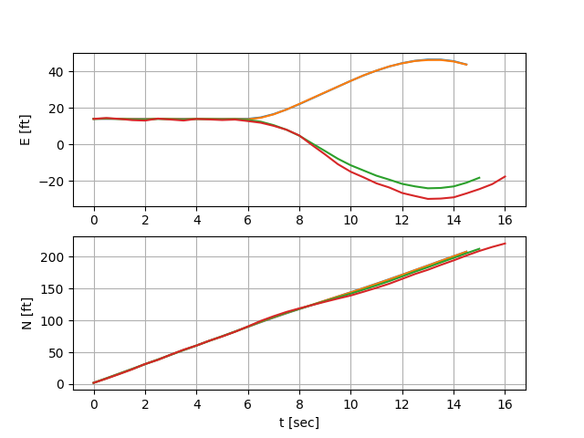
E, N vs time
no noise
low noise
medium noise
high noise

Slide 8
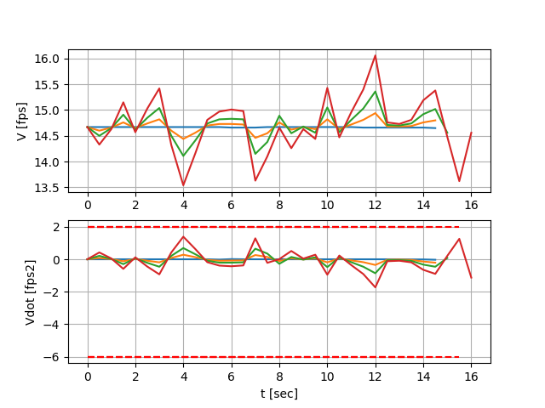
V, V-dot vs time
no noise
low noise
medium noise
high noise

Slide 9
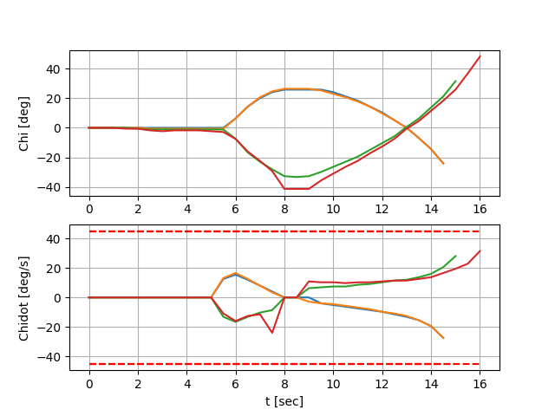
Chi, Chi-dot vs time
no noise
low noise
medium noise
high noise
corresponds to infeasible solution at this time step

Slide 10
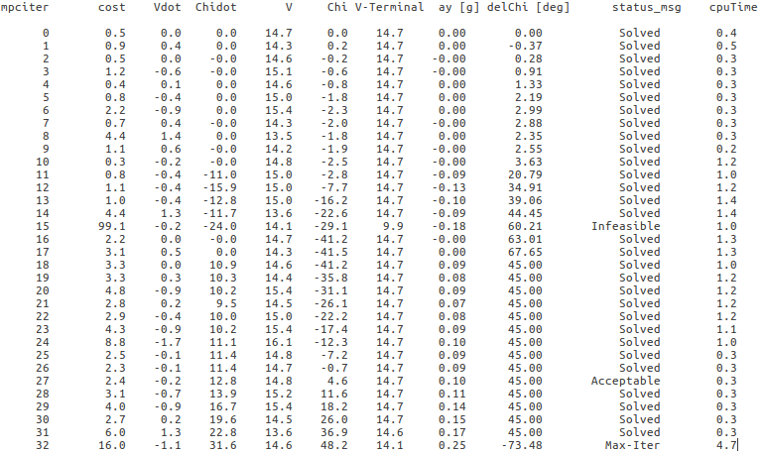
Log for ‘high noise’ case

Slide 11
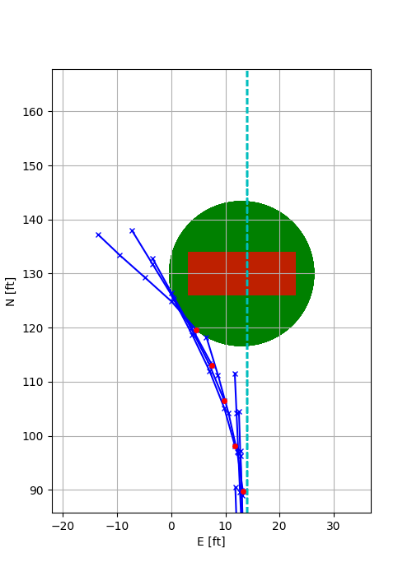
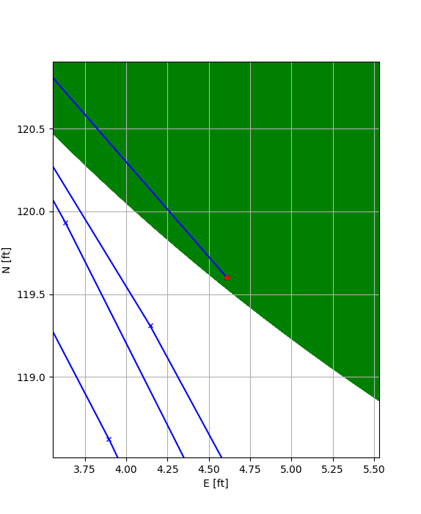
shifted due to noise
The noisy measurement places the position (E,N) inside the safe region causing infeasibility

