Slide 1
MPC Trajectory Generation
Robustness to Measurement Noise
Suvo Ganguli
2018-08-28

Slide 2
Robustness to Measurement Noise
MPC Problem
MPC Problem with Measurement Noise
Experiments

Slide 3
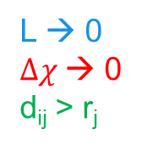

MPC Problem
$$Δχ$$
L
where:
subject to constraints:
L → 0
$Δχ$→ 0
d_{ij} > r_{j}
r_{j}
d_{ij}

Slide 4
MPC Problem – with Measurement Noise
$$Δχ$$
L
where:
subject to constraints:
L → 0
$Δχ$→ 0
d_{ij} > r_{j}
r_{j}
d_{ij}

Slide 5
Experiments
Std. Dev. | Units | Low Noise | Medium Noise | High Noise
 | m | 0.1 | 0.25 | 0.5
 | m | 0.1 | 0.25 | 0.5
 | m/s | 0.1 | 0.25 | 0.5
 | deg | 0.1 | 0.25 | 0.5

Slide 6
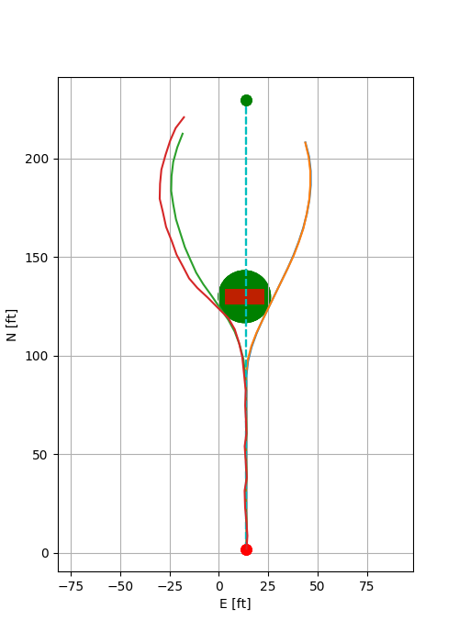
Path (E vs N)
low noise
medium noise
high noise

Slide 7
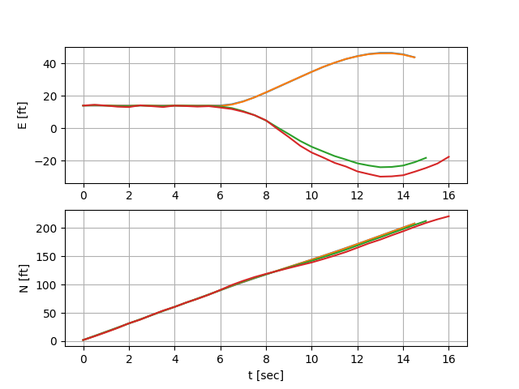
E, N vs time
low noise
medium noise
high noise

Slide 8
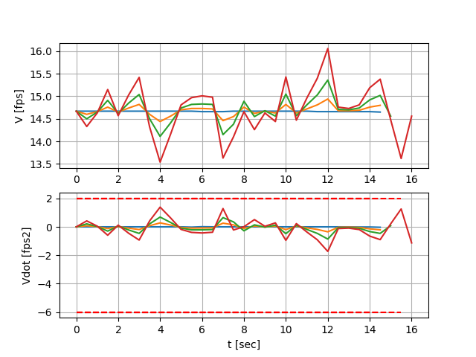
V, V-dot vs time
low noise
medium noise
high noise

Slide 9
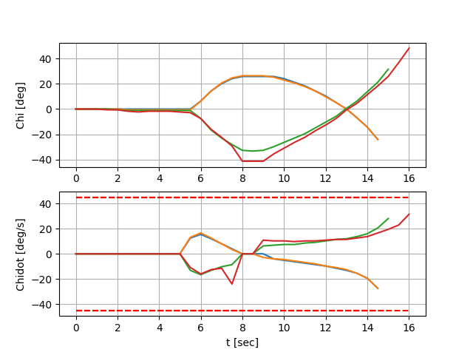
Chi, Chi-dot vs time
low noise
medium noise
high noise
corresponds to infeasible solution at this time step

Slide 10
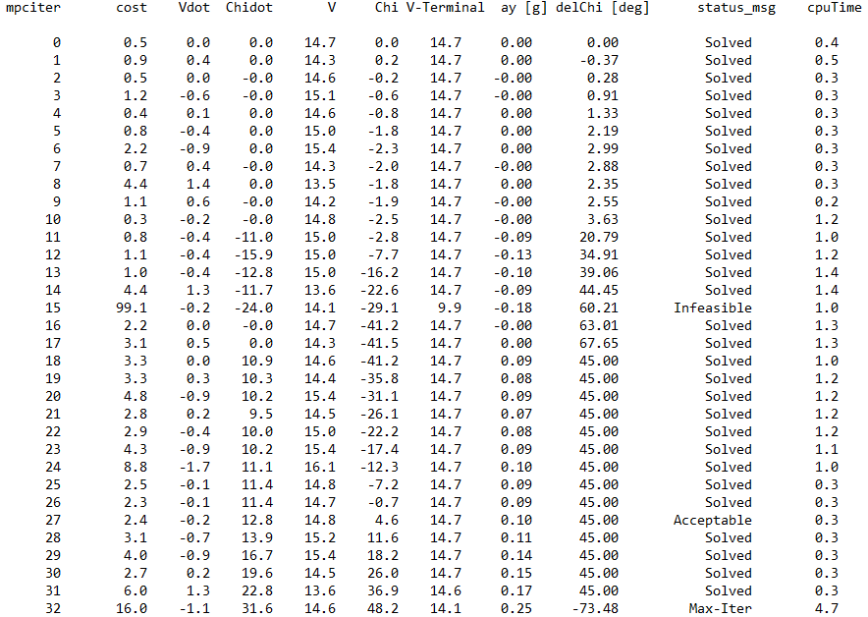
Log for ‘high noise’ case

