Slide 1
Lateral Control of a Car
Goal: Replace MPC kinematics control with dynamics control
Vdotc = 0
chidotc
or
Vc*chidotc = ayc
Nc
Ec
Ndotc
Edotc
kinematics
or
dynamics
Vc =constant
chi

Slide 2
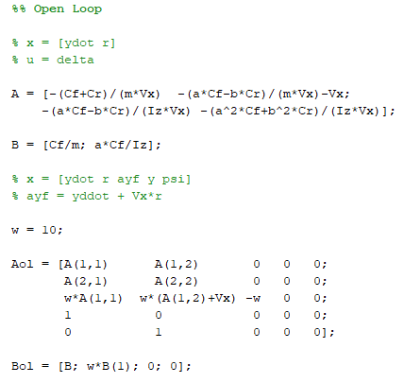
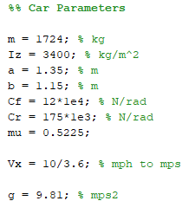
Lateral Dynamics of Car (Rigid Body Model)

Slide 3
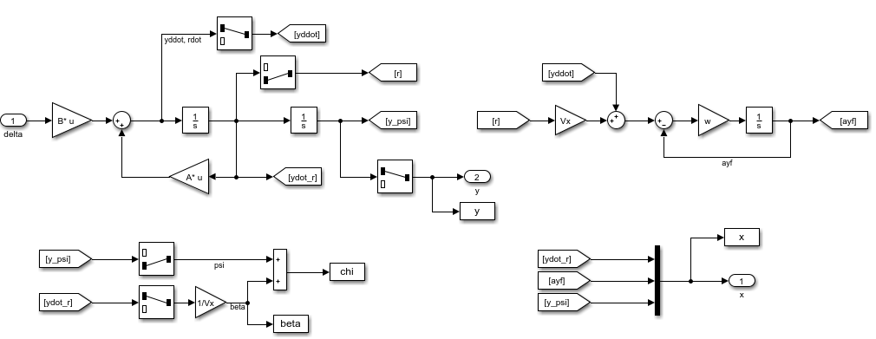
Open Loop

Slide 4
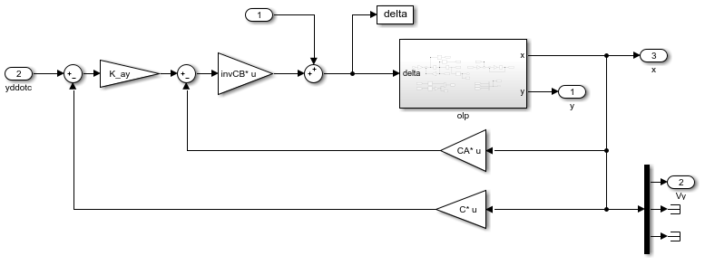
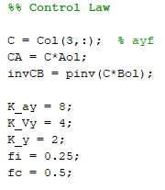
Control Law for Lateral Acceleration

Slide 5
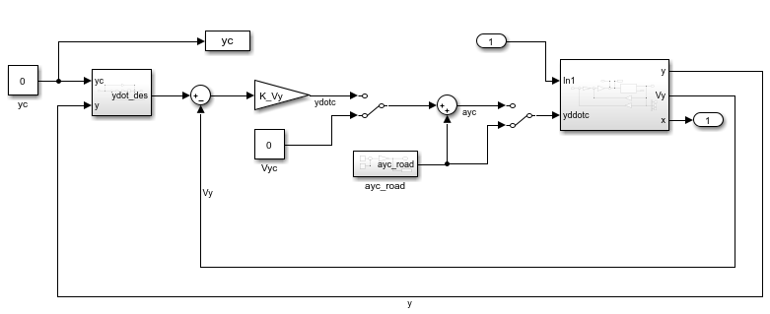
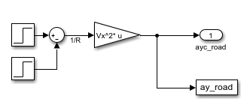
Closed Loop
ay_road = Vx^2/R = Vx^2*rho
during turn

Slide 6
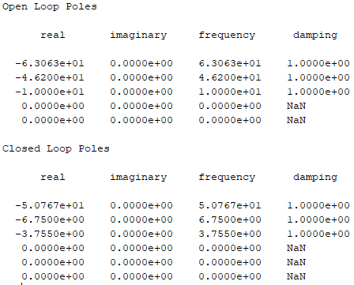
Open Loop and Closed Loop Poles
ydot, r
w=10
y, psi
y, psi
integrator in desired dynamics for y control (outer loop not used)

Slide 7
Plots
Vehicle starts pointing North, and take a 90 deg right turn between 1-7 sec
V^2/(R*9.8) = 2.78/(10.6*9.8) = 0.07 g
Vehicle skidding?
(see beta plot in next slide)
Vehicle completes 90deg turn

Slide 8
Plots
90 deg right turn
Skid to turn?

Slide 9
Plots
Does the vehicle skid to result in a non-zero y?
y = ydot*6 = 0.29*6 = 1.74 m
90 deg right turn
Steering angle

Slide 10
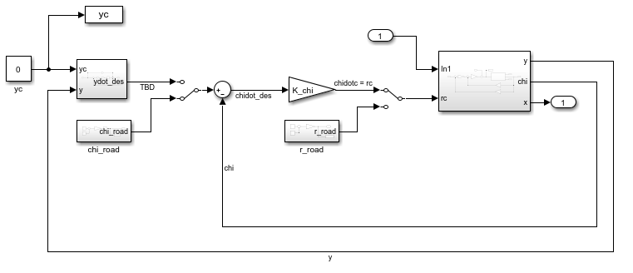
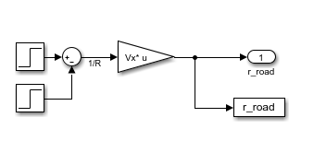
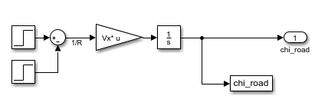
Closed Loop for Heading Angle (chi) control

Slide 11
Plots

Slide 12
Plots

Slide 13
Plots

