Slide 1
Project management Tools
for Agile team
Presented By:
Shuvo Islam
ASH1825032M
BSSE 1st Batch
IIT, NSTU
Mentor:
Dipok Chandra Das
Assistant Professor, IIT, NSTU

Slide 2
Agenda
Introduction
What problem to solve
Project Feature
Project Progress
ER Diagram
Use Case Diagram
GUI

Slide 3
Introduction
To progress with software projects, we need a simple, effective workflow, which enables them to manage projects as well as handle their bugs. From project starting to end we need to divide workflow in a formal way between teams.Here we need a system which will enable teams to work on projects or issues for managing the workflow within teams, assigning resources for specific tasks, scheduling tasks, bug tracking, resolving bugs, generating reports.

Slide 4

What problem to Solve?
Weather creating a new project or in an existing project, there need to divide the project into multiple epic in agile development or may arise various issue to solve, in these such a scenario we need project management system which will automate and smooth the workflow between multiple team.

Slide 5
AGILE
Sprint 1
Plane
Design
Development
Test
Review
Launch
Sprint 2
Plane
Design
Development
Test
Review
Launch

Slide 6
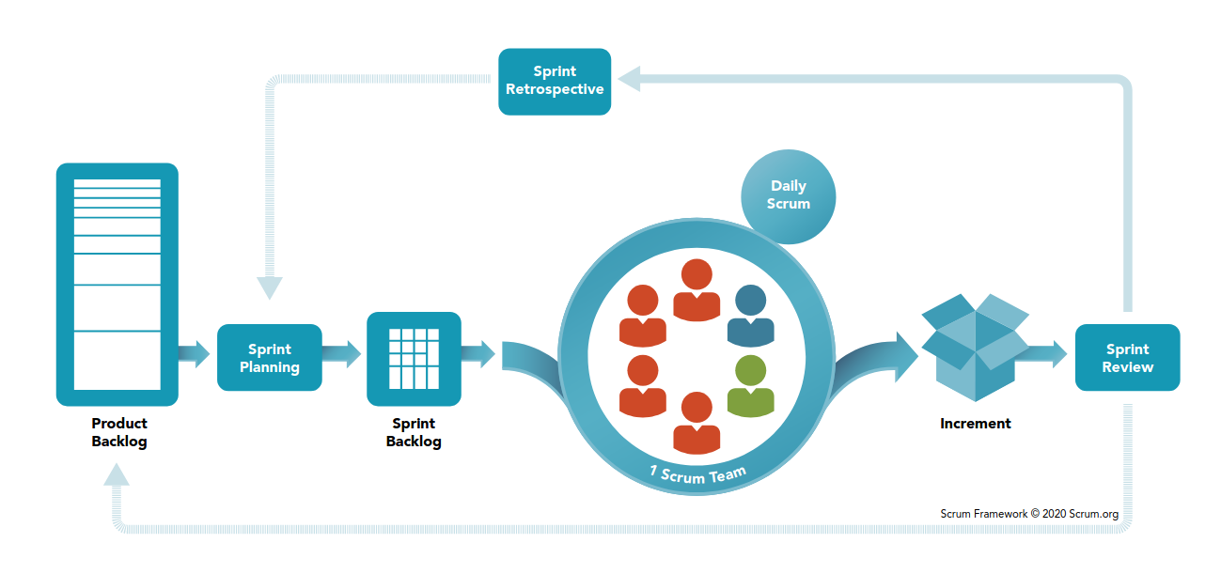
What is Scrum?

Slide 7
Project Feature
Providing support for Agile methodologies practices within agile team.
Task management
Mange multiple team by creating multiple board
Sprint planning
Issue generation to sprint
System will make it easy to create tasks to work on, with details, due dates and reminders.
Bug tracking and resolving bugs.
Project Configuration
Generation of the report

Slide 8
Project Progress
SRS document
Project Frontend 70%

Slide 9
Requirement Example
Requirement Id | R1.05.06
Title | Comment on Issue
Group | Main Functionality\Manage Issue\comment
Description | User will be able to add comment to issues. The user who are assigned to the issue, project lead and owner of the project will be able to comment on the issue
Priority | Medium
Source
Risk
Reference

Slide 10
User of the System
Project Owner
Project Lead
Assigned member to issues / Developer

Slide 11
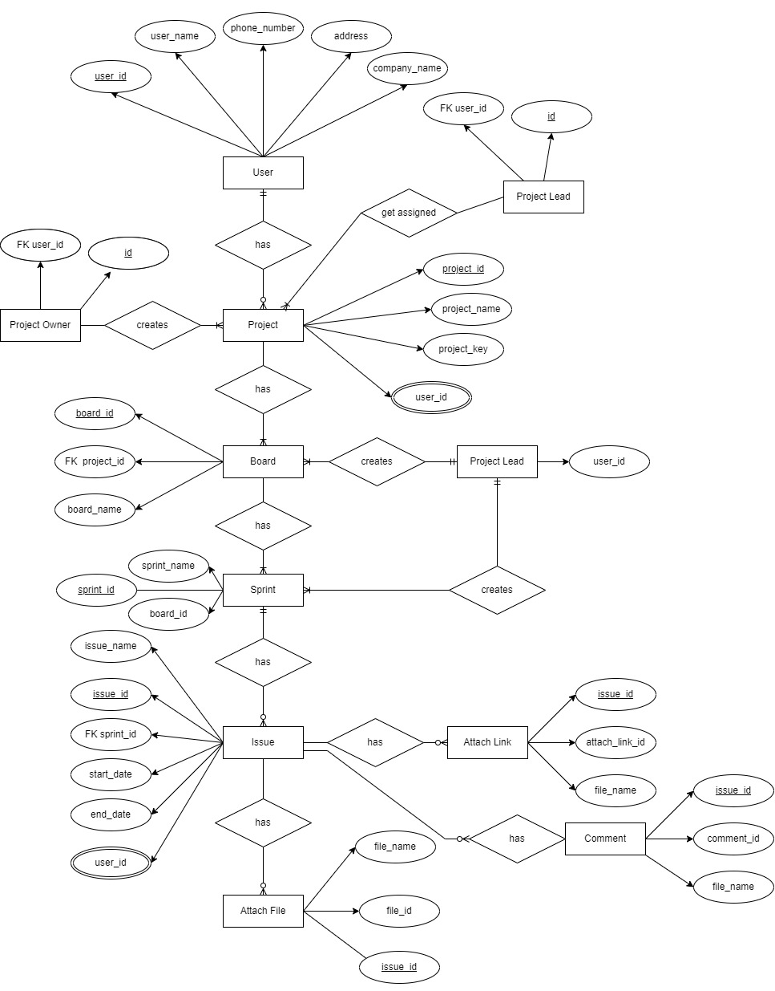
ER Diagram

Slide 12
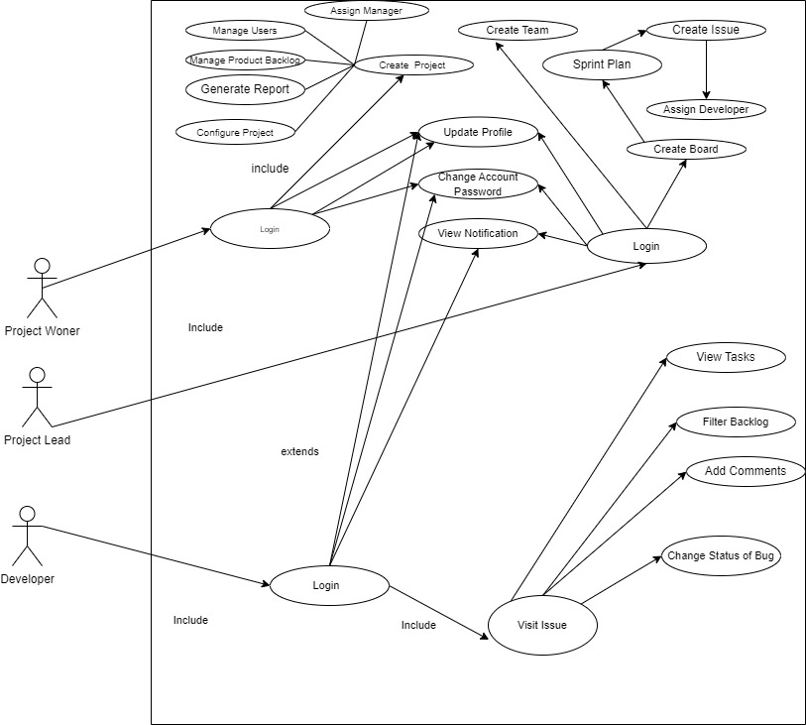
Use Case Diagram

Slide 13
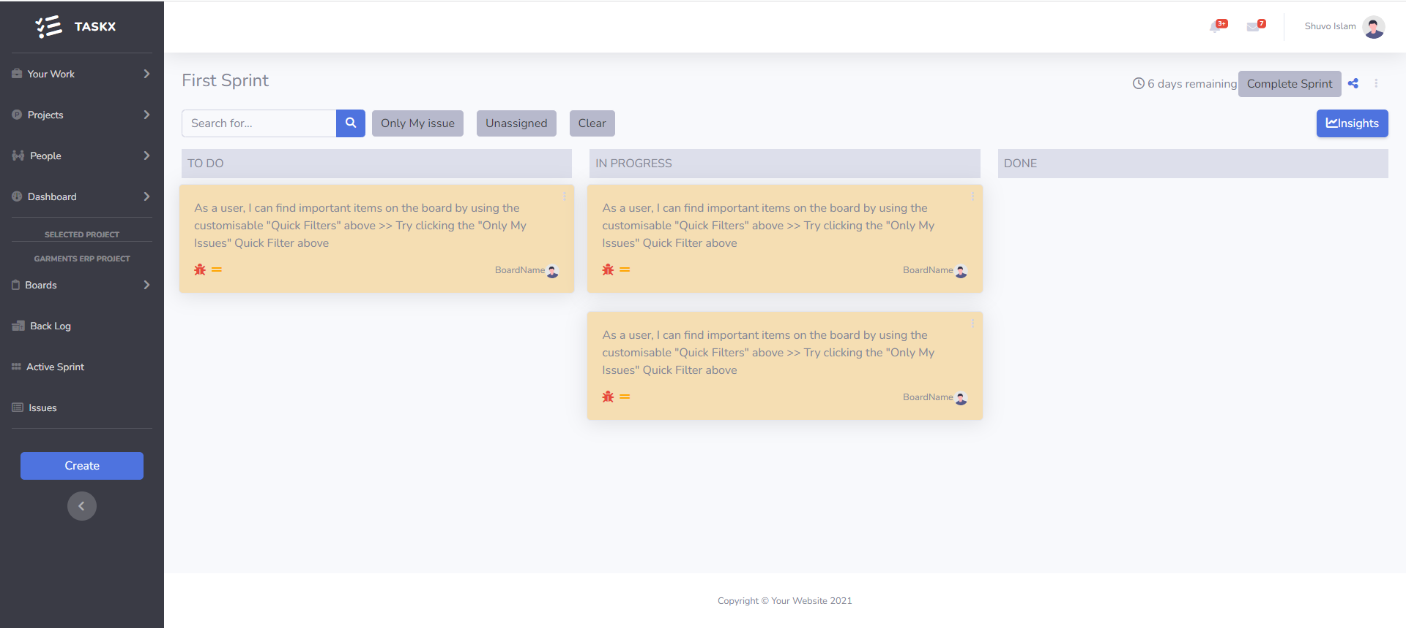
Sprint Dashboard with multiple Issues Page

Slide 14
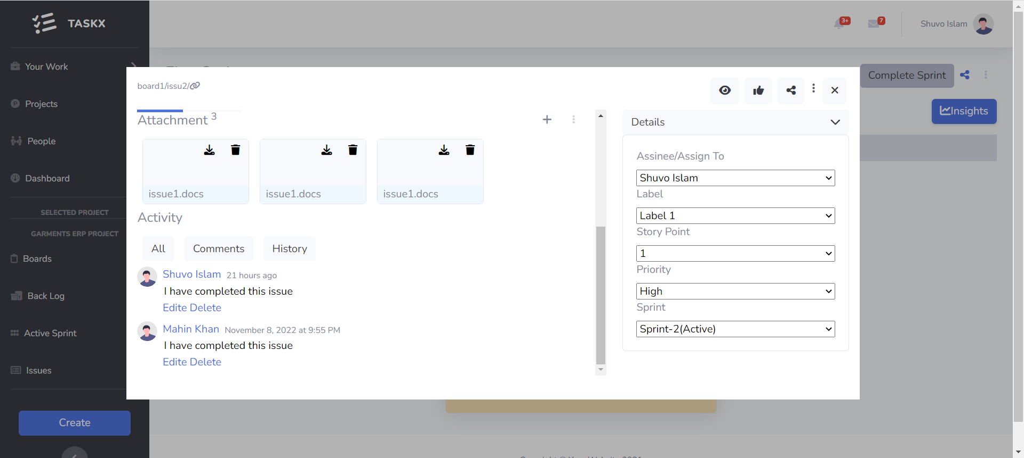
IssuE Edite Page

Slide 15
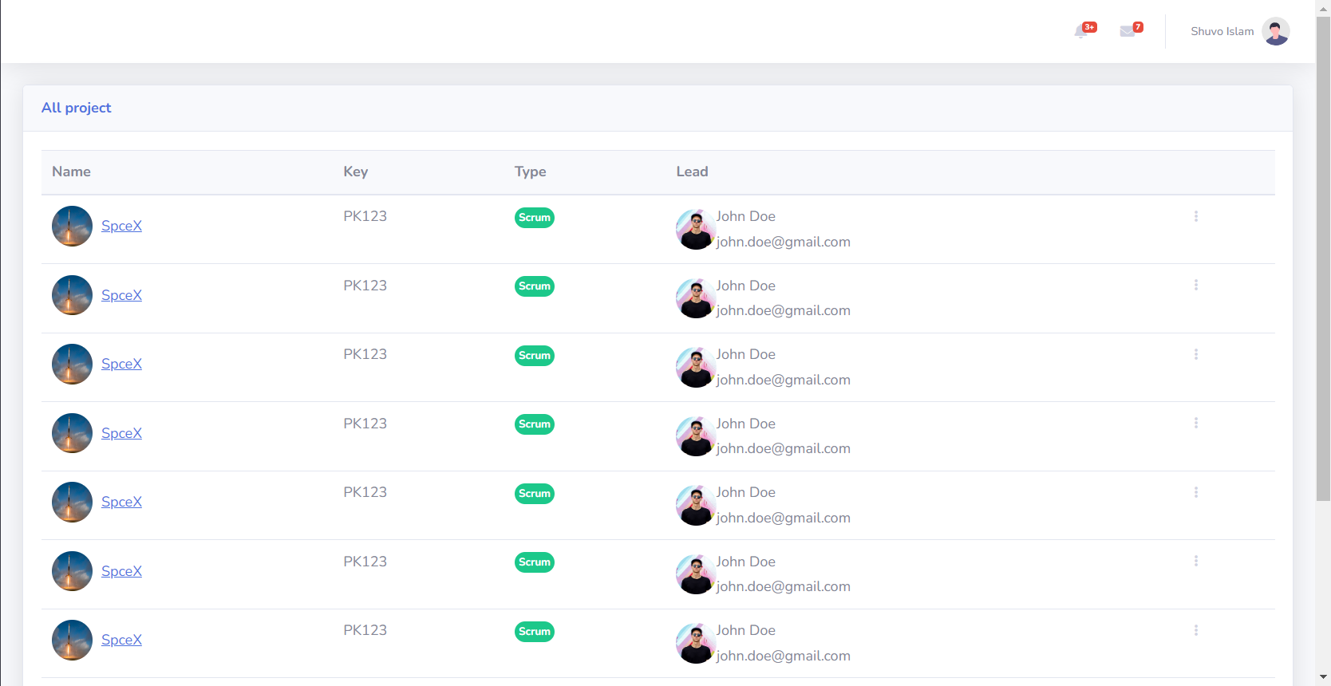
All projects PAGE

Slide 16

Challenges
Managing custom dependencies within different teams
Handling too many inputs fields
Fitting every project requirement only on Scrum template

Slide 17


