Slide 1
Electronic Heartbeat Reader/ Electronic Stethoscope
Title: Electronics Laboratory
Group name: Amplifier (03)
Presented By :
Md. Nayon Khan | 021 221 045
Suvom Karmakar | 021 221 027
Md. Ratul Hassan | 021 221 036
Shakil Ahmed | 021 221 040

Slide 2
Table Of Contents
Table Of Contents
Introduction
Block Diagram
Circuit Diagram
Implemented Project
Working Principle
Results
Cost estimation
conclusion

Slide 3
Introduction
In an era driven by technological advancements, the intersection of healthcare and innovation has birthed remarkable breakthroughs.
This presentation delves into the realm of medical technology, spotlighting the development of an "Electronic Heartbeat Reader / Electronic Stethoscope.
By amalgamating traditional medical tools with modern electronics, this project aims to enhance diagnostic capabilities, revolutionizing how we perceive and analyze vital signs

Slide 4

Block Diagram

Slide 5
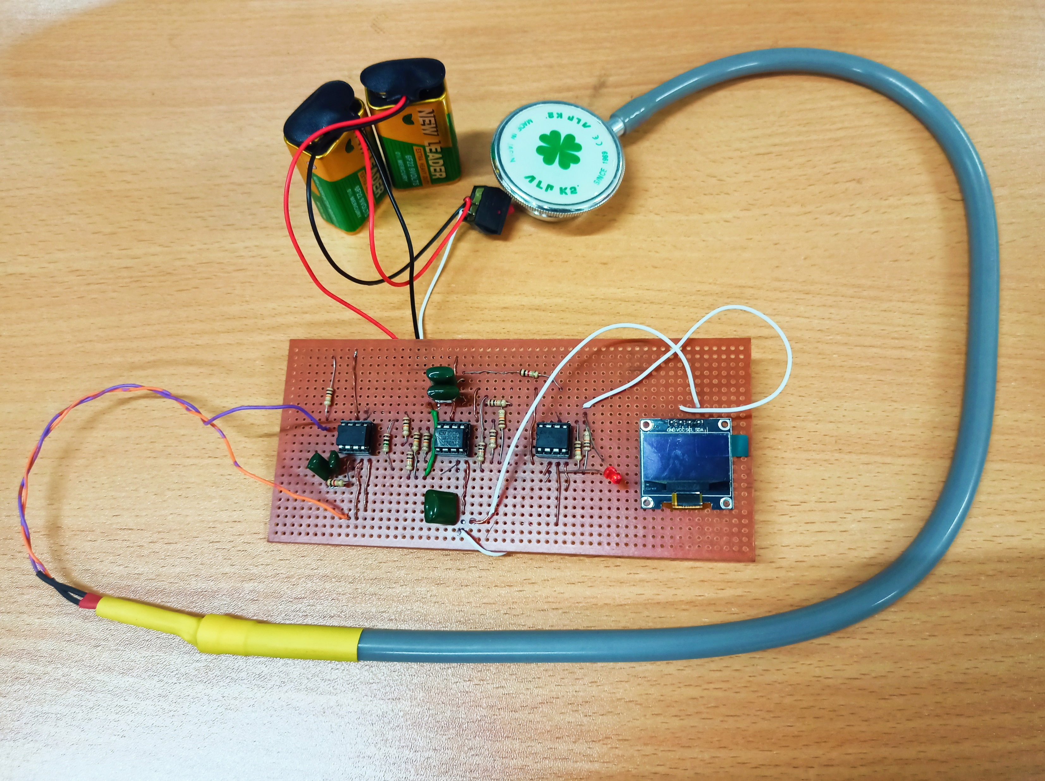
Implemented Project

Slide 6
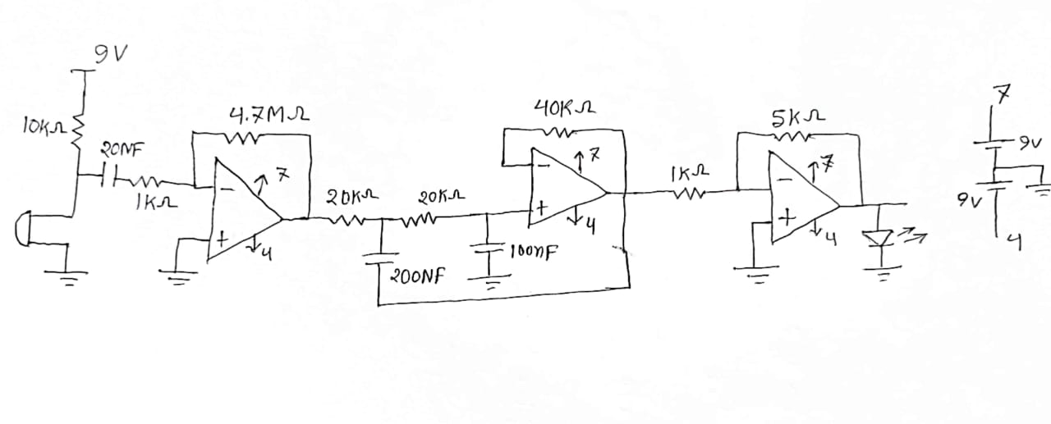
Circuit Diagram

Slide 7
Working Principle
At its core, a traditional stethoscope relies on sound conduction to detect internal sounds, restricting its usage in noisy environments.
Our electronic stethoscope transcends these limitations through cutting-edge electronics.
Employing sensitive microphones strategically placed, it captures physiological sounds with utmost precision.
These captured sounds are then amplified, filtered, and conveyed to medical professionals through audio outputs, transcending the auditory limitations of the conventional stethoscope.

Slide 8
Results
The outcomes of this project exceeded expectations.
Comparative trials against traditional stethoscopes revealed enhanced clarity in sound reception, enabling more accurate diagnoses.
Furthermore, the electronic stethoscope's ability to record and store readings opens doors for longitudinal patient monitoring.
Initial clinical tests showcased promising outcomes, setting the stage for wider adoption within the medical community

Slide 9
Cost Estimation
Op-Amp – 45tk
Capacitors, Resistors & LED – 40tk
Display – 245tk
Battery – 100tk
IC holder – 25tk
Stethescope – 250
Mic –15tk
Arduino UNO – 700tk
Veroboard – 20tk
________________________________________________
TOTAL = 1440tk (BDT)

Slide 10
Conclusion
In a world continually reshaped by technological marvels, the Electronic Heartbeat Reader / Electronic Stethoscope project stands as an exemplar.
It amalgamates medical heritage with digital innovation, amplifying medical practitioners' diagnostic acumen.
The project not only redefines stethoscope functionalities but also epitomizes the potential of technology to reinvigorate healthcare, ultimately leading to improved patient care and medical outcomes.

Slide 11

Question and Discussion

Slide 12

Thank you

