Slide 1
Electronic Heartbeat Reader/ Electronic Stethoscope
Title: Electronics Laboratory
Group name: Amplifier (03)
Group member :
Md. Nayon Khan | 021 221 045
Suvom Karmakar | 021 221 027
Md. Ratul Hassan | 021 221 036
Shakil Ahmed | 021 221 040

Slide 2
Table Of Contents
Table Of Contents
Circuit Diagram
Amplification
Low Pass Filter
Unity Gain
Audio Amplification

Slide 3
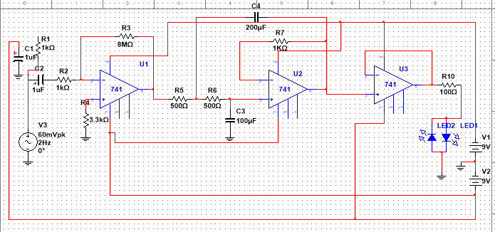
Circuit Diagram

Slide 4
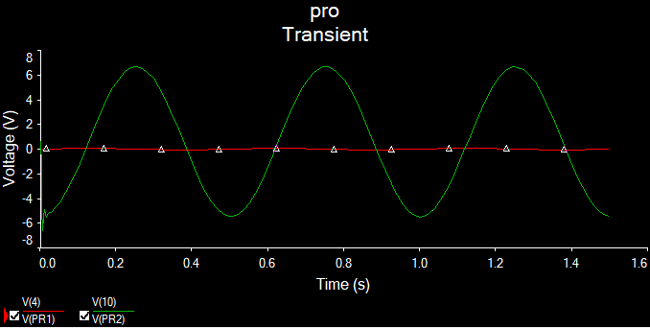

Amplification

Slide 5

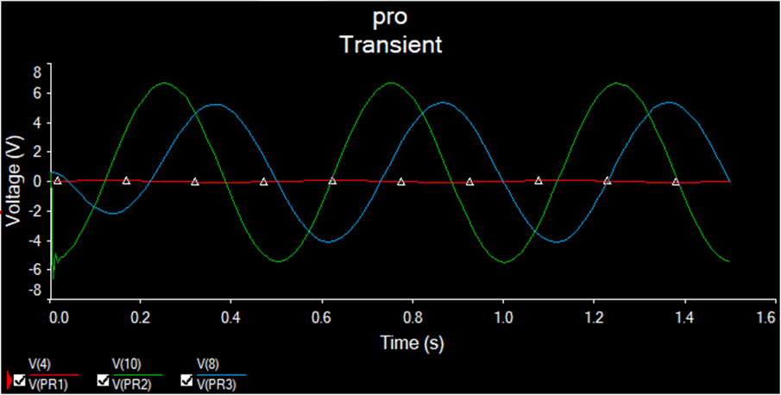

Using Low Pass Filter

Slide 6
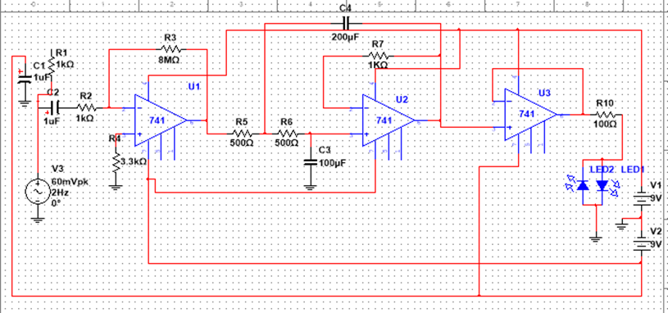
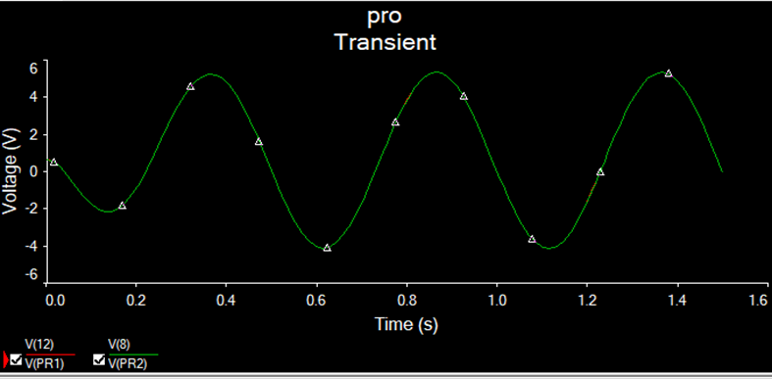

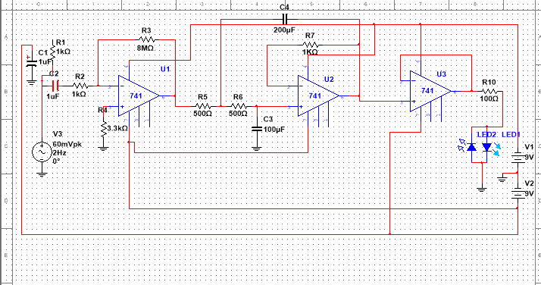
Keeping Unity Gain

Slide 7
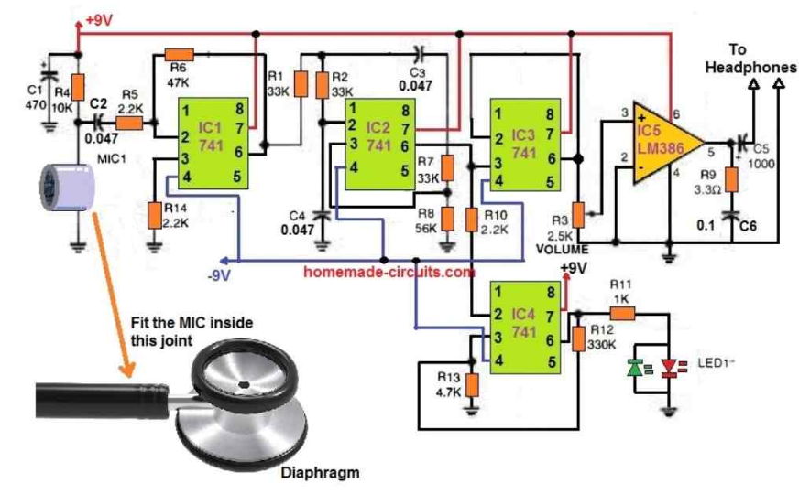
Audio Amplification for sound

Slide 8
References
http://www.hobby-circuits.com/circuits/audio/audio-preamplifier/107/electronic-stethoscope

Slide 9

Thank you

