Slide 1
MATLAB Presentation Simulation Laboratory
Group – 02
Name | Id
Suvom Karmakar | 021 221 027
Gazi Al Shahriar | 021 221 029

Slide 2
Introduction
MATLAB code is like a magic wand for turning plain pictures into amazing art.
It uses special tricks (algorithms) to make backgrounds look cool and blurry.
Every line of code is like a brushstroke, making the picture more interesting.
It's not just about finishing a task; it's what makes our blurred pictures come alive.
With MATLAB, we're not just writing code; we're creating awesome images.

Slide 3
Objective
Make blurring backgrounds easy with MATLAB.
Understand algorithms and use simple code.
Learn practical image tricks anyone can do.
Create cool blur effects easily.
Get awesome results without the hassle.

Slide 4
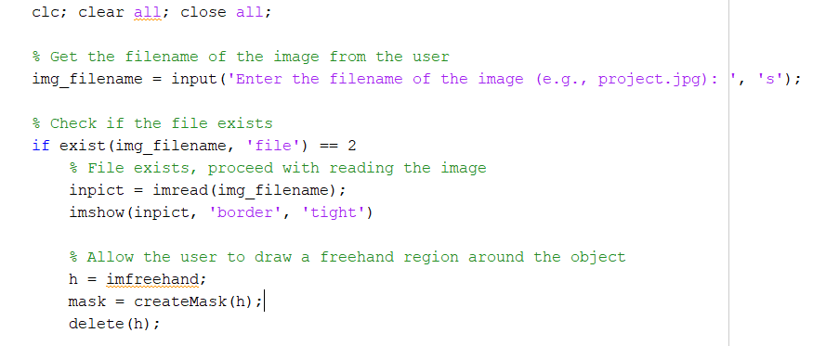
MATLAB code

Slide 5
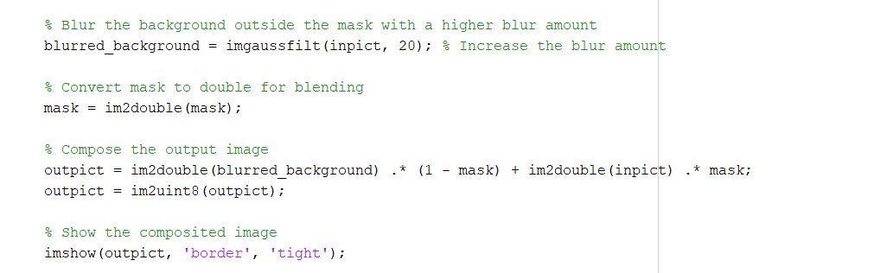
MATLAB code

Slide 6
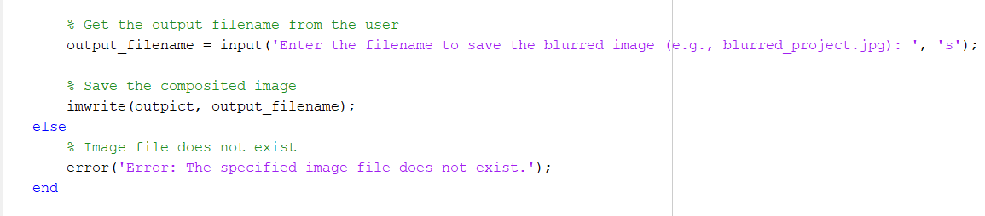
MATLAB code

Slide 7
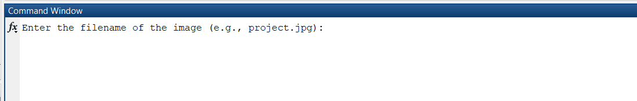
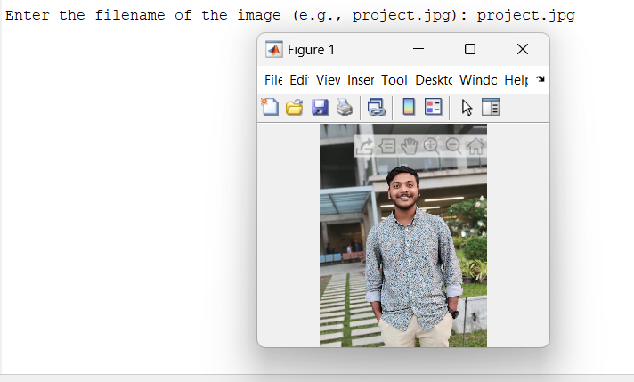
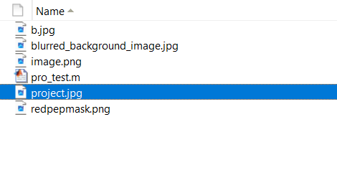
Project Output

Slide 8
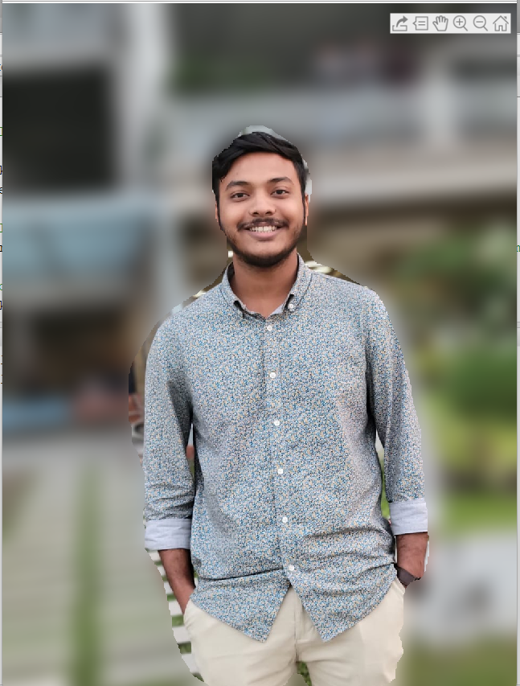
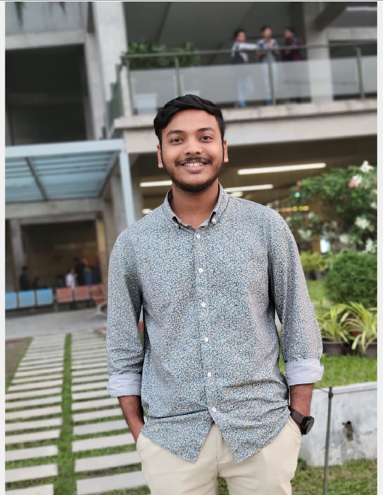
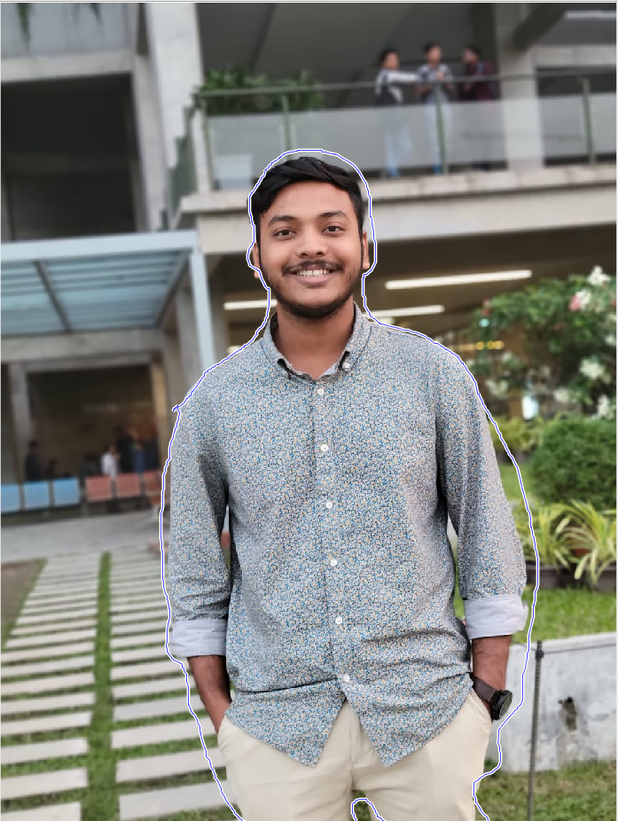
Project Output
After
Before
Create Mask

Slide 9
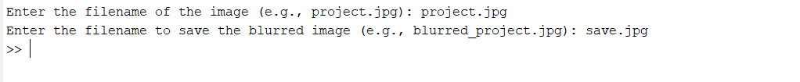
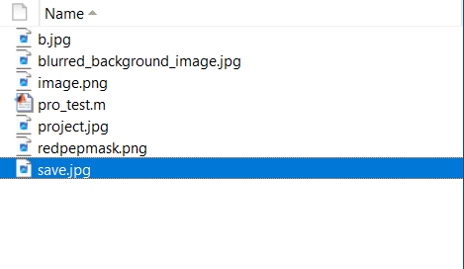
Project Output

Slide 10
Online Resource
Google
ChatGPT
Mathworks

Slide 11
Challenges
Complicated algorithms.
Tricky parameter adjustments.
Making it work fast for big groups of pictures.
Dealing with different kinds of pictures.
Fixing weird things that show up in the pictures.
Making it easy for people to use (if there's a menu).
Making sure it works like people expect in real life.

Slide 12
Conclusion
Successful demonstration of selective focus in digital images using MATLAB.
Utilization of advanced algorithms and MATLAB capabilities for visually compelling results.
Emphasis on the aesthetic impact of background blur in the project.
Overcoming challenges to pave the way for future innovations in image processing.
Acknowledgment of the journey and anticipation of exciting prospects at the intersection of MATLAB and creative visual enhancement.

Slide 13

clc; clear all; close all;

