Slide 1
Welcome
Suvom Karmakar
ID: 021 221 027
Electrical Wiring & Drafting

Slide 2
Table of Content
Layout
Switch Board Calculation
Switch Board Connection Diagram
Breaker selection for Switch Board grouping
Load Division
SDB & MDB Calculation
SDB & MDB Diagram
Single line Diagram (SLD)
Emergency Fire Alarm
Conclusion

Slide 3
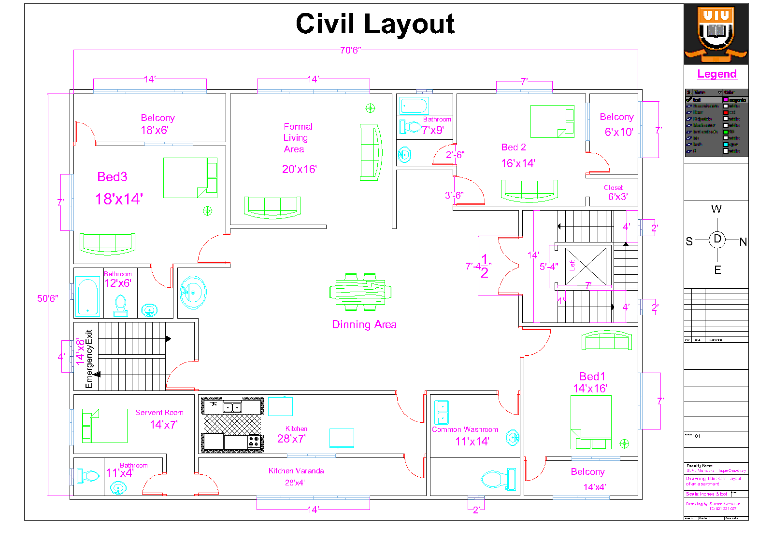
Civil Layout

Slide 4
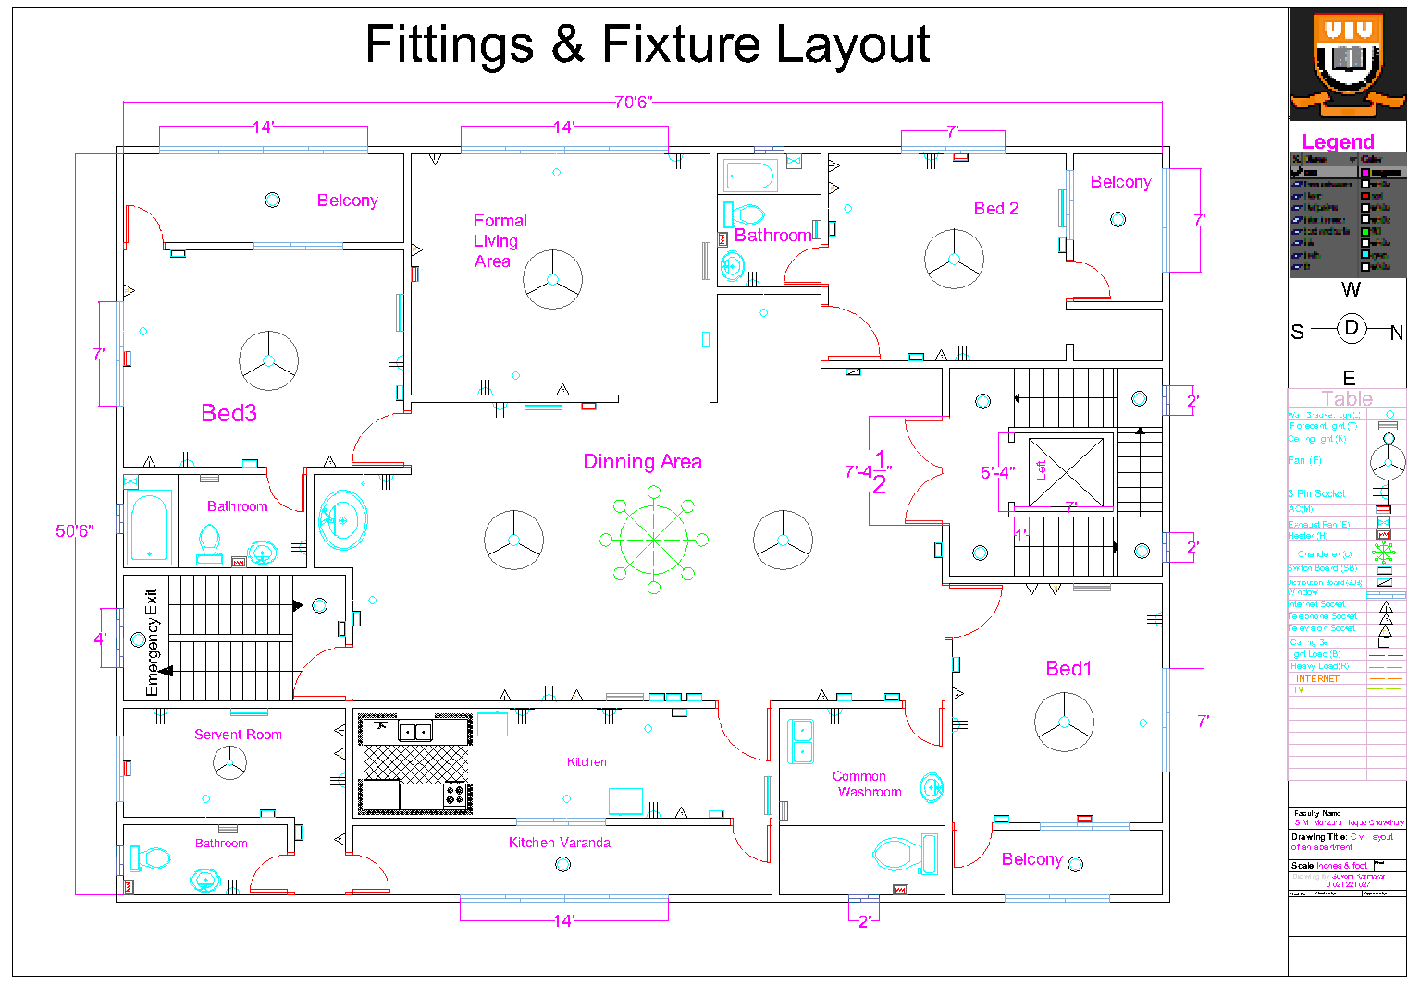
Fittings & Fixture Layout

Slide 5
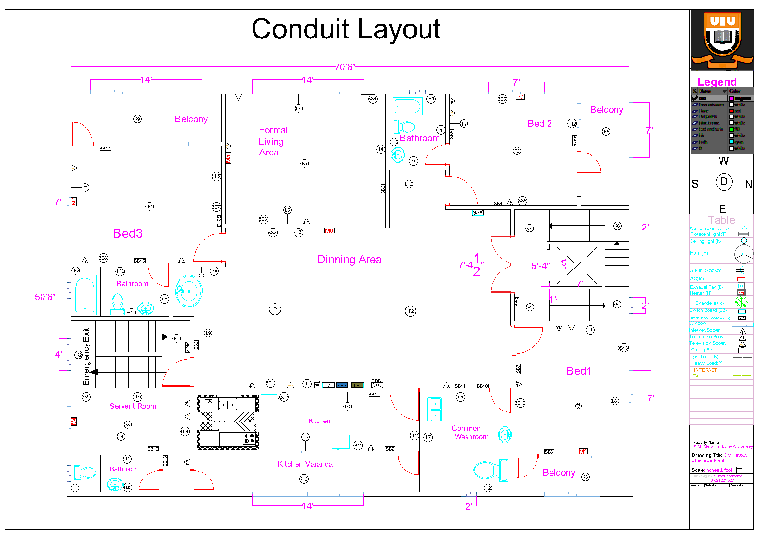
Conduit
Layout

Slide 6
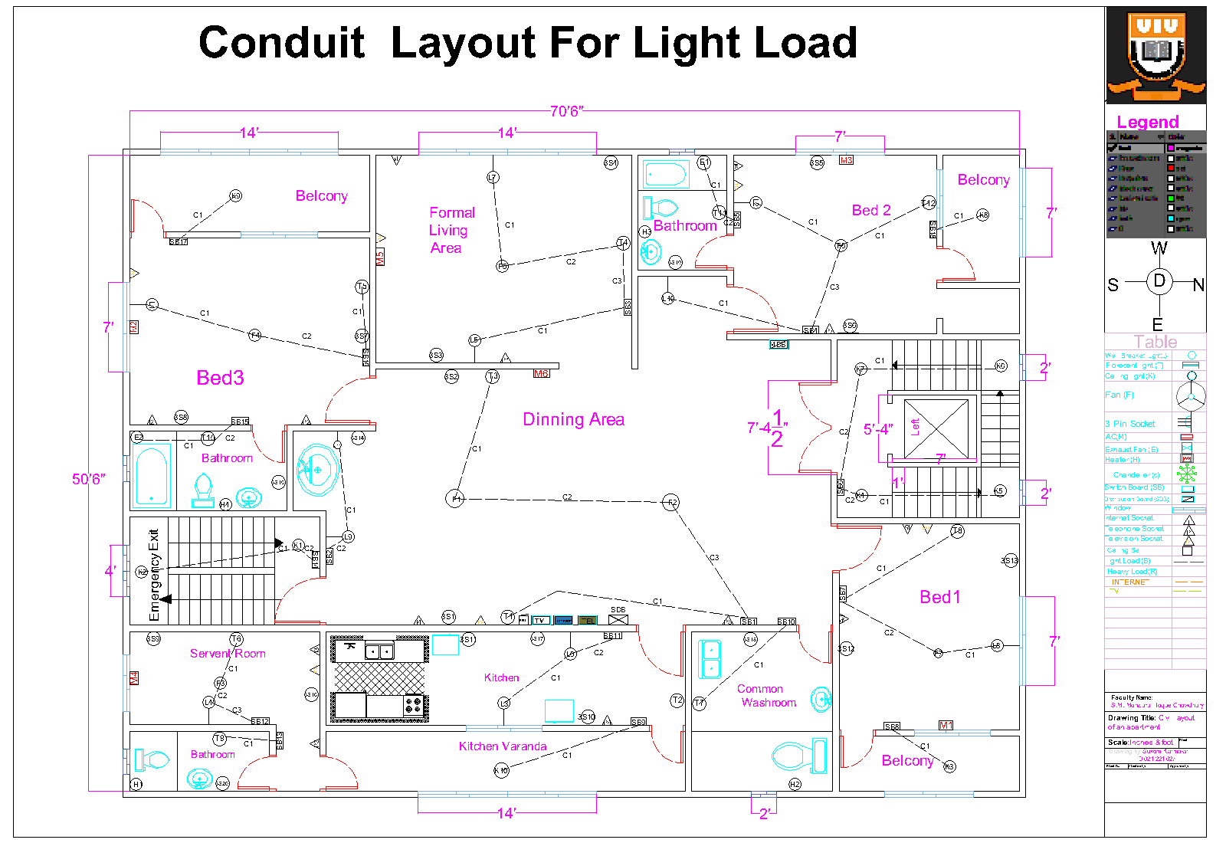
Conduit of Light Load
Layout

Slide 7
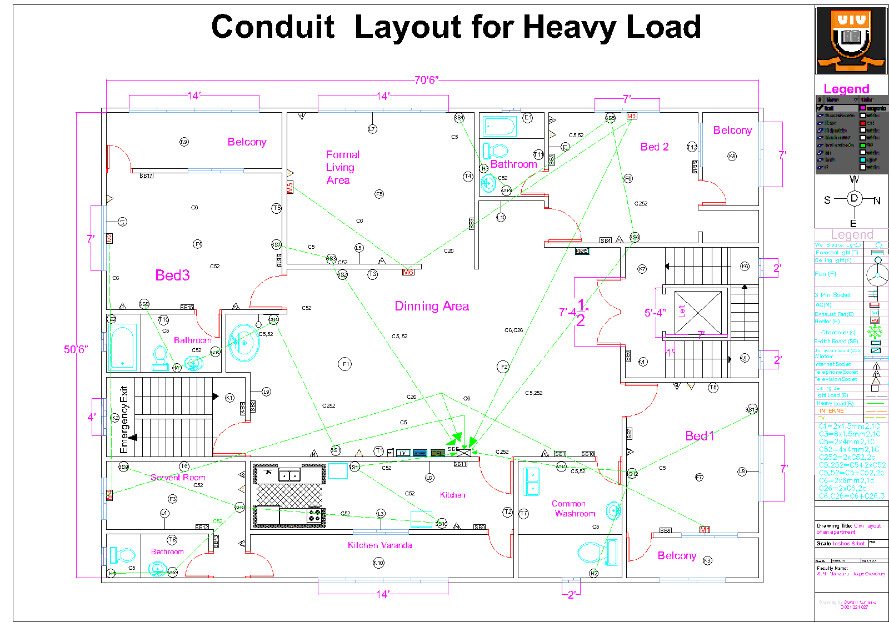
Conduit of Heavy Load
Layout

Slide 8
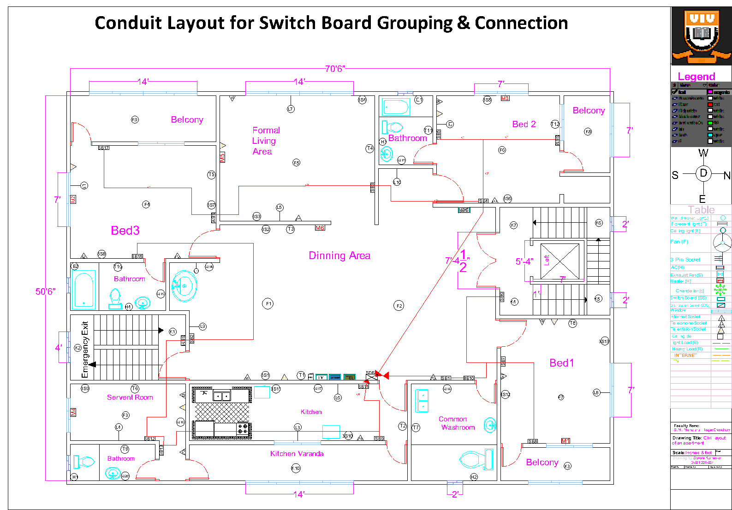
Switch Board Grouping
Layout

Slide 9
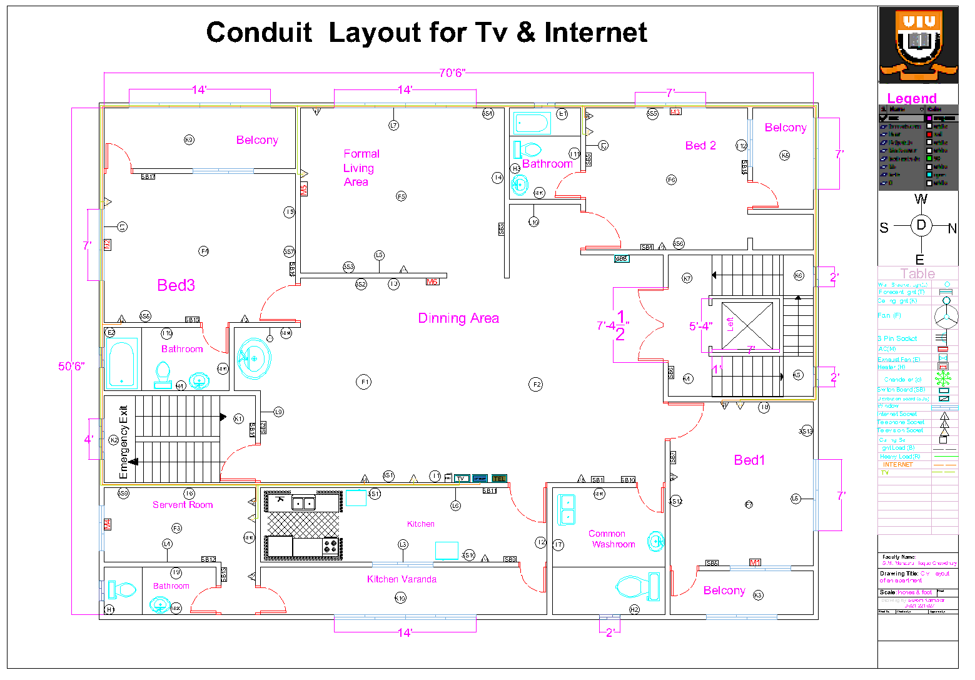
Conduit of TV and Internet Connection
Layout

Slide 10
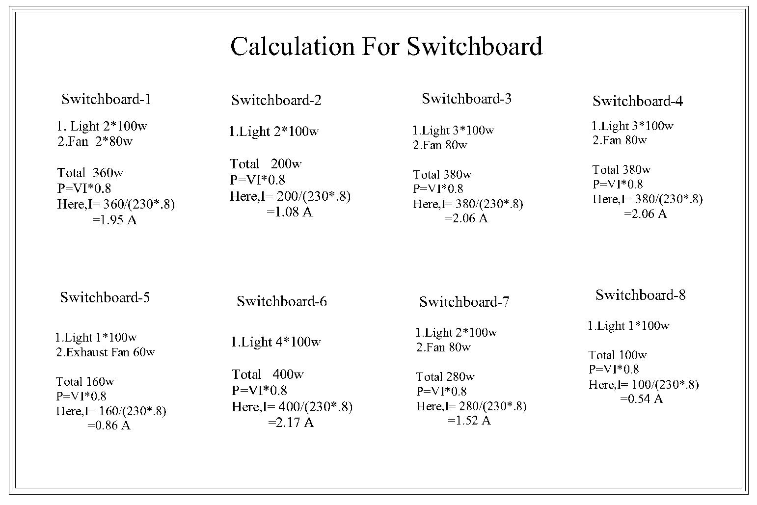
Switch Board calculation

Slide 11
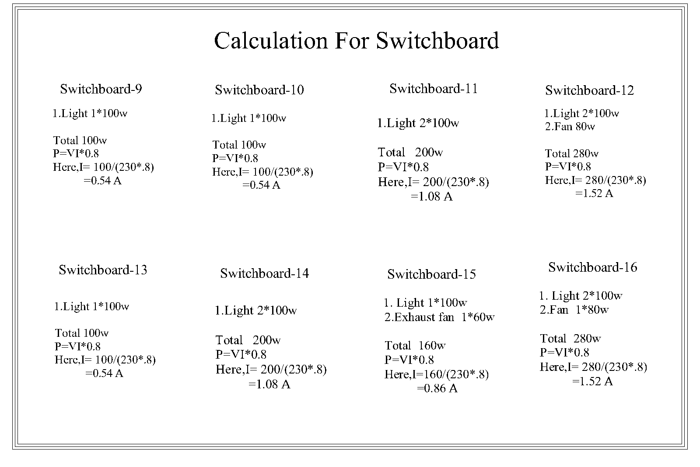
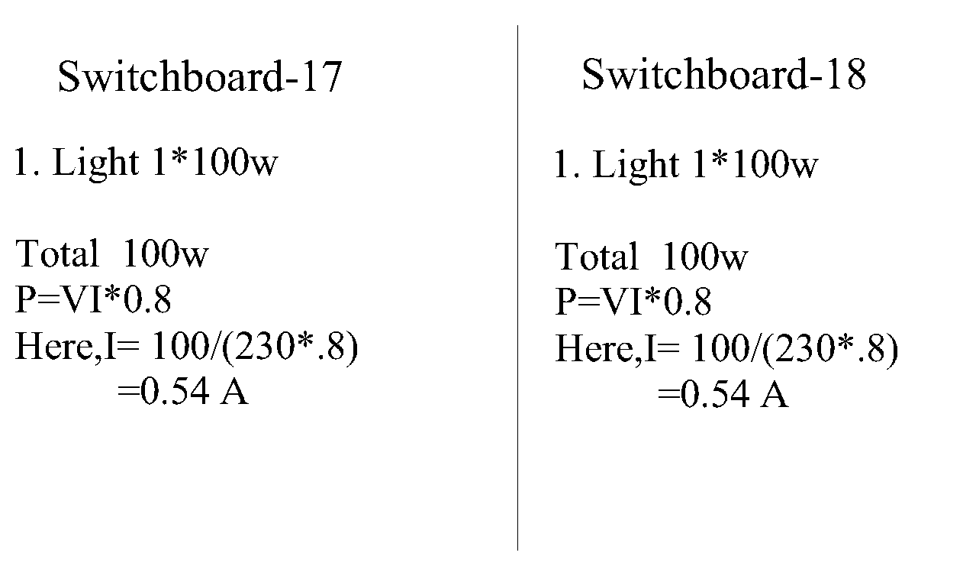
Switch Board calculation

Slide 12
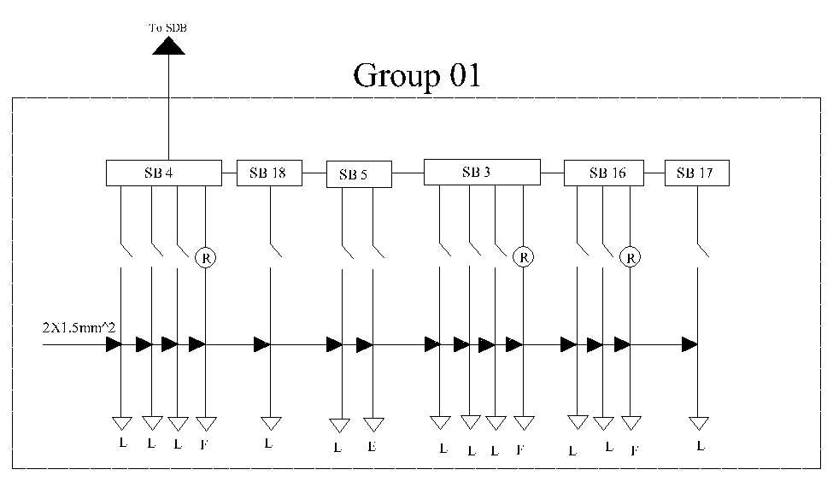
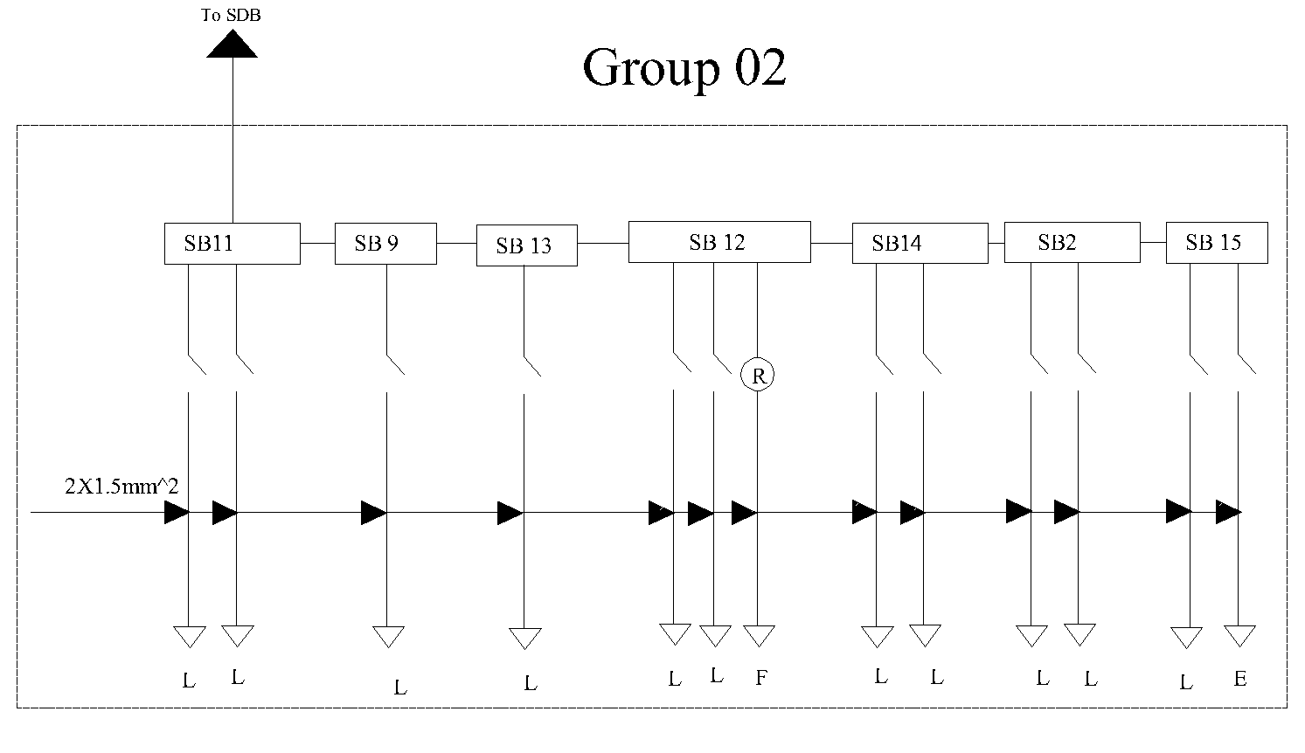
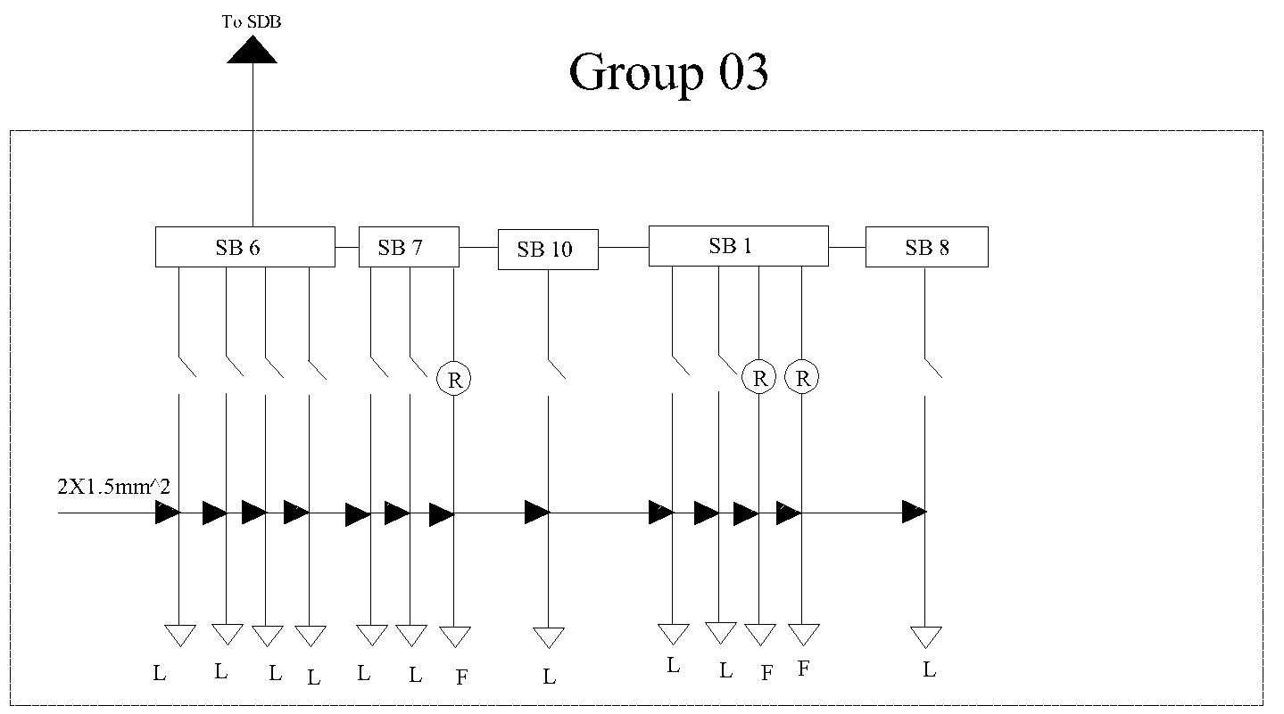
Switch Board Connection Diagram

Slide 13
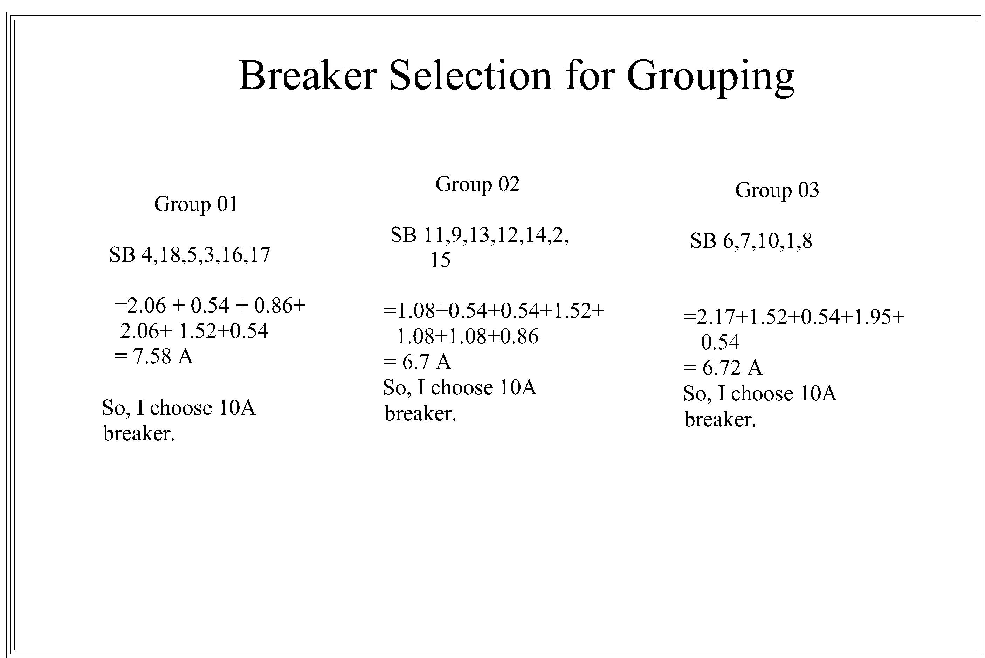
Breaker Selection for Switch Board Grouping

Slide 14
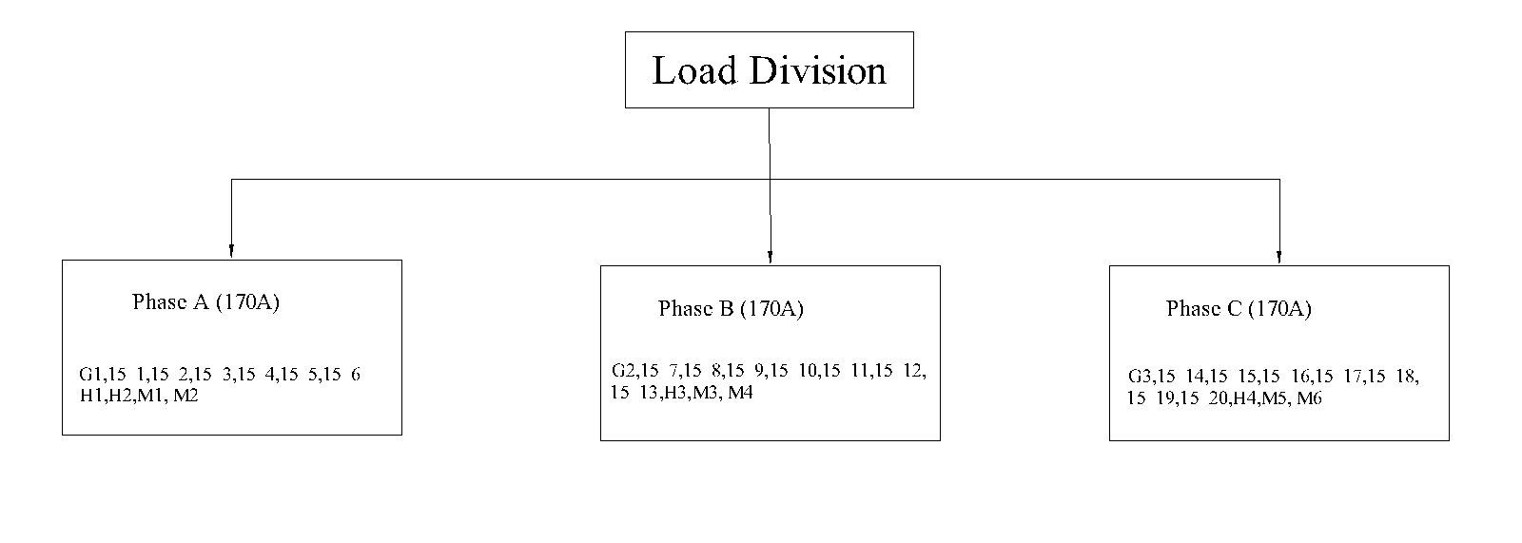
Load Division

Slide 15
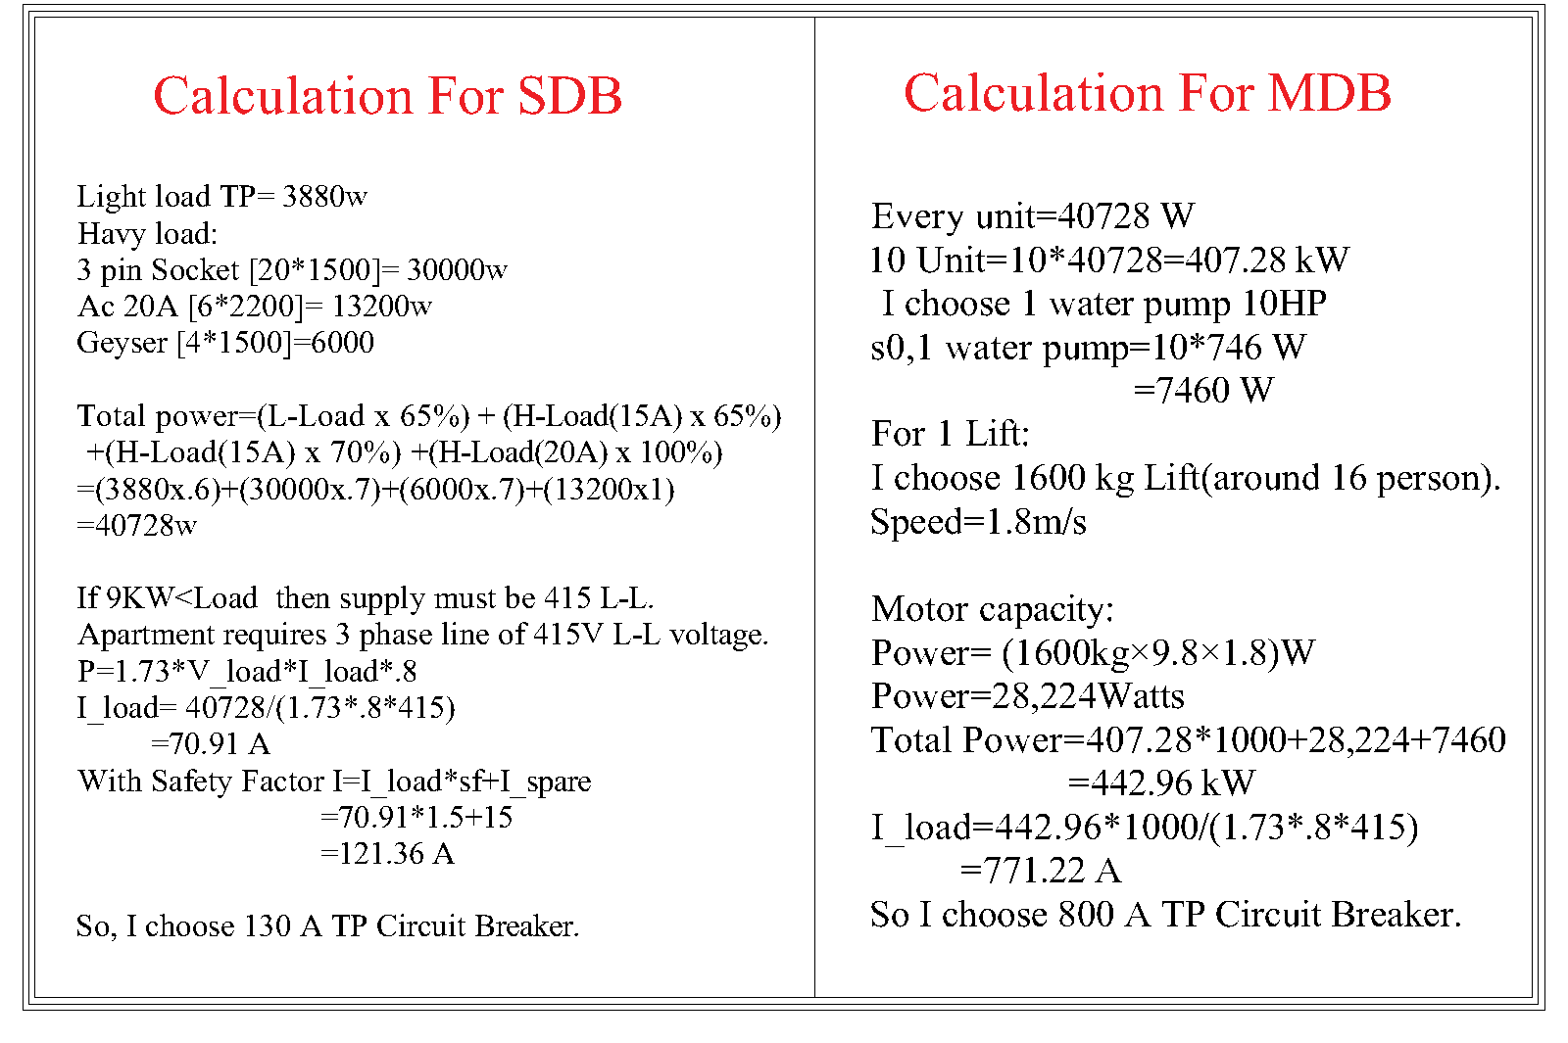
Calculation for SDB and MDB

Slide 16
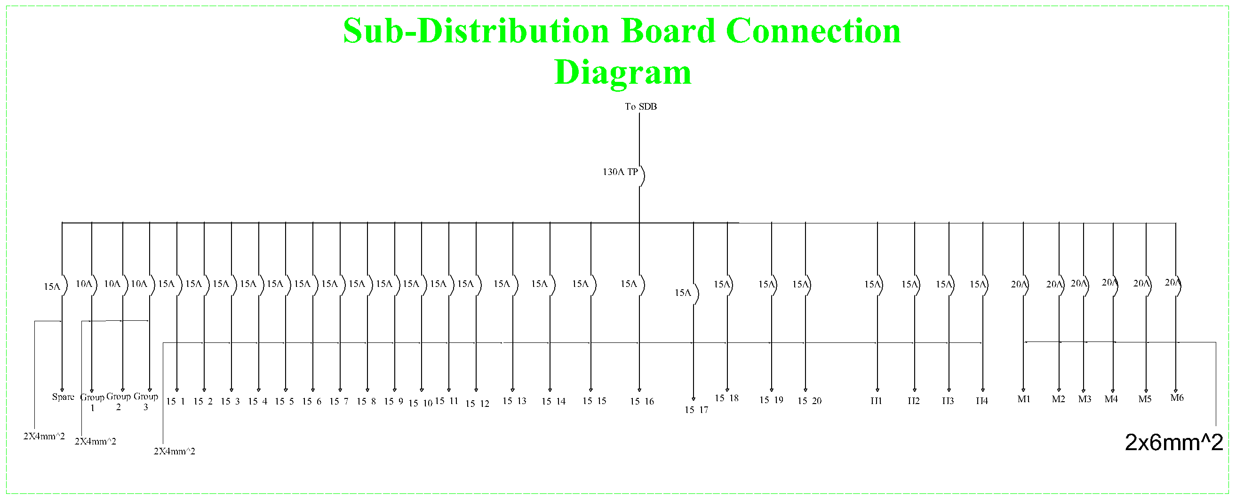
Sub-Distribution Board Diagram

Slide 17
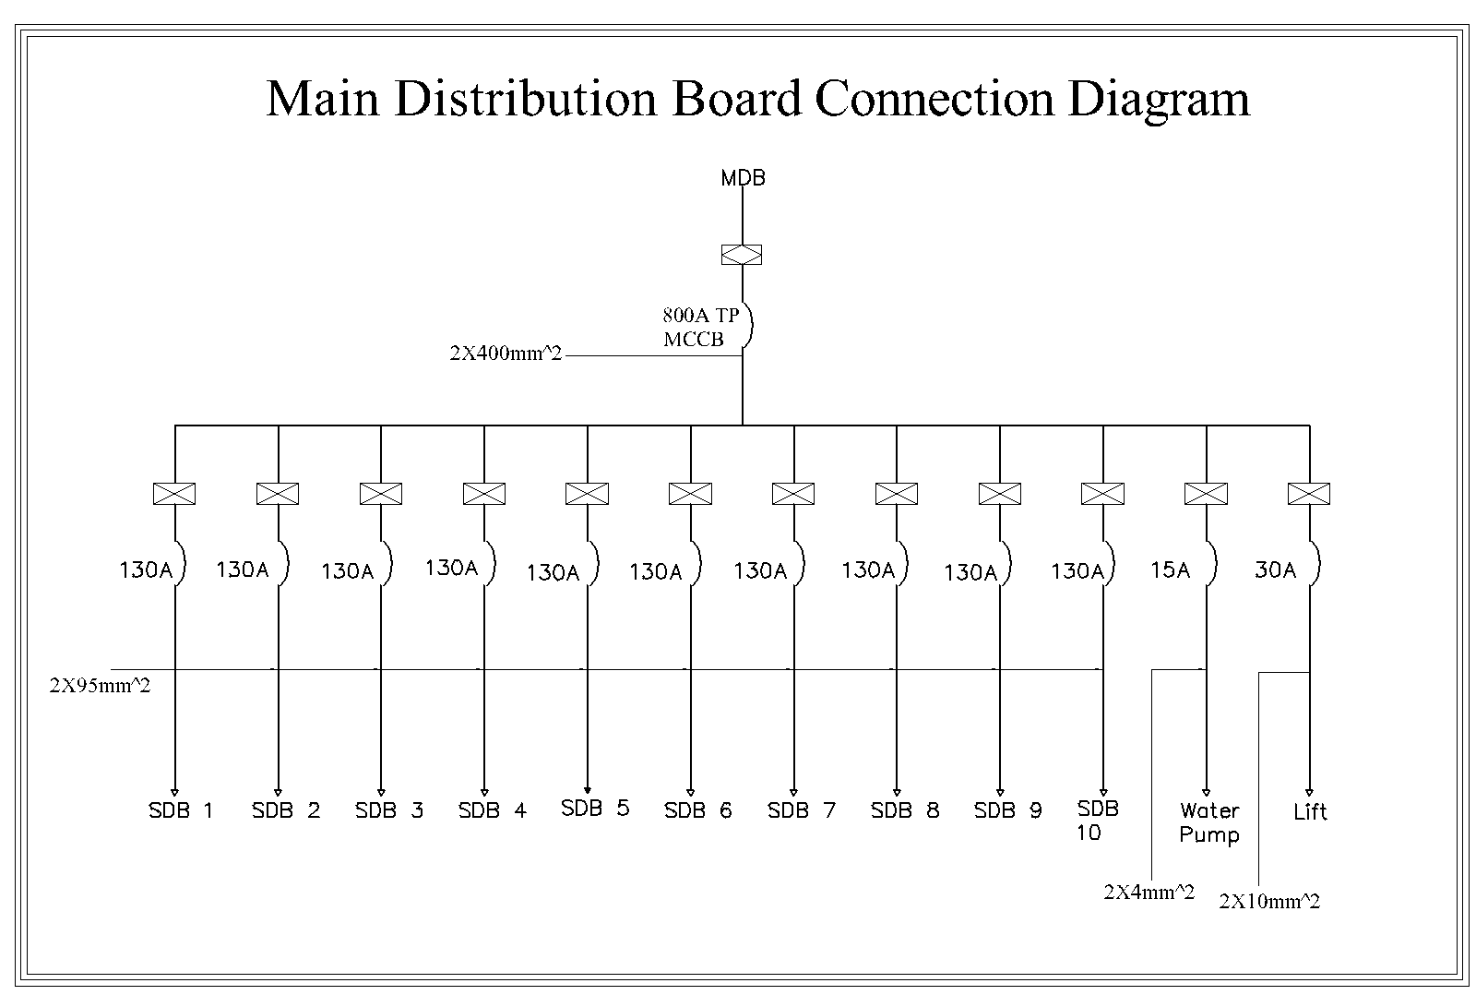
Main Distribution Board Diagram

Slide 18
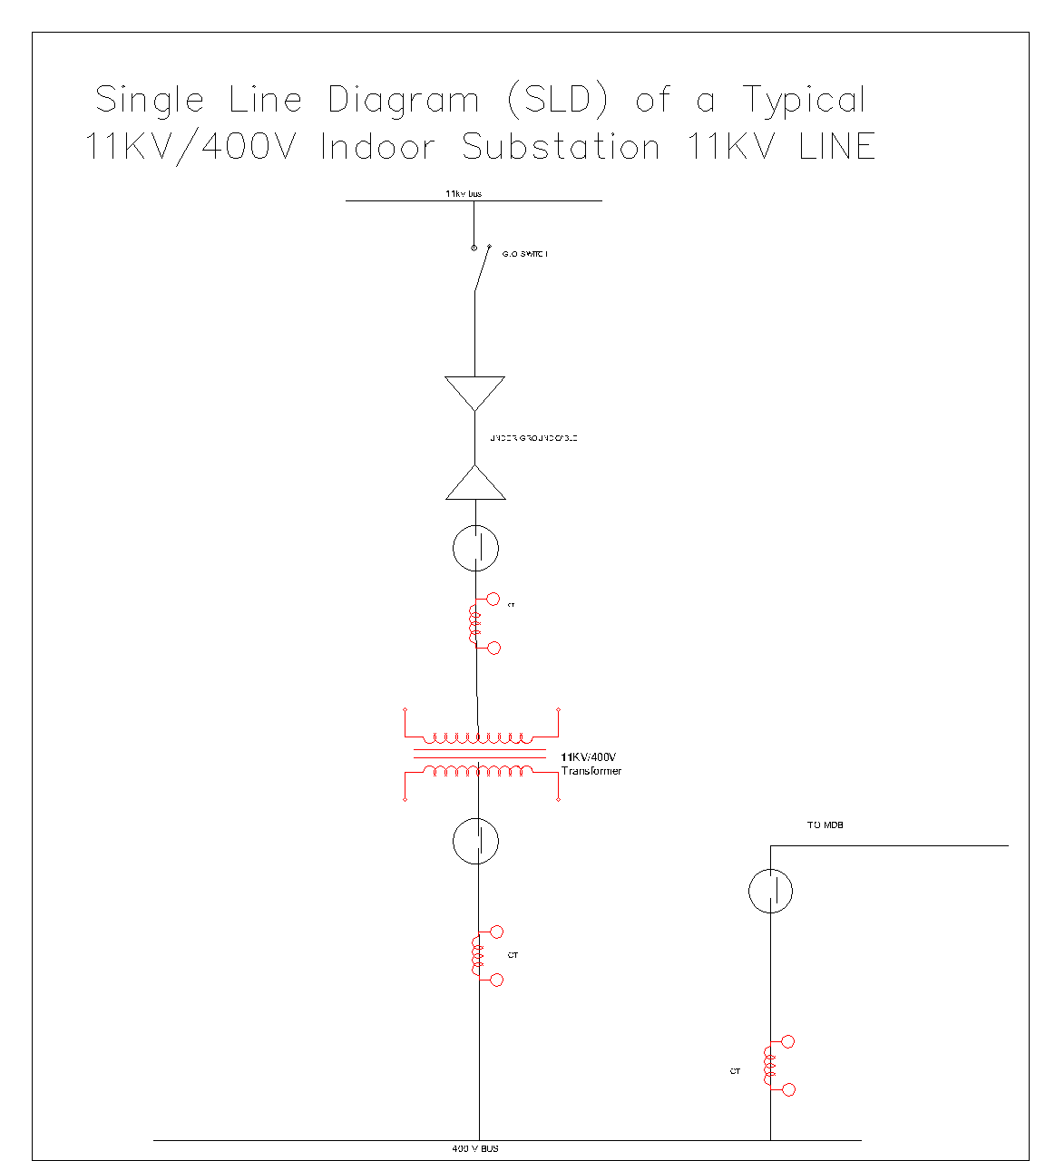
Single Line Diagram
Single Line Diagram (SLD) of a Typical 11KV/400V
Indoor Substation
Substation Area Requirements:
Total Area: 48m^2 (for 250 KVA)
Transformer Area: 13m^2 (for 250 KVA)
Location Consideration:
Placement: Substations preferred on the
ground floor, not in the basement
Regulatory Requirement in Bangladesh:
Rule: Buildings with a load exceeding 50KW must have 11KV/400V Electrical substations as per Bangladesh distribution company regulations.

Slide 19
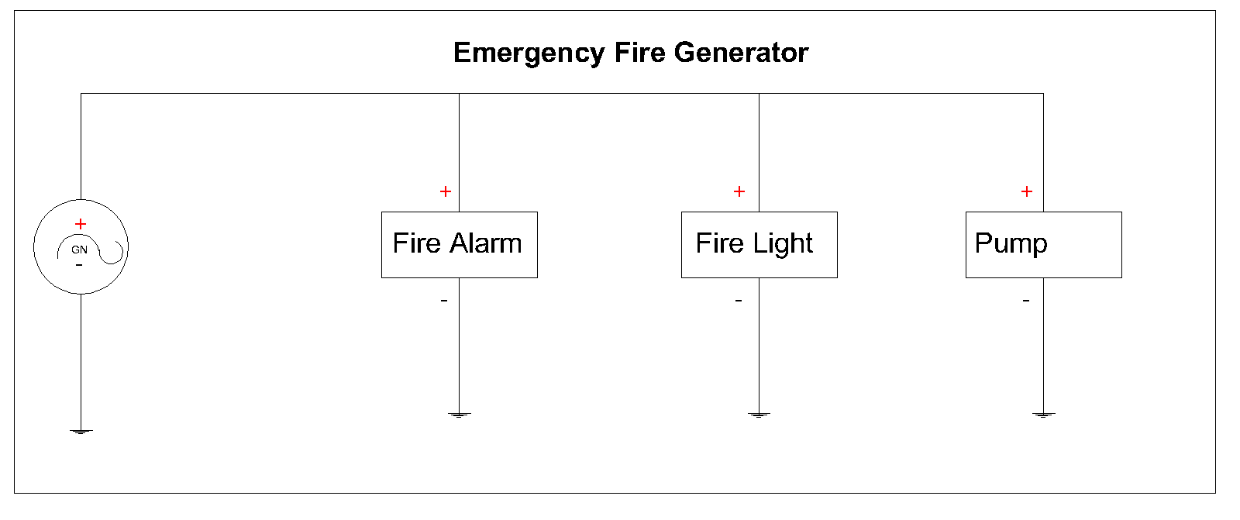
Emergency Fire Generator

Slide 20
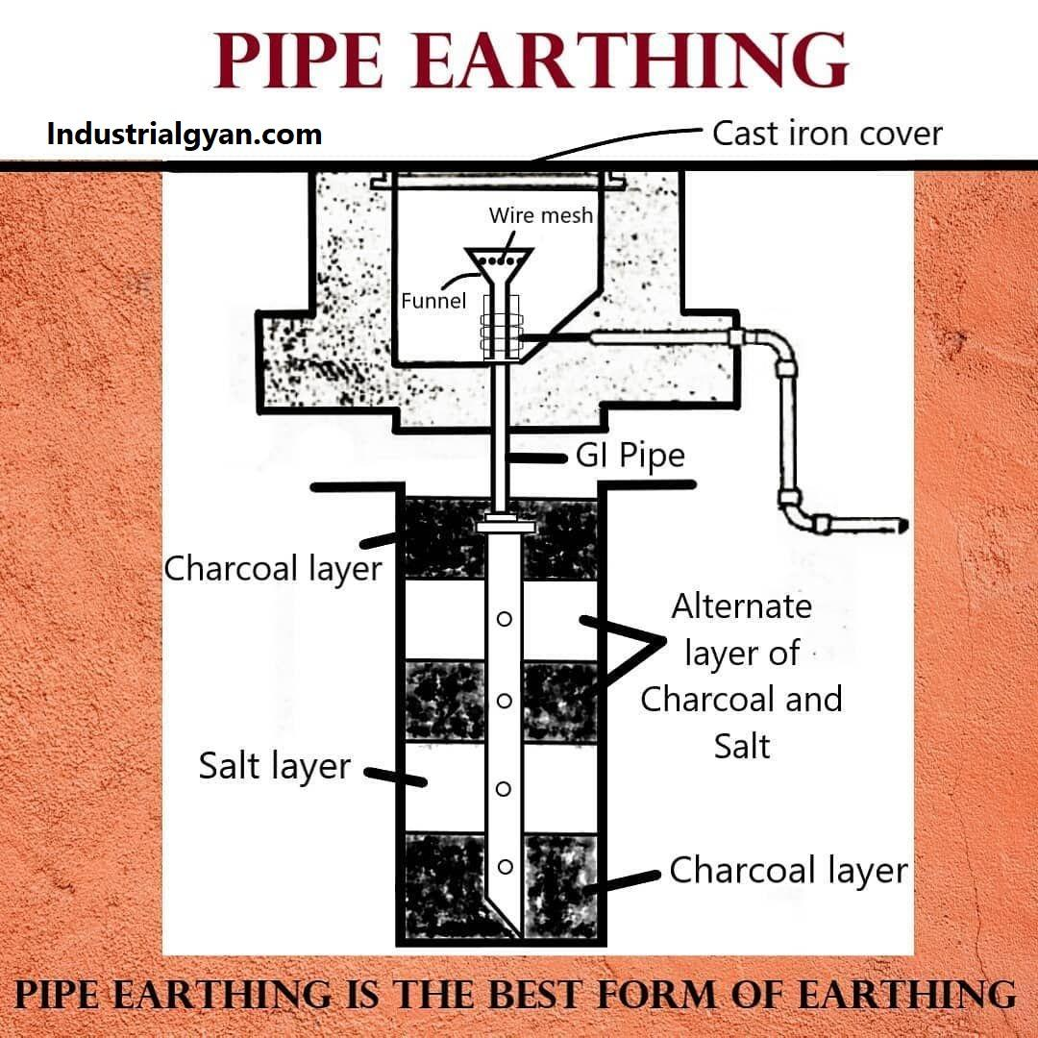
Earthing System
Pipe earthing works by securely connecting a metal pipe to the electrical system, allowing excess electrical current to safely dissipate into the ground, preventing electrical hazards.

Slide 21
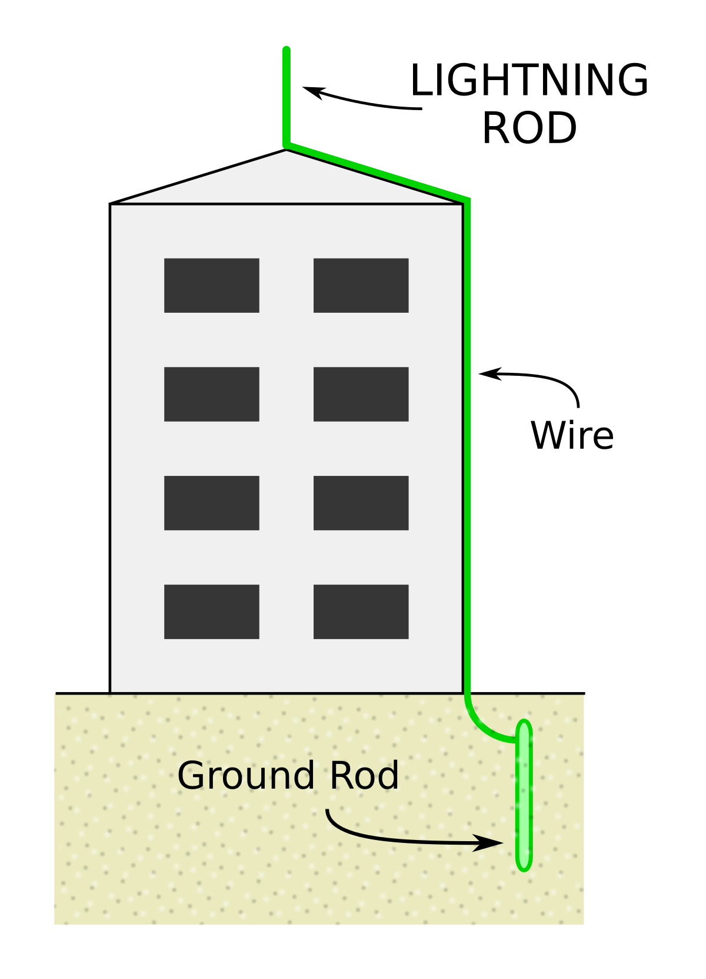
Lightning System
Components:
Air Terminals (Lightning Rods): Installed on high points, they intercept lightning strikes.
Conductors: Channel lightning currents safely to the ground.
Grounding System: Ensures effective dissipation of lightning energy into the ground.
How It Works:
When lightning approaches, the air terminals attract the electrical discharge.
The lightning current is then conducted through the system, preventing damage to the structure.
Grounding ensures the safe dissipation of the electrical energy into the ground.

Slide 22

Thank you

