Slide 1
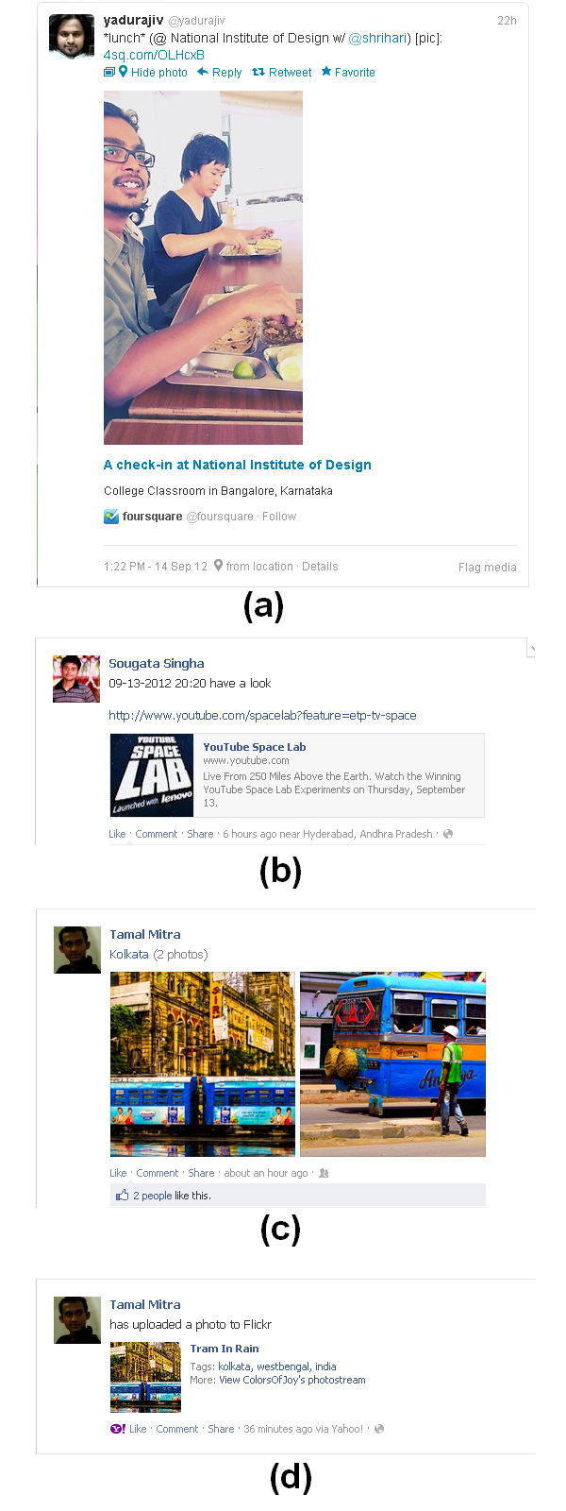
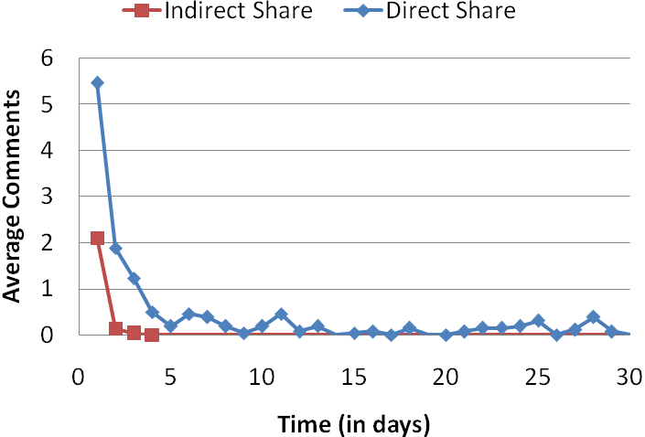
Abstract
Result and Analysis
Sharing of content is an important part of growing social networking culture. We examine the ineffectiveness of shared user-generated content (UGC) on social networking sites (SNSs). We divided the shared content into two categories direct share, where the content is created in SNS and indirect share, where the UGC is created in other websites/web-services. In particular, we study how the presentation parameter of the post affects the popularity of the content. The result is determined by analyzing views, likes and share of a direct and indirect shared content on Facebook. The findings indicate that indirect share, is less popular and short lived as compared to direct share. The study suggests that there is a need to design social networking feature that supports integration of UGC form other popular web-services.
 | Direct Share (average per post) | Indirect Share (average per post)
comments | 13.00 | 2.28
likes | 34.92 | 5.48
total | 47.92 | 7.76
Ineffective Sharing
H1. Indirect Shared content is less popular.
The popularity of the content can be measured as an aggregation of (1) number of people shares/repost the article, (2) number of people likes it or mark it as favorite, and (3) number of comments.
H2. Indirect Shared content is short lived.
We propose that it is more likely that direct share will have a larger life cycle as compared to indirect share.
We performed one-sided two-sample equal variance T-tests on two sets of data at 5% significance level. The first set contains 3 values for each of direct and indirect shares corresponding to average comments, average likes and average activities per post over the period of 30 days (see Table 1) for our first hypothesis. H1 is supported by a P-value of 0.0301. The second set contains day-by-day records of average number of posts from day 1 to day 30 for direct and indirect shares (see Figure 2) for our second hypothesis. The test supporting H2 had a P-value of 0.0398.
Notes:
Ineffective Sharing of UGC [CHI 2013: Work In Progress]

