Slide 1
Process Scheduling Simulator & IPv4 Subnetting Calculator Using Python + Linux
(Operating System & Networking project)
Members - Suvrat Jain, Ayati Arora, Kavyah Bhanushali, Kayana Agarwal

Slide 2
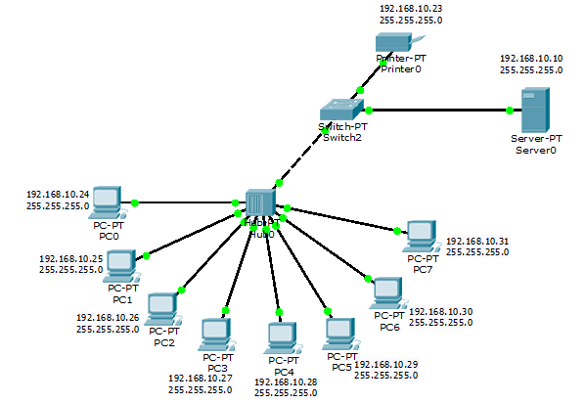
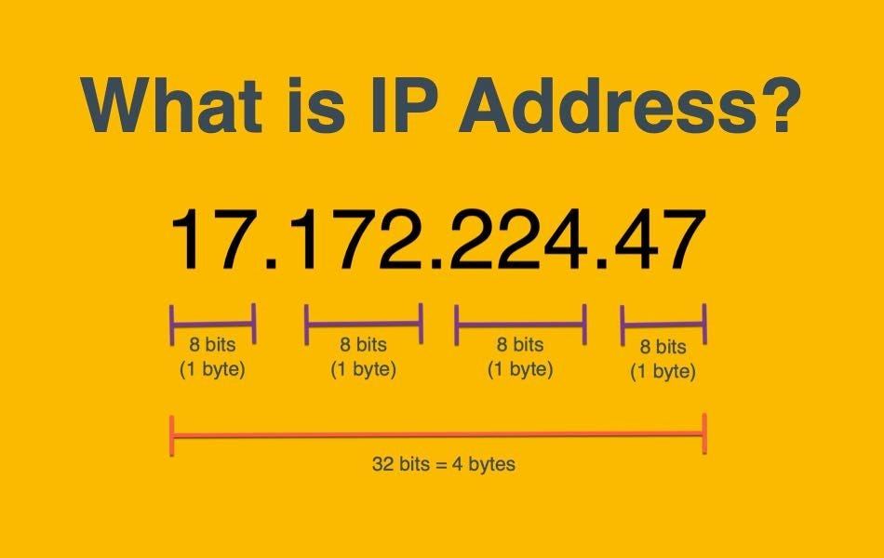
Internet Protocol Version 4 (IPv4)
Each device on the network is identified using a logical address called IPv4.
It plays an important role in routing data across the network, whether it be unicast, multicast, or broadcast.
An IPv4 address is composed of 32 bits divided into 4 octets, where each bit can be 0 or 1. Thus giving a total of 2³² addresses.
Each octet has numbers from 0-255

Slide 3

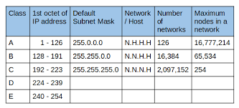
IPv4 Problem Statement
When IPv4 was developed, it was believed that internet wouldn’t grow at an exponential rate. Hence a lot of address spaces were kept reserved.
0.x.x.x address space was reserved to signify the current network.
127.x.x.x address space was reserved for loopback testing and self diagnosis.
However, in reality, internet exploded and now we are facing dearth of IPv4 addresses.

Slide 4
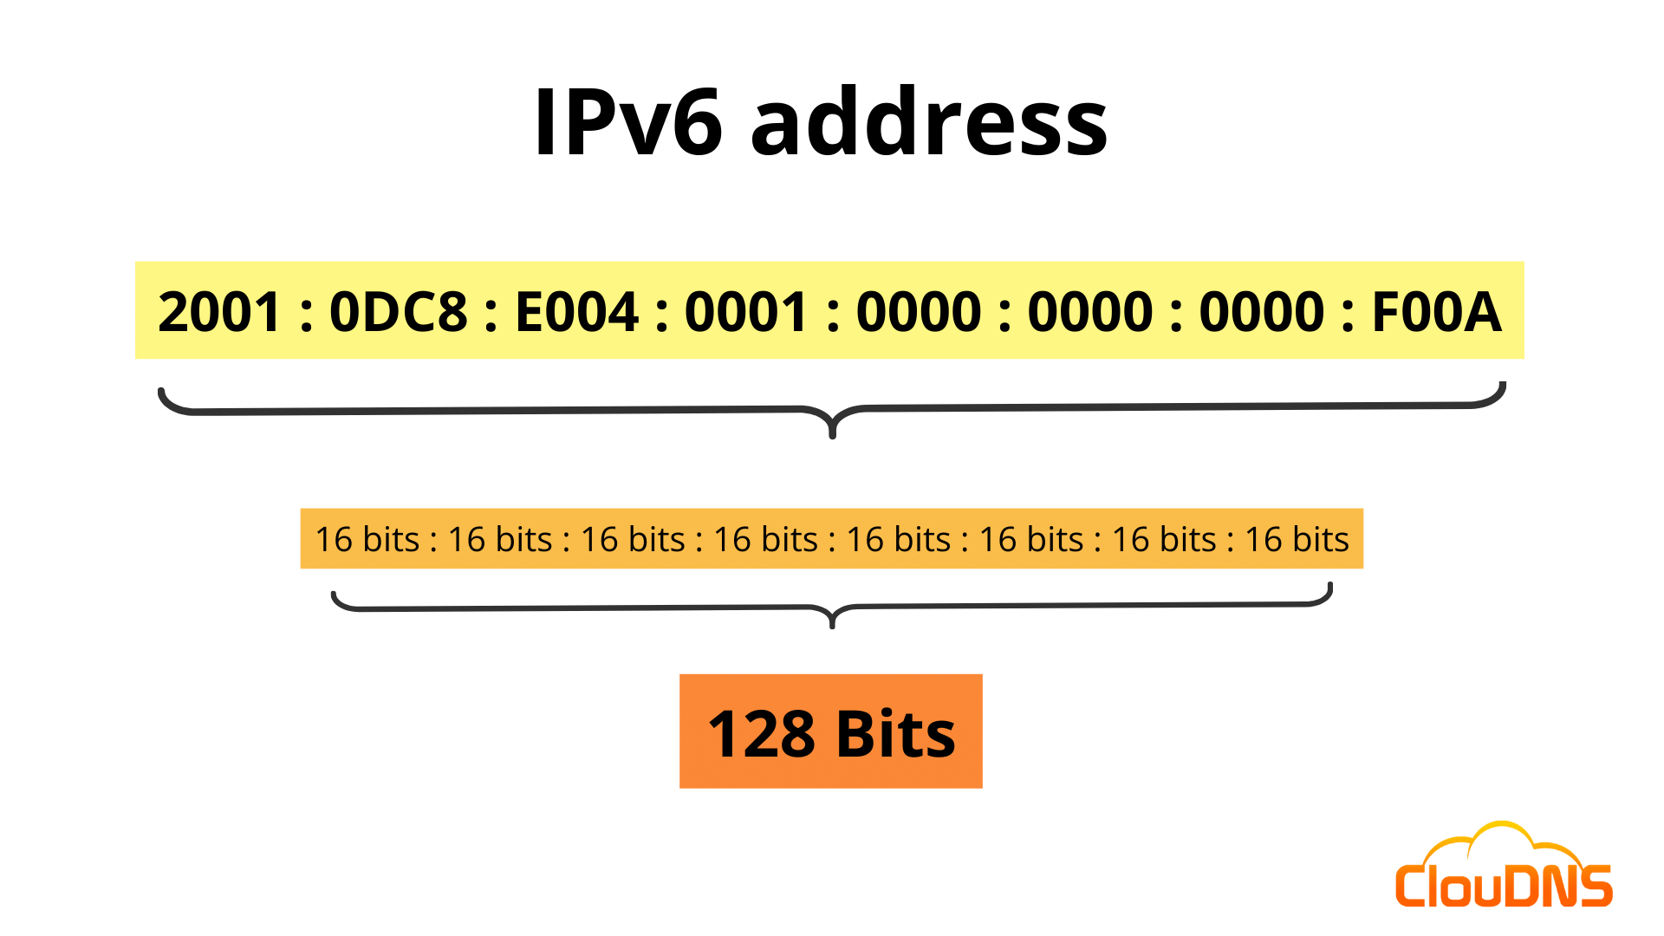
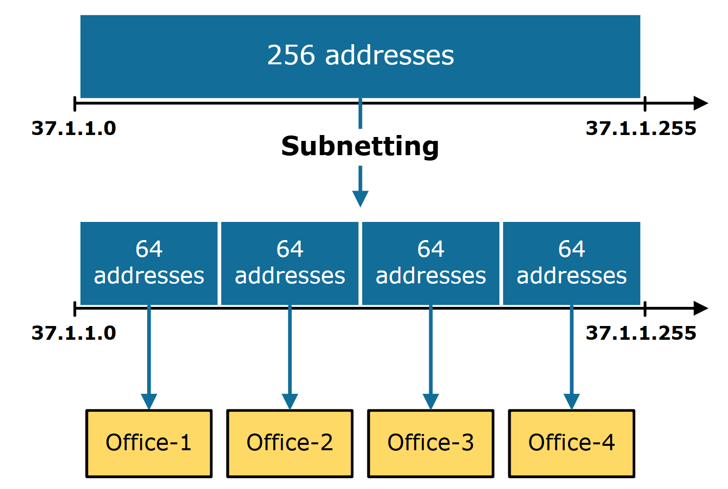
Possible Solutions
People are moving from IPv4 to IPv6 (containing 128 bits). But this transition is not smooth and hence a long-term solution.
Therefore, a short-term solution is achieved through subnetting where the large network is divided into smaller subnets.
Subnetting reduces the wastage of IPv4 address and maximizes its utilization.
Subnetting can be fixed length subnet mask (better) or variable length subnet mask (optimal).

Slide 5
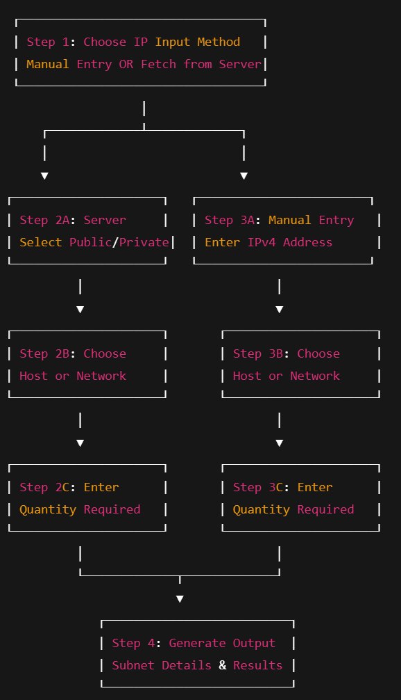
Simulator Workflow Diagram

Slide 6
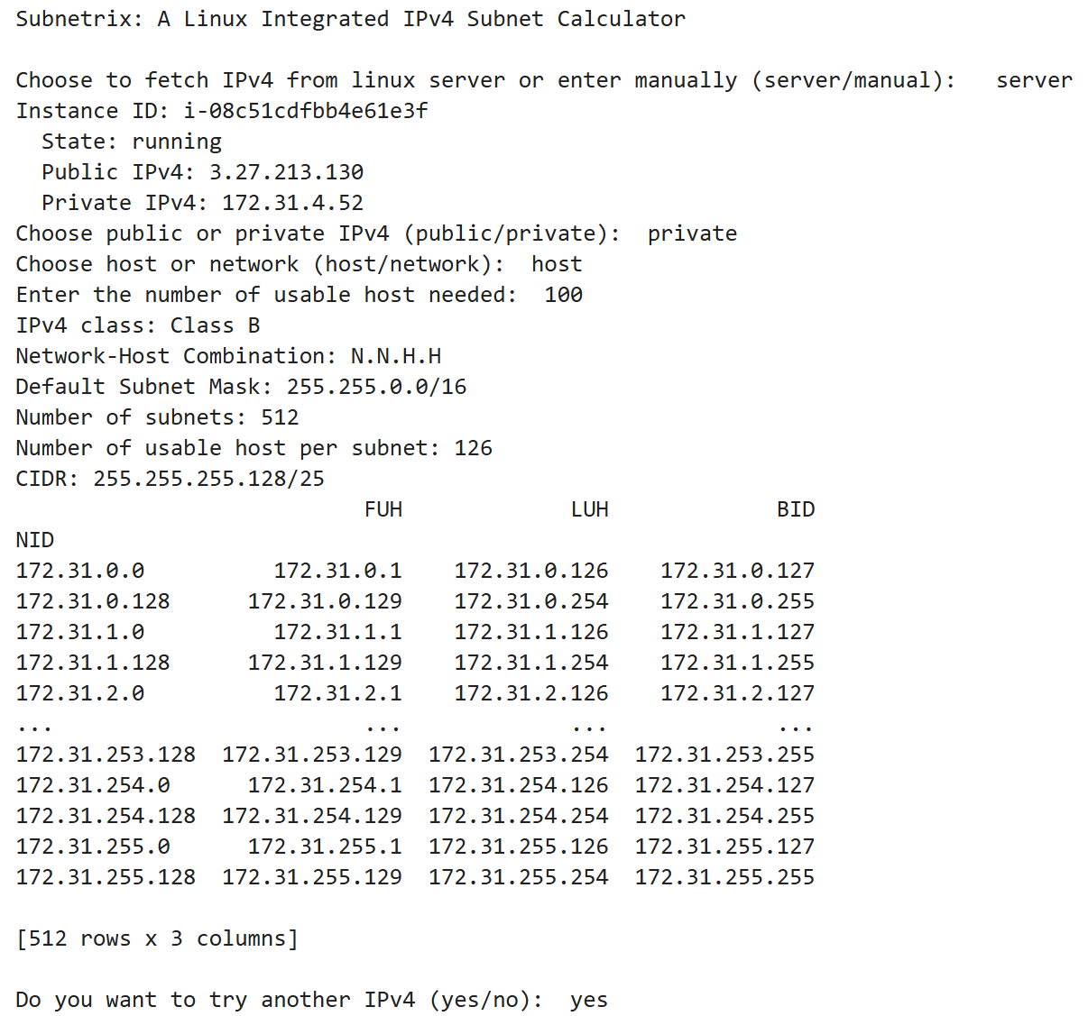
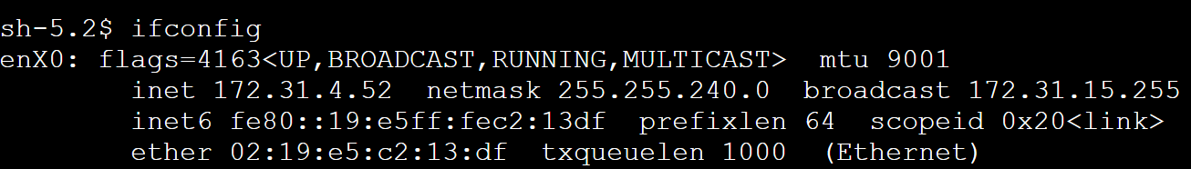

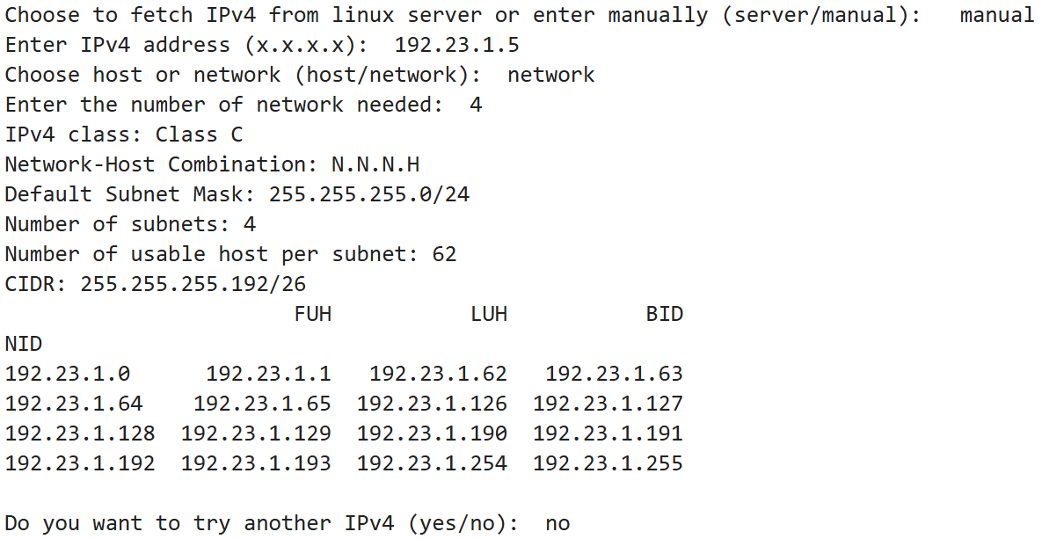
Results and Analysis

Slide 7
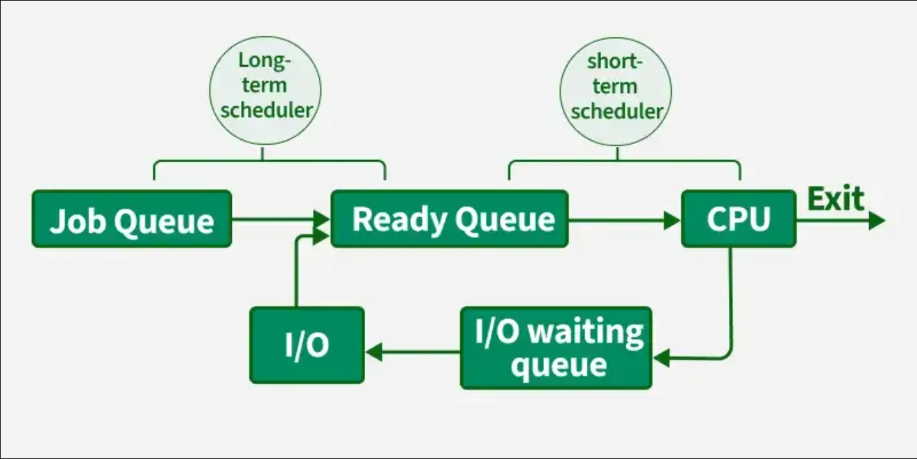
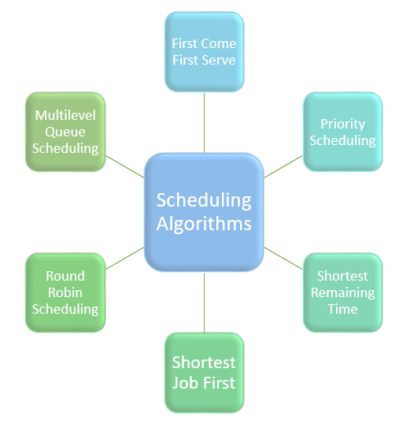
Process Scheduling Algorithms
Operating system acts as a bridge between hardware and applications, managing a huge volume of processes.
If processes are chosen at random for execution, then it will create chaos and even underutilization of resources like CPU and RAM
Therefore, various scheduling algorithms like FCFS, SJF, or SRTF are used to regulate the task.

Slide 8
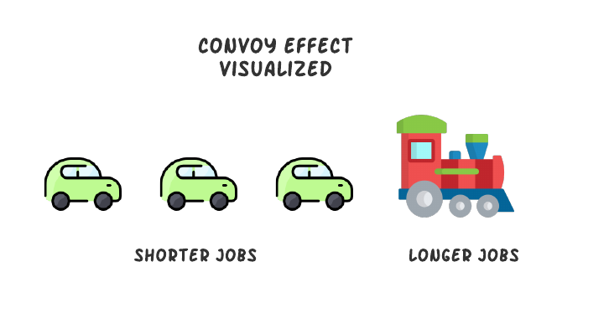
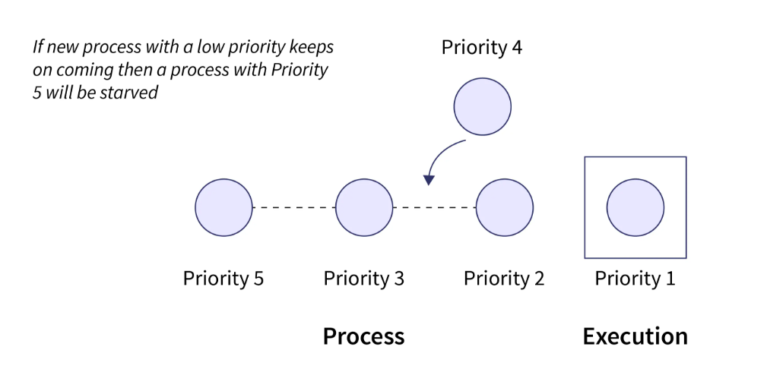
Scheduling Problem Statement
Individually each of the algorithms has some pros and cons.
FCFS suffers from convoy effect but escapes starvation effect. It is simplest to implement
SJF suffers from both convoy effect and starvation effect. It is difficult to implement.
SRTF suffers from starvation effect but escapes convoy effect. It is hardest to implement
Throughput order: SRTF > SJF > FCFS

Slide 9
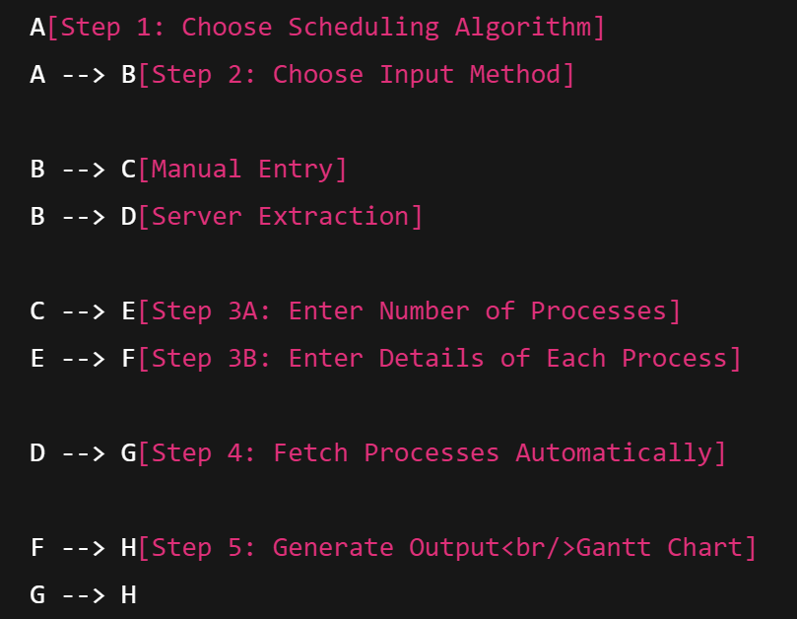
Possible Solutions
Simulator Workflow Diagram
Round Robin scheduling algorithm is an effective approach to the previously mentioned problems. It uses the idea of time quanta.
Nowadays, computers don’t use just a single scheduling algorithm, rather a mixture of them is used simultaneously.

Slide 10
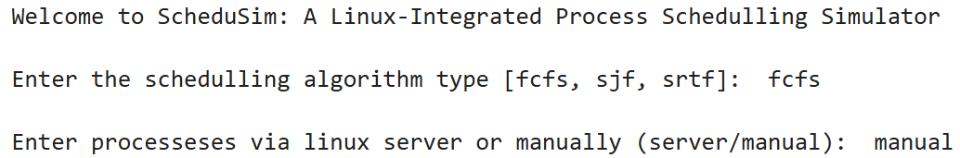
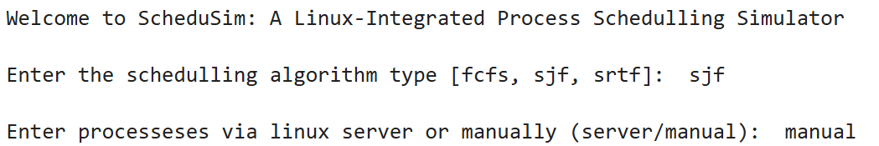
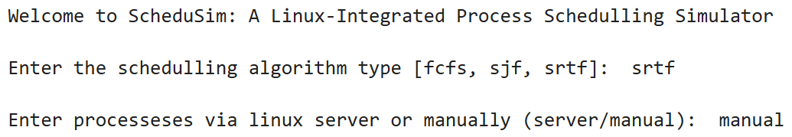
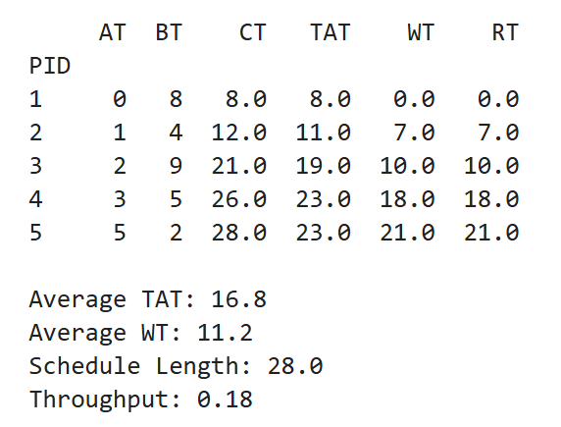
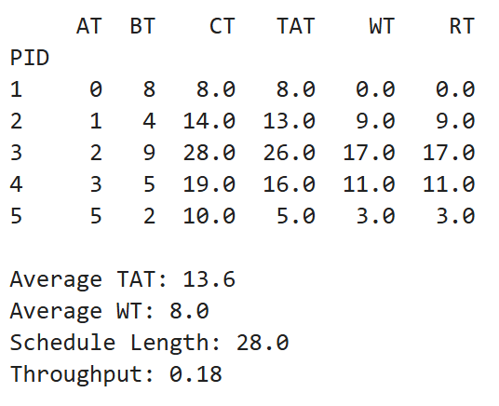
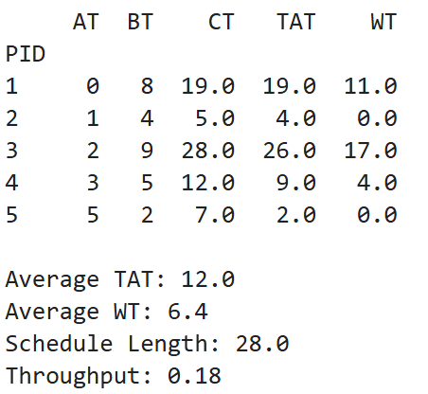
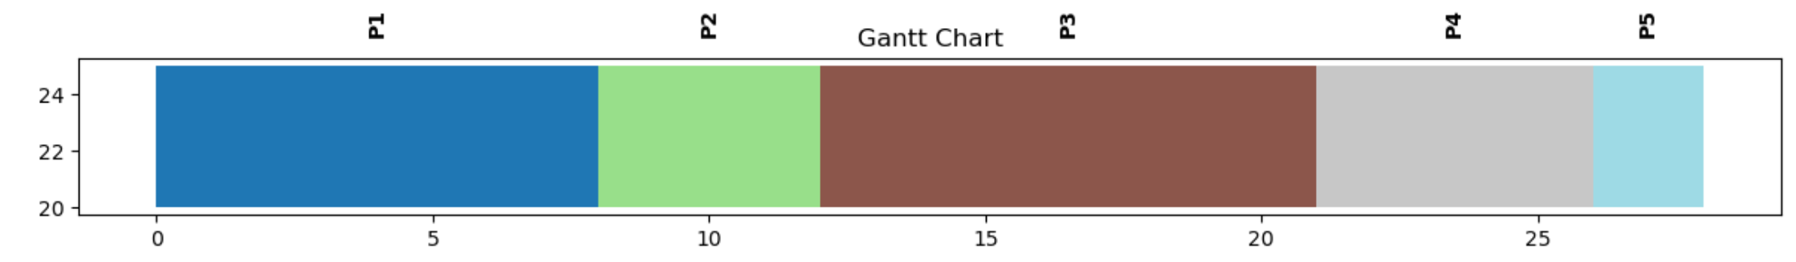
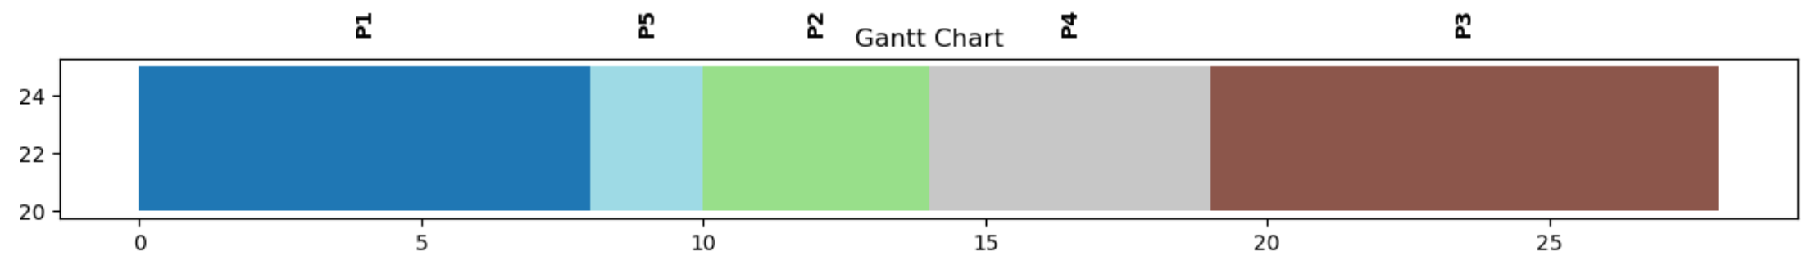
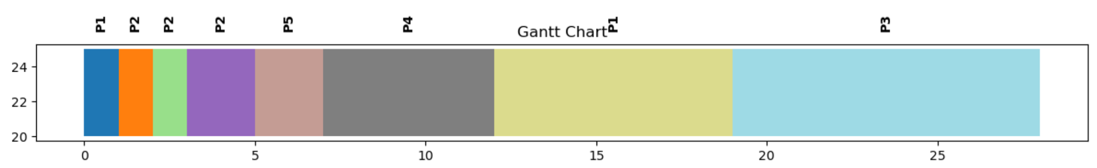
Results and Analysis

Slide 11
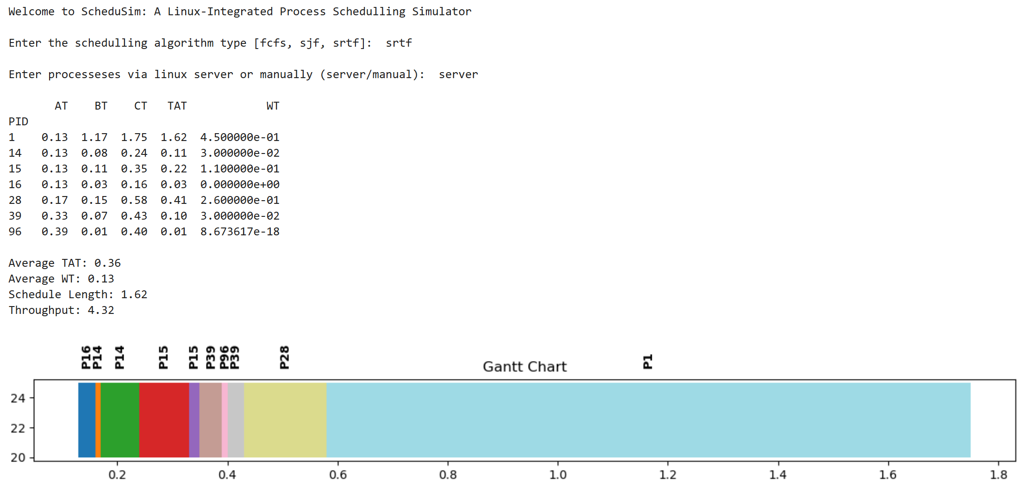
Results and Analysis Cont.

Slide 12
Team Contributions and Reflections
Suvrat: Team lead, scheduling algorithm code, subnetting code (class a implementation)
Kavyah: Subnetting code, readme files for installation and execution, PPT
Ayati: Linux server creation on AWS, integrating server with scheduling python code, PPT
Kayana: Linux server creation on AWS, integrating server with subnetting python code, PPT
Through this project we not only revisited the theoretical concepts but also got exposed to practically implementing these ideas and integrating them with Linux environment.
All relevant code files along with steps for installation and execution can be found in the following public GitHub repository:
https://github.com/suvrat-jain-git/OperatingSystem_Networking_Project.git

