Slide 1
Jacobian-Based Stability Analysis of Human Posture
Presenters: Suvrat (BS24DMU007), Jaskaran (BS24DMU020), Aryan (BS24DMU012), Ayati (BS24DMU024)

Slide 2
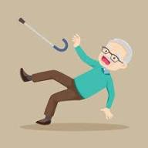
Problem Statement : Decoupling of Velocity Parameter
Decoupled Nature
Coupled Nature
Decoupled nature states that if body deviates in a particular direction, then corrective measure by the feedback system is in opposite direction.
In coupled nature, even if the body deviates in a particular direction let say x axis, still feedback system makes corrective measures in both x and z axes.

Slide 3
Benefit of Coupling Approach
Replicates the real scenario, where feedback corrections occur in a 2-D plane, in contrast to 1-D corrections in a decoupled state.
In 1-D approach the values obtained for kinematic parameters will be overestimated, thus resulting in wrong postural analysis by the model. However, coupled state overcomes this shortcoming.
Often in 1-D approach the summary metrics can be similar for 2 or more people, thus limiting only to broader classification of posture. In contrast, it is very rare to have similar values in coupled state due to internal variations in homeostatic mechanism.

Slide 4
X and Z coordinates given
Independent velocities are calculated using central difference formula
Dependent velocities are determined using x and Z as features and Vx or Vz as labels using random forest regressor
All possible partial derivatives are calculated using central difference formula
Eigenvalues are determined for each jacobian matrix to make inferences on posture stability
Workflow Diagram
The given process is performed for 2 patients (P1, P2).
For each patient it is repeated 4 times to run the battery of tests in posturalography study (Eyes Open & Firm Surface, Eyes Closed & Firm Surface, Eyes Open and Foam Surface, Eyes Closed and Foam Surface).
For each scenario visualizations have been created to prove the coupling of velocities and further the level of coupling.

Slide 5
Technical Details
X: coordinate in x axis, Z: coordinate in z axis
Vx: independent velocity in x i.e. Vx(x), Vz: independent velocity in z i.e. Vz(z)
dVx: dependent velocity in x i.e. Vx(x,z), dVz: dependent velocity in z i.e. Vz(x,z)
Vx/X: partial derivative of dependent velocity in x with respect to x
Vx/Z: partial derivative of dependent velocity in x with respect to z
Vz/X: partial derivative of dependent velocity in z with respect to x
Vz/Z: partial derivative of dependent velocity in z with respect to z
Eigenvalues are calculated for each coordinate using the 2x2 jacobian matrix formed:
  If both the eigenvalues have different sign it implies saddle/mixed posture
  If both the eigenvalues have negative sign it implies stable posture
  If both the eigenvalues have positive sign it implies unstable posture
  If any eigenvalue is 0 then trace is used for posture type determination

Slide 6
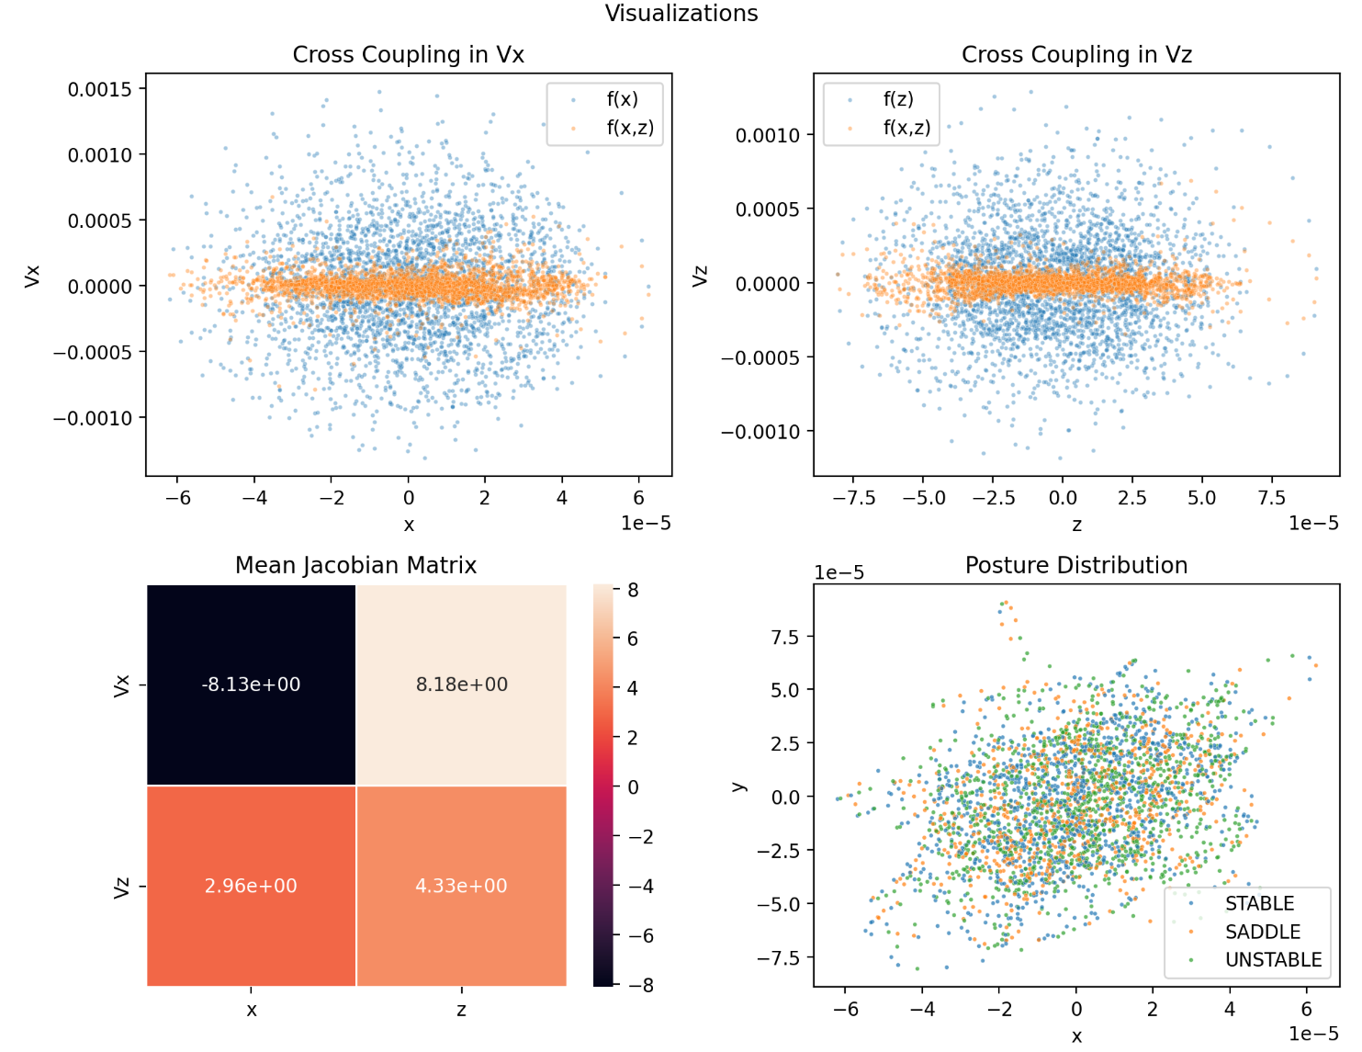
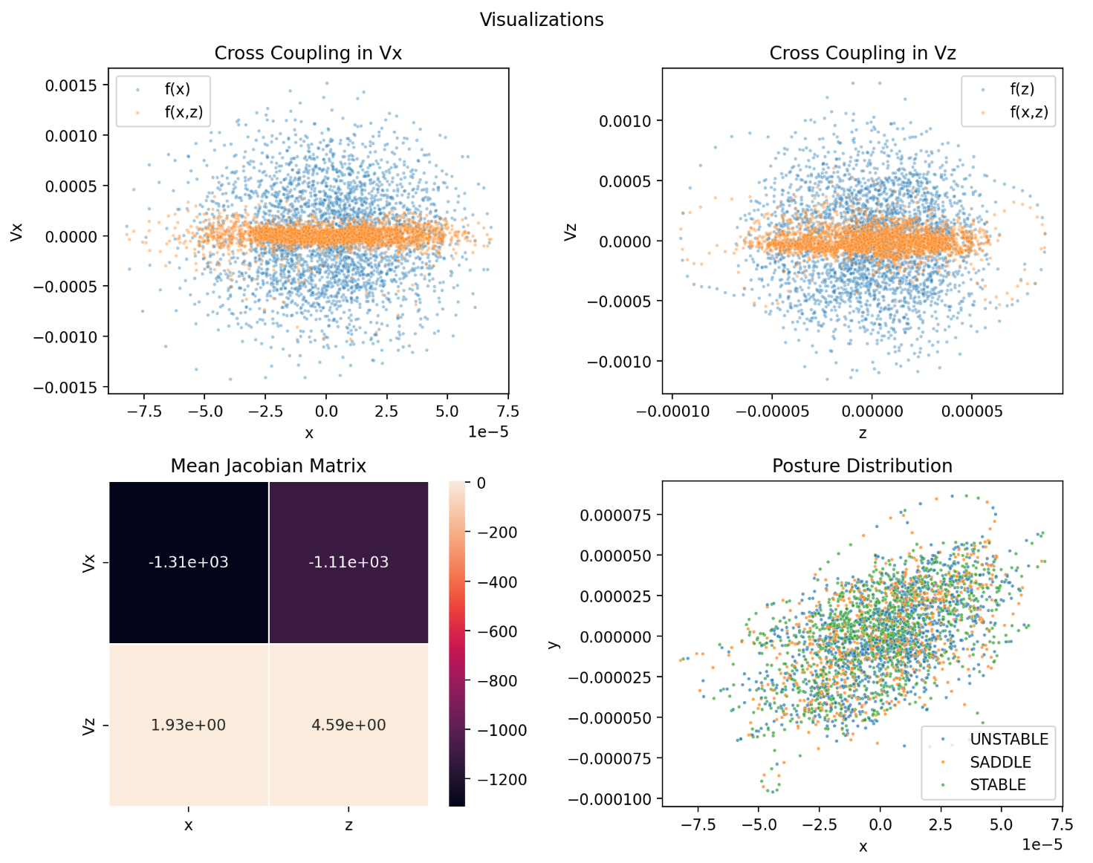
Result Analysis
P1: Eyes Open & Firm Surface
P1: Eyes Closed & Firm Surface

Slide 7
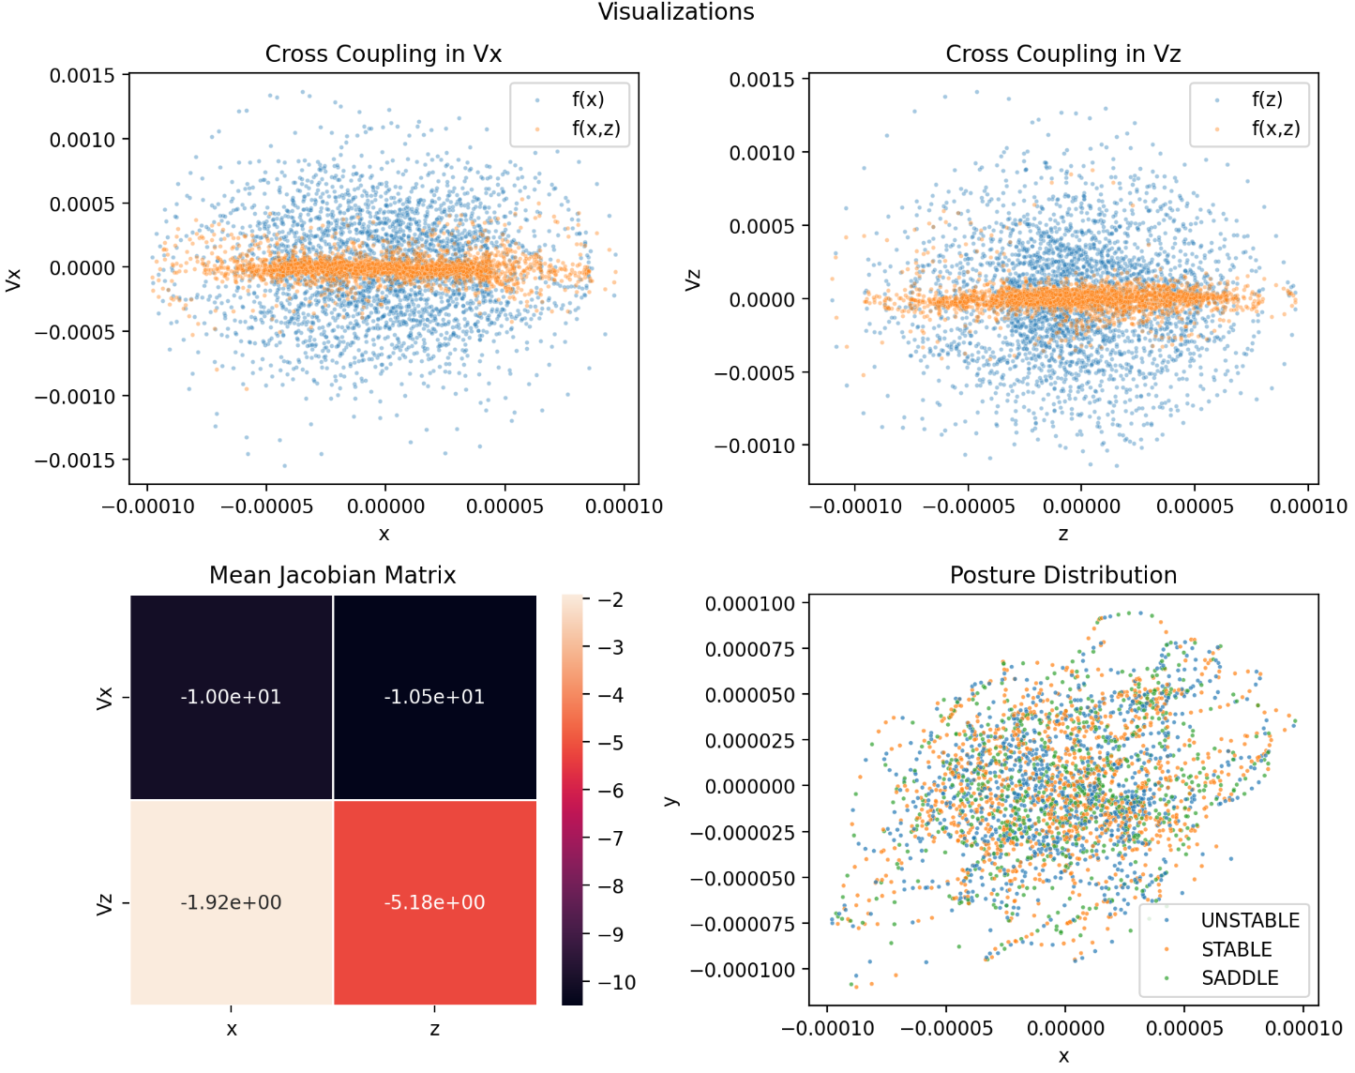
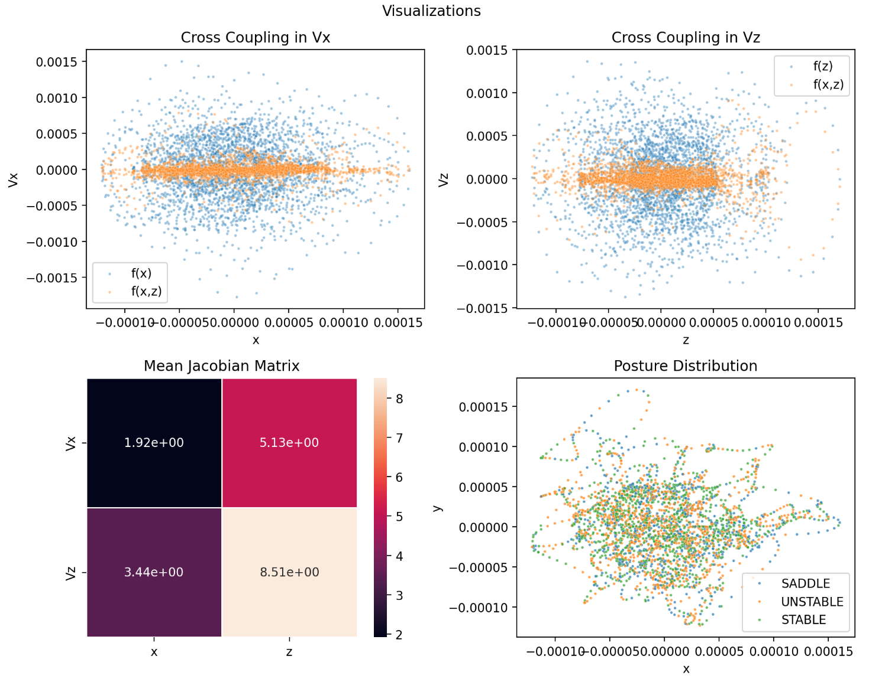
Result Analysis
P1: Eyes Open & Foam Surface
P1: Eyes Closed & Foam Surface

Slide 8
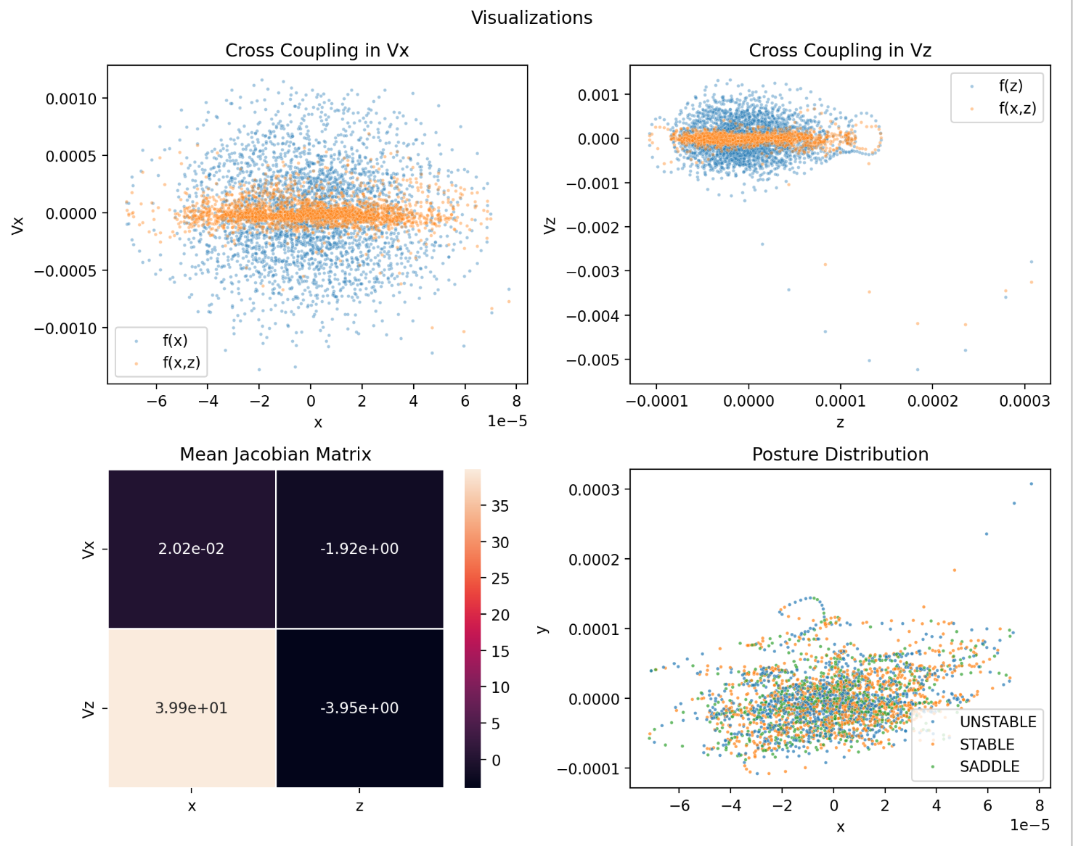
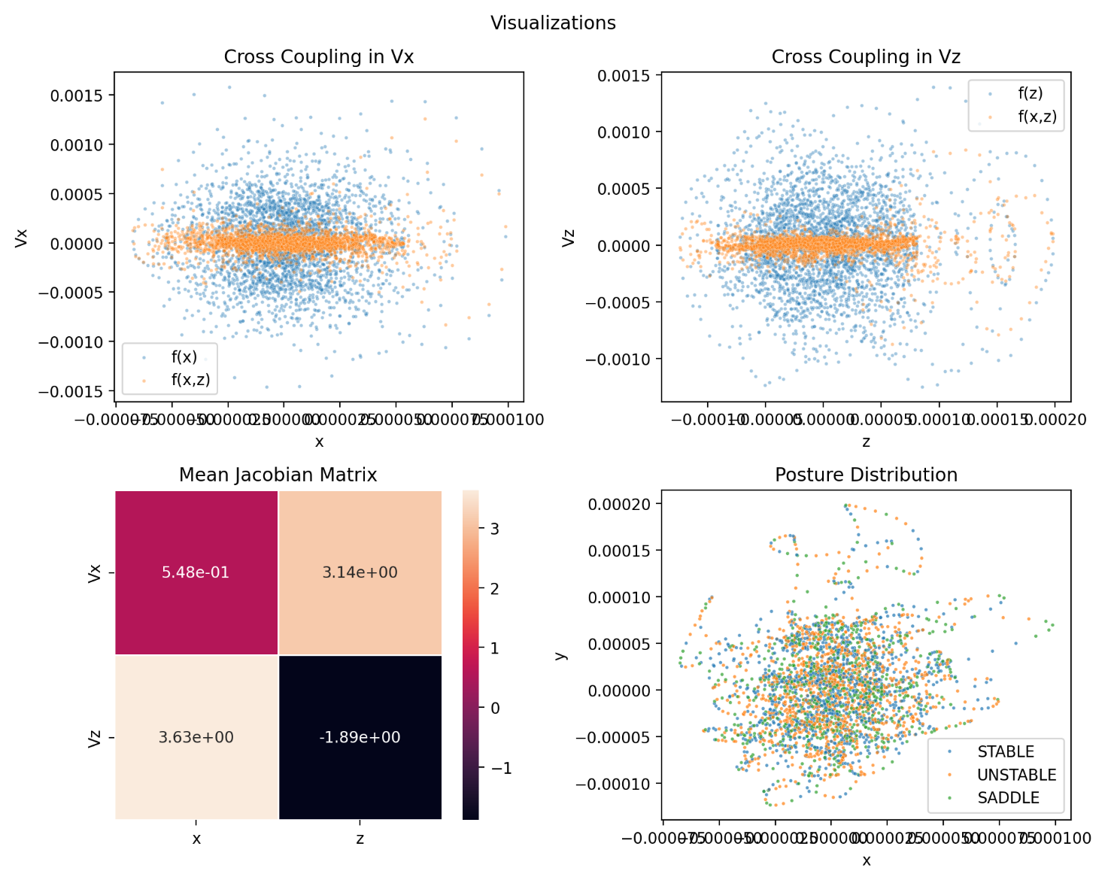
Result Analysis
P2: Eyes Open & Firm Surface
P2: Eyes Closed & Firm Surface

Slide 9
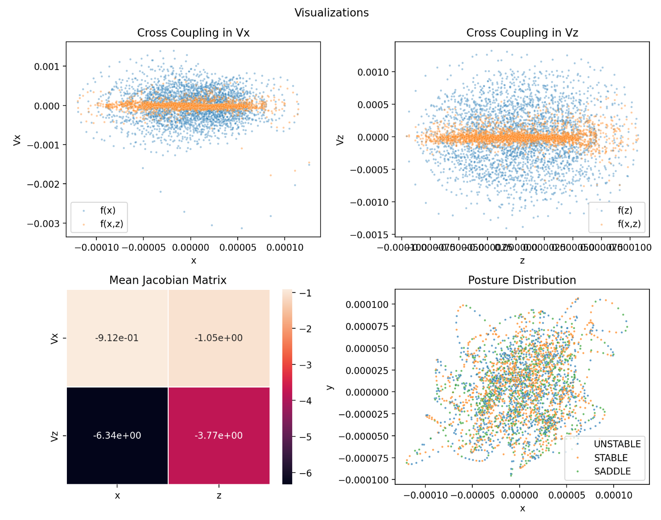
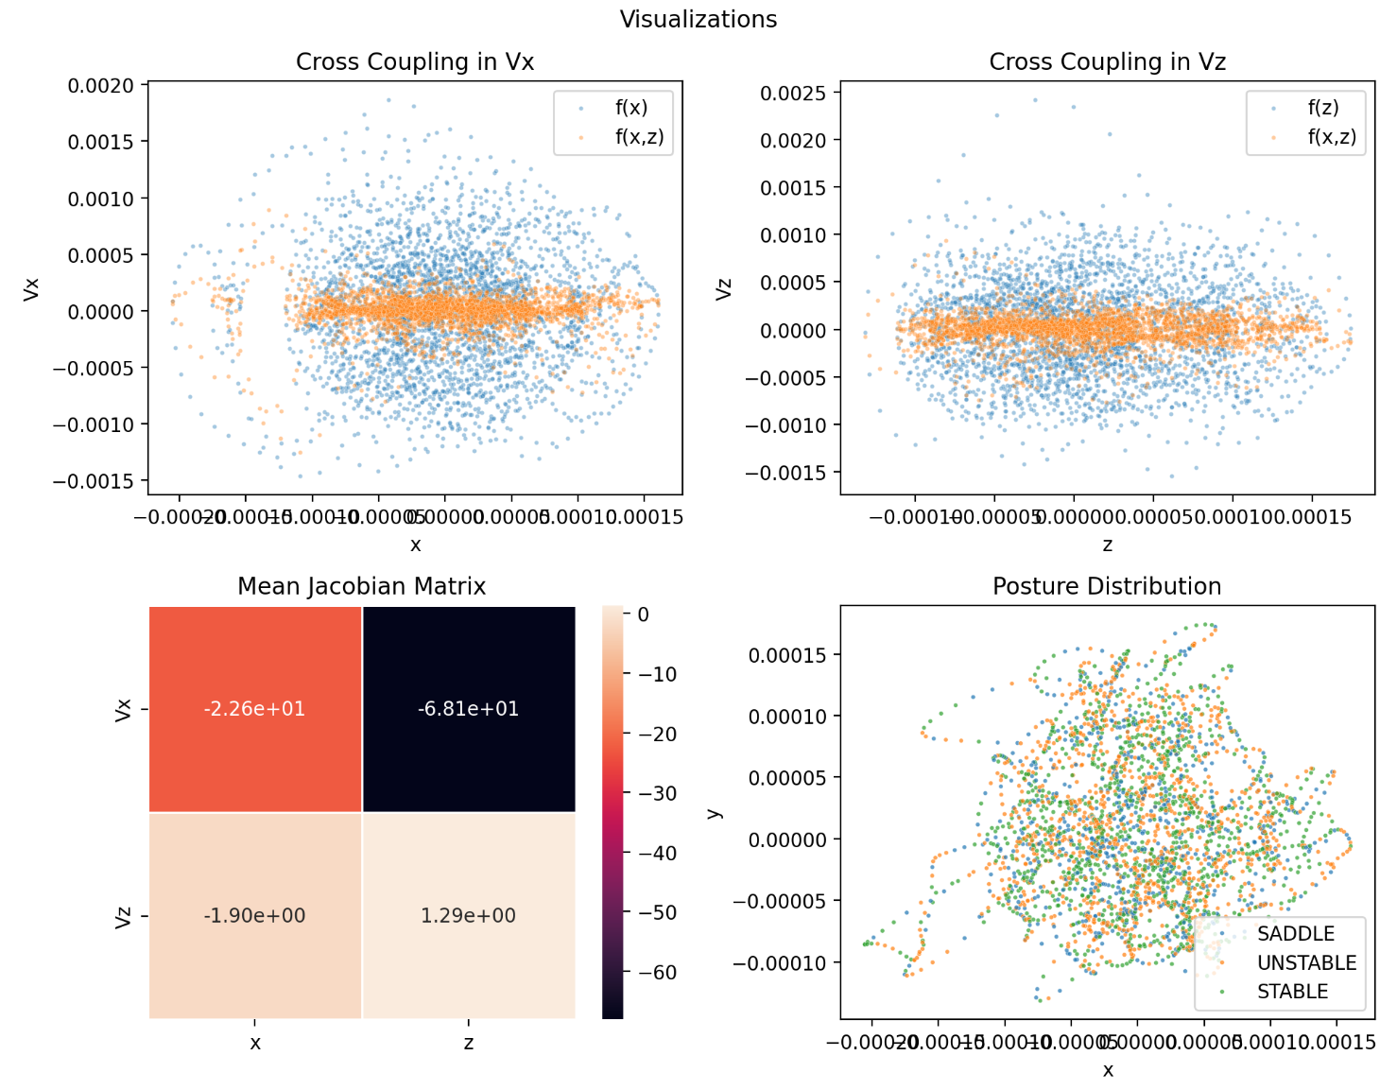
Result Analysis
P2: Eyes Open & Foam Surface
P2: Eyes Closed & Foam Surface

Slide 10
Clinical Test Thresholds Utilized
Test Type | System Tested
Eyes Open & Firm Surface | Standard
Eyes Closed & Firm Surface | Proprioception
Eyes Open & Foam Surface | Vision
Eyes Closed & Foam Surface | Vestibular Apparatus
Test | Normal | Physiological | Pathological
SOT, Modified CTSIB (Stable - Unstable) | >=30 | 10 – 29 | <10
LOS, COP (Saddle) | >=720 | 650 - 719 | <650

Slide 11
Comparative Analysis of 2 Patient
Patient | Test Type | Stable | Unstable | Stable - Unstable | Saddle | Inference
P1 | Open+Firm | 1127 | 1086 | 41 | 763 | Normal + Normal
 | Closed+Firm | 1173 | 1058 | 115 | 745 | Normal + Normal
 | Open+Foam | 1131 | 1107 | 24 | 738 | Physiological + Normal
 | Closed+Foam | 1147 | 1119 | 28 | 710 | Physiological + Physiological
P2 | Open+Firm | 1155 | 1104 | 51 | 717 | Normal + Physiological
 | Closed+Firm | 1124 | 1113 | 11 | 739 | Physiological + Normal
 | Open+Foam | 1162 | 1071 | 91 | 743 | Normal + Normal
 | Closed+Foam | 1141 | 1105 | 36 | 730 | Normal + Normal

Slide 12
Conclusion
Following the above exploration, it can be confidently said that feedback mechanisms related to posture work in a 2-D plane in a coupled manner.
Taking this approach helps medical professionals better analyze the posture status and make necessary corrective measures.
If the final output is normal, nothing needs to be done. If the final output is physiological, then bodily changes like fatigue, anxiety, stress, and old age need to be ruled out. Finally, if the output is pathological, further system-specific tests are prescribed for further diagnosis.

