Slide 1
NETCOOP AI · AGENTIC AI HACKATHON, IIT BHUBANESWAR
p. 1 / 6
DNS
Agentic AI Hackathon · IIT Bhubaneswar
NetCoop AI
DHCP
Network faults diagnosed by cooperating agents, and every claim cites its proof.
Specialist agents analyse a campus network's telemetry, exchange typed messages on a shared case board, and publish one explainable report, or honestly say there isn't enough evidence.
§1 Problem · §2 How it works · §3 Agents in action
§4 The report · §5 Robustness · §6 Results
--
[Team member name]
[role]
case board
--
[Team member name]
[role]
the fault (red link) and the four specialist agents reporting to one case board
github.com/suvronilchatterjee7-create/netcoop-ai
Notes:
NetCoop AI diagnoses network faults with cooperating specialist agents. The idea to remember: every claim in its report cites the message that proves it.

Slide 2
NETCOOP AI · AGENTIC AI HACKATHON, IIT BHUBANESWAR
p. 2 / 6
§1 Problem -> §2 How it works
Specialist agents reach one verdict by citing each other's evidence
performance
latency, jitter, loss, utilisation
infrastructure
devices, queues, interface errors
Case board
shared log
Raw telemetry
JSONL, legacy CSV
Translator
fields, units, data quality
Correlator
calibrated; claims only above the bar
Courtroom
only on a near tie
Reporter
One report
report.json + report.md
and a replayable trace.jsonl
Fig. 1 From raw telemetry to one report.
wireless / service
Wi-Fi, DNS, DHCP
connectivity
topology, blast radius
Problem. Evidence of a network fault is scattered across devices, links, Wi-Fi and services, in different formats.
Approach. Agents never call each other: they only post typed messages (13 types, such as CLUE, HYPOTHESIS, REQUEST, RESPONSE, SUPPORT, CONTRADICT, VERDICT) on a shared board.
Guarantee. The same input and configuration give a byte-identical trace¹.
¹ netcoop replay verifies every trace (tests/test_orchestrator.py)
Notes:
Telemetry in any format goes through the Translator onto a shared case board. Specialists post clues and hypotheses, ask each other for evidence and take stances. The correlator decides; the courtroom settles near ties; the reporter publishes one report.

Slide 3
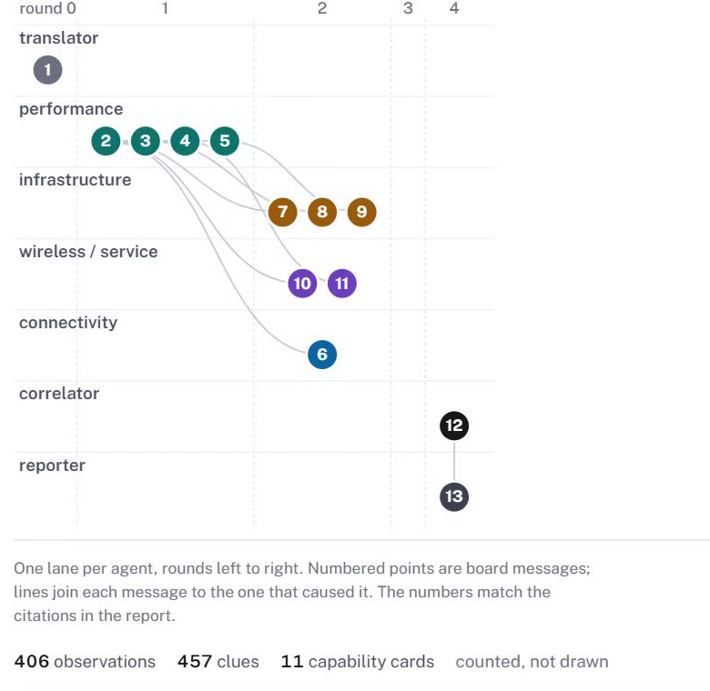
NETCOOP AI · AGENTIC AI HACKATHON, IIT BHUBANESWAR
p. 3 / 6
§3 Agents in action
One diagnosis, every message on the record
127.0.0.1:8765
The Translator reads raw telemetry into 406 observations¹.
Specialists compare each metric with calibrated baselines and post 457 clues¹, including the "checked, normal" ones.
Performance posts a HYPOTHESIS (link congestion), then 3 REQUESTs for evidence it cannot see itself.
Infrastructure and wireless RESPOND; three agents post SUPPORT stances. Connectivity confirms the symptoms sit inside the link's blast radius.
The correlator issues the VERDICT: diagnosed, confidence 1.00.
performance proposes link congestion
1
requests and answers between agents
2
the correlator's verdict
3
887 messages, 3 collaboration rounds¹
Fig. 2 The agents' message exchange for a link-congestion run: one lane per agent, rounds left to right, lines from each message to its cause.
¹ netcoop run data/samples/link_congestion__s500__i1.0__n0.0__m0.0
Notes:
Every point in Fig. 2 is a real message from this run. Performance proposes link congestion and asks for evidence it cannot see; infrastructure and wireless answer; three agents support it; the correlator issues the verdict.

Slide 4
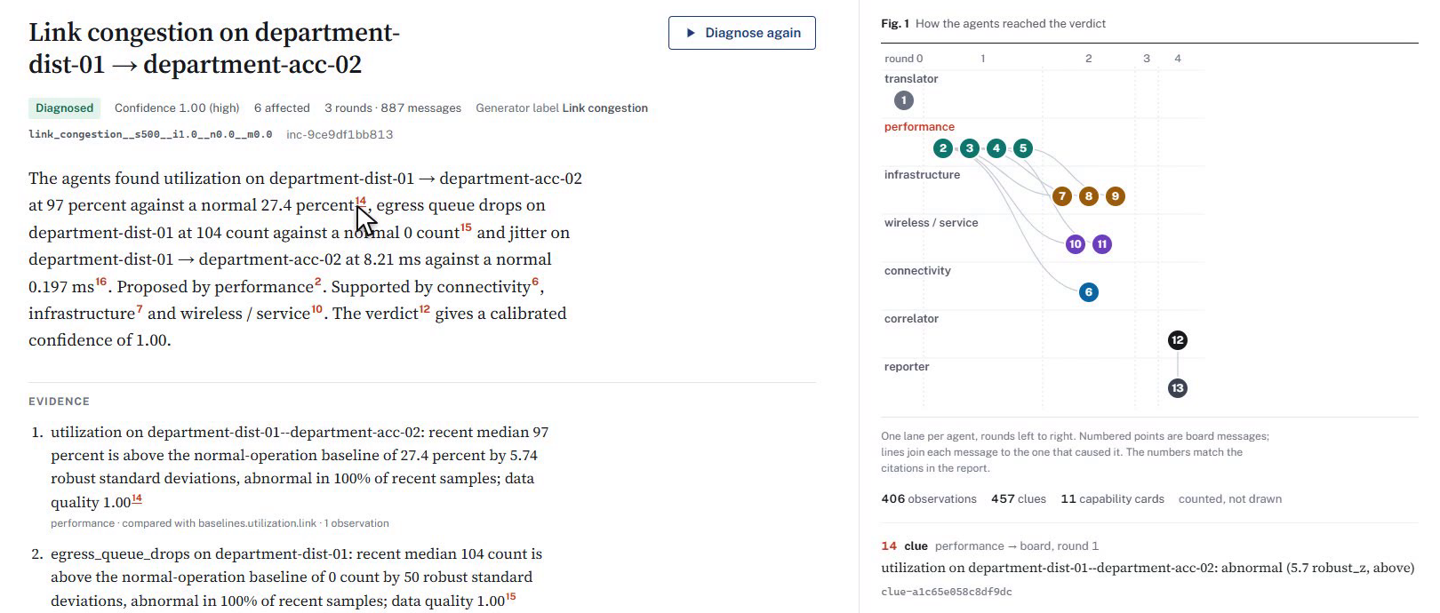
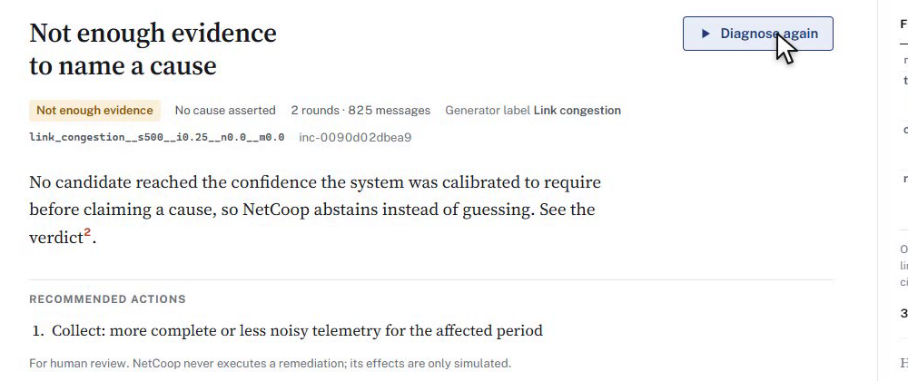
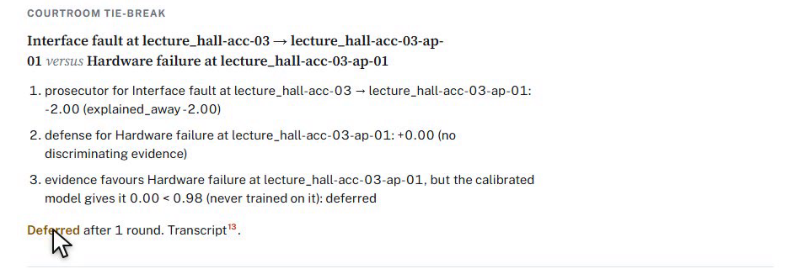
NETCOOP AI · AGENTIC AI HACKATHON, IIT BHUBANESWAR
p. 4 / 6
§4 The final report
The report reads like a paper: each claim links to its proof
127.0.0.1:8765
Root cause at a specific link: "Link congestion on department-dist-01 → department-acc-02"¹
Evidence with its baseline: utilisation 97% against a normal 27.4%; jitter 8.21 ms against 0.197 ms; 104 egress queue drops against 0¹
Recommended actions, for human review only; nothing is executed automatically
Also: affected devices, alternatives considered, data quality, limitations
1
2
3
127.0.0.1:8765
127.0.0.1:8765
Fig. 3 Hovering a red citation lights up the message that proves it.
1
root cause and calibrated confidence
2
a red citation
3
the cited message, highlighted
Courtroom: deferred
Not enough evidence
A fault type never seen in training: the judge defers rather than guess.
A faint fault: NetCoop abstains instead of guessing.
¹ report.md of the link-congestion sample (deliverables/4_sample_data_and_test_cases/example_reports)
Notes:
The report names the root cause at a specific link with a calibrated confidence. Every claim has a citation; hovering it lights up the proving message. When the evidence is not enough, NetCoop says so instead of guessing.

Slide 5
NETCOOP AI · AGENTIC AI HACKATHON, IIT BHUBANESWAR
p. 5 / 6
§5 Interoperability and robustness
Messy, foreign data bends but never breaks the pipeline
Table 1 Precision of claims as stacked format mutations increase.
PS C:\netcoop-ai> netcoop translate data/samples/interop_failure__s500__i0.5__n0.1__m0.0
dialects: {'device_stats.csv': 'legacy_v1', 'link_stats.csv': 'legacy_v1', 'service_checks.csv': 'legacy_v1', 'topology_edges.csv': 'legacy_v1', 'wifi_stats.csv': 'legacy_v1'}
stats: {'files': 5, 'tables': 5, 'topology_tables': 1, 'series': 466, 'samples': 13980, 'errors': 0}
mutations stacked
runs
precision of claims
1
0
48
97.5%
1
48
97.1%
2
50
96.3%
Fig. 4 A legacy CSV export: 5 files, 466 series, 13,980 samples, 0 errors³.
3
46
95.7%¹
1
dialect detected: legacy_v1
Bad input → typed ERROR messages and lower data-quality scores; the Translator never raises on input (22 kinds of corruption tested²).
Agent failure or timeout → that agent is isolated and its missing evidence is listed in the report.
Fatal problem → never a false "no fault".
¹ docs/EVALUATION.md, robustness · ² docs/INTEROP_RESULTS.md · ³ netcoop translate, interop sample
Notes:
A legacy export with different field names and units is read with zero errors. Under up to three stacked format corruptions, precision of claims stays at or above 95.7 percent. Failures are typed and isolated; a fatal problem never produces a false all-clear.

Slide 6
NETCOOP AI · AGENTIC AI HACKATHON, IIT BHUBANESWAR
p. 6 / 6
§6 Results and what we deliver
On 1,080 fresh runs, 98.6% of claims are right
98.6%¹
77.2%¹
100%¹
0²
precision of claims (12 wrong of 846)
accuracy
root localisation
wrong claims on 120 runs of never-seen fault types
Table 2 Full system, fresh test suite; last row: without → with courtroom.
Deliverables
metric
value
Working prototype: the netcoop CLI and a local dashboard (netcoop serve)
Source, setup, dependencies, and 246 tests passing in CI⁴
Architecture documentation: agents, protocol, orchestration, correlation, errors, workflow
Nine labelled samples: normal operation plus eight fault scenarios
A 4 min 25 s demo video
Extensible: new agents and faults are data, external agents join over MCP, runs pause and resume, humans review actions
abstention rate
21.7%
macro-F1
0.860
courtroom invoked
227 runs
wrong claims on ambiguous cases
32 → 0³
NetCoop AI: every claim cites its proof.
github.com/suvronilchatterjee7-create/netcoop-ai
¹ docs/EVALUATION.md · ² ambiguity suite, seeds 100–109 · ³ docs/COURTROOM_RESULTS.md · ⁴ pytest, 246 passed
Notes:
On 1,080 runs never used for development, 98.6 percent of claims are right, every correct diagnosis is located at the right device, and fault types never seen in training produced zero wrong claims. Everything shown is delivered and runnable.

