Slide 1
Status of Immigration: A Case Study of Shankharapur Municipality Ward 9, Sankhu
Thesis Proposal presentation- December 2025
Kristal Suwal
M.A. Rural Development
Bhaktapur Multiple Campus
Tribhuvan University

Slide 2
Introduction - Background
Defining Migration: A major component of population change driven
by socio-economic factors, affecting the size, structure, and social characteristics of both origin and destination points.
• Types of Migration:
Internal: Movement within a country (rural-to-rural, rural-to-urban, etc.).
International: Movement across national borders
• Nepal’s Context: Historical shifts from hills to the Terai began after malaria eradication; currently, infrastructural development and social services drive rapid movement to urban centers like Kathmandu

Slide 3
Statement of the Problem
• Urban Pressure:
Shankharapur Municipality Ward 9 is a developing area near Kathmandu experiencing a continuous flow of in-migration.
• Unknown Consequences:
While the causes of migration are often identifiable, the specific qualitative consequences (positive or negative) on the destination area require sensible research.
• Research Questions:
◦ What factors keep people migrating?
◦ What are the specific "pull factors" for Ward 9?
◦ What are the trends, causes, and consequences of this movement?

Slide 4
Objectives of the Study
General Objective:
To assess the status, trends, causes, and consequences of immigration in Shankharapur Municipality Ward 9.
•Specific Objectives:
1. To identify the main causes of immigration.
2. To analyze demographic migration trends.
3.To examine the socio-economic consequences of immigration in the study area

Slide 5
Rationale of the Study
• Theoretical Significance: Contributes to existing literature by examining demographic trends and underlying drivers of immigration in a local context.
• Applied Significance: Provides practical insights for planners and policymakers to design targeted interventions and improve living conditions.
• Sustainable Development: Identifies new perspectives to enhance public participation and accelerate urban development in the ward.
• Academic Value: Serves as a foundation and reference for future researchers in the field of migration and rural development

Slide 6
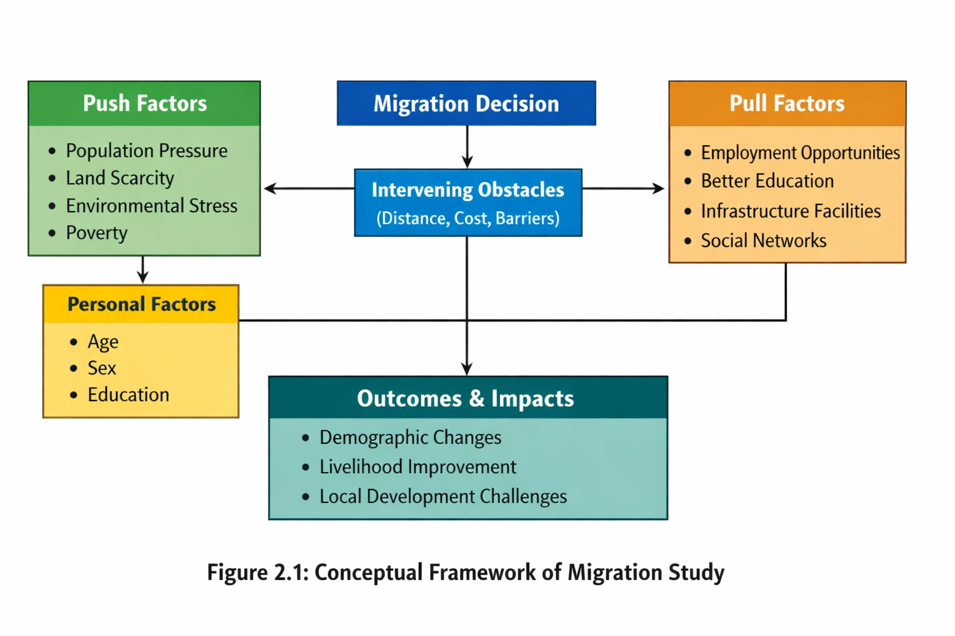
Conceptual Framework

Slide 7
Literature Review
• The "Laws of Migration" Ravenstein (1885) : migration occurs in systematic streams and is heavily influenced by distance.
• Push-Pull Theory Everett Lee (1966):migration is a balance between "push" factors and "pull" factors.
• Gravity Model Zipf (1946) and Stewart (1950) : migration volume is proportional to population size and inversely related to the distance travelled.
• Economic Perspective Todaro (1976) : migration is driven by "expected income" differences rather than just actual current earnings.

Slide 8
Literature Review – Empirical & Policy Context
National context (Nepal): research by CEDA (1977) and Gurung (1984) identified that over 50% of kathmandu's migrants are aged 20–30, driven by land scarcity and food shortages in the hills.
Local observations: (Kunwar, 2015; Niroula, 2016) show that Maoist insurgency and infrastructure development accelerated rural-to-urban movement.

Slide 9
Research Design & Methodology
• Research Design: Employs both descriptive and exploratory designs to investigate the "how" and "why" of in-migration.
• Nature of Data:
◦ Primary: Collected via field observations and interviews.
◦ Secondary: Sourced from libraries, published articles, CBS records, and municipal documents.
• Study Area & Population: Shankharapur Municipality Ward 9, which contains 87 households selected for the study.
• Sampling Technique: Random sampling was used to select the ward, while a purposive method will be used to draw samples from the population

Slide 10
Data Collection & Analysis
Tools for Collection:
◦ Observation: Used to assess social status, community participation, and the relationship between migrants and residents.
◦ Unstructured Interviews: Divided into sections covering demographics, reasons for moving, socio-economic variables, and consequences.
• Data Analysis: Both qualitative and quantitative methods will be used; qualitative findings will be presented in tabular forms.
• Ethical Considerations: Obtaining formal approval from the ward office, securing verbal consent from participants, and maintaining strict confidentiality

Slide 11
Limitations of the Study
• Geographic Focus: The study is confined to Ward 9, which may restrict the generalization of findings to other regions.
• Sample & Time: Constraints on time and financial resources limited the sample size and the ability to cover temporary or seasonal migrants extensively.
• Data Reliability: Results depend on the honesty of respondents, who may be reluctant to share sensitive socio-economic information

Slide 12
Conclusion & Expected Outcomes
• Framework for Planning: The study intends to bridge the gap between macro-level migration theories and local-level realities in Ward 9.
• Integrative Approach: By combining demographic, socio-economic, and policy perspectives, the research will provide a comprehensive view of how immigration shapes rural-urban transition.
• Final Goal: To provide evidence-based recommendations that support sustainable integration and infrastructure planning at the ward level

