Slide 1
LIBERTY DATA DRIVE 2026
Tariff cuts, uneven income paths
Among India, China, Mauritius, Thailand, the Philippines, Pakistan, Côte d’Ivoire and Senegal, what happened to GNI per capita in the ten years after tariff-cutting episodes in 1991–1998—and what does this suggest for Nepal’s tariff schedule?
Ten countries pass the policy-data screen. Eight have documented episode years for the main comparison. Outcomes are mixed; the analysis does not identify a causal growth effect.
Outcome source: UNDP HDR25, GNI per capita in 2021 PPP dollars. Event outcome coverage: 1990–2008.
Suwarna Pyakurel · Solo · Participant review copy · Organiser approval pending
1
Notes:
Research question covers the eight dated cases. The screen uses raw tariff changes 1995–2005, which is different from the implementation window. All dates are annual episode conventions; finer temporal precision differs by source. No causal estimate is claimed.

Slide 2
LIBERTY DATA DRIVE 2026
A policy-data rule, followed by documentary dating
Screen: mean tariff decline ≥20 percentage points, 1995–2005, with both tariff endpoints and some UNDP GNI data. All ten qualifying countries stay visible.
India
1991
Philippines
1995
China
1992
Pakistan
1997
Mauritius
1994
Côte d'Ivoire
1998
Thailand
1995
Senegal
1998
Bangladesh and Kenya: timing precision insufficient for the main tariff-event definition; retained in screening and a separate date grid. CIV/SEN share a regional reform.
Sources: EFW raw 4Aii; budget, executive-order, WTO, PIIE, SPDC and IMF records. Full locations: source appendix and date ledger.
Suwarna Pyakurel · Solo · Participant review copy · Organiser approval pending
2
Notes:
Dates: IND1991 budget; CHN1992 implemented cuts; MUS1994 consolidated schedule; THA1995 January programme; PHL1995 EO264 effective August28; PAK1997 tariff peak cut; CIV1998 March transition; SEN1998 April national phase. Sources differ in precision. The date-quality decisions followed earlier exploratory outcome inspection, so no preregistration claim is made. Programme start is not necessarily first liberalisation ever. BGD/KEN are not omitted because of outcomes.

Slide 3
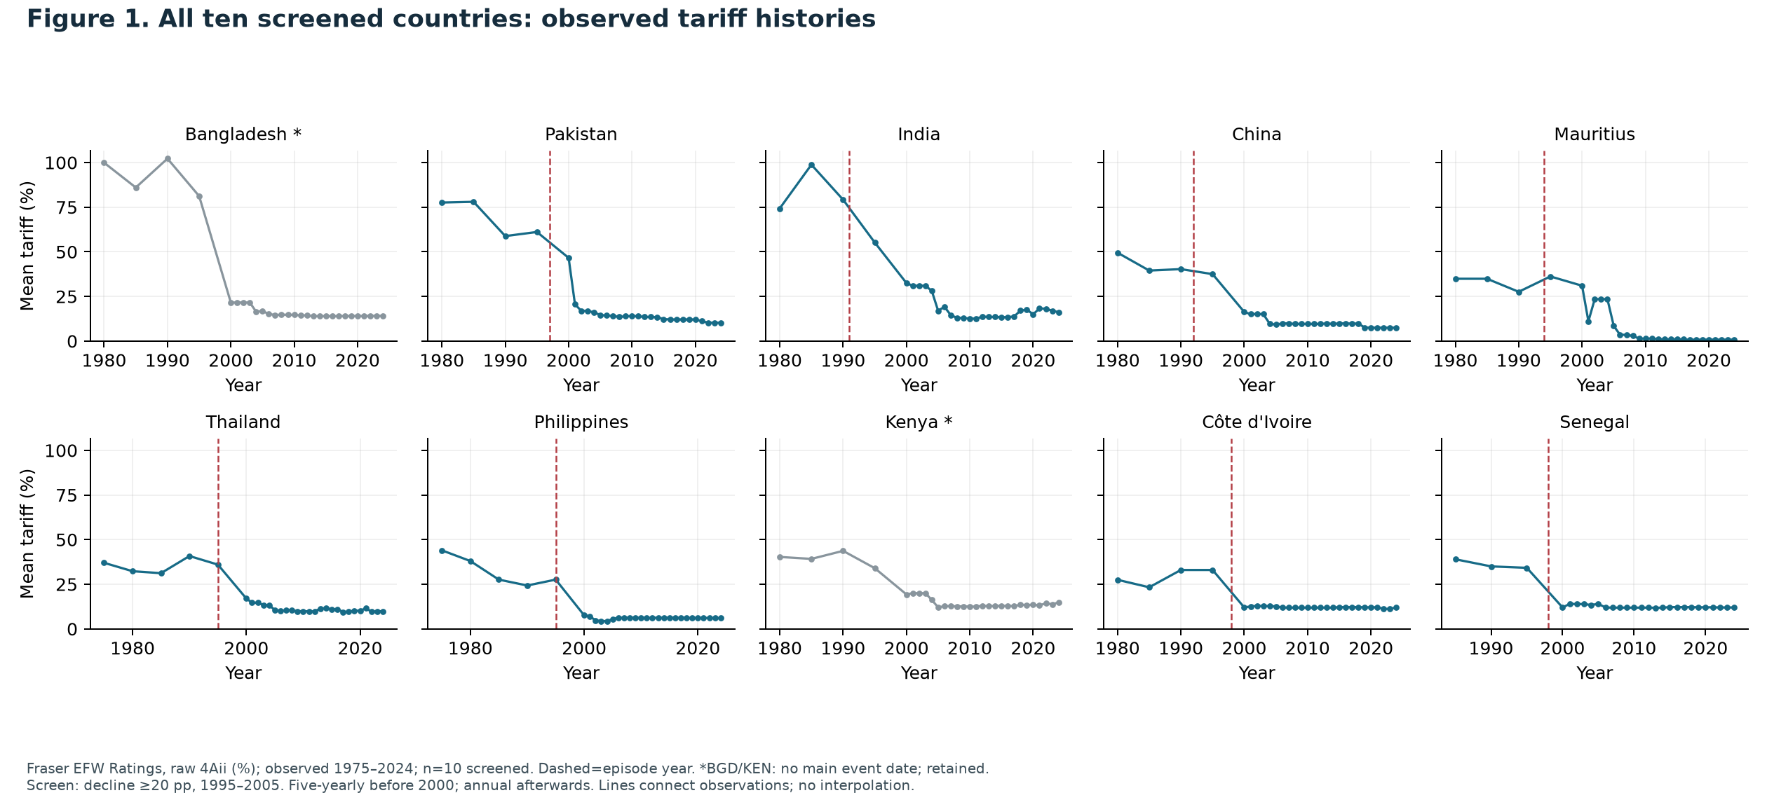
LIBERTY DATA DRIVE 2026
Large tariff declines are visible in the policy data
Suwarna Pyakurel · Solo · Participant review copy · Organiser approval pending
3
Notes:
Figure1; notebook cell 17. All ten screened countries, including BGD/KEN. Dataset observation years rather than presumed annual historical observations. The raw EFW mean is not a statutory maximum or a chain-linked rating.

Slide 4
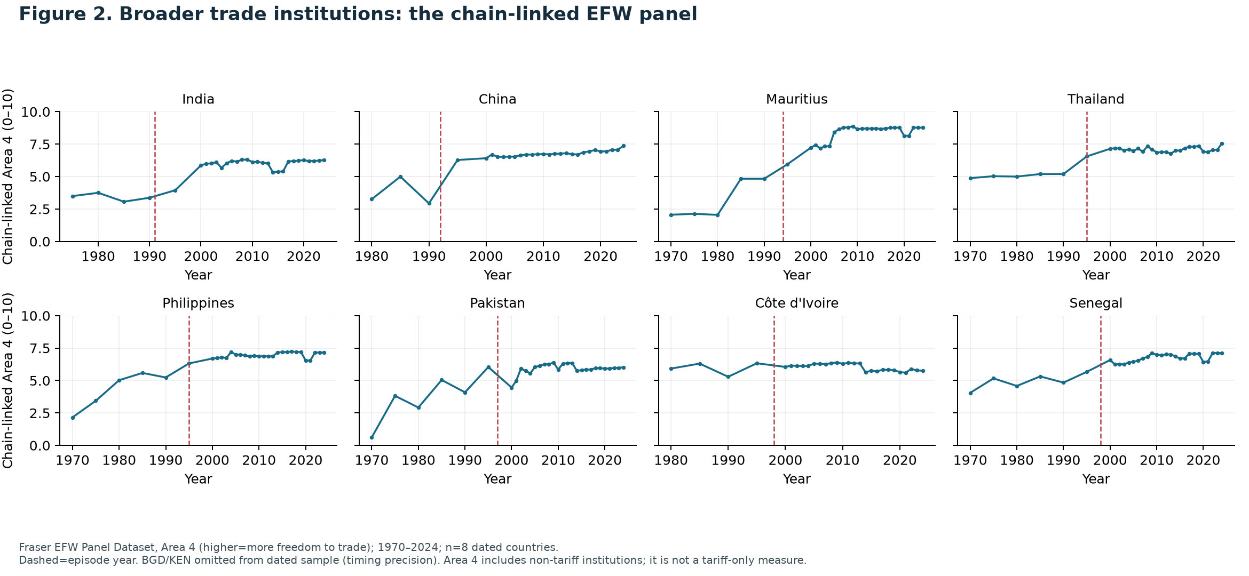
LIBERTY DATA DRIVE 2026
Use the required chain-linked panel as context
Suwarna Pyakurel · Solo · Participant review copy · Organiser approval pending
4
Notes:
Figure2 analyses EFW Panel Dataset Area4 independently of the raw tariff series. Area4 combines several trade institutions. It must not be called a tariff-only measure. Exact organiser acceptance of the combined panel/raw-subcomponent interpretation is pending; the declaration asks this explicitly.

Slide 5
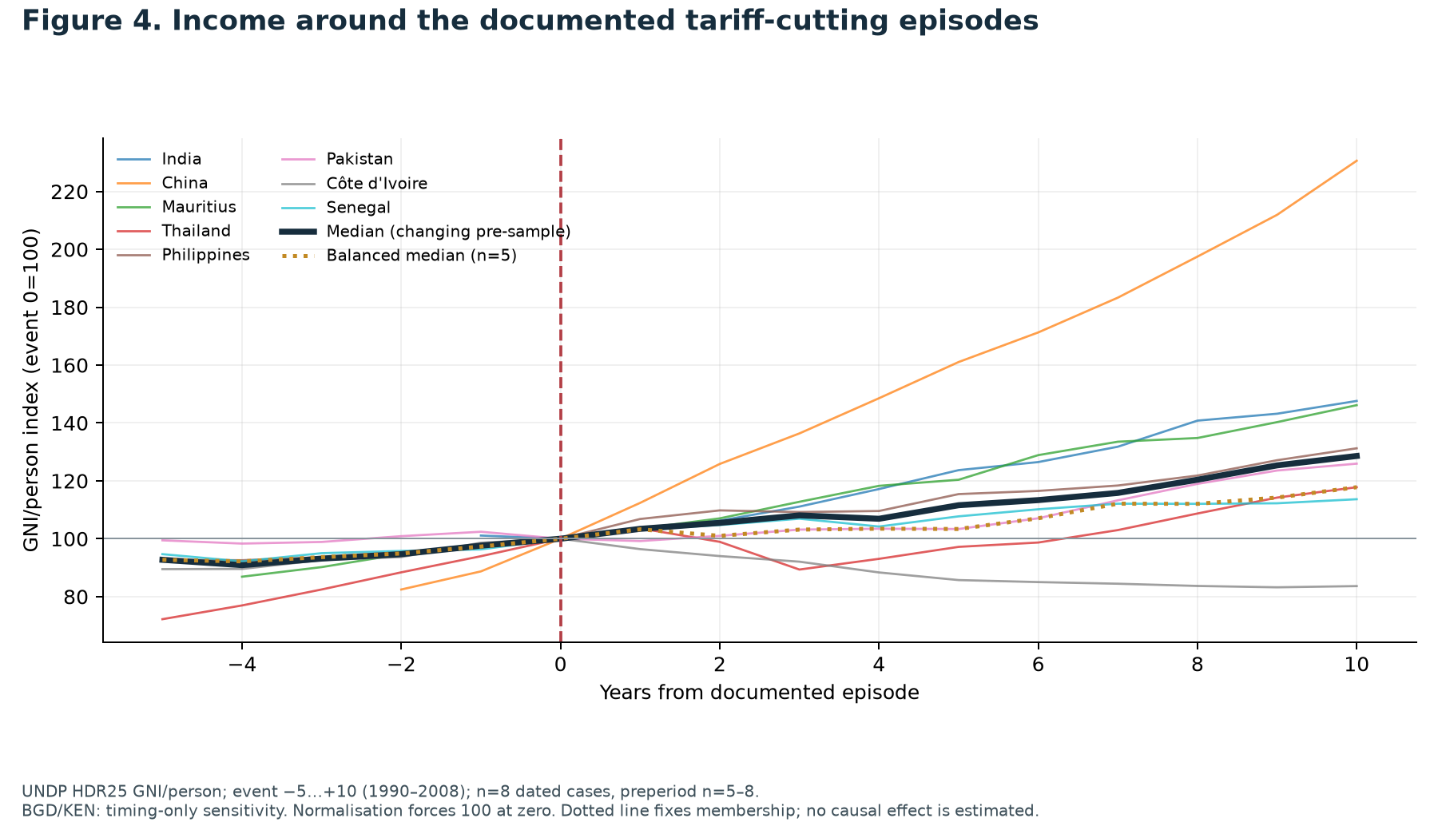
LIBERTY DATA DRIVE 2026
Income rose in 7 of 8 cases; that does not establish an effect
Event alignment
Every series equals 100 at reform by construction. That meeting point is not evidence.
Solid median changes membership before reform. Dotted median holds the five full-window countries fixed.
Suwarna Pyakurel · Solo · Participant review copy · Organiser approval pending
5
Notes:
Figure4. No tariff-driven income gain is identified. India, China and Mauritius lack five full pre-years in UNDP; the balanced subset therefore differs. Broader market reforms and macroeconomic conditions are plausible alternative explanations. Raw full-period income plots are in Appendix B.

Slide 6
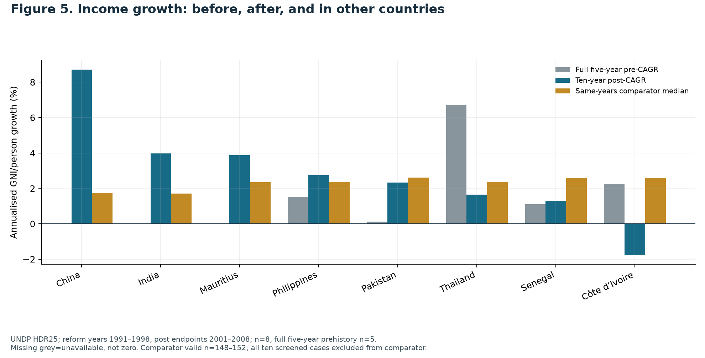
LIBERTY DATA DRIVE 2026
Growth accelerated in 3 of 5 cases with full prehistory
Suwarna Pyakurel · Solo · Participant review copy · Organiser approval pending
6
Notes:
Figure5. Full five-year pre-CAGR compared to ten-year post-CAGR; missing pre-bars are not zero. The comparator is median non-case CAGR over each country’s same calendar years, with valid sample sizes 148–152. It is not an untreated control. China and India grew quickly but do not enter the full-prehistory acceleration count.

Slide 7
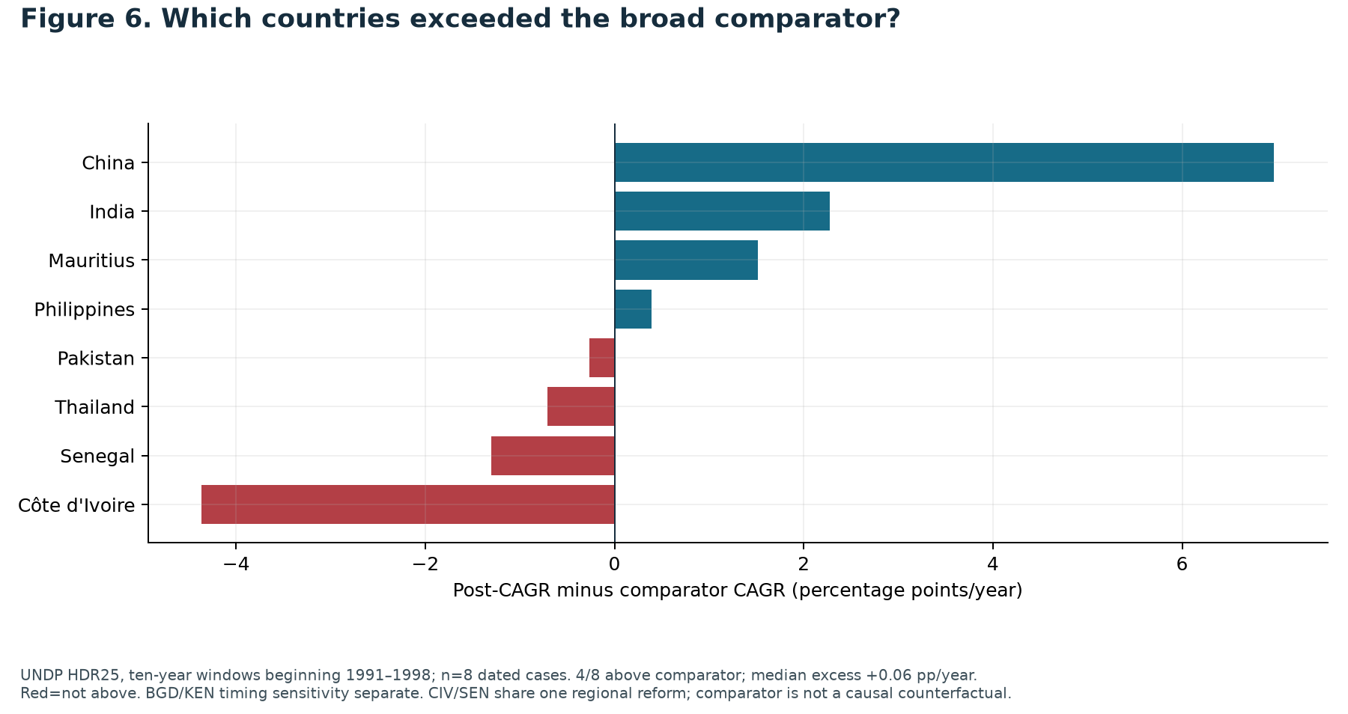
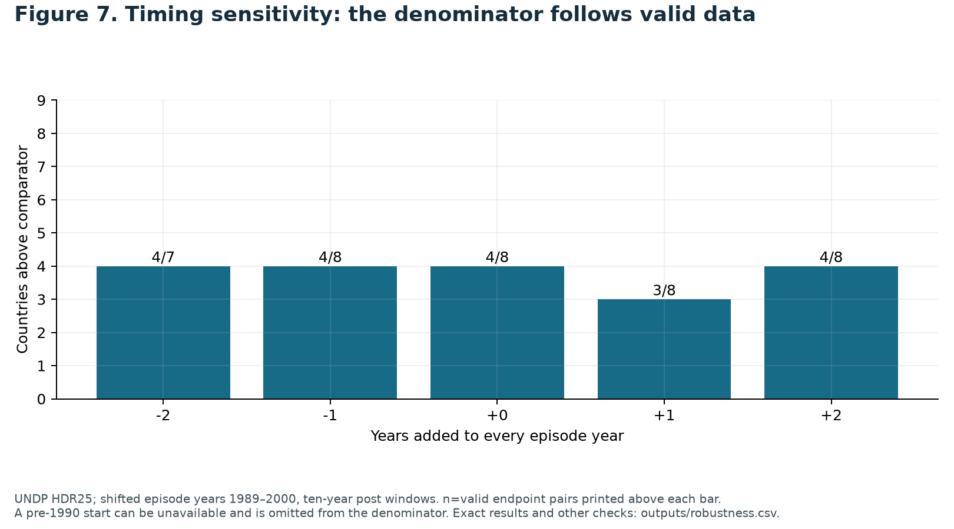
LIBERTY DATA DRIVE 2026
Only 4/8 exceeded the broad comparator
Median excess: +0.06 pp/year.
Dating shifts change the sign of the median. The descriptive premium is fragile.
Figures 6–7. Contrary cases remain. Comparator countries can also reform; this comparison does not isolate tariff effects.
Suwarna Pyakurel · Solo · Participant review copy · Organiser approval pending
7
Notes:
Figure6 red cases are Pakistan, Thailand, Senegal and Côte d’Ivoire. Figure7 valid denominators exclude unavailable pre-1990 starts. Thailand’s Asian financial crisis and Côte d’Ivoire’s political conflict are realistic alternative explanations, documented by WTO1999 and World Bank2003. The analysis does not quantify their contributions or claim they fully explain the patterns.

Slide 8
LIBERTY DATA DRIVE 2026
The conclusion survives only in a cautious form
Dependence on cases
Timing uncertainty
Without China: 3/7 above comparator; median -0.27 pp/year. Removing both WAEMU countries changes the composition, not the main sample.
Adding Bangladesh/Kenya under all 12 stated timing combinations gives 5/10 above comparator. Those are assumed event years, not newly verified laws.
Competing explanations
Transfer to Nepal
China/India’s wider reforms; Thailand’s financial crisis; Côte d’Ivoire’s instability and conflict. No matched counterfactual separates these from tariff changes.
Historical national averages cannot identify an optimal Nepal tariff or predict revenue, jobs, prices or income gains. Raw means and statutory tariff peaks are different objects.
Suwarna Pyakurel · Solo · Participant review copy · Organiser approval pending
8
Notes:
Sensitivity outputs include five-year post-windows, shifts, excluding China, dropping both WAEMU cases, retaining one WAEMU case, using completion2000, and threshold changes limited to documented cases. A lower numerical threshold adds countries without sourced dates; its dated subset is not a complete expanded sample. These are limitations, not hidden successes.

Slide 9
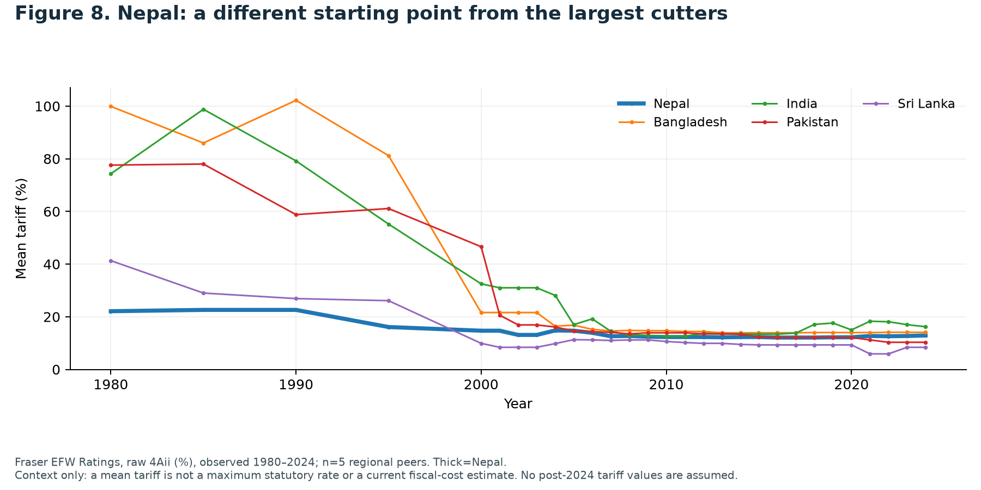
LIBERTY DATA DRIVE 2026
One modification: a transparent ceiling on tariff peaks
Nepal: amend Schedule 1 of the Customs Tariff Act 2081, as amended, to cap standard non-preferential ad valorem basic duties in HS25–97 at 20% over three budgets. Retain lower rates.
Authority: Ministry of Finance proposes; Federal Parliament enacts; Customs administers. Mechanism: reduce the tax wedge on affected imports, widening choice and competition.
Figures 1–2 show historical policy changes; 4–7 limit the growth claim; 8 shows Nepal’s different starting point. A 20% ceiling is proposed, not an estimated optimum.
Current legal source: official 2026/27 tariff compilation, pages 4–5 and 215; Customs Tariff Act 2081.
Suwarna Pyakurel · Solo · Participant review copy · Organiser approval pending
9
Notes:
Exactly one modification. Scope: non-preferential basic ad valorem duties only, HS chapters25–97; currently lower rates retained. Specific/mixed duties, other charges, VAT, excise, import prohibitions and preferences are outside the proposed amendment. The three-budget transition and20% ceiling are normative design choices; no affected-line count or fiscal/growth effect is estimated. Current compilation page215 shows higher non-agricultural basic duties, but a full product-level appraisal is still needed before implementation. This goes beyond existing band simplification; it is not described as an already implemented ceiling.

Slide 10
LIBERTY DATA DRIVE 2026
More freedom to exchange, with costs stated openly
Liberty principle: purchasers and sellers should have wider freedom to exchange under predictable rules. Protection gives concentrated benefits to selected producers while spreading costs across buyers.
Strongest objection: tariff revenue may fall before public finances adjust, while protected firms and workers face concentrated losses. A gradual transition does not remove these costs. Our data do not quantify them.
Policy judgement: lower remaining tariff peaks cautiously; do not promise a growth premium. The historical evidence is mixed and cannot establish the proposed ceiling’s welfare effect.
Suwarna Pyakurel · Solo · Participant review copy · Organiser approval pending
10
Notes:
The normative liberty case is presented separately from the descriptive empirical evidence. The recommendation cannot be justified solely by the positive income trajectories. External submission checks remain: organiser acceptance of dataset release/interpretation, approved declaration, exact deadline, participant review and judge-access test. Those are not computational checks.

Slide 11
LIBERTY DATA DRIVE 2026
Appendix A · Chart index
Cell numbers count markdown and code cells; all chart values are generated by the notebook.
Fig1
All ten screened countries: observed tariff histories
page 3 · cell 17
Fig2
Broader trade institutions: the chain-linked EFW panel
page 4 · cell 18
Fig3
Raw income histories before making event comparisons
page 12 · cell 19
Fig4
Income around the documented tariff-cutting episodes
page 5 · cell 20
Fig5
Income growth: before, after, and in other countries
page 6 · cell 21
Fig6
Which countries exceeded the broad comparator?
page 7 · cell 22
Fig7
Timing sensitivity: the denominator follows valid data
page 7 · cell 23
Fig8
Nepal: a different starting point from the largest cutters
page 9 · cell 24
Exact data: outputs/FigN_data.csv. Charts: figures/FigN.png and .pdf. Working file includes original dataset bytes.
Suwarna Pyakurel · Solo · Participant review copy · Organiser approval pending
A11
Notes:
Source of this index is figures/chart_index.csv produced from actual notebook cell positions. Figure3 is Appendix B at page12. Sources follow in Appendix C. All eight figures have independent data exports.

Slide 12
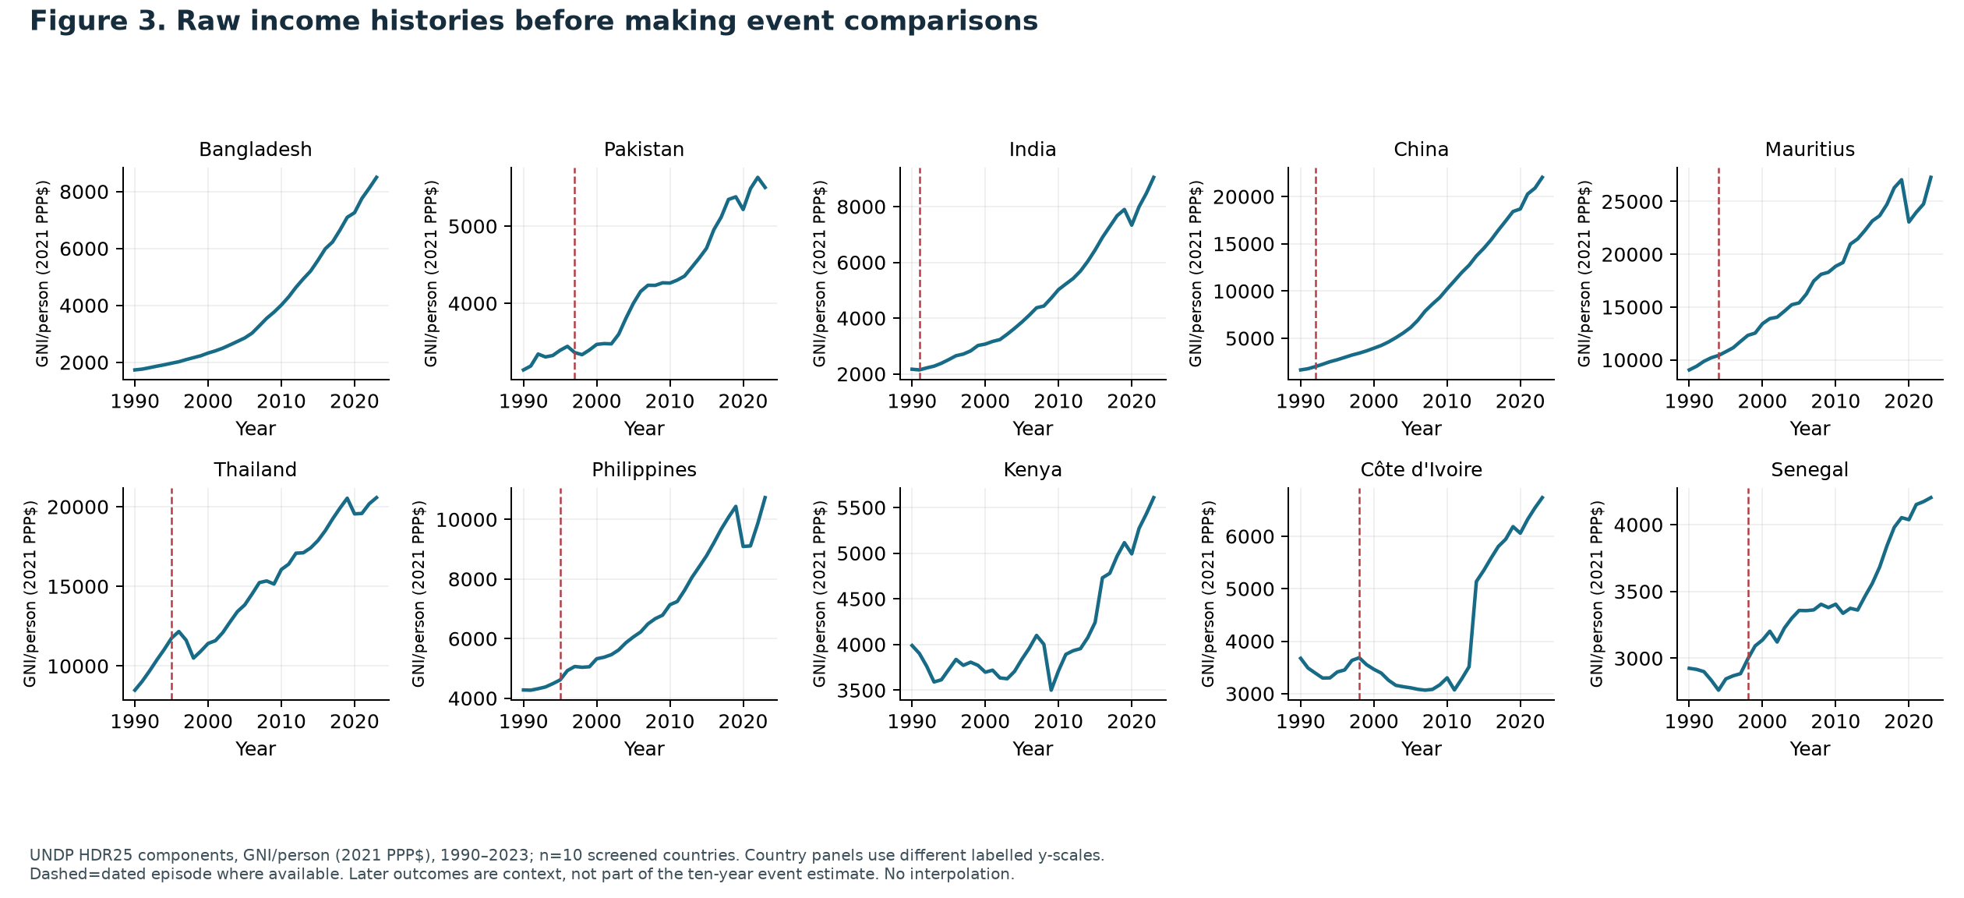
LIBERTY DATA DRIVE 2026
Appendix B · Full-period raw income histories
Suwarna Pyakurel · Solo · Participant review copy · Organiser approval pending
A12
Notes:
Figure3: complete supplied UNDP GNI series1990–2023, including all ten screened countries. Different labelled panel scales. Event-window conclusions in main slides use only their defined post periods. This figure provides inspection context, not an extra causal claim.

Slide 13
LIBERTY DATA DRIVE 2026
Appendix C1 · Public sources and access dates
IND1991
Government of India, Ministry of Finance · Union Budget Speech 1991–92 · 1991
Accessed 2026-10-16. Budget speech paragraphs 107 and 148; PDF pages 24 and 31
CHN1992
Zhang Yansheng, Wan Zhongxin and Zhang Shuguang; Institute for International Economics · Measuring the Costs of Protection in China, chapter 2 (open excerpt) · 1998
Accessed 2026-10-16. The Chinese Trade-Administration System, printed page 5; PDF page 3
MUS1994
World Trade Organization · Trade Policy Review: Mauritius, Secretariat summary · 1995
Accessed 2026-10-16. WTO 1995 review, Secretariat: Recent evolution
THA1995
World Trade Organization · Trade Policy Review: Thailand, Secretariat summary · 1995
Accessed 2026-10-16. WTO 1995 review, press release tariff paragraph and Recent evolution
PHL1995
President of the Philippines; Lawphil public reproduction · Executive Order No. 288, recital concerning EO264 · 1995
Accessed 2026-10-16. Executive Order 288, first WHEREAS recital
PAK1997
Social Policy and Development Centre · Evaluation of the Federal Budget 1999–2000, Research Report 23 · 1999
Accessed 2026-10-16. SPDC Evaluation of Federal Budget 1999-2000, PDF page 33, tax-reform discussion
CIV1998
International Monetary Fund · Côte d’Ivoire: Selected Issues and Statistical Appendix, Country Report 00/107 · 2000
Accessed 2026-10-16. IMF Country Report 00/107, printed page 18, Box 2; PDF page 19 (visually inspected)
Source titles are clickable in PDF. Full URLs, source files, checksums and locations: research/sources.md and source_register.csv.
Suwarna Pyakurel · Solo · Participant review copy · Organiser approval pending
A13
Notes:
Full bibliography with literal URLs is supplied in research/sources.md and the working-file package. All sources are public; full books need not be bought because the cited China chapter is a free excerpt. Archive readability and date precision vary and are disclosed. No statistical chart values are taken from policy sources.

Slide 14
LIBERTY DATA DRIVE 2026
Appendix C2 · Public sources and access dates
SEN1998
International Monetary Fund · Senegal: Statistical Appendix, Country Report 99/5 · 1999
Accessed 2026-10-16. IMF Country Report 99/5, printed page 32, Table 27; PDF page 33 (visually inspected)
BGDtiming
GATT · Bangladesh balance-of-payments review, BOP/W/160 · 1995
Accessed 2026-10-16. GATT BOP/W/160, paragraph 5; WTO 2000 government report tariff table
KENtiming
Government of Kenya / IMF · Enhanced Structural Adjustment Facility Policy Framework Paper 1996–1998 · 1996
Accessed 2026-10-16. Kenya Policy Framework Paper 1996-1998, paragraph 6; PDF page 5
EFW
Fraser Institute · Competition-supplied EFW workbook: chain-linked panel and raw Ratings · Coverage 1970–2024; release acceptance pending
Accessed 2026-10-16. Panel Area4 and Ratings raw 4Aii; original workbook hash preserved
UNDP
UNDP Human Development Report Office · All composite indices and components time series · HDR25; 1990–2023
Accessed 2026-10-16. GNI/person 2021 PPP dollars; components and country codes
EFW2026
Cato Institute / Fraser Institute · Economic Freedom of the World 2026, publisher landing page · 2026
Accessed 2026-10-16. Confirms release covers 2024; does not establish supplied file byte identity
EFWMETHOD
Fraser Institute / Cato Institute · EFW 2026: Explanatory Notes and Data Sources · 2026
Accessed 2026-10-16. Area4 A(ii), printed page94 / PDF page8; rating floor methodology
Source titles are clickable in PDF. Full URLs, source files, checksums and locations: research/sources.md and source_register.csv.
Suwarna Pyakurel · Solo · Participant review copy · Organiser approval pending
A14
Notes:
Full bibliography with literal URLs is supplied in research/sources.md and the working-file package. All sources are public; full books need not be bought because the cited China chapter is a free excerpt. Archive readability and date precision vary and are disclosed. No statistical chart values are taken from policy sources.

Slide 15
LIBERTY DATA DRIVE 2026
Appendix C3 · Public sources and access dates
NPLTARIFF
Nepal Department of Customs · Integrated Customs Tariff FY2083/84 · 2026/27
Accessed 2026-10-16. PDF pages4–5: legal basis and Schedule1; page215: higher non-agricultural basic duties
NPLACT
Nepal Law Commission · Customs Tariff Act 2081 · 2024
Accessed 2026-10-16. Act first page and import Schedule1; direct PDF URL in fetch_law_manifest.json
NPLFIN
Nepal Law Commission / Department of Customs · Finance Act 2083 listing · 2026
Accessed 2026-10-16. Current legislation listing; use current integrated tariff for implemented rate context
THACRISIS
World Trade Organization · Trade Policy Review: Thailand · 1999
Accessed 2026-10-16. Financial crisis is a realistic competing explanation for growth slowdown
CIVCONFLICT
World Bank · Côte d’Ivoire: Strengthening Public Expenditure Management and Controls, Report27141-IVC · 2003
Accessed 2026-10-16. Summary: instability since1999 and civil conflict2002; alternative explanation, not quantified here
Source titles are clickable in PDF. Full URLs, source files, checksums and locations: research/sources.md and source_register.csv.
Suwarna Pyakurel · Solo · Participant review copy · Organiser approval pending
A15
Notes:
Full bibliography with literal URLs is supplied in research/sources.md and the working-file package. All sources are public; full books need not be bought because the cited China chapter is a free excerpt. Archive readability and date precision vary and are disclosed. No statistical chart values are taken from policy sources.

Slide 16
LIBERTY DATA DRIVE 2026
Appendix D · AI disclosure and reproducibility
OpenAI Codex assisted with inspecting datasets, writing and debugging code, checking reproducibility, researching public policy sources, drafting analysis documentation and generating the presentation. The participant is responsible for reviewing the work and explaining all submitted claims.
The working notebook embeds both original datasets and the date ledger. Run all cells from an empty directory or fresh Colab runtime. Exact figure tables, source locations, package versions and validation reports are included.
Solo entry: no team contribution statement. Organiser declaration approval, dataset-scope acceptance, final deadline and signed-out sharing checks remain external pending items. No submission or organiser contact has been made by the assistant.
Suwarna Pyakurel · Solo · Participant review copy · Organiser approval pending
A16
Notes:
This disclosure describes AI assistance; it does not assert that participant review has already occurred. The prepared package is a participant review copy. Fresh empty-directory execution is checked in outputs/clean_runtime_verification.json. Computational reproducibility does not imply causal identification or organiser approval.

