Slide 1
Automobile Insurance Management System – Hexaware Technologies
Trainer’s Name: Presented By:
Mr.Javeed Suwasthika Sri K V

Slide 2
Introduction
Insurance companies need efficient digital systems
Manual processes are time-consuming and error-prone
Automation improves:
Accuracy
Speed
Customer experience
This system provides a complete solution for vehicle insurance
management

Slide 3
Scope
Display available insurance policies
User registration and login
Proposal submission for vehicle insurance
Proposal review and approval by officers
Quote generation and premium calculation
Online payment and policy activation
Policy status tracking (proposal, active, expired)
Email notifications and reminders

Slide 4
Definition
Automobile Insurance Management System is a full-stack web application
Designed to manage:
Vehicle insurance policies
Customer information
Claims and payments
Enables interaction between:
Users (customers)
Officers (insurance staff)
Ensures secure, fast, and automated insurance processing

Slide 5
Modules
Patient Module User Module – Registration, login, proposal submission
Officer Module – Proposal review and approval
Policy Management Module – Create and manage policies
Claim Management Module – Handle insurance claims
Payment Module – Premium payment processing
Security Module – Authentication and authorization

Slide 6
Technologies Used
Frontend: React
Backend: Spring Boot
Database: MySQL
Authentication: JWT
Tools: Postman, Swagger, GitHub

Slide 7
User Features
Register and login
Apply for insurance policy
Upload documents
Track policy status
Make premium payment
Download policy document

Slide 8
Officer Features
Secure login
Review proposals
Request additional documents
Approve or reject policies
Generate quotes
Update policy status

Slide 9
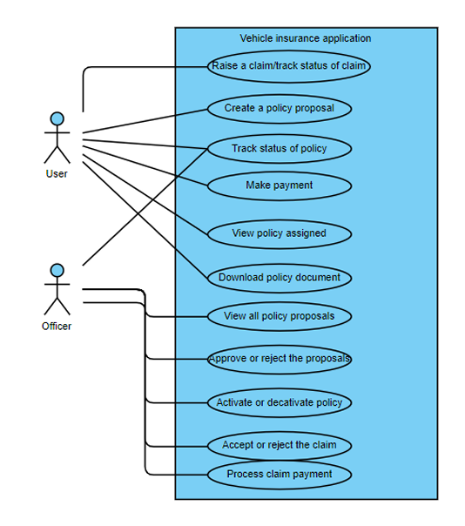
Usecase Diagram

Slide 10
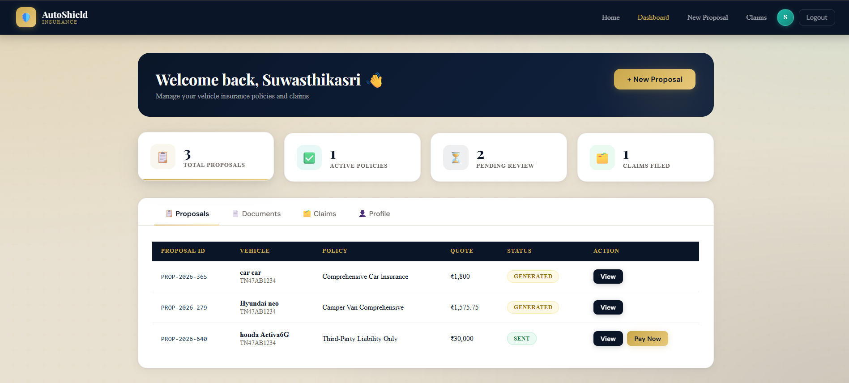
Screenshots -User

Slide 11
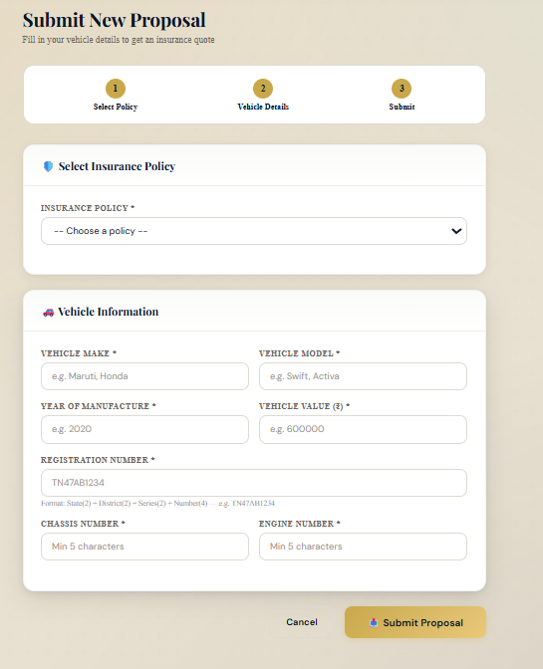
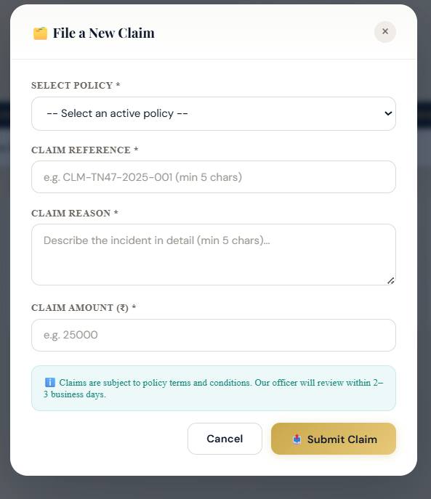
USER SIDE

Slide 12
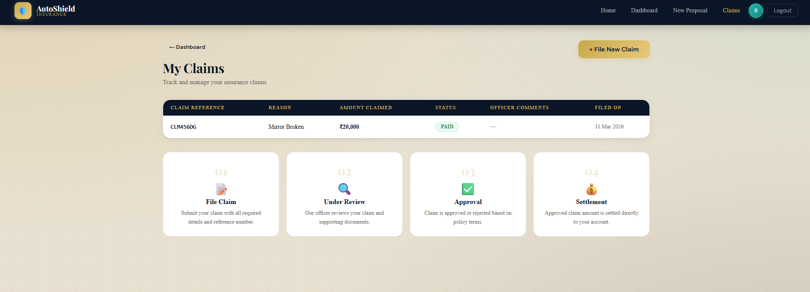
USER –Claim page

Slide 13
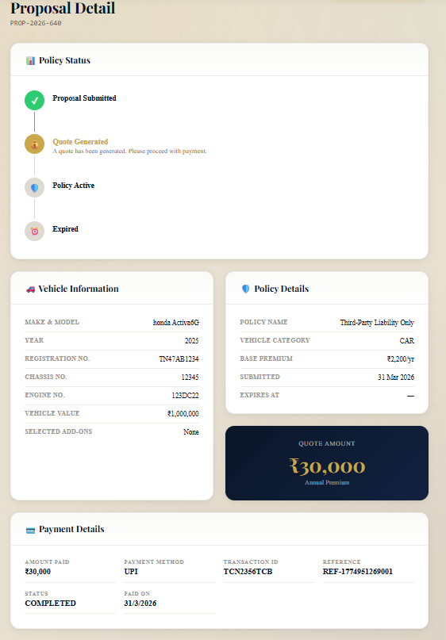
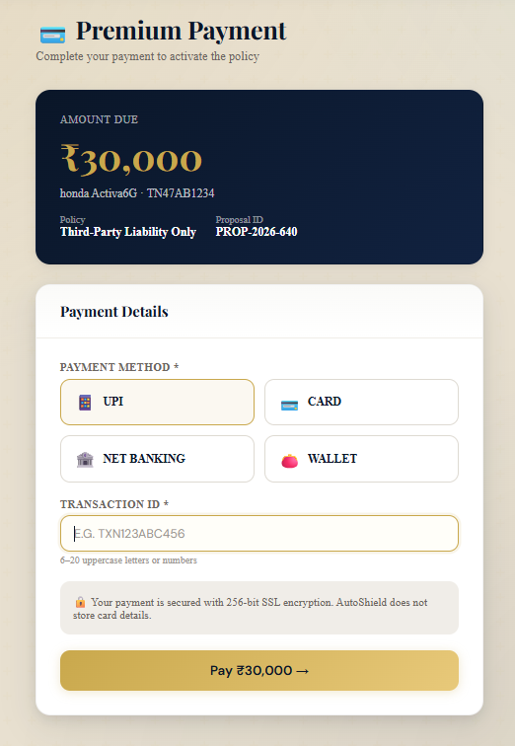
PAYMENT

Slide 14
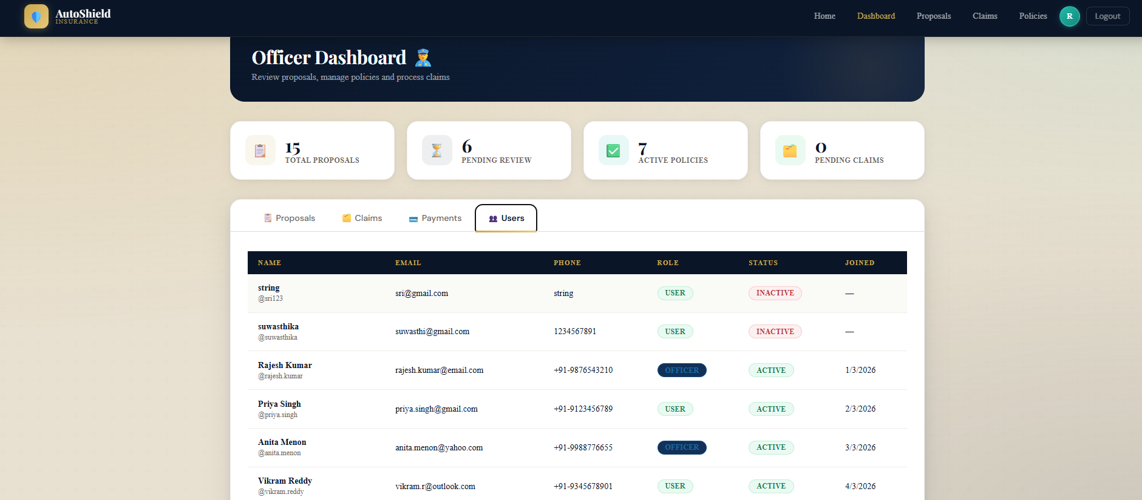
OFFICER -DASHBOARD

Slide 15
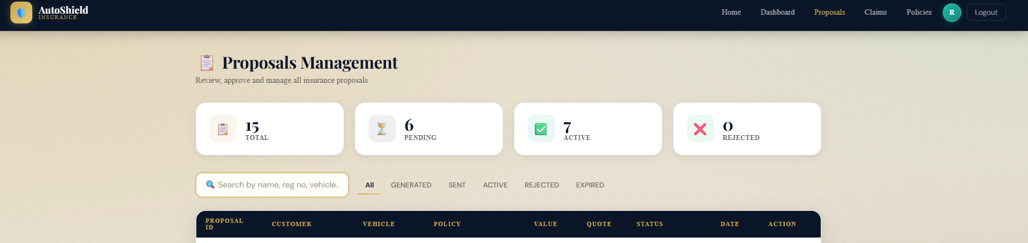
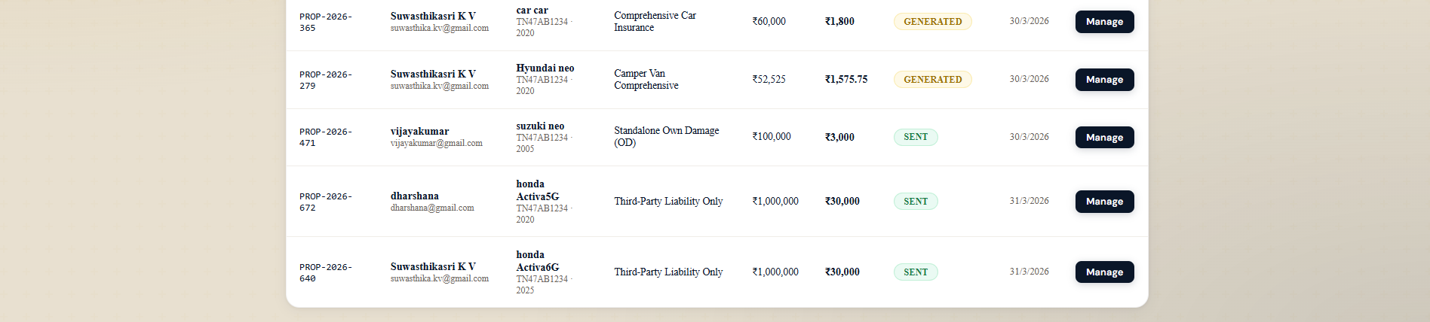
OFFICER- PROPOSAL MANAGEMENT

Slide 16
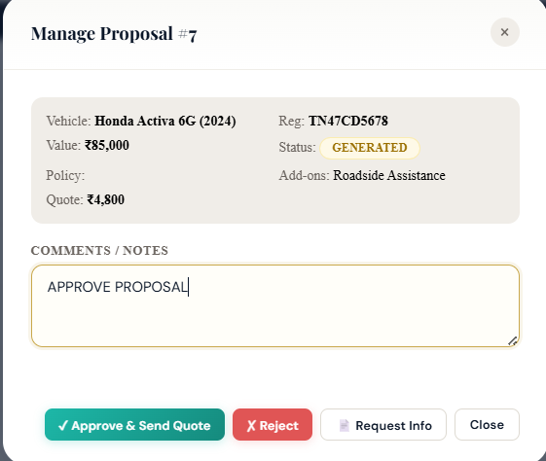
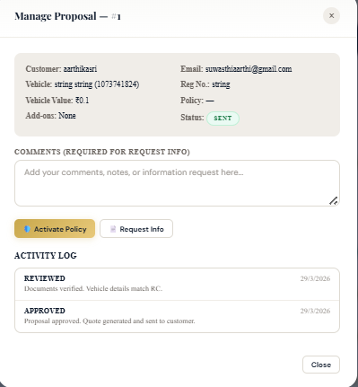
OFFICER- PROPOSAL MANAGEMENT

Slide 17
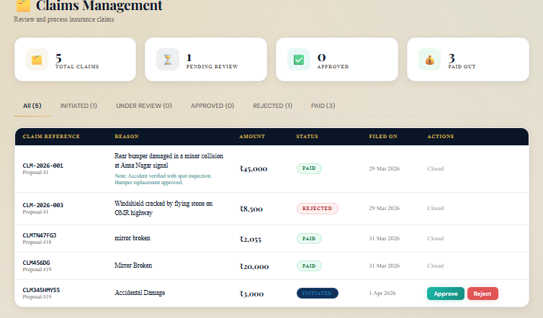
OFFICER – CLAIM MANAGEMENT

Slide 18
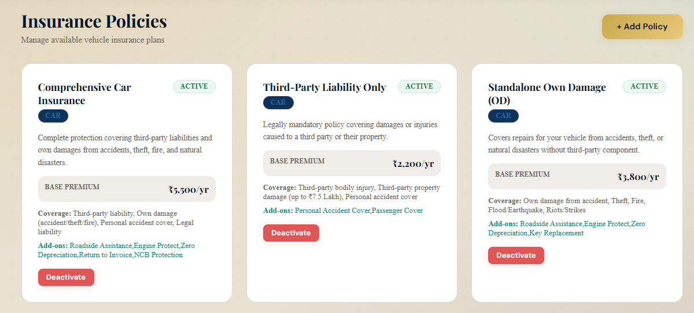
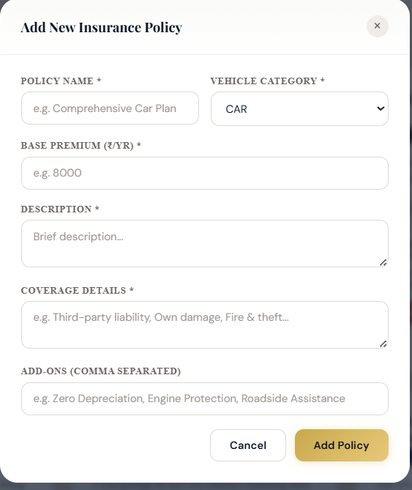
OFFICER-POCLICY CREATION

Slide 19
Conclusion
Automates insurance management process
Improves efficiency and reduces manual work
Provides secure and user-friendly system
Enhances customer experience and
transparency

