Slide 1

Indian Institute of Technology, Guwahati
CS-561 Project Presentation
Energy Efficiency in Workplace Based on Occupant’s Routine
Presented By:
Group 26 – Team Alphabet
Dated: 22nd April 2017
CS 561

Slide 2
Outline
Motivation
Methodology
Segmentation and Features
Activity Recognition (Using Naïve Bayes and HMM)
Activity Prediction (HMM)
Experiment and Results
Demo
Conclusion and Future work

Slide 3
Motivation
Energy-saving workplaces require autonomous and optimized control of integrated devices and appliances with the objective of saving energy while preserving the comfort of occupant.
A state of art artificial intelligence system can be built to control equipment to reduce energy consumption.
Learning user activities and behavior can help us identify the planning to control equipment for better usage.

Slide 4
Approach
Building data set for the location
Activity Recognition based on context information
Activity Prediction
Combining AI Planning - We haven’t attempted this. Can be done in future.

Slide 5
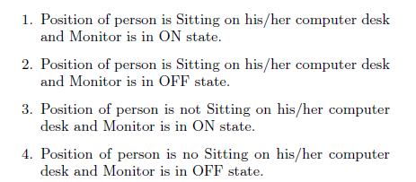
Methodology: Data Collection and Tagging
Identifying equipment, location and user activities.
Identified Equipment: Workstation, Overhead Lights
Activities: User presence, absence and usage of computer system
Collecting sensory data based on user activities identified.
Tagging the data with activities.

Slide 6
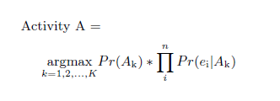

Methodology: Activity Recognition
This is very well researched area and several researchers used different model for the same like: HMM, KNN, Decision Tree, LSTM neural net etc.
We used HMM and Naïve Babes models for AR and used HMM for AP.
Naïve Bayes
We minimized following loss function to get the activity

Slide 7
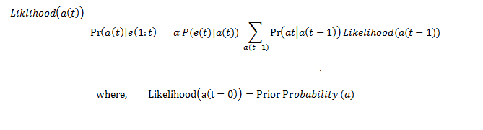
Methodology: Activity Recognition
Hidden Markov Model
Used Viterbi Algorithm to get the most probable sequence and used this activity sequence to get the likelihood of activity at time t as below.
Given prior belief, transition model and observation model calculated Likelihood of activity given current evidence.

Slide 8
Methodology: Activity Recognition
Hidden Markov Model
Recursively updated the belief of an activity at each time t with likelihood Pr(At) calculated above.

Slide 9
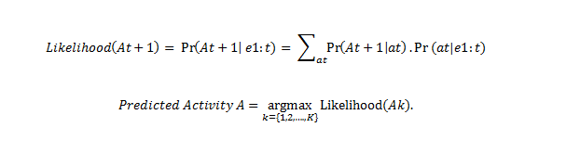
Methodology: Activity Prediction
Hidden Markov Model
We used prediction model of HMM to predict next activity for time t+1 given evidence e (1:t)

Slide 10
Experiment: Dataset
We have worked on two data sets.
Collected sensory data in Robotics Lab
Online Benchmark dataset – CASAS

Slide 11
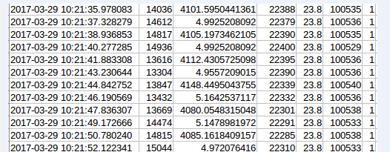
Experiment: Dataset Collection and Tagging
Collected sensory data from our lab using following sensors:
PIR, Ultrasonic, Light Sensor, Barometer
Used Raspberry Pi and libraries to collect and process the data.
Format: <Date Time, PIR, Ping, Light, Temperature, Pressure, Activity-Tag>

Slide 12
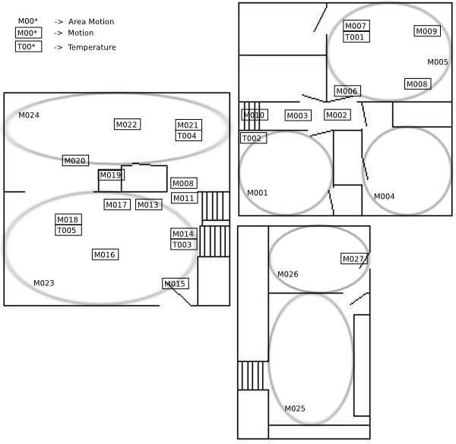
Experiment: Online Dataset and Feature Extraction
CASAS dataset was used, which contains sensor data that was collected in the home of a volunteer adult resident and a dog.
27 Motion sensors were used to record activities.

Slide 13
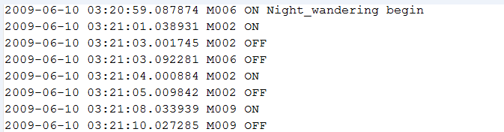
Experiment: Online Dataset and Feature Extraction
Activities Identified:
{Bed_to_toilet, Breakfast, Bed, C_work, Dinner, Laundry., Leave_home, Lunch, Night_wandering, R_medicine}
Data format:
<Date(yyyy-mm-dd), Time, Sensor_Id, Sensor_State, Activity, Begin/End>

Slide 14
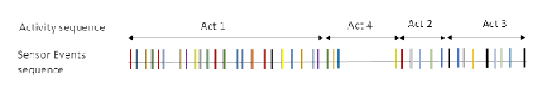
Experiment: Online Dataset and Feature Extraction
Segmentation: Data was segmented into separate sequences of activity occurrences.
Features Extracted:
Sensors Used
Time of Use
Day of Week
Previous Activity
Activity Length

Slide 15
Experiment: Algorithm Evaluation
We used earlier described annotated data set to train the system.
Used Maximum Likelihood Estimation (MLE) technique to estimate parameters for both Naïve Bayes and HMM model.
Training Parameters for Naïve Bayes Model
Prior Beliefs Pr(Activity) =
(#Sensor Events for Activity)/ (# Total Sensor Events)
Observation Pr(Ei|Activity) =
(#Ei in sensor events for the activity)/ (# Total Sensor Events for Activity)

Slide 16
Experiment: Algorithm Evaluation
Training Parameters for HMM Model
Prior Beliefs Pr(Activity) =
(#Sensor Events for Activity)/ (# Total Sensor Events)
Observation Pr(Ei|Activity) =
(#Ei in sensor events for the activity)/ (# Total Sensor Events for Activity)
Transition Tr(Aj -> Ai):
Pr(Ai|Aj) =
(# of times Aj -> Ai)/ (# Occurrences of Activity Aj)

Slide 17

Experiment: Results
We predicted activity with our model and compared with tagged activity. If activity tag is A and predicted activity is A', updated entry in matrix Freq(A,A‘).
Freq(i, j) = Frequency or number of times actual activity Ai predicted as activity Aj.
We used Java 8 and NetBeans IDE for implementation of model.

Slide 18
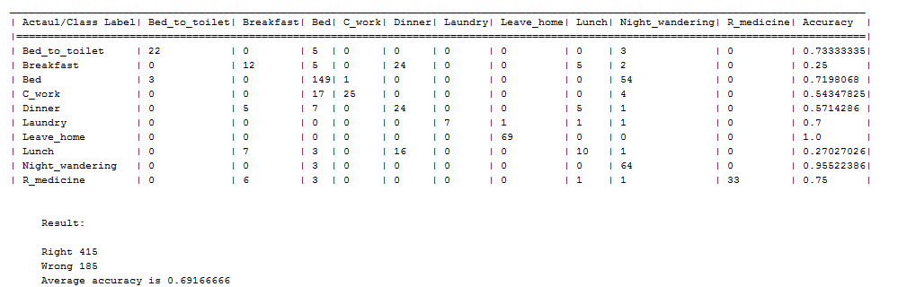
Experiment: Results
Naïve Bayes

Slide 19
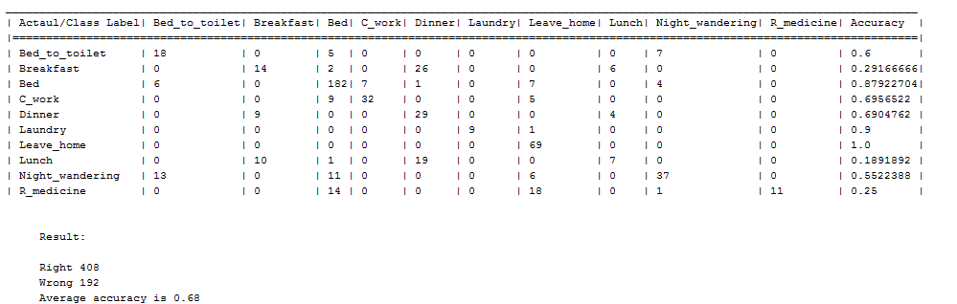
Experiment: Results
Hidden Markov Model

Slide 20
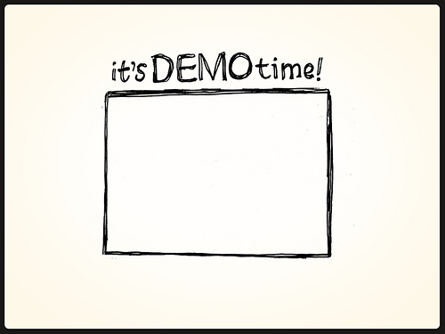
Demo

Slide 21
Conclusion and Future Work
We collected data from robotics lab.
Applied AR and AP on benchmark data with accuracy around 70%.
We worked on prediction of activity for time (t+1). It can be extended to find next activity sequence (t+k). HMM model can be used to do so.
'Internet of Things' (IoT) concepts can be applied to make equipments intelligent and able to communicate over a network.
Protocols and messages need to be built for these communication models.
AI Planning algorithms can be used to intelligently control equipments for energy efficiency.

Slide 22
Thank You

